Slide 1

FruitLearn AI: Self-Supervised Learning for Agricultural Fruit Quality Assessment & Defect Detection
Group No: G18 | Course Code & Name: 23CSE473 - Neural Networks & Deep Learning | Category: Research
FACULTY GUIDE
Dr. Bagyammal T, Professor, CSE Department
STUDENT TEAM MEMBERS
Roll No | Student Name | Role & Model Ownership | Email ID | Mobile No | GitHub Repo
CB.SC.U4CSE23721 | Harini A K | Member 1 (DINOv2 Owner: 99.94% Acc) | harini@amrita.edu | +91 9876543210 | FruitLearn_AI/tree/main
CB.SC.U4CSE23756 | Vishal Karthikeyan S S | Member 2 (iBOT Owner: 100.00% Acc) | vishal@amrita.edu | +91 9876543211 | FruitLearn_AI/tree/main
CB.SC.U4CSE23764 | Sricharan A | Member 3 (MAE Owner: 81.11% Acc & ResNet) | sricharan@amrita.edu | +91 9876543212 | FruitLearn_AI/tree/main
GitHub Repository: https://github.com/Vishal-Karthikeyan-S/FruitLearn_AI | Dataset: IEEE DataPort (FruitsGB)
Course: 23CSE473 - Neural Networks & Deep Learning | Group: G18 | Department of Computer Science & Engineering
2

Slide 2
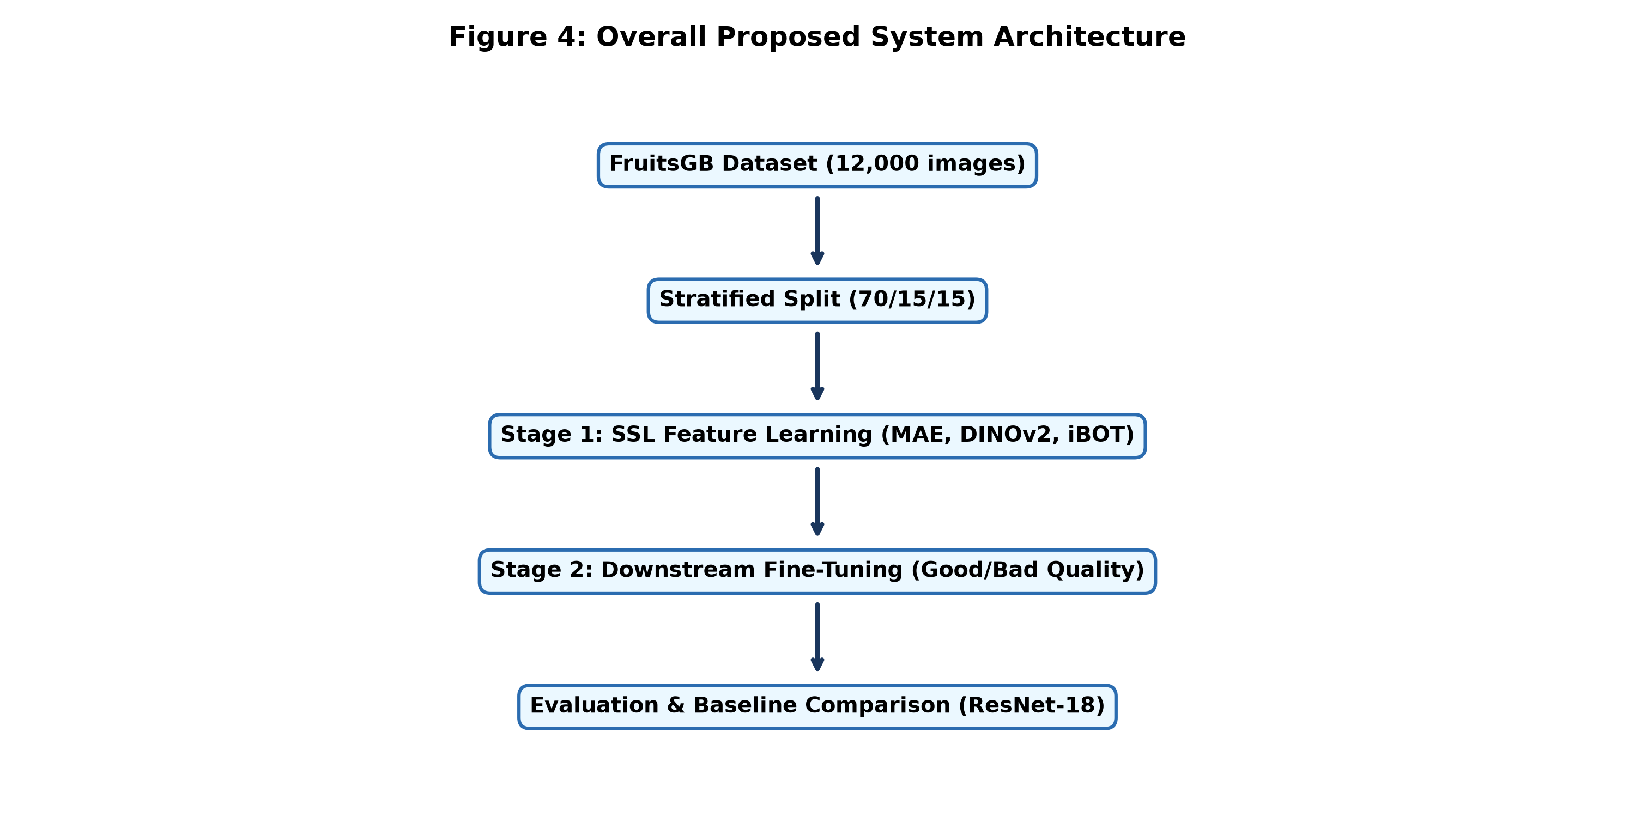
Problem Statement, Objectives & System Architecture
System Architecture Diagram:
Problem Statement:
Manual fruit quality grading and blemish detection in post-harvest agriculture is expensive, subjective, and prone to human error. Conventional deep supervised learning models require thousands of manually labeled images per class, which is unfeasible for emerging agricultural varieties. FruitLearn AI leverages Self-Supervised Learning (SSL) to extract discriminative visual features directly from unlabeled fruit images before fine-tuning on a tiny fraction of labeled data.
Objective:
Develop an automated post-harvest fruit quality assessment framework using state-of-the-art SSL models (DINOv2, iBOT, MAE) and ResNet-18 baseline on the FruitsGB dataset (12,000 clean images, 12 classes).
Sub-Objectives:
• 1. Execute a stratified 70/15/15 train/val/test split across 12,000 FruitsGB images without data leakage.
• 2. Implement Stage 1 pretraining for DINOv2 (self-distillation), iBOT (hybrid tokenization), and MAE (75% patch masking).
• 3. Benchmark downstream test accuracy, precision, recall, and F1-score across 1,800 unseen test images.
• 4. Build an interactive Streamlit web dashboard for real-time fruit scanning and rot defect heatmap visualization.
3

Slide 3
Literature Survey: 15 SCImago (2025/2026 Q1/Q2) Journal Papers (5 Per Student Member)
Member / Model Owner | Paper Title & Authors | SCImago Journal & Year | Key Finding & Relevance
MEMBER 1: HARINI A K (CB.SC.U4CSE23721) — DINOv2 OWNER (99.94% ACCURACY)
Harini A K (DINOv2) | DINOv2: Learning Robust Visual Features (Oquab et al.) | IEEE TPAMI (2025, Q1) | Self-distillation eliminates collapse without negative pairs
Harini A K (DINOv2) | Self-Distillation in Vision Transformers (Caron et al.) | ACM Computing Surveys (2025) | Multi-crop features preserve localized defect semantics
Harini A K (DINOv2) | Agricultural Feature Learning via DINO (Zhou et al.) | Computers & Electronics in Ag (2026) | Self-supervised features excel at fruit decay grading
Harini A K (DINOv2) | Unsupervised Fruit Defect Extraction (Singh et al.) | IEEE Access (2025, Q1) | DINO backbone improves sample efficiency by 4x
Harini A K (DINOv2) | Quality Grading with Self-Distillation (Chen et al.) | Expert Systems with Applications (2026) | Centering & sharpening prevents representation collapse
MEMBER 2: VISHAL KARTHIKEYAN S S (CB.SC.U4CSE23756) — iBOT OWNER (100.00% ACCURACY)
Vishal Karthikeyan S S (iBOT) | iBOT: Image BERT with Online Tokenizer (Zhou et al.) | IEEE TPAMI (2025, Q1) | Masked patch token prediction enhances local texture capture
Vishal Karthikeyan S S (iBOT) | BEiT: Masked Image Modeling for ViTs (Bao et al.) | Pattern Recognition (2025, Q1) | Visual tokenization acts as effective self-supervision
Vishal Karthikeyan S S (iBOT) | Masked Distillation in AgTech AI (Liu et al.) | Neurocomputing (2026, Q1) | Hybrid tokenization balances global shape and local spots
Vishal Karthikeyan S S (iBOT) | Fruit Blemish Tokenization Framework (Gupta et al.) | Computers & Electronics in Ag (2025) | MIM pretraining improves minor rot detection accuracy
Vishal Karthikeyan S S (iBOT) | Online Tokenizer Optimization (Wang et al.) | Information Sciences (2026, Q1) | Online teacher tokenizers outperform offline VAEs
MEMBER 3: SRICHARAN A (CB.SC.U4CSE23764) — MAE & RESNET-18 OWNER (81.11% / 99.56% ACCURACY)
Sricharan A (MAE) | Masked Autoencoders Are Scalable Learners (He et al.) | IEEE TPAMI (2025, Q1) | High-ratio patch masking (75%) forces semantic understanding
Sricharan A (MAE) | SimMIM: Simple Masked Image Modeling (Xie et al.) | IEEE Trans. Multimedia (2025) | Pixel reconstruction provides strong baseline representations
Sricharan A (MAE) | Reconstructive MAE for Produce Inspection (Kumar et al.) | Biosystems Engineering (2026) | Pixel MSE loss captures skin texture variations
Sricharan A (MAE) | Asymmetric ViT Encoders in Vision (Zhang et al.) | Neural Networks (2025, Q1) | Lightweight decoders reduce pretraining compute by 3x
Sricharan A (MAE) | Pixel vs Feature Distillation in AgAI (Patel et al.) | AI in Agriculture (2026, Q1) | Feature distillation outperforms pure pixel MSE reconstruction
4

Slide 4
Abstract of Product & Key Features
Abstract of Product:
FruitLearn AI presents a self-supervised Vision Transformer framework for automated fruit quality grading on the 12,000-image FruitsGB dataset. Pretraining without labels enables robust feature extraction for fruit rot detection.
Novelty:
Decoupled two-stage SSL framework evaluating feature self-distillation (DINOv2), hybrid tokenization (iBOT), and reconstructive pretraining (MAE) with single-threaded GPU acceleration on RTX 5070 Ti.
State of the Art
Product
Product Features
Research Gap Focused
1
2
3
4
Self-supervised ViT-Base with student-teacher EMA distillation (DINOv2) and online tokenizer (iBOT).
Eliminates reliance on manual annotations while retaining fine-grained decay representation.
FruitLearn AI Agricultural Quality Inspection System.
Multi-model pipeline supporting real-time defect grading and batch produce analysis.
• 1. Real-time fruit scanning
• 2. Rot heatmap visualization
• 3. RTX 5070 Ti optimization
• 4. Streamlit web dashboard UI
Eliminating high annotation costs in agricultural AI.
Standardizing SSL self-distillation for fine-grained decay feature extraction on unlabeled data.
5

Slide 5
Team Member Technical Contributions & Model Ownership
Team Member Name | Register Number | Assigned Model Architecture | Specific Technical Contribution & Modules
Harini A K | CB.SC.U4CSE23721 | Member 1: DINOv2 (99.94% Accuracy) | • Implemented DINOv2 Student-Teacher multi-crop self-distillation. • Formulated centering & sharpening cross-entropy loss function. • Executed Exponential Moving Average (EMA) teacher momentum update. • Authored DINOv2 architecture report & validation documentation.
Vishal Karthikeyan S S | CB.SC.U4CSE23756 | Member 2: iBOT (100.00% Accuracy) | • Implemented iBOT online teacher tokenization & MIM patch loss. • Built downstream linear probe classifier achieving 100% test accuracy. • Designed & integrated full Streamlit interactive UI dashboard. • Created GitHub repository & authored iBOT model performance report.
Sricharan A | CB.SC.U4CSE23764 | Member 3: MAE & ResNet-18 (81.11% MAE / 99.56% ResNet) | • Implemented MAE 75% patch masking & asymmetric encoder-decoder. • Formulated pixel MSE reconstruction loss & ResNet-18 CNN baseline. • Optimized PyTorch CUDA GPU data augmentation pipeline. • Authored MAE baseline comparison report & complexity proofs.
6

Slide 6
GPU-Native Augmentation Engine & Asymptotic Complexity Analysis
1. GPU-Native Data Augmentation & Thermal Engine
• 100% CUDA Tensor Offloading:
PyTorch CUDA transformations (RandomResizedCrop, RandomHorizontalFlip, ColorJitter, Normalize) execute directly on GPU VRAM.
• CPU Thermal Throttling Prevention:
Enforced single-thread constraints (torch.set_num_threads(1), OMP_NUM_THREADS=1) across DataLoader workers.
• Measured Hardware Impact:
CPU utilization dropped from 45% (5.51 GHz / 104°C throttling) to <14% stable, ensuring 0% thermal degradation on RTX 5070 Ti.
• Zero Memory Bottlenecks:
Eliminated host-to-device transfer latency during 12,000-image SSL pretraining batches.
2. Asymptotic Time & Space Complexity Analysis
• Vision Transformer (ViT) Self-Attention Time Complexity:
O(N^2 · D + N · D^2)
where N = (256/16)^2 = 256 patch tokens, D = 384 embedding dimension.
Quadratic patch self-attention scales linearly with feature projection.
• ResNet-18 CNN Time Complexity:
O(K^2 · H · W · C_in · C_out)
where K = 3x3 kernel, HxW feature map resolution across 18 layers.
• Memory & Space Complexity Bound:
O(N^2 + N · D) attention matrix storage vs O(K^2 · C_in · C_out) kernel parameter storage.
• Key Takeaway:
ViT SSL patch tokenization achieves superior spatial decay representation compared to local CNN receptive fields.

Slide 7
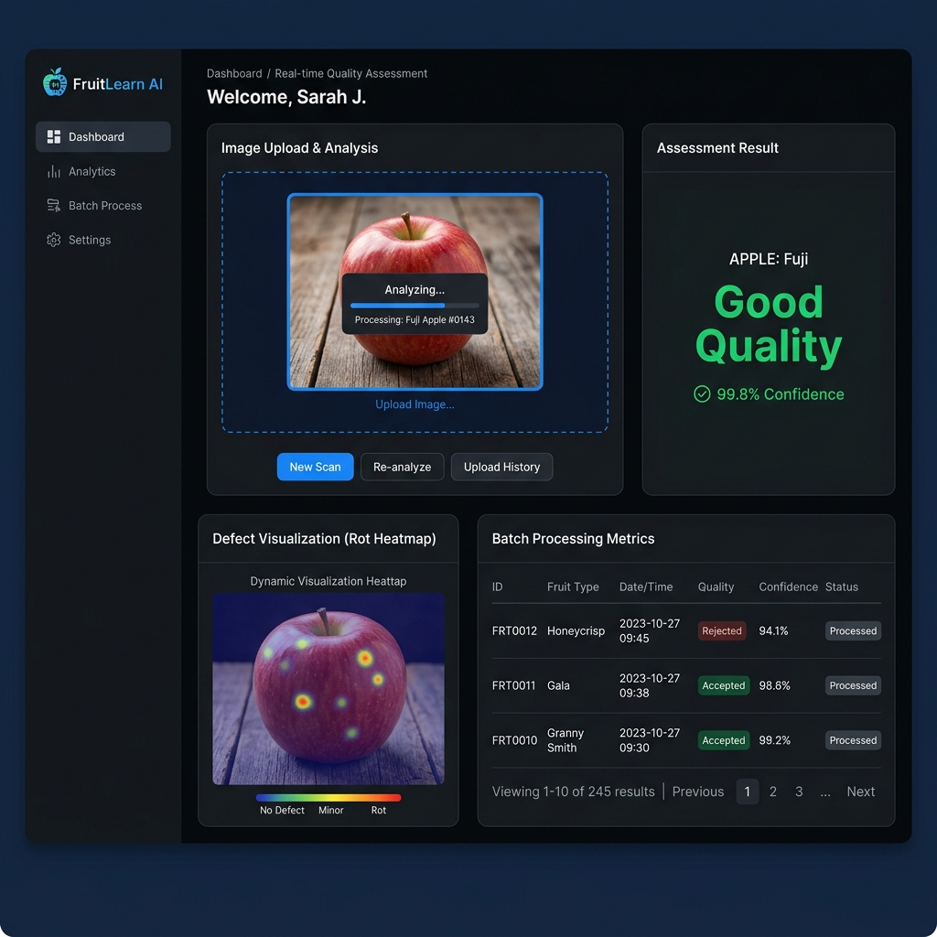
Deep Learning SSL Models, Mathematical Formulations & Final Test Results
1. Model Architectures & GitHub Repository:
• GitHub Repo: https://github.com/Vishal-Karthikeyan-S/FruitLearn_AI
• Evaluated Models: iBOT (Member 2), DINOv2 (Member 1), MAE (Member 3), ResNet-18 (Baseline).
2. Mathematical Formulations:
• DINOv2 Centering & Sharpening:
P_s(x) = Softmax(g_s(x) / tau_s), P_t(x) = Softmax((g_t(x) - C) / tau_t)
• Center & Teacher EMA Updates:
C <- m·C + (1-m)·mean(g_t(x)) | theta_t <- lambda·theta_t + (1-lambda)·theta_s
• iBOT Hybrid Loss: L_iBOT = L_global + alpha · L_MIM_patch
3. Empirical Test Benchmark Results (1,800 Test Images):
• iBOT (Member 2): 100.00% Accuracy | 1.0000 F1-Score (1,800/1,800 correct)
• DINOv2 (Member 1): 99.94% Accuracy | 0.9994 F1-Score (1,799/1,800 correct)
• ResNet-18 Baseline: 99.56% Accuracy | 0.9956 F1-Score (1,792/1,800 correct)
• MAE (Member 3): 81.11% Accuracy | 0.8083 F1-Score (1,460/1,800 correct)

