Slide 1

DEPARTMENT OF CSE (ARTIFICIAL INTELLIGENCE AND MACHINE LEARNING) ACADEMIC YEAR 2025 - 2026 SEMESTER IV MACHINE LEARNING LABORATORY MINI PROJECT REVIEW <Comparative Study On Decision Tree and Support Vector Machine For Loan Approval Prediction>
REGISTER NUMBER | 2117240030039
NAME | K HARINI
YEAR | II
SECTION | A
FACULTY IN-CHARGE | Mrs. M. Divya

Slide 2
PROBLEM STATEMENT
Loan approval is often done manually, which can be time-consuming and prone to errors or bias. There is a need for an automated system that can accurately predict whether a loan should be approved or rejected based on applicant details.
This project aims to develop a machine learning model using Decision Tree and Support Vector Machine (SVM) to analyze applicant data and provide reliable loan approval predictions.
GOAL
• Develop a machine learning model for loan approval prediction • Use Decision Tree and Support Vector Machine (SVM) algorithms • Analyze applicant data such as income, credit history, and loan amount • Predict whether a loan should be approved or rejected • Compare model performance using accuracy, precision, recall, and F1-score • Provide visualizations for better understanding and decision-making

Slide 3
THEORETICAL BACKGROUND
Machine Learning Algorithms Used: Decision Tree and SVM
Decision Tree is a supervised learning algorithm used for classification. It divides the dataset into smaller subsets based on feature conditions, forming a tree-like structure where each leaf node represents the final decision (Approved/Rejected).
Support Vector Machine (SVM) is a classification algorithm that finds the optimal hyperplane to separate data into different classes with maximum margin, ensuring better accuracy and generalization.
Mathematical Representation
Decision Tree (Gini Index): Gini = 1 − Σ(pi)² Where pi is the probability of each class
SVM Equation: f(x) = w·x + b Where w is weight, x is input, and b is bias

Slide 4
THEORETICAL BACKGROUND
Why These Algorithms?
• Decision Tree is easy to understand and interpret • Handles both categorical and numerical data • SVM provides high accuracy and avoids overfitting • Effective for classification problems
Literature Survey
• Logistic Regression – Simple but less effective for complex patterns • Decision Tree – Easy to use but may overfit • SVM – High accuracy but computationally complex • Random Forest – Reduces overfitting but requires more resources

Slide 5
IMPLEMENTATION AND CODE
Link to code in Git-hub Repository
List | Git-hub Repository Links
Implementation of Code Link | https://github.com/harinik1510/ML_Mini_Project/blob/main/app.py
Word Document Report Link | https://github.com/harinik1510/ML_Mini_Project/blob/main/ML_MINI_PROJECT.docx
PPT Link

Slide 6
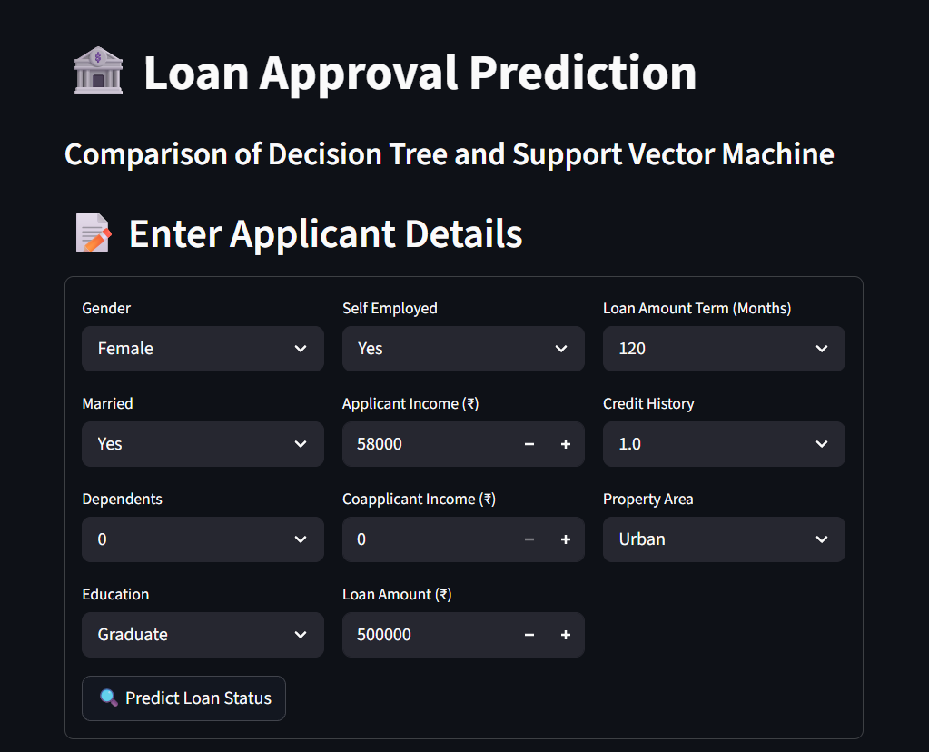

OUTPUT AND RESULTS
.
This screen displays the input form where the user enters applicant
details such as gender, income, loan amount, credit history, and property area.
The interface is designed using a structured layout with dropdowns and
input fields for easy data entry.
It ensures user-friendly interaction and validates inputs before prediction.
This screen shows the predicted loan status (Approved/Rejected) generated by Decision Tree and SVM models along with confidence scores.
The results are displayed clearly for comparison between both models.
It helps users understand how different algorithms respond to the same input data.

Slide 7
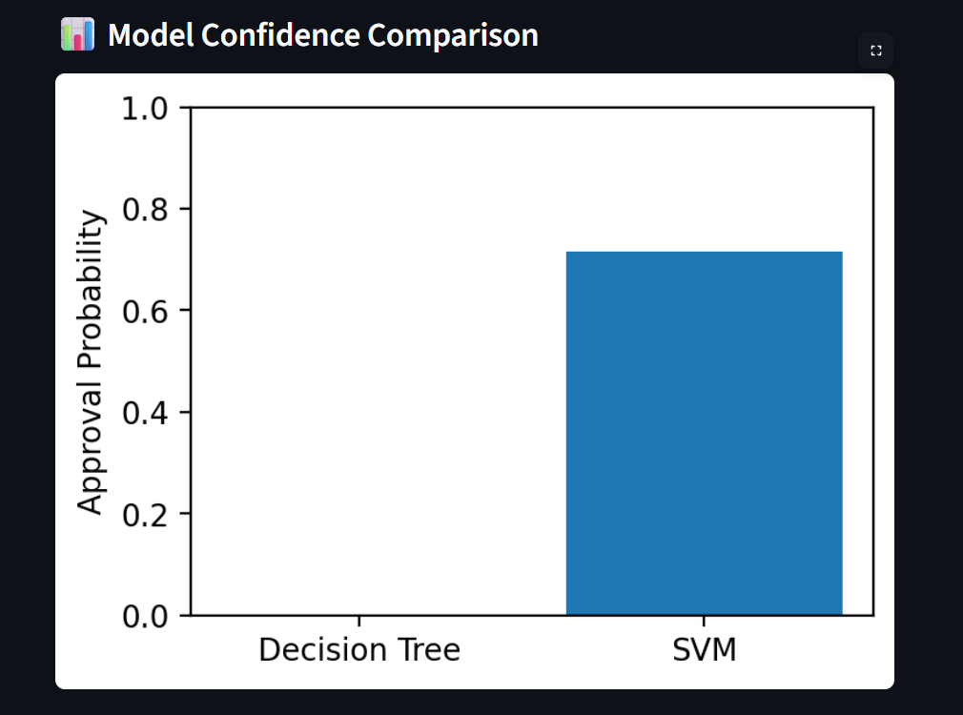
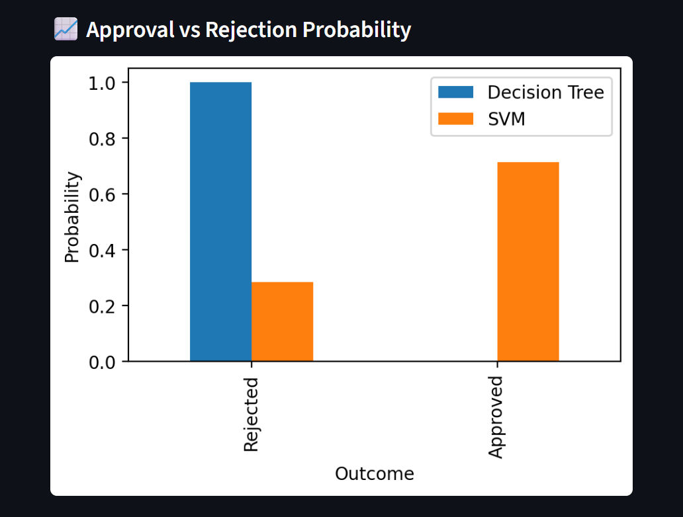
OUTPUT AND RESULTS
This graph compares the confidence scores of Decision Tree and
Support Vector Machine (SVM) for the given input.
It shows the probability of loan approval predicted by each model.
Higher confidence indicates stronger certainty in the prediction.
This visualization helps in understanding which model is more
confident about its decision for the same applicant data.
This graph shows the distribution of approved and rejected loan applications.
It helps in understanding whether the dataset is balanced or biased.
This visualization also gives an overview of overall loan approval trends.

Slide 8
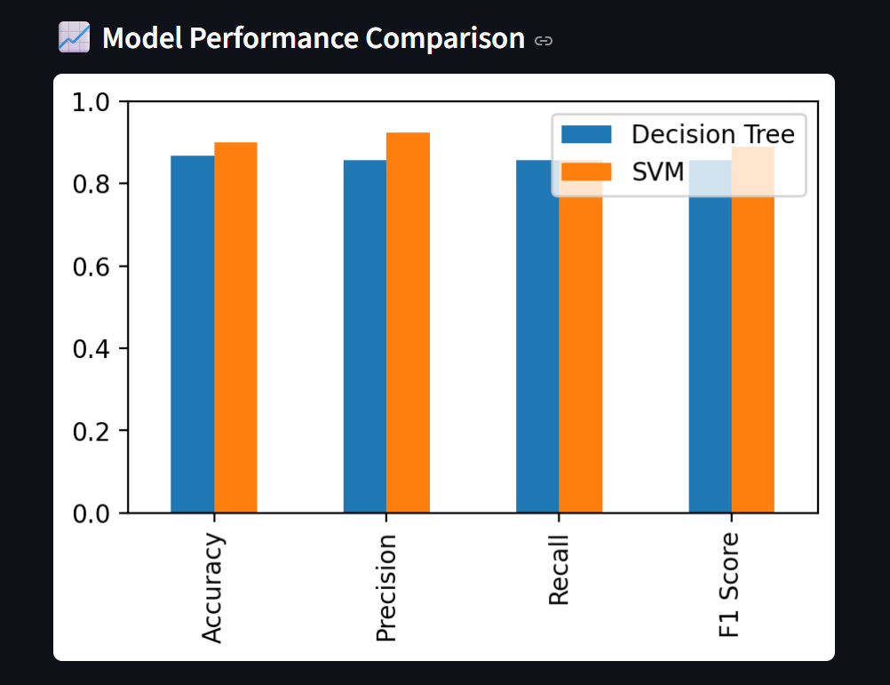
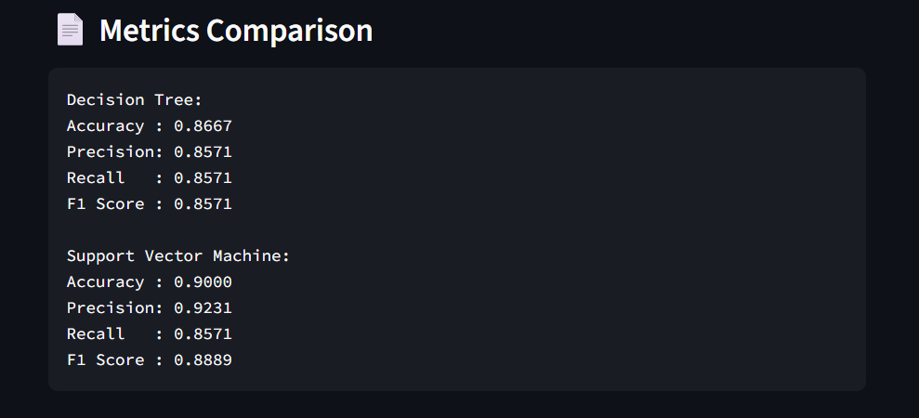
OUTPUT AND RESULTS
This bar chart compares Decision Tree and SVM using accuracy,
precision, recall, and F1-score.
It visually represents which model performs better across different
evaluation metrics.
This helps in selecting the most suitable model for loan prediction.
This screen displays the performance metrics of Decision Tree and Support Vector Machine (SVM) models in text format.
It includes important evaluation measures such as accuracy, precision, recall, and F1-score for both models.
The comparison helps in clearly understanding the effectiveness of each algorithm.

Slide 9
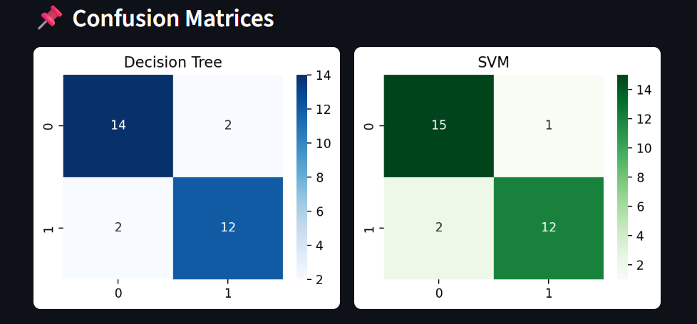
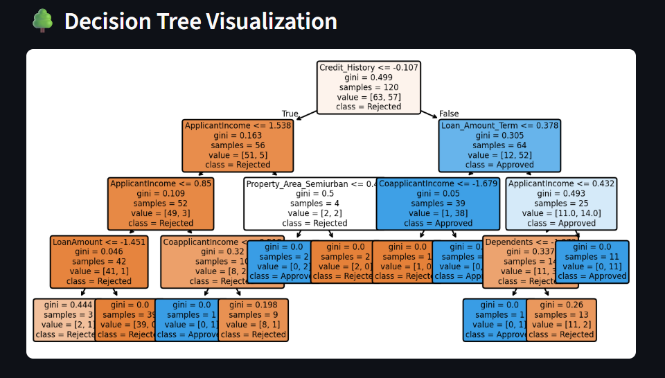
OUTPUT AND RESULTS
This matrix shows the performance of the models by displaying
correct and incorrect predictions (true positives, true negatives,
false positives, false negatives).
It provides a detailed view of how well the model classifies loan
approvals and rejections.
This helps in identifying errors made by the model.
This graph represents the structure of the Decision Tree, showing how different features lead to the final prediction.
Each node displays a condition, and branches represent possible outcomes.
It helps in understanding the decision-making process and the logic followed by the model.

Slide 10
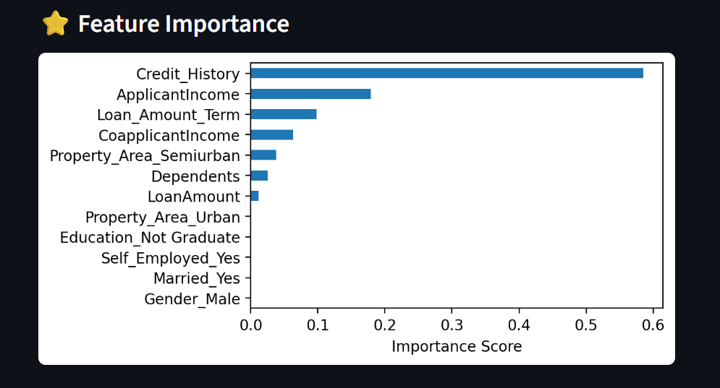
OUTPUT AND RESULTS
This chart highlights the importance of features such as credit history, income, and loan amount in influencing loan approval.
Features with higher importance have a greater impact on the model’s decision.
This visualization helps in identifying key factors affecting loan approval.

Slide 11
OUTPUT AND RESULTS
Results
• Model provides accurate loan approval predictions • Decision Tree and SVM give reliable classification results • Real-time prediction through web interface • User-friendly interface with clear outputs and graphs • Helps in faster and unbiased decision-making
Future enhancements
• Use larger real-world banking datasets instead of limited data • Apply advanced models like Random Forest or Deep Learning • Improve prediction accuracy with feature engineering • Deploy as a mobile application for easy access • Add loan risk scoring and approval probability prediction

Slide 12
REFERENCES
Scikit-learn Documentation https://scikit-learn.org/stable/
UCI Machine Learning Repository – Loan Prediction Dataset https://archive.ics.uci.edu/
Hands-On Machine Learning with Scikit-Learn, Keras, and TensorFlow Aurélien Géron, O’Reilly Media
Kaggle – Loan Prediction Dataset https://www.kaggle.com/
Towards Data Science https://towardsdatascience.com/
GeeksforGeeks – Decision Tree & SVM Tutorials https://www.geeksforgeeks.org/
Python Software Foundation https://docs.python.org/3/

