Slide 1

A Project Review Project title: Intelligent Energy Consumption Analytics for Smart Buildings
Submitted by
Batch No:
20
2420030447-G.SHAILAJA
2420030296-KISARA HARINI
2420030297-V.VARSHA
Under the Esteemed guidance of
Mrs. Dr.Swapnika
Assistant Professor
Department of Computer Science and Engineering
Koneru Lakshmaiah Education Foundation (Deemed to be University estd. u/s. 3 of the UGC Act, 1956) Off-Campus: Bachupally-Gandimaisamma Road, Bowrampet, Hyderabad, Telangana - 500 043. Phone No: 7815926816, www.klh.edu.in

Slide 2
Outline of the presentation
Problem Statement
Abstract
Project flow diagram
Literature Survey
Objectives with justification
Research gaps
Novelty/Innovation/Feseability
Tools
Project plan

Slide 3
Problem Statement
Smart buildings generate large amounts of energy-related data from appliances, sensors, environmental conditions, and building systems.
Traditional energy monitoring mainly focuses on historical consumption and does not provide sufficient intelligence about future consumption patterns.
Analyze historical energy consumption
Identify important consumption patterns
Predict future energy consumption
Identify factors influencing energy usage
Compare different ML models
Provide visual and actionable energy insights
The main problem is that buildings generate a huge amount of energy data, but raw data alone does not tell us what will happen in the future.
Our project solves these problems by applying machine learning algorithms to historical energy data and generating meaningful insights instead of just displaying raw numbers.

Slide 4
Abstract
The increasing demand for energy and rapid development of smart buildings have made efficient energy management an important research area.
This project proposes an Intelligent Energy Consumption Analytics framework by integrating:
Data Preprocessing → EDA → Feature Engineering → Machine Learning → Model Evaluation → Visualization.
Three benchmark datasets are considered:
Energy Efficiency Dataset
Appliances Energy Prediction Dataset
ASHRAE Great Energy Predictor III Dataset
The project applies machine learning models including:
Linear Regression,Decision Tree,Random Forest,XGBoost,CatBoost
The models are evaluated using MAE, MSE, RMSE and R² Score to identify the most suitable model for energy consumption prediction.

Slide 5
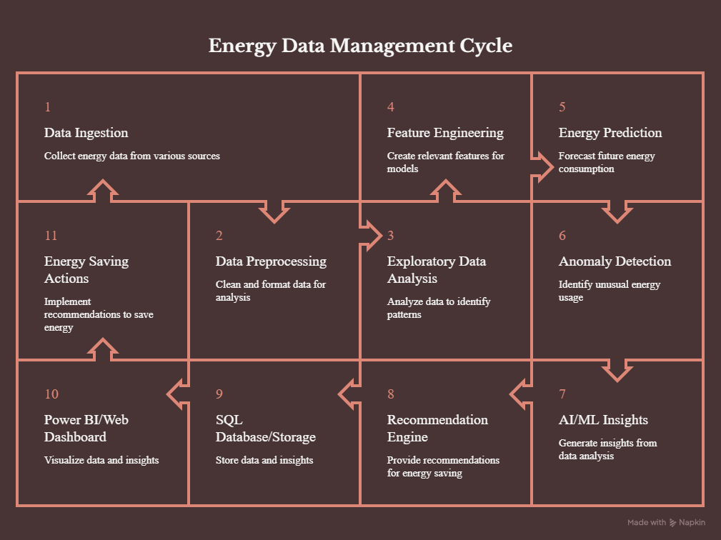
Project flow diagram

Slide 6
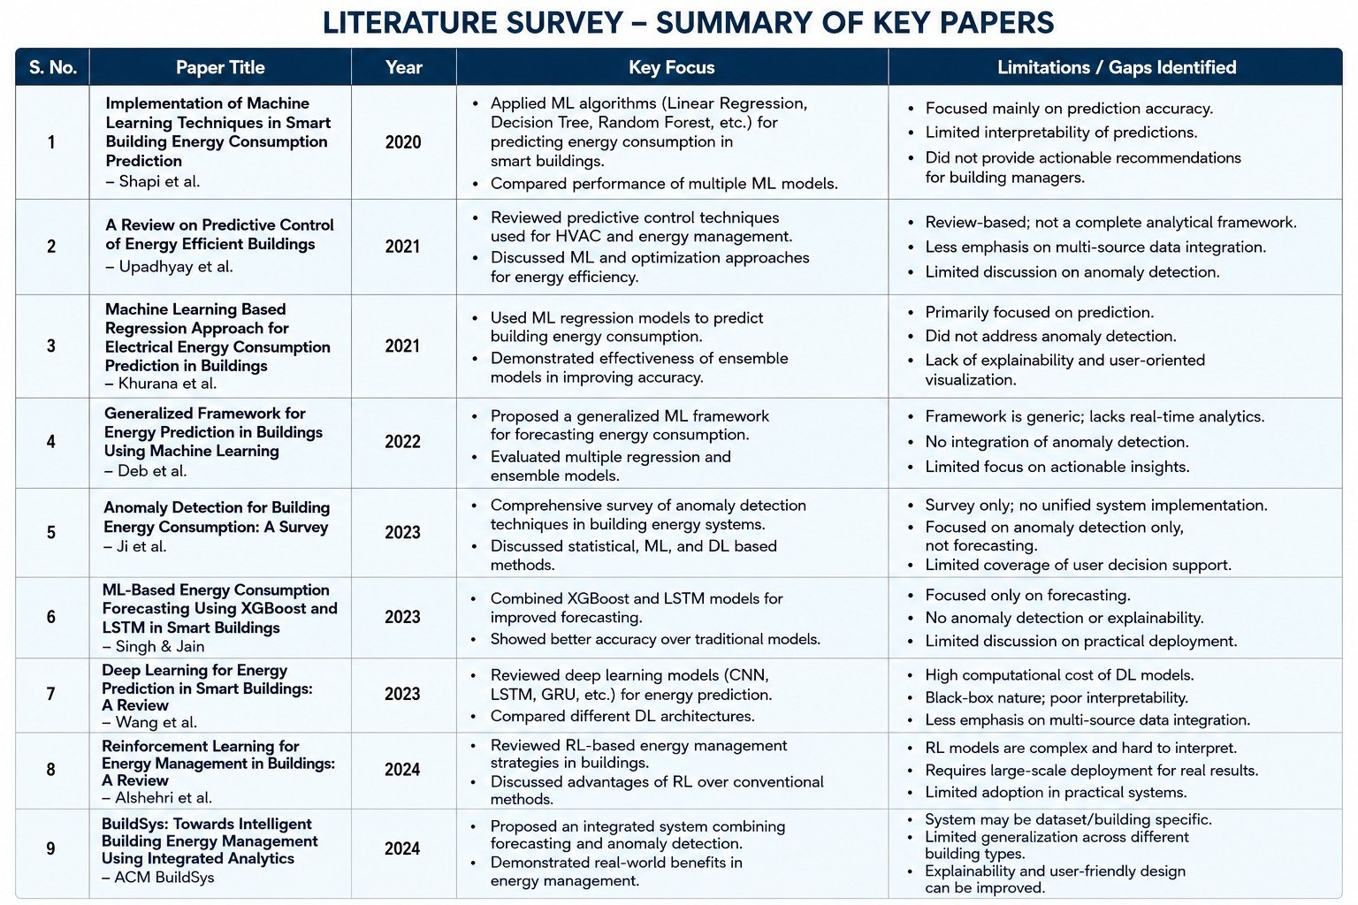

Slide 7
Research Papers
1. https://link.springer.com/article/10.1186/s42162-025-00483-y?utm_source=chatgpt.com
3. https://link.springer.com/article/10.1007/s10489-024-05451-9?utm_source=chatgpt.com
4 . https://link.springer.com/article/10.1007/s44243-024-00032-3?utm_source=chatgpt.com
5. https://ieeexplore.ieee.org/document/10949956?utm_source=chatgpt.com
6. https://ieeexplore.ieee.org/document/10042664/
7. https://ieeexplore.ieee.org/document/8623540?utm_source=chatgpt.com
8. https://link.springer.com/article/10.1007/s10462-023-10660- 8?utm_source=chatgpt.com
2. Intelligent system for fine building energy consumption management through optimized and integrated machine learning models | Discover Applied Sciences | Springer Nature Link

Slide 8
Objectives with justification
1. Enhance an End-to-End Energy Analytics Framework
→ Integrate data ingestion, preprocessing, EDA, ML, database and visualization.
2. Analyze Building Energy Consumption
→ Identify consumption patterns based on factors such as temperature, humidity, time,
appliances and building conditions.
3. Enhance Energy Prediction Models
→ Predict future energy consumption using Machine Learning algorithms.
4. Detect Abnormal Energy Consumption
→ Identify unusual or unexpected energy usage patterns.
5. Enhance Interactive Dashboards
→ Visualize energy consumption, predictions, anomalies and important energy trends.
6. Generate Energy-Saving Recommendations
→ Convert analytical results into practical recommendations for reducing energy wastage.

Slide 9
Research gaps
Gap 1 — Limited Focus on Actionable Energy Analytics
Existing studies primarily focus on predicting energy consumption using ML and deep-learning models.
Prediction alone does not explain why consumption is high or what actions can reduce it.
Gap 2 — Limited Integration of Multiple Data Sources
Energy consumption is influenced by multiple factors such as historical usage, temperature, humidity, occupancy, HVAC and lighting.
Many approaches do not comprehensively integrate these heterogeneous factors for analysis.
Gap 3 — Limited Integration of Forecasting and Anomaly Detection
Energy forecasting and anomaly detection are often addressed as separate tasks.
Integrating both can help identify unexpected consumption patterns and potential energy inefficiencies.

Slide 10
Research gaps
Gap 4 — Lack of Interpretability in Complex Models
Advanced ML and deep-learning models can achieve high predictive performance but may be difficult for non-technical building managers to interpret.
There is a need for more explainable energy analytics.
Gap 5 — Limited User-Friendly Decision Support
Many existing solutions emphasize model performance rather than easy-to-understand insights and actionable recommendations.
A user-friendly analytics dashboard can help building managers understand consumption patterns and make informed decisions.

Slide 11
Novelty
1. Dual Intelligence
The system performs both:
Energy Prediction + Anomaly Detection
rather than focusing on only one.
2. Energy Recommendation Engine
The system converts ML results into recommendations such as:
Reduce unnecessary appliance usage
Identify unusual energy consumption
Optimize high-consumption periods
Identify inefficient usage patterns
3. End-to-End Framework
Integrates:
Data Engineering → Analytics → ML → Database → Dashboard → Recommendations

Slide 12
Feasibility of the Project
1.The project can be developed using:
Python
Pandas
NumPy
Matplotlib
Seaborn
Scikit-learn
SQL/MySQL
Power BI
Streamlit or similar web technologies
Energy datasets provide variables required for consumption analysis and prediction.
2. Economic Feasibility
Most tools are free/open source.
Public benchmark datasets can be used.
No specialized hardware is required for the initial implementation.
Development can be performed using existing computers.

Slide 13
Feasibility of the Project
3. Operational Feasibility
The dashboard can provide:
Energy consumption trends
Prediction results
Anomaly alerts
Energy insights
Recommendations
This makes the output understandable even to non-technical users.
4. Schedule Feasibility
The project can be developed progressively:
Data Collection → Preprocessing → EDA → Feature Engineering → ML → Anomaly Detection → Database → Dashboard → Recommendations → Testing

Slide 14
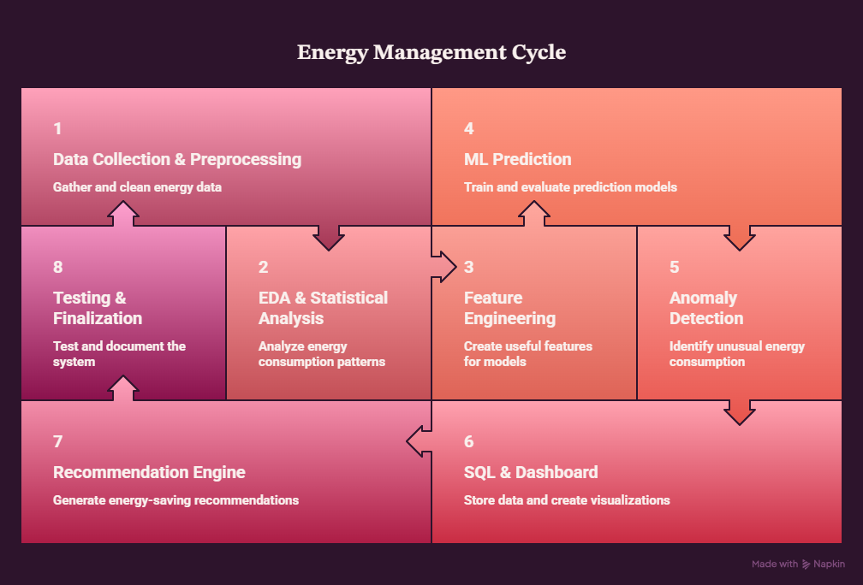
Project Plan

Slide 15
Thank you

