Slide 1
ENGINEERING CAPSTONE PROJECT – 1
City Connect
Smart Civic Services Platform
An AI-powered platform for reporting and tracking local civic issues
Team: Shravanya Sai Siri • Harini Kisara • Varsha Reddy
Guide: Ms. Prathusha | A.Y. 2026–2027
CITY CONNECT • SMART CIVIC SERVICES
01

Slide 2
Project Overview
WHAT IS CITY CONNECT?
City Connect is an AI-powered civic complaint management platform that connects citizens with relevant government authorities.
For citizens
For authorities
Role of AI
Report local issues with details, location and photographs.
View, assign, monitor and update complaints from one dashboard.
Analyze and categorize complaints, identify departments and help prioritize issues.
CITY CONNECT • SMART CIVIC SERVICES
02

Slide 3
Problem Statement
WHY IS THIS NEEDED?
Citizens may find it difficult to report civic problems to the correct department and follow their progress.
Damaged roads & potholes
Garbage accumulation
Road damage can affect everyday travel.
Waste may remain unreported or unresolved.
Drainage & water issues
Streetlight problems
Leaks and overflowing drains need attention.
Damaged lights can affect public spaces.
CITY CONNECT • SMART CIVIC SERVICES
03

Slide 4
Proposed Solution
ONE CENTRALIZED DIGITAL PLATFORM
• Citizens submit civic complaints through a digital interface.
• Each complaint can include category, description, location, photographs and supporting details.
• AI analyzes the complaint and suggests its category and concerned department.
• Authorities manage complaints through a centralized dashboard.
• Citizens can track complaint status and receive updates.
CITY CONNECT • SMART CIVIC SERVICES
04

Slide 5
How the System Works
COMPLAINT WORKFLOW
01
02
03
04
05
Report
Analyze
Route
Manage
Track
›
›
›
›
Citizen enters issue details, location and photo.
AI categorizes the complaint and helps assess priority.
System identifies the relevant department.
Officials assign and update the complaint.
Citizen follows progress through resolution.
Report → AI analysis → Department → Official updates → Resolution
CITY CONNECT • SMART CIVIC SERVICES
05

Slide 6
Role of Artificial Intelligence
HOW AI SUPPORTS THE PROCESS
Complaint analysis
Categorization
Department & priority
Interprets submitted details to understand the reported civic issue.
Groups the issue into a relevant category, such as garbage, water or roads.
Helps identify the concerned department and assess priority using severity and location.
AI is intended to assist complaint handling; the abstract does not specify a particular AI model or guarantee fully automated decisions.
CITY CONNECT • SMART CIVIC SERVICES
06

Slide 7
Users & Key Functions
TWO SIDES OF THE PLATFORM
Citizen
Government official
• Submit a complaint
• Add category, description, location and photos
• Track complaint status
• Receive progress updates
• View complaints in a centralized dashboard
• Monitor complaint status
• Assign complaints to departments
• Update progress through resolution
CITY CONNECT • SMART CIVIC SERVICES
07

Slide 8
Expected Outcomes
WHAT THE PROJECT AIMS TO IMPROVE
Faster handling
Better allocation
Transparency
Reduce complaint response time.
Support efficient use of resources.
Make complaint progress visible to citizens.
Accountability
Data-driven planning
Help track responsibility and status.
Identify recurring civic problems for decision-making.
CITY CONNECT • SMART CIVIC SERVICES
08

Slide 9
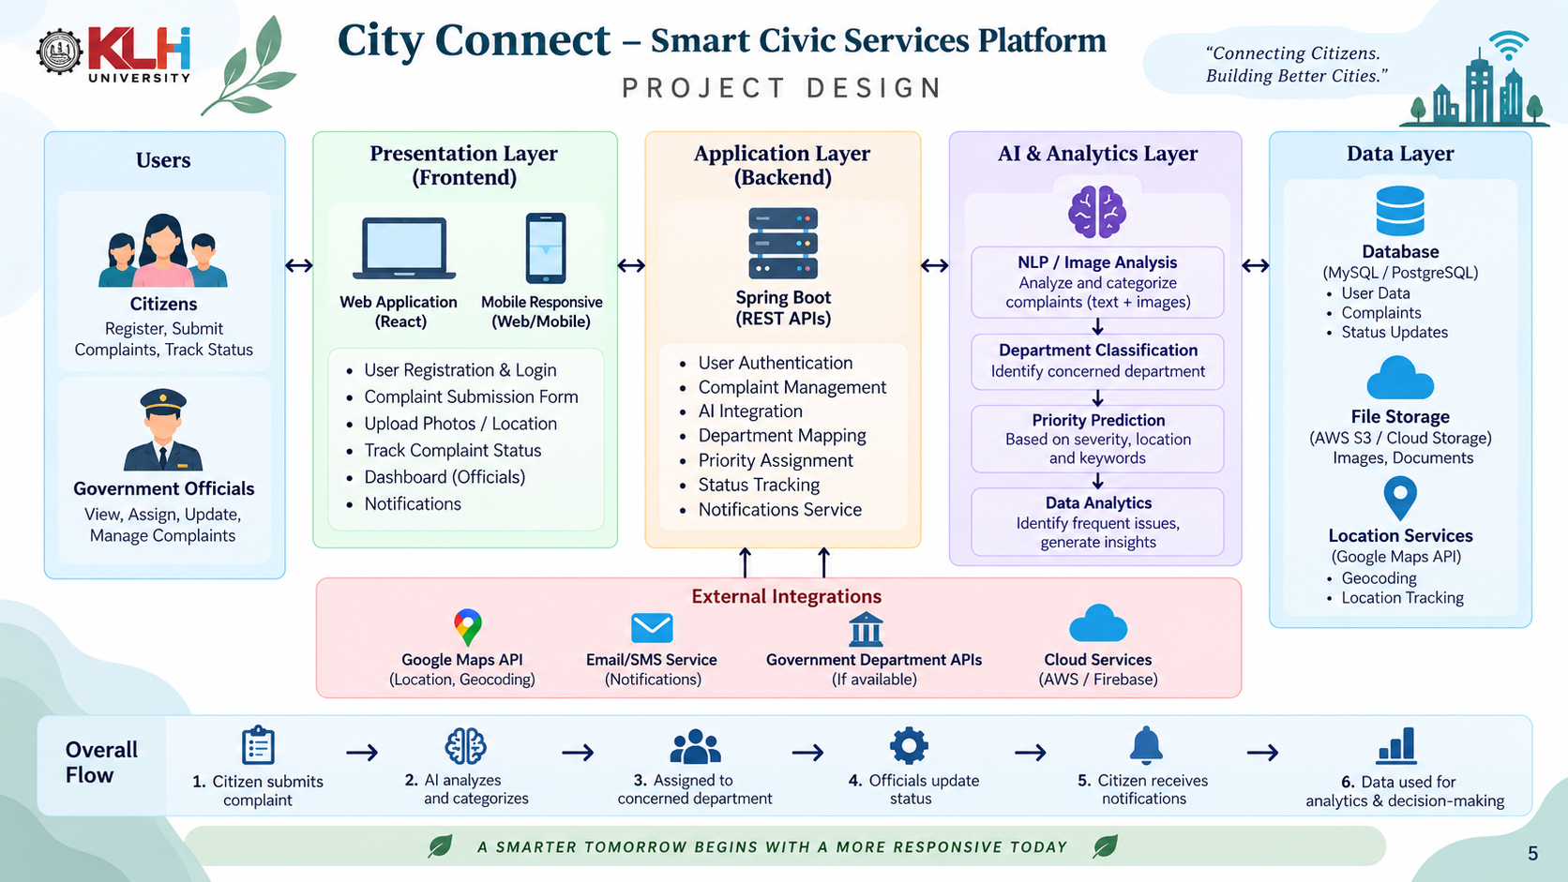
Project Design – City Connect

Slide 10
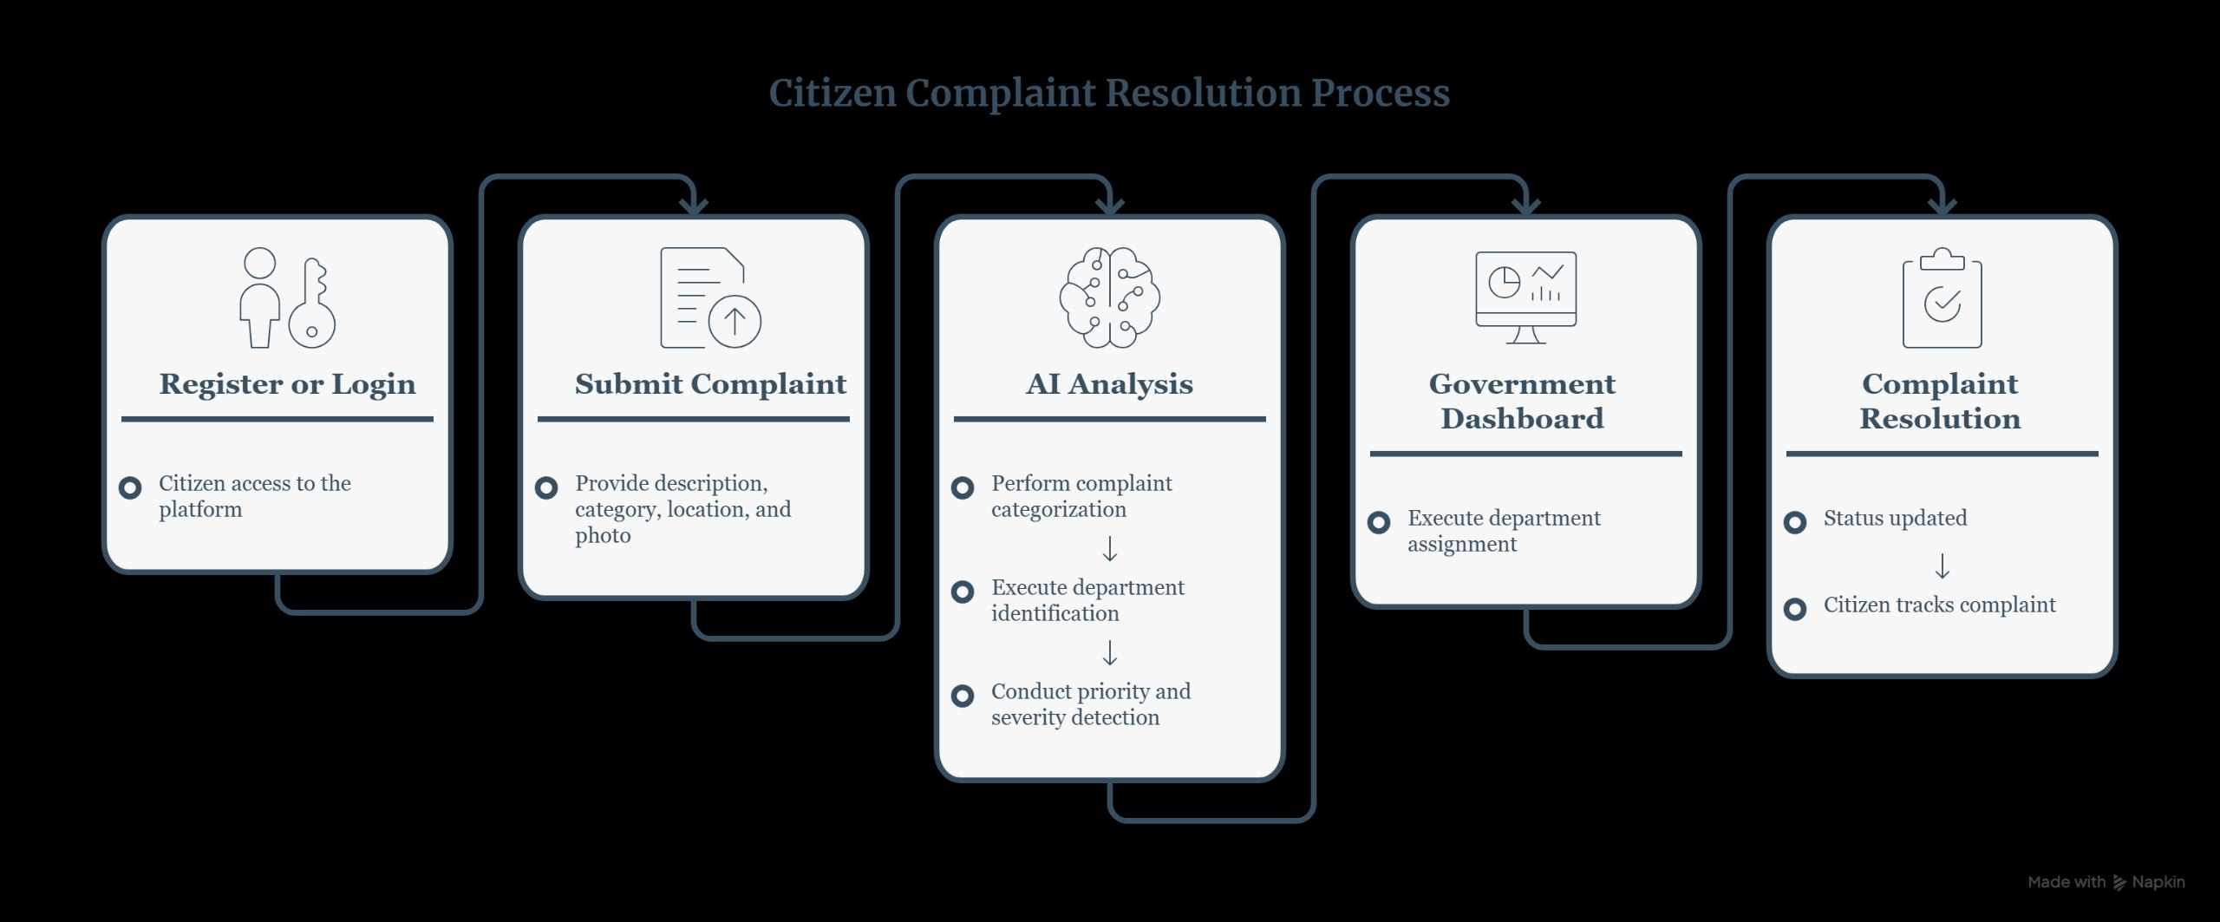

Slide 11
Project Design
SYSTEM COMPONENTS & INTERACTION
Citizen interface
AI analysis layer
Officials’ dashboard
Complaint form captures category, description, location, photos and supporting details.
Analyzes complaint details; supports categorization, department identification and priority assessment.
Central view to review, assign, monitor and update complaint status.
Information flow
Citizen submits → System records details → AI assists classification/routing → Officials manage → Citizen tracks updates
Design principle: one shared complaint record supports visibility for citizens and officials.
CITY CONNECT • SMART CIVIC SERVICES
11

Slide 12
Project Methodology
PLANNED DEVELOPMENT APPROACH
1. Identify
2. Design
3. Build
4. Integrate AI
5. Test & refine
List common civic issues and user needs.
Define citizen flow, official dashboard and complaint status flow.
Implement complaint submission and management components.
Add analysis for categorization, department suggestion and priority support.
Test submissions, routing, status updates and usability.
›
›
›
›
Methodology follows an iterative cycle: design → implement → test → improve.
Present these as your actual completed steps only where implementation/testing is already done.
CITY CONNECT • SMART CIVIC SERVICES
12

Slide 13
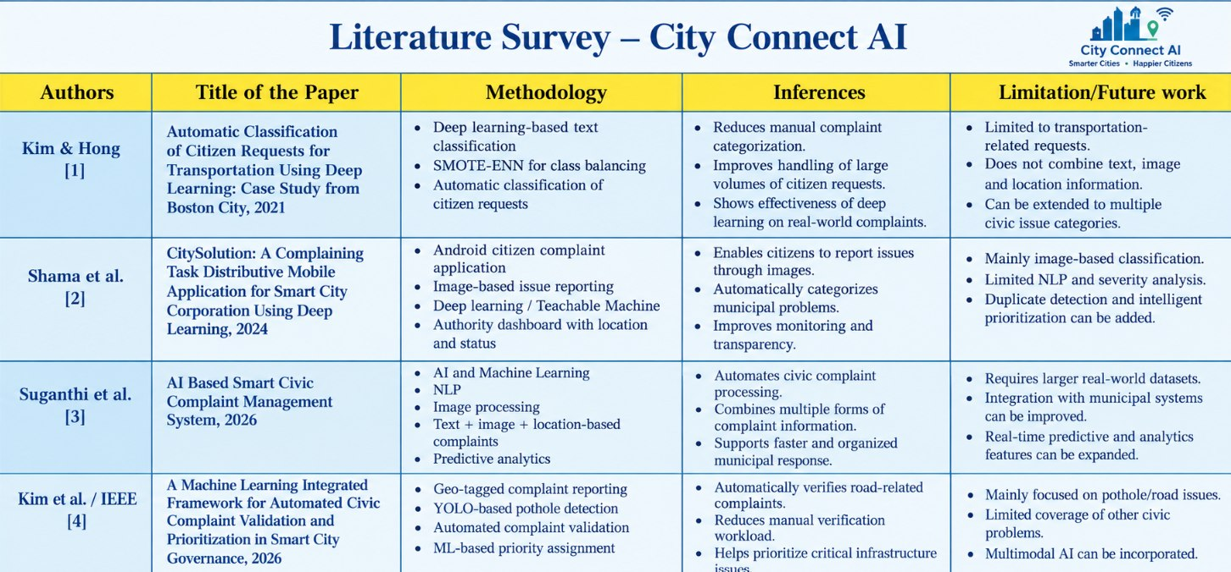

Slide 14
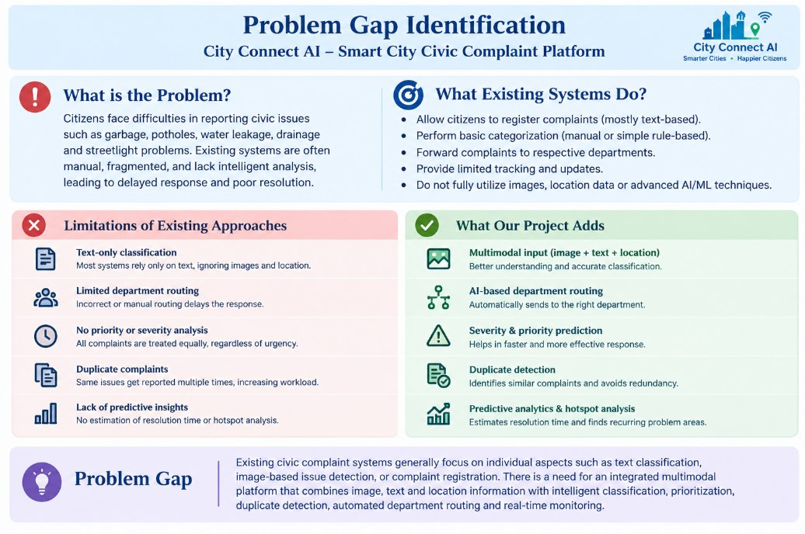

Slide 15
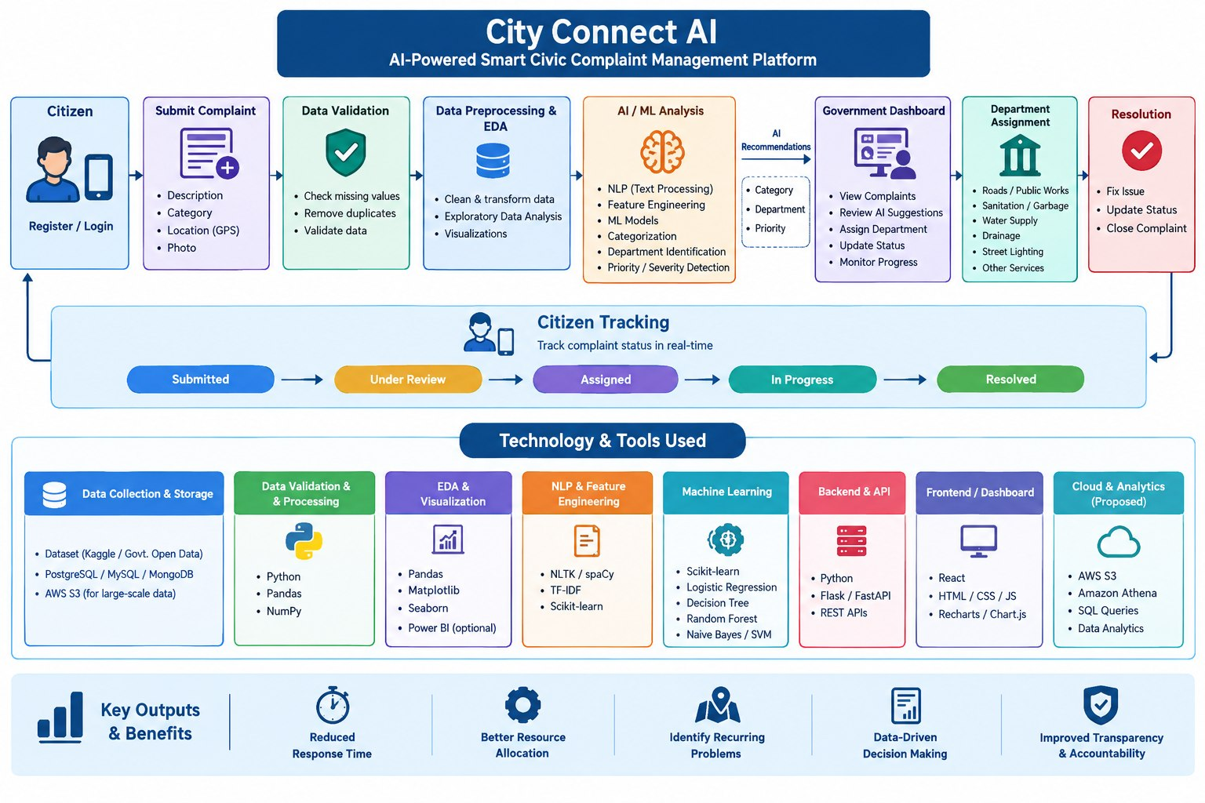

Slide 16
Technical Soundness
WHY THE APPROACH IS PRACTICAL
Structured complaint data
Role-based workflows
Using consistent fields (category, description, location, photo and status) makes reports easier to process.
Citizens submit and track; officials review, assign and update. Each role has a clear purpose.
Centralized status tracking
AI as decision support
A shared complaint record helps keep progress updates consistent across the workflow.
AI can assist classification and prioritization; officials remain responsible for handling decisions.
Technical validation should include form checks, category/routing checks, status-update tests and user-flow testing.
CITY CONNECT • SMART CIVIC SERVICES
13

Slide 17
Innovation, Creativity & Novelty
WHAT IS DISTINCTIVE IN THE PROPOSED APPROACH?
AI-assisted intake
Location + severity context
Citizen-to-official loop
Complaint details are analyzed to help categorize issues and identify the relevant department.
Issue location and severity are considered when helping assess complaint priority.
Reporting, assignment, progress updates and citizen tracking are connected in one workflow.
Creativity focus: combine AI support, location-based information and transparent tracking in a single civic-service experience. These are proposed differentiators, not claims of being the first such system.
CITY CONNECT • SMART CIVIC SERVICES
14

Slide 18
Limitations & Challenges
WHAT THE PROJECT MUST ACCOUNT FOR
Data quality
AI errors
Incomplete descriptions, unclear photos or inaccurate locations can affect analysis.
Categorization or priority suggestions may be incorrect and need human review.
Operational dependency
Access & privacy
Resolution depends on department participation, resources and timely status updates.
The platform needs secure handling of user details, photos and location information; access to internet/devices may vary.
These limitations can be addressed through validation, human oversight, privacy safeguards and clear complaint-status procedures.
CITY CONNECT • SMART CIVIC SERVICES
15

Slide 19
Conclusion
City Connect aims to make civic complaint management more accessible, transparent and efficient.
By combining AI, location-based services, data analytics and centralized complaint management, the platform supports better communication between citizens and authorities.
Thank you • Questions?
CITY CONNECT • SMART CIVIC SERVICES
09

