Slide 1
Matrix Chain Multiplication Optimization Tool
Data Structures and Algorithms -3 (25CS2103E)
Team Members:
K. Harini-2520030399
T.Sudeshna-2520030591
K.Kavya-2520030564
Under the Esteemed Guidance of
Dr. CH. Anuradha

Slide 2
Contents
Abstract
Introduction
Literature Survey
Problem Statement and Objectives
Work Flow
Flow Chart
Results
Hardware and Software Requirements
Conclusion

Slide 3
Abstract
• Our project finds the best order to multiply matrices. It uses Dynamic Programming to reduce the number of calculations..
• Different parenthesization orders can require significantly different scalar multiplications.
• The tool accepts matrix dimensions and applies dynamic programming to find the minimum-cost order.
• It generates the optimal parenthesization and minimum number of scalar multiplications.
• Cost tables and split positions can be displayed to trace how the solution is obtained.
• The tool provides a practical way to understand dynamic programming and algorithmic efficiency.

Slide 4
Introduction
Matrix multiplication is associative, meaning matrices can be multiplied in different orders.
However, different multiplication orders can have significantly different computational costs.
Matrix Chain Multiplication determines the best order for multiplying a sequence of matrices.
The project provides an interactive tool to solve and visualize this optimization problem.
Dynamic Programming is used to systematically evaluate possible multiplication orders.
The main goal is to reduce computational cost and improve efficiency.

Slide 5
Literature Survey
Matrix Chain Multiplication is a fundamental problem in computer science and algorithm optimization.
The problem can be solved by considering different possible parenthesization orders.
Evaluating every possible arrangement independently can require unnecessary computation.
Dynamic Programming reduces this complexity by storing and reusing intermediate results.
The problem demonstrates the concepts of optimal substructure and problem decomposition.
The proposed tool applies these concepts in a practical and interactive way.

Slide 6
Problem Statement and Objectives
Problem Statement:
To determine the optimal multiplication order for a given sequence of matrices such that the total number of scalar multiplications is minimized.
Objectives:
Accept matrix dimensions as input.
Apply Dynamic Programming to evaluate possible multiplication orders.
Find the minimum number of scalar multiplications.
Generate the optimal parenthesization.
Display cost tables and split positions.
Help users understand how Dynamic Programming solves the problem.

Slide 7
WORK FLOW
Start
↓
Enter Matrix Dimensions
↓
Create Dynamic Programming Tables
↓
Evaluate Possible Split Positions
↓
Calculate Multiplication Costs
↓
Store Minimum Cost
↓
Trace Split Positions
↓
Generate Optimal Parenthesization
↓
Display Minimum Cost and Results
↓
End

Slide 8
FLOW CHART
( START )
↓
/ Enter Matrix Data /
↓
[ Initialize DP ]
↓
[ Calculate Costs ]
↓
◇ Minimum Cost? ◇
↓
[ Store Best Split ]
↓
[ Optimal Order ]
↓
/ Display Results /
↓
( END )

Slide 9
Results
The tool identifies the optimal multiplication order for the given matrices.
It calculates the minimum number of scalar multiplications required.
The optimal parenthesization is generated and displayed.
Cost tables show the intermediate results obtained during Dynamic Programming.
Split positions help users trace how the optimal solution was obtained.
The results demonstrate how Dynamic Programming reduces unnecessary computation.

Slide 10
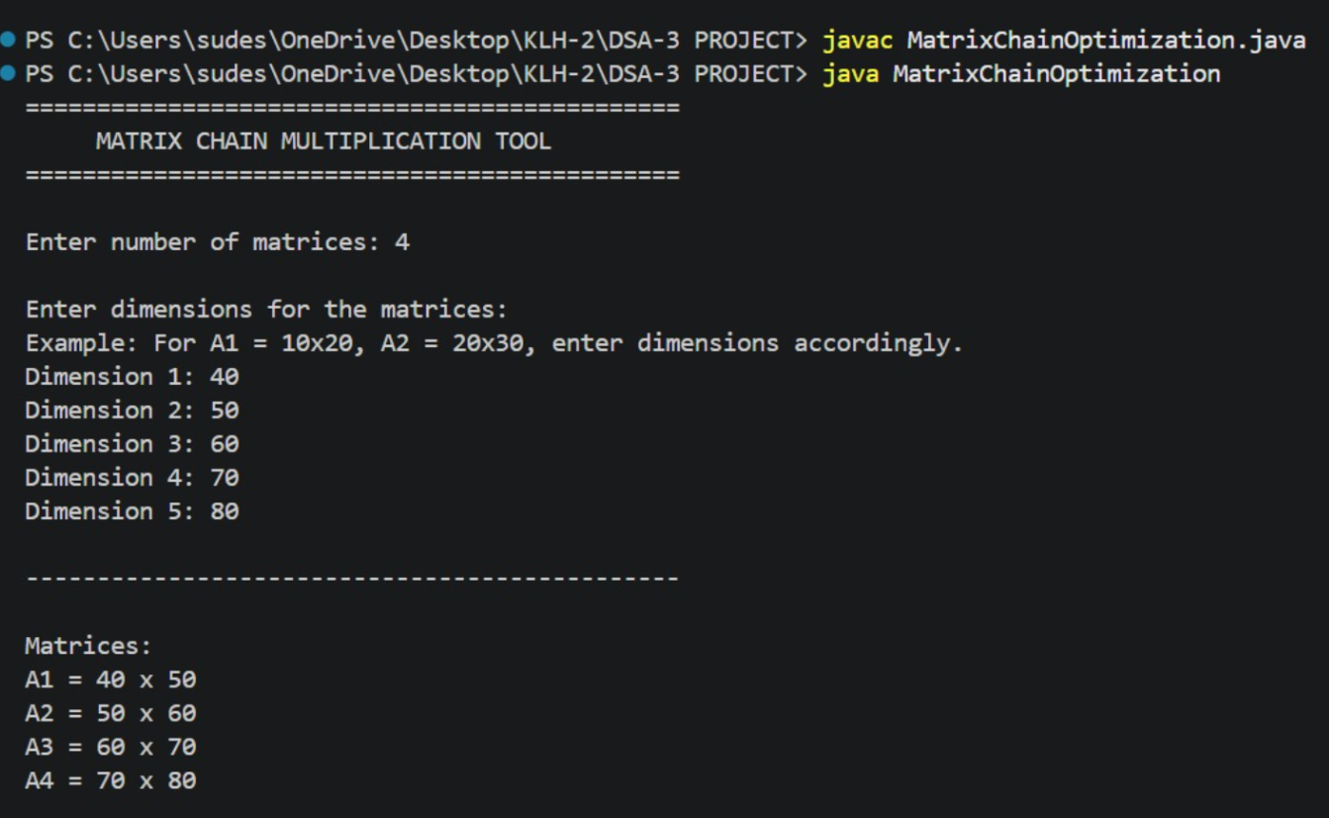
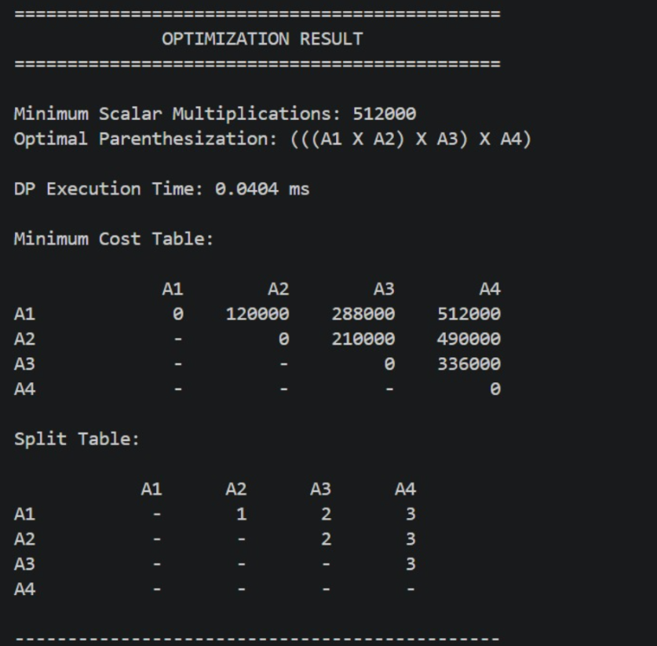
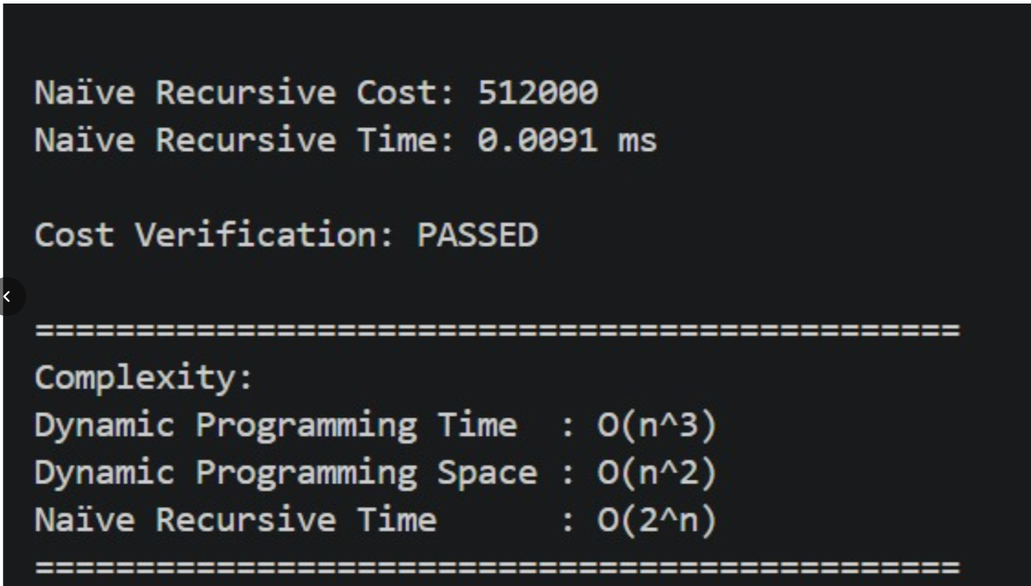
OUTPUTS

Slide 11
Hardware and Software Requirements
Hardware Requirements
Computer/Laptop
Keyboard and Mouse
Sufficient RAM
Sufficient Storage
Software Requirements
Operating System: Windows / Linux / macOS
Programming Environment
Development IDE
Application interface for entering matrix dimensions
Tool for displaying optimization results

Slide 12
Conclusion
The Matrix Chain Multiplication Optimization Tool provides an efficient solution for finding the minimum-cost multiplication order.
Dynamic Programming is used to systematically solve the optimization problem.
The tool generates the optimal parenthesization and minimum multiplication cost.
Cost tables and split positions make the optimization process easier to understand.
The project demonstrates the practical application of Dynamic Programming.
It highlights how problem decomposition can improve computational efficiency.

Slide 13
Future Scope
Add step-by-step visualization of the Dynamic Programming process.
Provide interactive visualization of cost tables and split positions.
Support larger sequences of matrices.
Add performance comparison between Dynamic Programming and brute-force approaches.
Improve the user interface for easier learning and analysis.
Extend the tool into a broader educational platform for algorithm optimization.

Slide 14
Thank You
Questions?
Thank You

