Slide 1
🌍📊 Global Retail Sales Performance
&
Profit Insights Dataset 💼📦

Slide 2
Introduction
This report presents a comprehensive analysis of the given sales dataset. The dataset contains information about sales transactions including country, state, category, sub-category, sales, profit, shipping cost, shipping mode, order priority, quantity, and order dates.The objective of this report is to analyze sales performance, profitability, shipping patterns, customer behavior, and statistical relationships among variables.

Slide 3
Dataset Description
The SuperStoreOrders dataset provides a comprehensive overview of global retail sales transactions recorded between 2011 and 2014. It contains exactly 51,290 rows and 21 variables, covering detailed information about orders, customers, products, shipping methods, and financial performance. The dataset includes attributes such as order dates, shipping modes, customer segments, product categories, sales amounts, discounts, profits, and regional markets. It enables analysis of sales trends, profitability, discount impact, and customer purchasing behavior. With structured and complete data, this dataset is highly suitable for exploratory data analysis, to support strategic decision-making in retail operations.

Slide 4
Data Cleaning
The dataset has been thoroughly checked for data quality issues and is found to be completely clean. There are no missing (null) values in any of the columns, ensuring that all records are complete. Additionally, no duplicate entries are present in the dataset. This confirms that the data is accurate, consistent, and reliable. Therefore, it is well-prepared for further analysis, modeling, and visualization without requiring additional data cleaning steps.

Slide 5
📊 1️⃣ Sales Performance Analysis

Slide 6
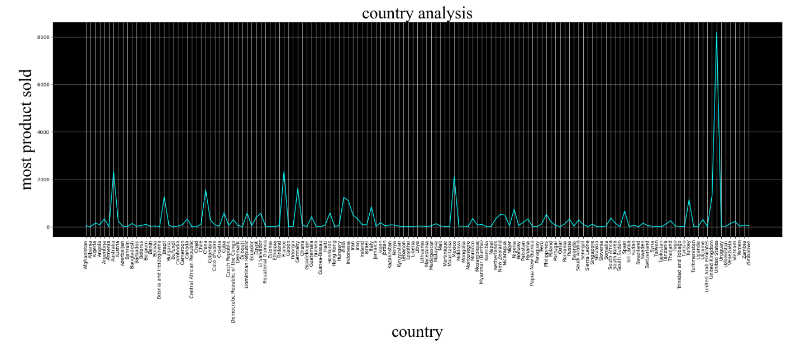
1. Which country has the highest sales count?
The United States has the highest sales among all countries, while countries like Zimbabwe record the lowest sales. This shows that most of the revenue come mainly from the United States compared to other countries.

Slide 7
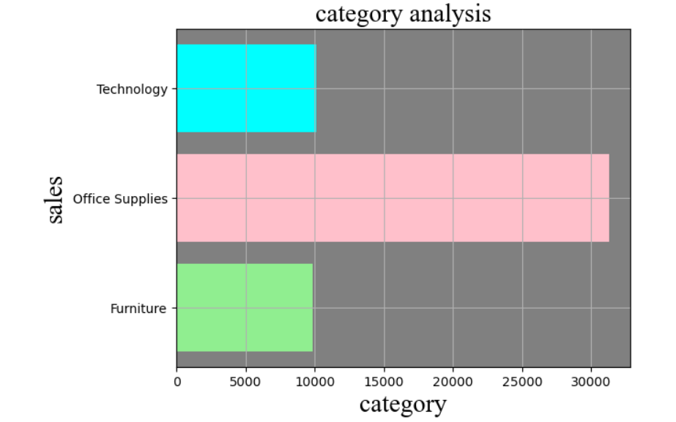
2. Which category has the highest sales?
Office Supplies records the highest sales among all categories. Technology shows medium sales, while Furniture has the lowest sales. This indicates that Office Supplies contributes the most to overall revenue compared to other categories.

Slide 8
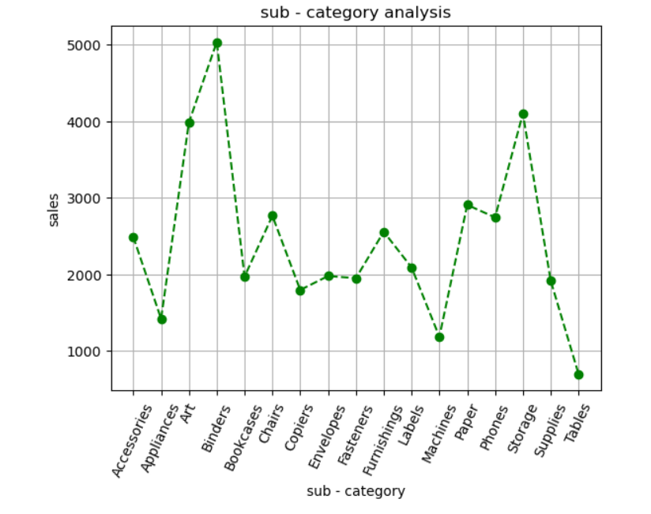
3. Which sub-category has the highest sales?
Binders records the highest sales among all sub-categories. Tables has the lowest sales. Phones and Storage also perform well, but Binders clearly contributes the most to overall sub-category sales.

Slide 9
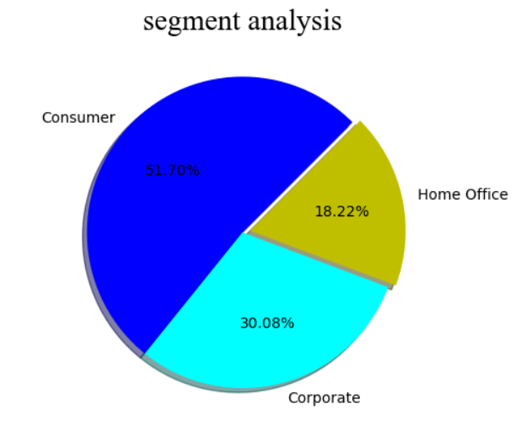
4. Which customer segment has the highest percentage?
Consumer has the highest share at 51.70%, while Home Office has the lowest share at 18.22%. Corporate stands in the middle with 30.08%. This shows that most sales come from the Consumer segment.

Slide 10
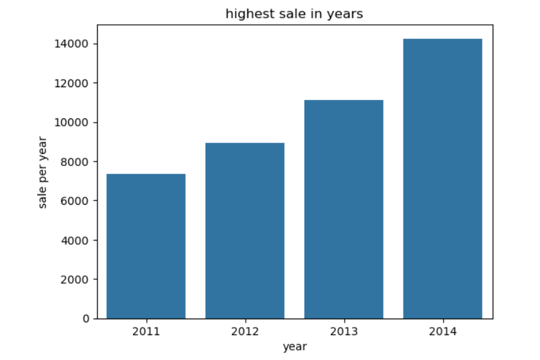
5. Which year has the highest sales?
The sales analysis shows that 2014 has the highest sales, while 2011 recorded the lowest sales. Sales increased steadily each year from 2011 to 2014.

Slide 11
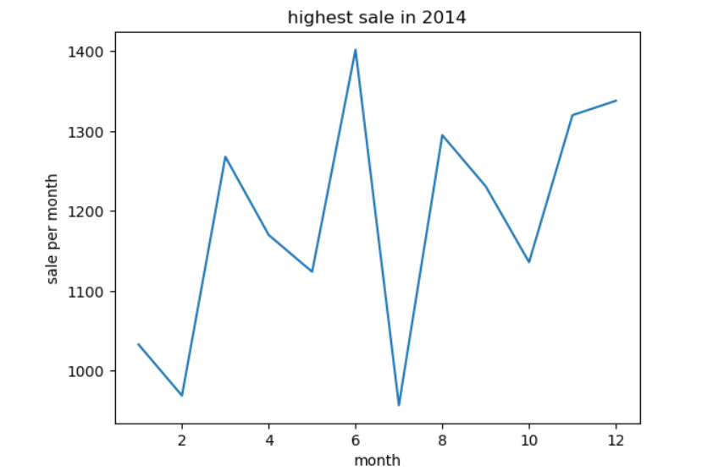
6. The highest sales occurred in 2014. In which month were sales highest?
In 2014, the highest sales occurred in June, while the lowest sales were seen in July. Sales fluctuated across months but peaked around mid-year.

Slide 12
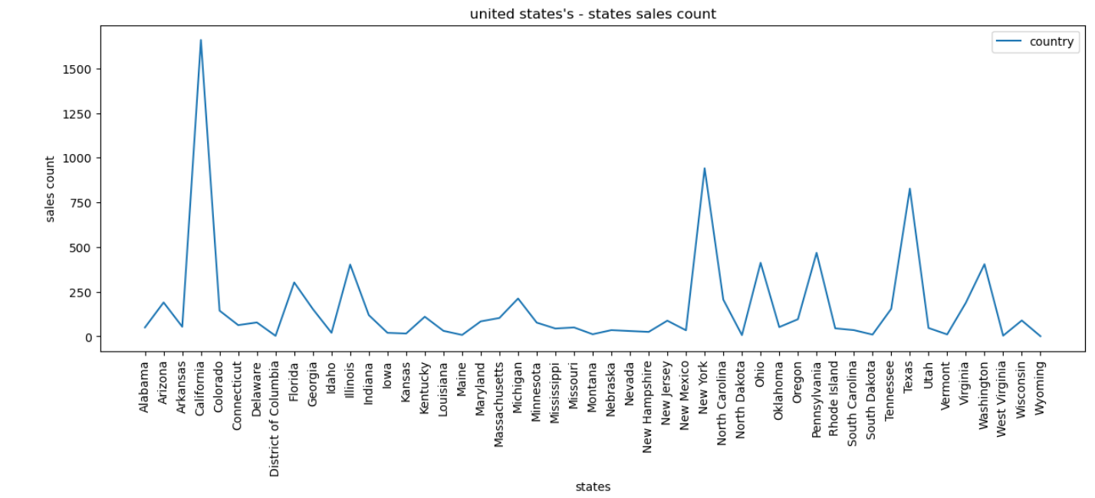
7. In the United States, which state has the highest sales count?
The state-wise sales analysis shows that California records the highest sales count in the United States, indicating strong customer demand. In contrast, Wyoming has the lowest sales count, reflecting minimal sales activity. Other states fall between these two extremes with moderate sales performance.

Slide 13
💰 2️⃣ Profit Analysis

Slide 14
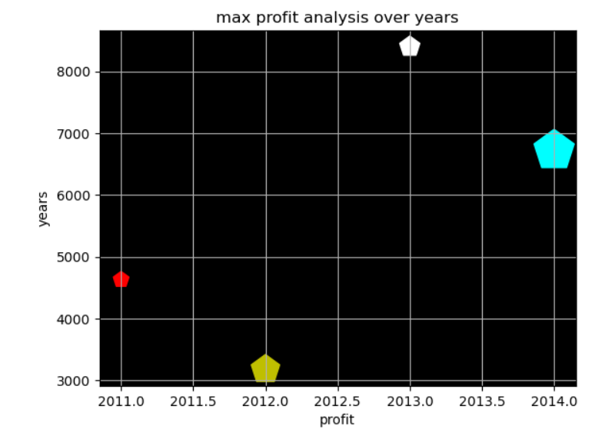
1. In which year was the profit turnover highest?
From the max profit analysis over the years, 2013 recorded the highest profit compared to other years. Profit increased from 2011 to 2013, then slightly decreased in 2014. Therefore, 2013 was the best-performing year in terms of maximum profit turnover.

Slide 15
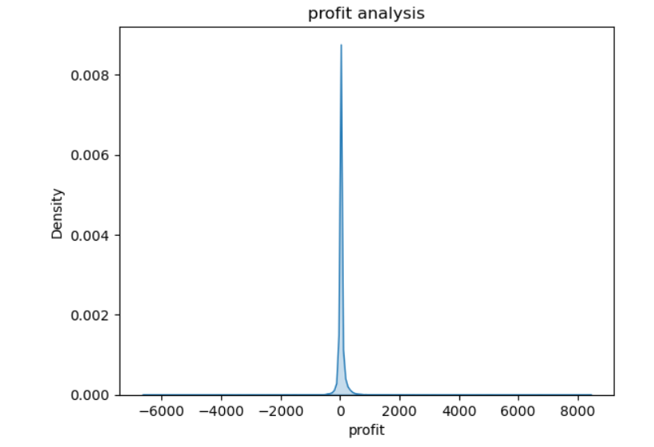
2. Perform profit-over-time analysis for the given dataset.
Most orders make only small profit or no profit. A few orders give very high profit, and some cause big losses. Overall, profit values are mostly near zero.

Slide 16
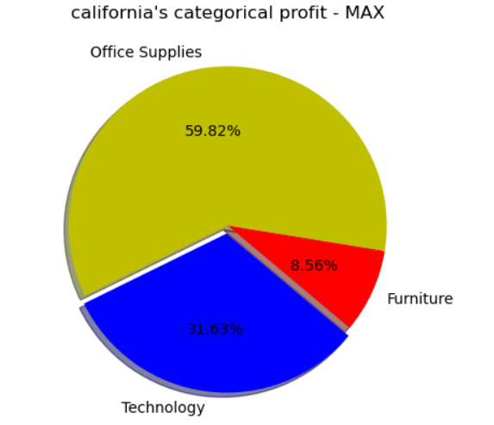
3. In California, which category has the maximum profit?
In California, Office Supplies generate the highest profit, contributing the largest share among categories. Technology follows as the second highest profit category, while Furniture records the lowest profit, indicating weaker performance compared to the other categories in the state.

Slide 17
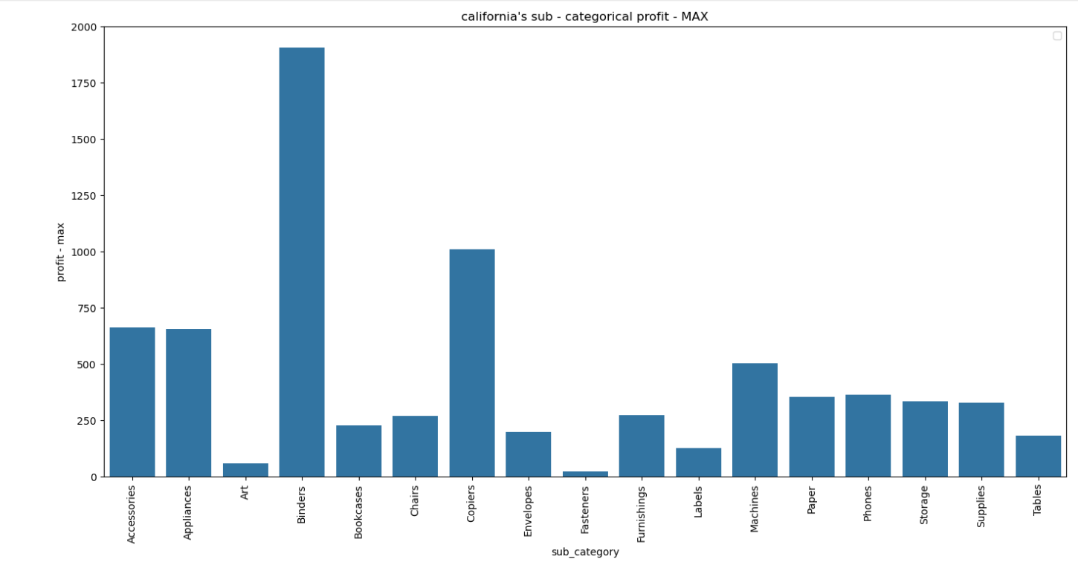
4. In California, which sub-category has the maximum profit?
Binders record the highest profit, making them the best-performing item. In contrast, Fasteners have the lowest profit, showing very weak performance. Other sub-categories earn moderate profits compared to these two extremes.

Slide 18
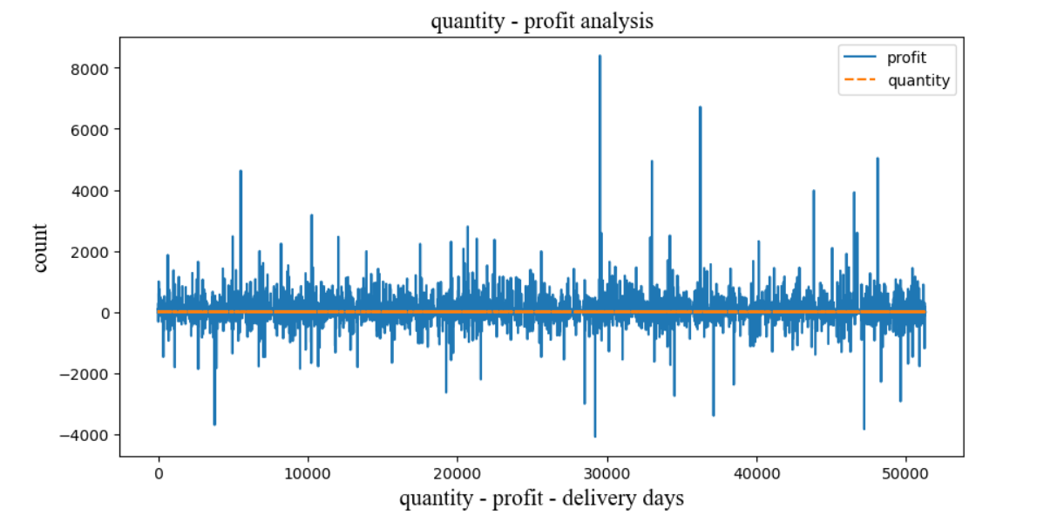
5. Perform quantity–profit analysis.
The graph shows the relationship between quantity and profit. Most profit values stay near the center, meaning profit does not strongly increase with higher quantity. Some sales show very high profit and some show losses. This indicates a weak relationship, where selling more items does not always guarantee higher profit.

Slide 19
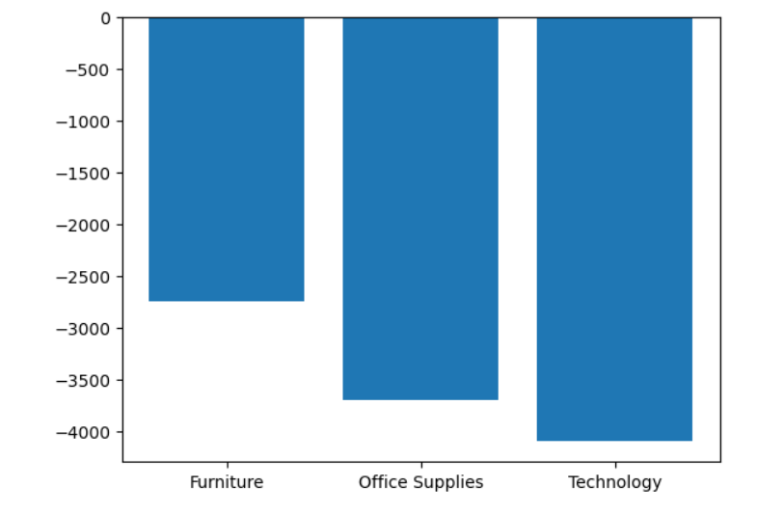
6. Which category has the highest loss?
The graph shows that Technology has the highest loss because it has the most negative value. Office Supplies also shows a high loss but less than Technology. Furniture has the lowest loss among the three categories. This means Technology is performing the worst in terms of profit.

Slide 20
🚚 3️⃣ Shipping & Order Analysis

Slide 21
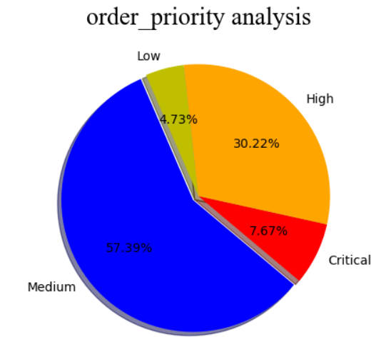
1. Which order priority range has the highest percentage?
Medium priority orders have the highest percentage. Most customers prefer medium priority delivery, while high priority is second. Critical and low priority orders are comparatively fewer.

Slide 22
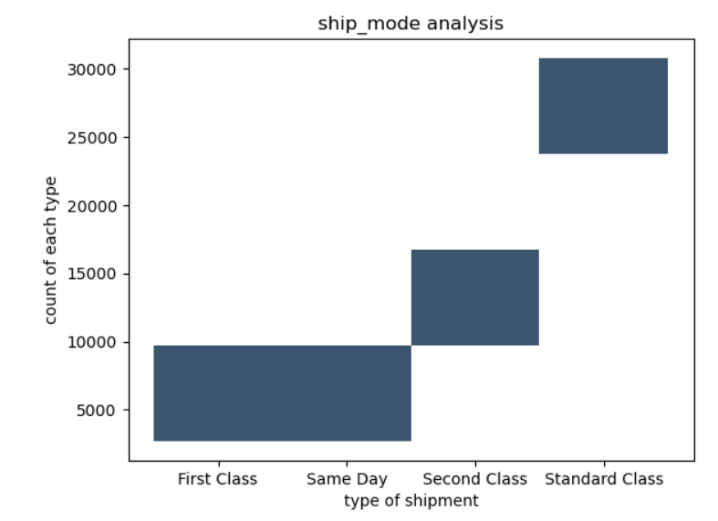
2. Which shipping mode has been used the most by customers?
Standard Class shipping is used the most by customers. Second Class follows next, while First Class and Same Day shipping are used less frequently in the dataset.

Slide 23
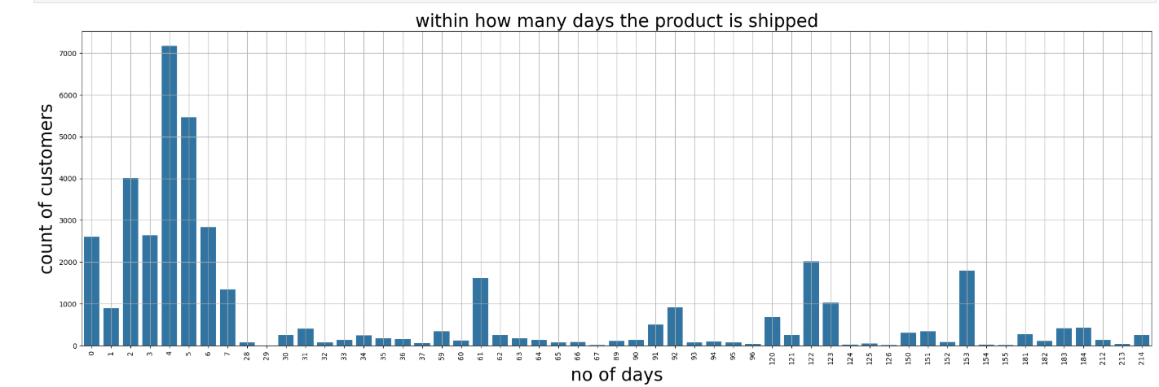
3. Within how many days was the product shipped?
Most products are shipped within a few days after ordering. The highest number of orders are delivered in shorter time periods, while very few orders take many days to ship. Overall, shipping is generally quick.

Slide 24
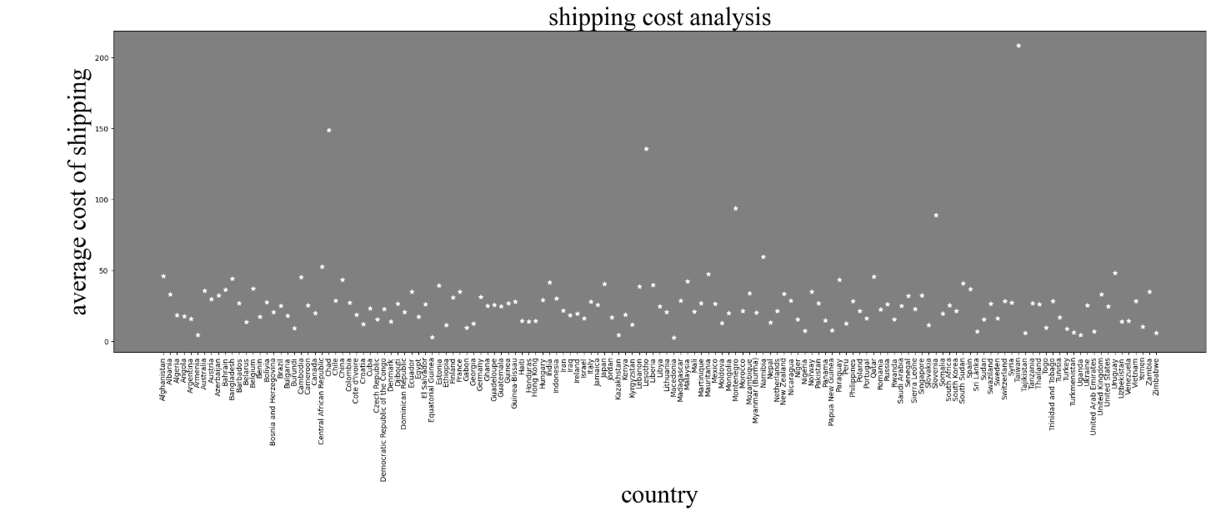
4. In which country is the shipping cost highest?
The shipping cost analysis shows that the United States has the highest average shipping cost, while countries like Burundi and Guinea-Bissau have the lowest shipping costs, indicating minimal delivery expenses in those regions.

Slide 25
📦 4️⃣ Product-Level Analysis

Slide 26
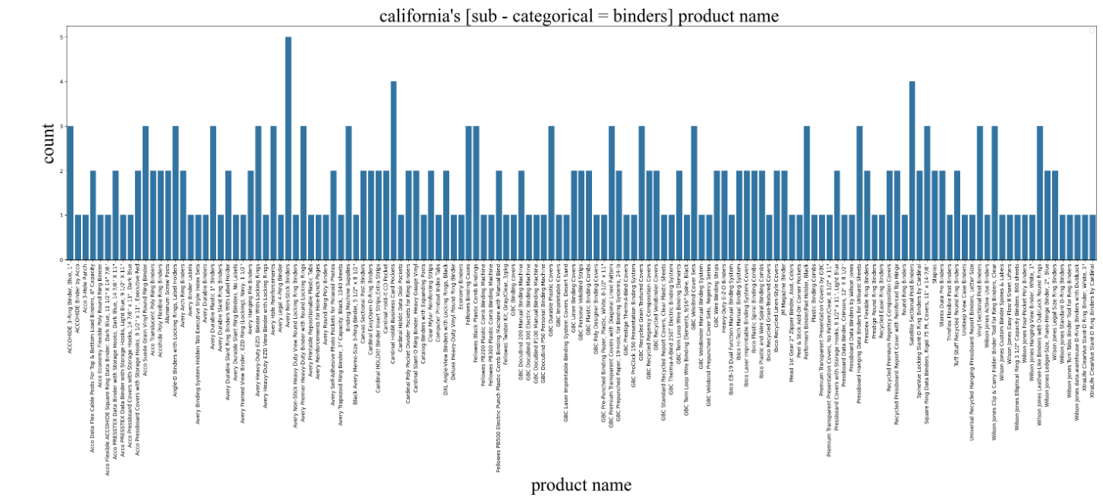
1. What are the products sold under the sub-category Binders in California?
Wilson Jones Legal Size Ring Binders record the highest sales, making them the most popular product in California under the Binders sub-category. In contrast, Acco Pressboard Covers with Storage Hooks have the lowest sales, showing very low demand. Other binder products have moderate sales compared to these two extremes.

Slide 27
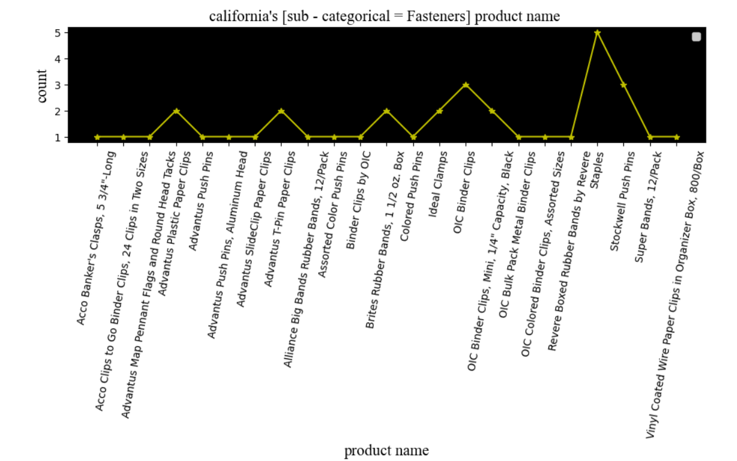
2. What are the products sold under the sub-category Fasteners in California?
Staples record the highest sales, making them the most sold product in the Fasteners sub-category. In contrast, Acco Banker's Clasps,show the lowest sales, indicating very low customer demand. Other fastener products have moderate sales compared to these two extremes.

Slide 28
📈 5️⃣ Statistical Analysis

Slide 29
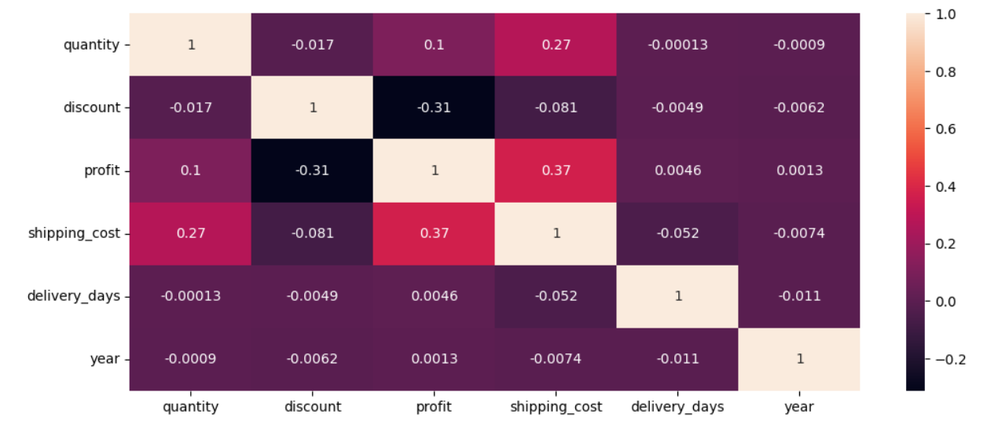
1. Find the correlation between the numerical variables in the dataset.
The heatmap shows relationships between numerical variables. Profit and shipping cost have a moderate positive correlation (0.37), meaning they increase together. Discount and profit have a negative correlation
(-0.31), showing higher discounts reduce profit. Other variables like quantity, delivery days, and year have very weak correlations close to zero.

Slide 30
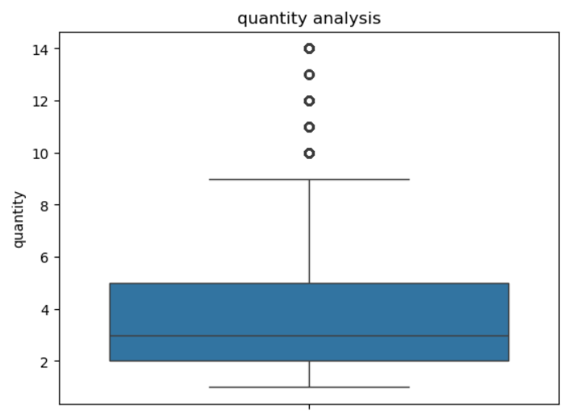
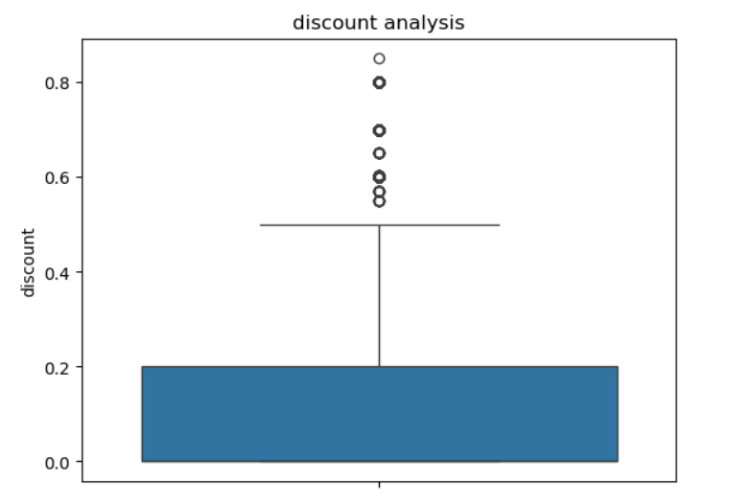
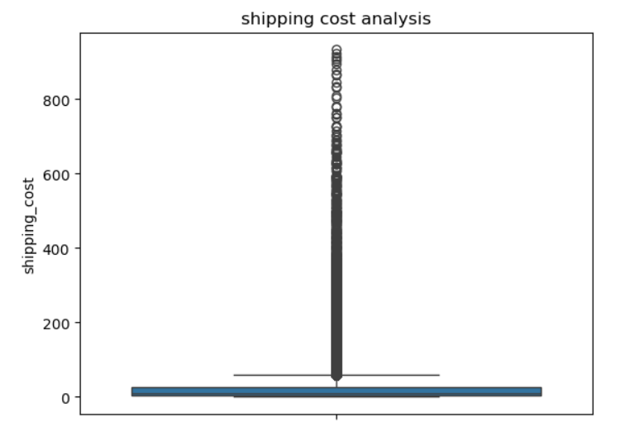
2. Identify the outliers in the dataset.

Slide 31
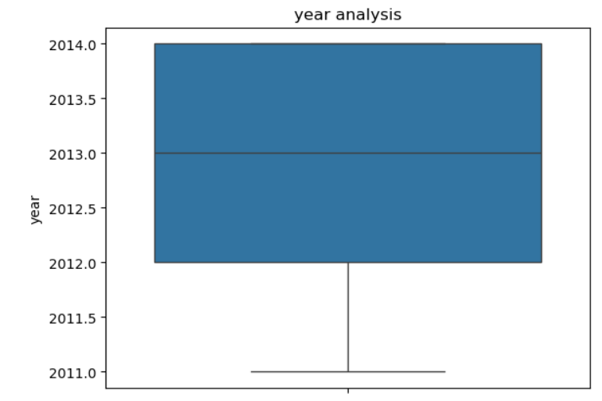
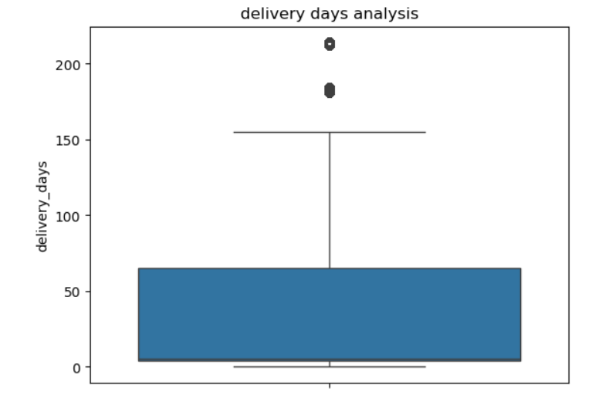
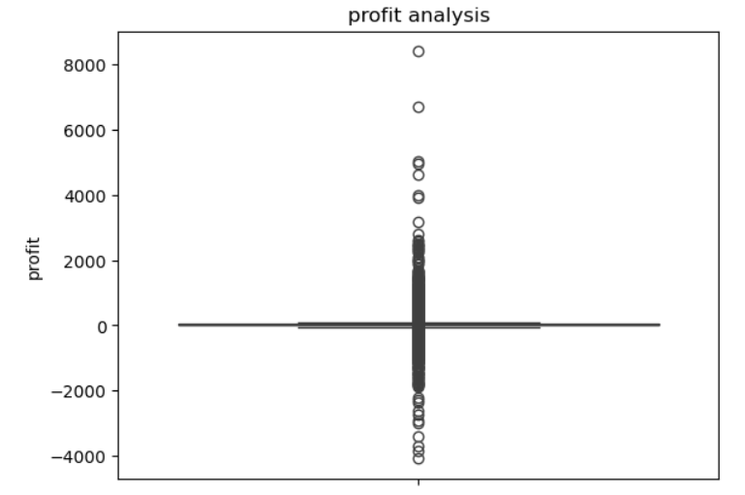

Slide 32
Overall review
The business should focus more on making profit, not just increasing sales. Losses in the Technology category should be reduced by fixing prices and costs. Big discounts on low-profit products should be avoided. More importance should be given to products that earn higher profit, like Office Supplies and Binders. Products that do not perform well should be improved or removed. Discounts should be given only to loyal customers. Shipping costs can be reduced by using Standard Class delivery. The company should keep Consumer customers happy and use the successful ideas from California in other regions.

