Slide 1

VILVAH Sales Analysis (2015–2025)
Vilvah Store Sales Overview

Slide 2

INTRODUCTION
The dataset used for this analysis represents the sales performance of VILVAH STORE over a period of 10 years (2015–2025). It captures detailed information about customer behavior, product performance, and overall business trends.
The data includes multiple dimensions such as:
Customer Demographics – Gender and Age groups
Geographical Data – Sales across different cities
Product Information – Various skincare products and categories
Time-Based Data – Yearly and monthly sales trends
Customer Feedback – Ratings and satisfaction levels

Slide 3
DATA PROCESSING
The dataset was already clean and well-structured.
There were no null (missing) values in the data.
There were no duplicate records found.
A new column called Rating Status was created for better analysis.
Another column called Month of Ordered Date was added to understand monthly trends.
These additions help in better visualization and reporting.

Slide 4
KEY PERFORMANCE INDICATORS
Total Revenue ₹6,10,53,550 – Represents the total income generated from sales during the period.
Total Sales Volume 50,000 Units – Indicates the total number of products sold.
Average Customer Rating 4.0 / 5 – Reflects overall customer satisfaction and product quality.
Customer Distribution Balanced sales across gender and wide coverage across age groups (18–50).
Top Performing Cities Cities like Mumbai, Hyderabad, and Coimbatore show strong sales performance.

Slide 5
Sales Analysis

Slide 6
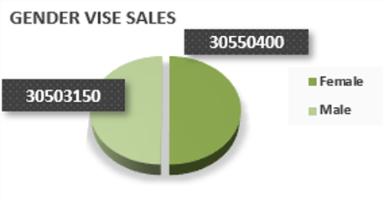
GENDER-WISE SALES INSIGHTS
Sales are evenly split between Male and Female customers
No major dominance observed
Balanced target audience engagement

Slide 7
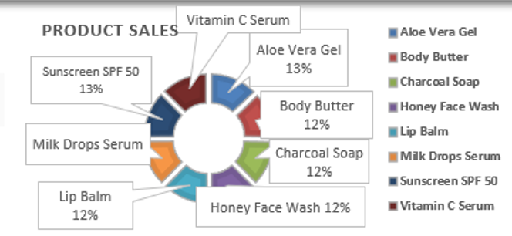
TOP PRODUCT PERFORMANCE
Highest Performing Products – 13%
Aloe Vera Gel
Sunscreen SPF 50
Vitamin C Serum
Milk Drops Serum
Lowest Performing Products – 12%
Body Butter
Charcoal Soap
Honey Face Wash
Lip Balm

Slide 8
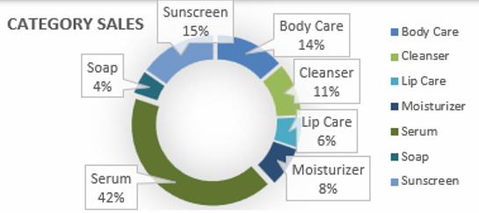
CATEGORY-WISE SALES
Unlike product performance, category sales are highly skewed, where Serum alone contributes 42%, while Soap contributes only 4%, showing a 38% gap between highest and lowest categories.

Slide 9
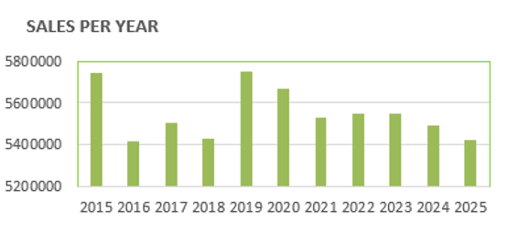
YEAR-WISE SALES TREND
The sales trend shows a stable performance, with peaks in 2015 and 2019 (~57.5 Lakhs) and a lowest point around 54 Lakhs, resulting in a small variation of ~3.4 Lakhs, indicating consistent business stability.

Slide 10
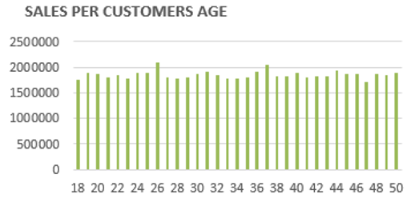
CUSTOMER AGE ANALYSIS
Sales peak at age 26 (~20.85 Lakhs), with the lowest contribution from early-age customers (~18–20 years at ~17.5–18 Lakhs) and an average around ~19.3 Lakhs, indicating stable performance across all age groups

Slide 11
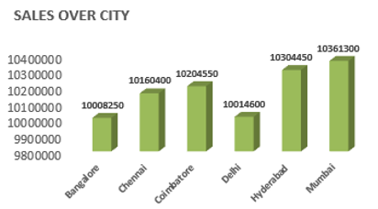
CITY-WISE PERFORMANCE
City-wise sales remain stable, with Mumbai leading at ~103.61 Lakhs and Bangalore at the lower end (~100.08 Lakhs), resulting in a narrow variation of ~3.5 Lakhs and an average around ~102 Lakhs, indicating consistent performance across all major cities

Slide 12
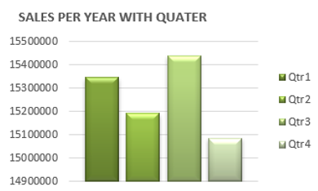
QUARTERLY SALES ANALYSIS
Q3 recorded the highest sales (15,400,000), Q4 the lowest (15,100,000), with an average quarterly sales of 15,275,000.
Seasonal demand impact observed

Slide 13
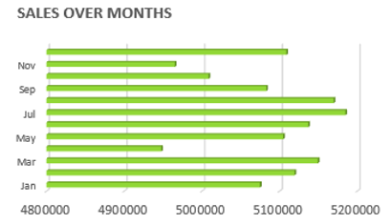
MONTHLY SALES TRENDS
Sales peak around July–September (~5.15M–5.2M), while early months remain lower (~4.95M–5.05M), highlighting clear opportunities for marketing during low-sales periods.
Marketing opportunities in low months

Slide 14
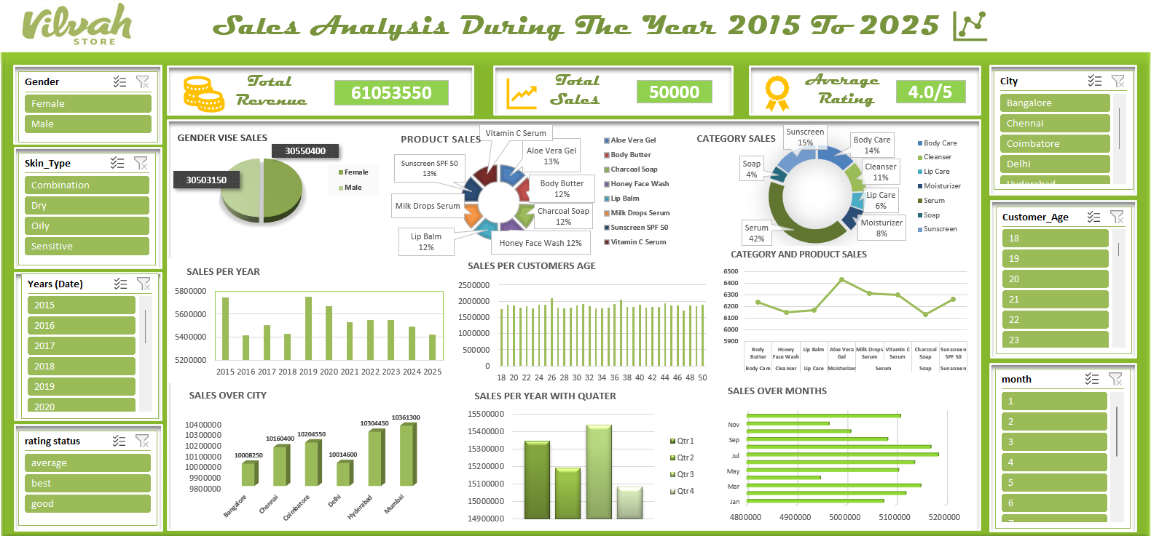
DASHBOARD

Slide 15
KEY BUSINESS INSIGHTS
Sales are highest in mid-year (July to September)
Early months have lower sales
Clear seasonal trend is observed
Marketing can improve low-sales months
Focus more on peak months to maximize profit

Slide 16
THANK YOU

