Slide 1
Employee Data Analysis using Excel
STUDENT NAME: HARINI.V
REGISTER NO: 312204993
DEPARTMENT: B.COM (GENERAL)
COLLEGE: NAZARETH COLLEGE OF ARTS AND SCIENCE

Slide 2
PROJECT TITLE
Employee Performance Analysis using Excel

Slide 3


AGENDA
Problem Statement
Project Overview
End Users
Our Solution and Proposition
Dataset Description
Modelling Approach
Results and Discussion
Conclusion
3/21/2024 Annual Review

Slide 4

PROBLEM STATEMENT
Data collection & Management of Employee performance data.
Visualization of Employee performance trends & Comparisons using Chart, Graph & Dashboard.
Analysis of performance Matrics by Department, Team or Individual.

Slide 5

PROJECT OVERVIEW
Identification of top performers, underperformer & training needs.
Departmental & Term performance Comparison.
Performance matric calculation & Analysis.
Data collection & Management.
.

Slide 6

WHO ARE THE END USERS?
HR Manager
Department Heads
Team Lead
Employees
Talent Management Teams
By Considering The Needs And Requirements Of These End Users,You Can Design An Effective Employee Performance Analysis System In Excel.

Slide 7

OUR SOLUTION AND ITS VALUE PROPOSITION
Automated performance tracking
Customizable dashboards
Data- driven insight
Enhanced decision- making
Improved employee engagement
Streamlined performance management
Strategic workforce planning.

Slide 8
Dataset Description
Employee information table
Performance Matrics table
Performance evaluations table
Training & development table
Feedback & surveys table
Sales / productions data table.
Data type includes:
Employeer ID
Department
Ratings
Goal
Comments

Slide 9

THE "WOW" IN OUR SOLUTION
AUTOMATED PERFORMANCE TRACKING:
Effortless monitor employee performance Matrics, eliminated manual data entry.
PREDICTIVE ANALYTICS:
Identify potential performance issues before they arise, enabling proactive interventions.
CUSTOMIZABLE PERFORMANCE MATRICS:
Align matric with organization goals, ensuring relevant performance measurements.
REAL TIME REPORTING:
Generate instant reports, facilitating timely decision- making.
3/21/2024 Annual Review
9

Slide 10
MODELLING
REGRESSION ANALYSIS:
Predict employee performance based on hystorical data.
CLUSTER ANALYSIS:
Group employee with similar performance characteristics.
DECISION TREES:
Identify factors influencing employee performance.
CONDITIONAL FORMATTING:
Highlight performance trends & outlines.
PIVOT TABLES:
Analyze & Summarize large datasets.
10

Slide 11
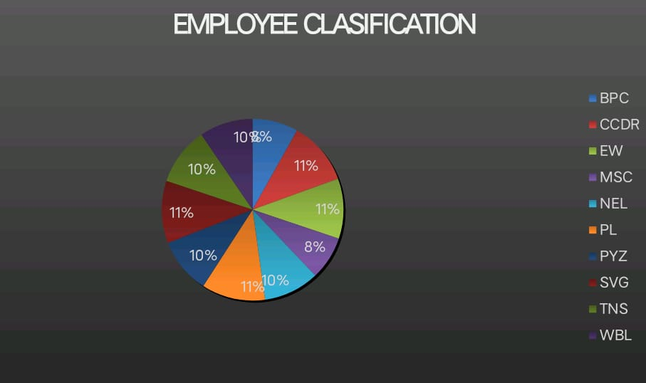
RESULTS
11

Slide 12
conclusion
Empowers data driven decision making enhance performance management boosts employee engagement and growth.
By leveraging excel for employee performance analysis, organization.
Unlock employee potential drive business success stay competitive in the market.
Embrace data driven performance management & empower your work force to excel.

