Slide 1
IntelliFRA: An AI-Based Platform for Automated Transformer Fault Analysis
Department of Information Technology
B.Tech. Final Year Project Presentation | Academic Year 2024–25
Stage: Final Review / Project Defense
Presented by
Under the guidance of
Harini Panigrahi
Neha Verma
Prapti Bhayde
Yooraj Gole
Prof. Bhanu Tekwani
Vidyalankar Institute of Technology, Wadala, Mumbai

Slide 2
Outline
01
Introduction
07
Methodology
02
Problem Statement & Motivation
08
Dataset & Tools
03
Objectives
09
Results & Discussion
04
Literature Survey
10
Conclusion & Future Scope
05
Research Gaps
11
Publications
06
Proposed System Architecture
12
References

Slide 3
Introduction
01
Section
Duplicate this slide to introduce each major part of the talk.

Slide 4
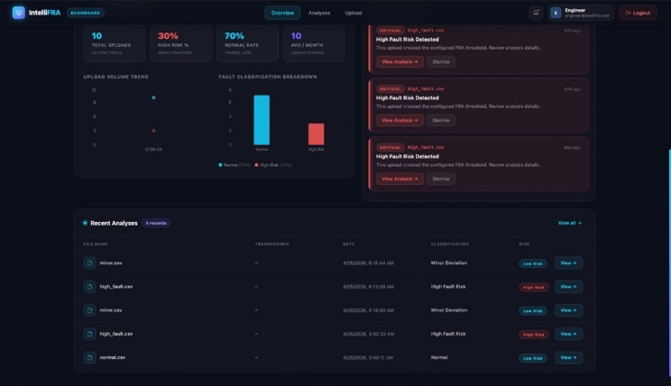
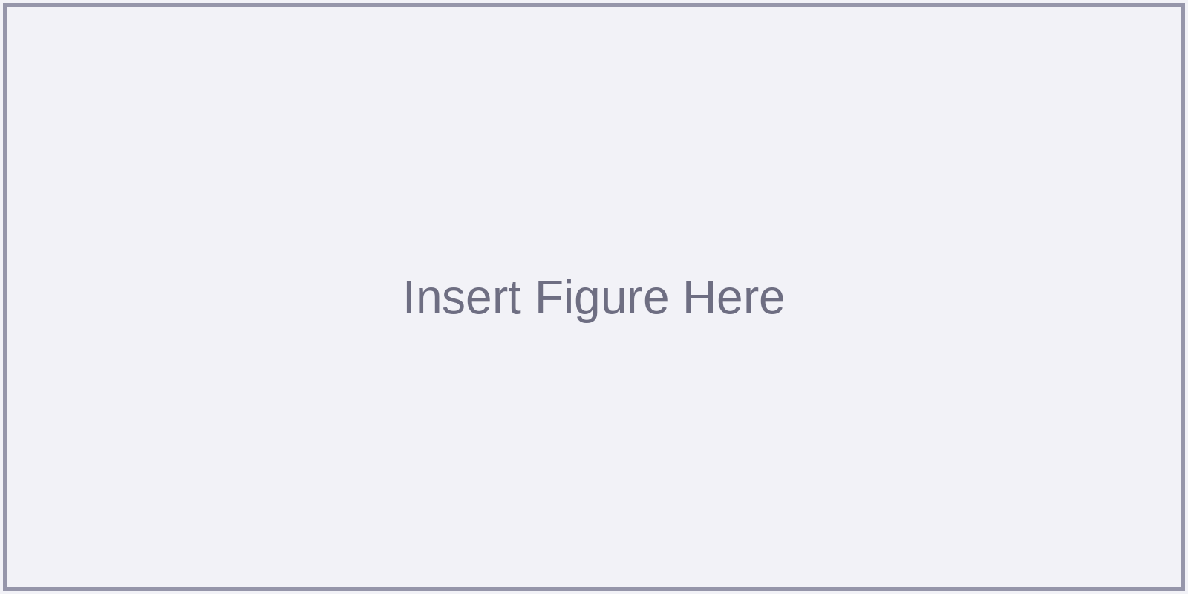
Introduction
Critical Grid Infrastructure: High-voltage power transformers are irreplaceable grid nodes; unexpected internal mechanical failures cause prolonged outages and multimillion-dollar losses.
Sweep Frequency Response Analysis (SFRA): Standardized under IEC 60076-18 as the premier non-intrusive electrical test for detecting internal core/winding mechanical deformation.
Operational Bottleneck: Field engineers currently rely on manual visual trace overlays and scalar indices (CC, ASLE) that cannot reliably distinguish operational noise from real structural damage.
IntelliFRA Solution: An open-source AI platform integrating 1D-CNN severity classification, Autoencoder anomaly gating, and interactive web visualization for real-time substation triage.
Fig. 1: IntelliFRA Interactive Web Diagnostic View (500-pt Recharts trace & CEA recommendations)

Slide 5
Problem Statement & Motivation
Problem Statement
Motivation
To design, develop, and benchmark an automated, end-to-end AI diagnostic platform capable of ingesting raw SFRA magnitude files (CSV/TXT), standardizing variable frequency samples, classifying winding mechanical faults into four severity grades with high accuracy, and detecting out-of-distribution anomalous signatures without requiring historical baseline curves—all executing with sub-millisecond CPU latency across an authenticated web application.
Grid Reliability & Financial Impact: Manufacturing lead times for transmission transformers exceed 12 months. Early mechanical detection prevents catastrophic dielectric breakdown and millions in equipment replacement costs.
Inadequacy of Traditional Metrics: Scalar indices (CC, ASLE) require manual cutoff threshold tuning per transformer family, often failing to separate operational noise from true physical faults.
Closed-Set ML Fragility: Standard supervised neural networks blindly force every input into predefined training labels; unsupervised anomaly gating is critical to detect unknown winding topologies.
Operational Need: Substation crews need an instant screening tool to immediately greenlight healthy units and escalate genuine fault signatures without waiting weeks for expert report overlays.

Slide 6
Objectives
To simulate and generate a physics-informed synthetic dataset of 50,000 SFRA curves across six degradation archetypes (NF, DLF, LCF, RDF, IDF, SCF) on a logarithmic frequency grid (1 kHz–2 MHz).
1
To design and train a dual-AI diagnostic pipeline: a 140,644-parameter 1D-CNN for severity classification and a 312,532-parameter dense Autoencoder for unsupervised out-of-distribution anomaly gating.
2
To implement multi-tiered fail-safe guardrails: incorporating discrete first-difference morphological filters (smoothness, monotonicity, peak counts) and deterministic FFT spectral fallbacks.
3
To deploy an auditable, authenticated web platform (FastAPI + React 19 + SQLite) providing sub-millisecond CPU execution, interactive Recharts visualization, and tenant data isolation.
4

Slide 7
Literature Survey
Sr. | Author(s) & Year | Method / Technique | Dataset | Result | Limitation
1 | Ryder (2003) [1] | SFRA principles & scalar indicators (CC, ASLE) | Field utility transformer sweeps | Establishes baseline transfer-function mapping | Sensitive to test-lead noise; requires subjective human thresholds
2 | Shintemirov et al. (2010) [3] | Sub-band correlation & evidential reasoning | Lab winding models & simulation | Improved condition grading across discrete sub-bands | Fails on compound multi-mode deformations; rigid sub-band boundaries
3 | Secue & Mombello (2008) [11] | Resonance pole tracking & band deviation | Physical test transformers | Classified axial vs. radial winding deformations | Requires historical baseline from the identical physical unit
4 | Ince, Kiranyaz et al. (2016) [15] | 1D-CNN on raw waveforms without manual features | Motor current benchmark waveforms | Adaptive localized spectral feature learning from raw data | Evaluated solely on motor drives; not applied to transformer SFRA
5 | Phillip, Singh & Ramlal (2025) [6, 10] | Deep learning for narrow-band transformer FRA | Simulated & narrow-band field data | High classification accuracy on isolated frequency bands | Closed-set only; lacks anomaly gating, web interface & fail-safes

Slide 8
Research Gaps Identified
1
2
3
Closed-Set Classifier Fragility
Hand-Crafted Feature Dependency
Lack of Production-Ready Systems
Supervised models force all inputs into predefined training categories, blindly misclassifying unfamiliar winding topologies, sensor noise, or unmodeled failure modes as normal or wrong fault grades.
Conventional techniques rely on rigid sub-band segmentation or scalar metrics (ASLE, CC) that require manual threshold tuning and fail to generalize across different MVA ratings and voltage classes.
Prior studies stop at offline Jupyter notebooks without building an auditable, end-to-end deployable platform with fail-safe fallbacks, sub-millisecond CPU latency, and interactive visualization for field crews.

Slide 9
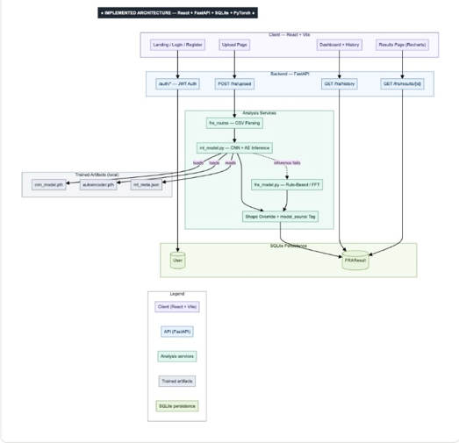
Proposed System Architecture
Input Ingestion
• CSV / TXT format auto-detect
• Minimum 50 valid float points
• Memory-bounded parsing
Preprocessing
• Edge-value pad to 500 points
• Per-sample Z-Score scaling
• Eliminates MVA gain offsets
Dual-AI Engine
• 1D-CNN (140k params; 4 classes)
• Autoencoder (312k params; anomaly)
• Zero missed critical faults
Multi-Tier Guardrails
• Morphological shape filters
• Monotonicity & peak checks
• Deterministic FFT fallback
Storage & UI Dashboard
• FastAPI async REST endpoints
• SQLite tenant-isolated DB
• React 19 & Recharts UI
Fig. 2: IntelliFRA End-to-End Five-Stage Ingestion, Inference, and Triage Architecture

Slide 10
Methodology
1
2
3
4
5
Physics-Based Data Synthesis
Standardization & Preprocessing
Dual Neural Architecture
Training & Validation Rigor
Guardrails & Production UI
Stochastic lumped-mode generator spanning 1 kHz–2 MHz. Superimposes 8–12 Lorentzian modes across 6 physical fault archetypes (50,000 curves total).
Robust CSV/TXT parsing, boundary edge-value replication to 500 samples, and independent per-sample z-score normalization (μ=0, σ=1, ε=1e-6).
1D-CNN (140,644 parameters) with 3 Conv blocks and Dropout (p=0.2) + Dense Autoencoder (312,532 parameters) trained strictly on healthy baselines.
PyTorch, Adam (lr=1e-3, 20 epochs), 80:20 split (40k/10k). Supplementary 5-fold cross-validation on 12k uncapped sweeps and shifted OOD test set.
Morphological filters (smoothness, monotonicity, peak counts) + FFT fallback, integrated into FastAPI REST API and React 19 interactive Recharts UI.

Slide 11
Dataset & Tools Used
Dataset
Tools & Technologies
Name | IntelliFRA Physics-Synthesized SFRA Corpus
Source | Physics-informed stochastic lumped-mode generator (1 kHz–2 MHz)
No. of samples | 50,000 curves (12,500 per operational severity class)
No. of classes | 4 Classes: Normal, Minor Deviation, Moderate Fault, High Fault Risk
Train / Test split | 80:20 Split (40,000 Train / 10,000 Validation) + 5-Fold CV (12,000 sweeps)
Languages & AI Frameworks: Python 3.10, PyTorch, Scikit-learn, NumPy, SciPy
Backend & Storage: FastAPI (asynchronous REST), SQLAlchemy, SQLite, Pydantic, Uvicorn, Bcrypt, JWT Authentication
Frontend & Visualization: React 19, Vite, Tailwind CSS, Recharts, Framer Motion, Lucide Icons
Optimization & Metrics: Adam optimizer (lr=1e-3), Cross-Entropy & MSE loss, single-core CPU latency profiling

Slide 12
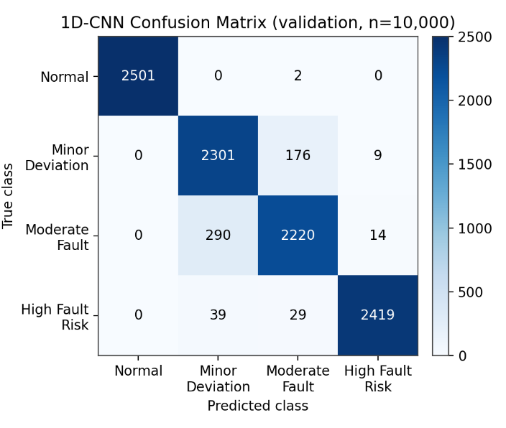
Results
94.41%
1D-CNN Validation Accuracy
(Macro F1 = 0.9443; Support = 10,000)
98.47%
Autoencoder Anomaly Accuracy
(100% Fault Recall across 7,497 faults)
0.274 ms
Full-Pipeline CPU Latency
(Sub-millisecond real-time triage)

Slide 13
Comparison with Existing Methods
Method | Accuracy (%) | Precision (%) | Recall (%) | F1-score (%)
Proposed 1D-CNN (IntelliFRA) | 81.03% (94.41%*) | 82.80% (94.43%*) | 81.90% (94.41%*) | 82.34% (94.43%*)
Random Forest (100 trees, depth 15) | 72.57% ± 1.05% | 73.50% | 72.60% | 73.00%
SVM (RBF Kernel, C=1.0) | 66.13% ± 0.65% | 67.80% | 66.20% | 67.20%
Multilayer Perceptron (MLP 128-64) | 64.95% ± 0.94% | 65.90% | 64.90% | 65.30%
* Benchmark on 12,000 uncapped sweeps under 5-fold stratified cross-validation; 94.41% accuracy on the 10,000-sweep held-out split. On a separate shifted test set (±15% pole shift, heavy noise), 1D-CNN leads with 56.88% (vs. RF 51.21%, SVM 50.83%, MLP 49.33%).

Slide 14
Conclusion & Future Scope
Conclusion
• Automated Triage: Successfully engineered an intelligent web platform that removes human subjectivity and manual overlay bottlenecks in transformer SFRA testing.
• High Classification & Zero-Miss Recall: 1D-CNN achieves 94.41% validation accuracy, while the Autoencoder flags anomalies with 98.47% accuracy and 100% recall on faulty sweeps.
• Sub-Millisecond Inference: Full-pipeline CPU execution in 0.274 ms with multi-tiered morphological filters and deterministic FFT spectral energy fail-safes.
• Complete B.Tech. Objective Fulfillment: All project objectives completed, delivering a deployable, open-source React/FastAPI tool for power utilities.
Future Scope
• Utility Field Fine-Tuning: Transfer learning and domain adaptation on measured substation SFRA recordings (IEEE DataPort and Indian utility fleets).
• Automated Inspection Reports: Adding one-click PDF engineering diagnostic report generation and automated three-phase baseline curve overlays.
• Adaptive Envelopes & Lab Testbed: Upgrading heuristic shape overrides with adaptive envelope trackers and physical laboratory winding testbed validation.

Slide 15
Publications & Competitions
Paper(s)
Harini Panigrahi, Neha Verma, Prapti Bhayde, Yooraj Gole, and Bhanu Tekwani*,
“IntelliFRA: An AI-Based Platform for Automated Transformer Fault Analysis,”
International Conference on Trends in Electrical, Electronics and Computer Systems (ITEECS 2025).
(Status: Submitted / Under Review | Length: ~8.5 pages)
Competitions
• Final Year Capstone Project, Department of Information Technology, Vidyalankar Institute of Technology, Mumbai (Academic Year 2024–25).
• Selected for Institutional B.Tech. Final Review Showcase and Research Presentation.

Slide 16
References
[1] S. A. Ryder, “Diagnosing Transformer Faults Using Frequency Response Analysis,” IEEE Electrical Insulation Magazine, vol. 19, no. 2, pp. 16–22, 2003.
[2] IEC 60076-18, “Power Transformers - Part 18: Measurement of Frequency Response,” International Electrotechnical Commission (IEC), Geneva, Switzerland, 2012.
[3] T. Ince, S. Kiranyaz et al., “Real-Time Motor Fault Detection by 1-D Convolutional Neural Networks,” IEEE Trans. Ind. Electron., vol. 63, no. 11, pp. 7067–7075, 2016.
[4] M. Sakurada and T. Yairi, “Anomaly Detection Using Autoencoders with Nonlinear Dimensionality Reduction,” in Proc. MLSDA, Gold Coast, Australia, pp. 4–11, 2014.
[5] M. Phillip, A. Singh, and C. J. Ramlal, “Towards Automated Frequency Response Analysis of Power Transformers with Deep Learning,” Applied Artificial Intelligence, vol. 39, no. 1, 2025.

Slide 17
Thank You
Questions & Suggestions
Department of Information Technology | Vidyalankar Institute of Technology, Mumbai
Project Team: Harini Panigrahi, Neha Verma, Prapti Bhayde, Yooraj Gole | Guide: Prof. Bhanu Tekwani (bhanu.tekwani@vit.edu.in)

