Slide 1
TECHNICAL PRESENTATION
INTELLIGENT ROBOT VISION
Computer Vision Techniques for Intelligent Perception and Robotic Interaction
K.M.Santhiya(192371030)
M.Shakthi(192312538)
R. Hema priya(1972260018)
M.Nivedha(192471040)
P.Harini(192521402)
A complete vision pipeline helps a robot perceive, recognize, locate, track and interact with objects in unknown environments.
01

Slide 2
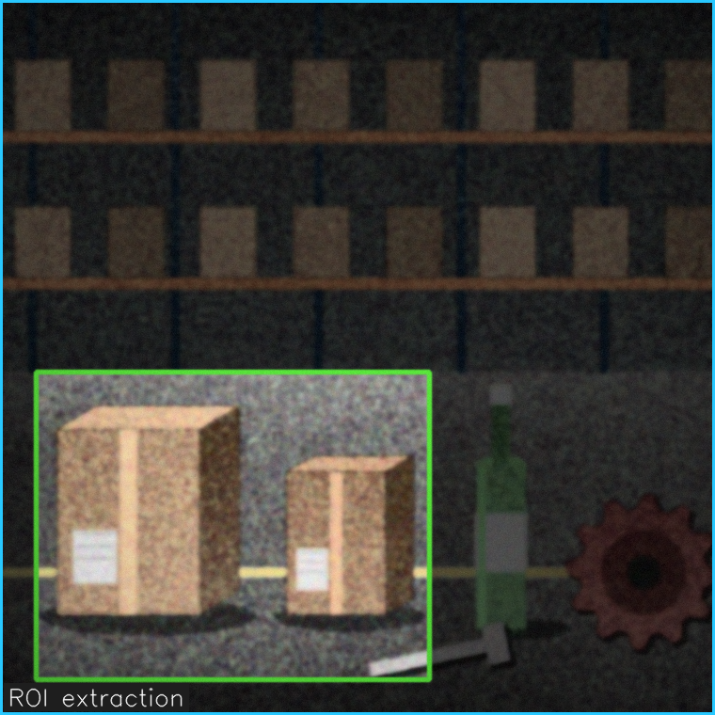
A. IMAGE ACQUISITION & PREPROCESSING
Intelligent Robot Vision
DEFINITION:
Image acquisition and preprocessing convert raw camera data into clean, suitable visual information for robot perception.
WORKING PROCESS:
• Image Capture – Camera sensors capture the scene continuously.
• Color / Format Conversion – Convert RGB images to grayscale or suitable color spaces.
• Noise Removal – Reduce sensor noise using filters such as Gaussian or median filtering.
• Enhancement – Improve contrast, brightness, and image quality for later vision tasks.
• Segmentation / ROI – Focus processing on important regions or objects.
KEY TECHNOLOGIES:
Cameras • Image Processing • Filtering • Contrast Enhancement • Segmentation
Camera
→
Capture
→
Filter
→
Enhance
→
ROI
→
Vision Input
02

Slide 3
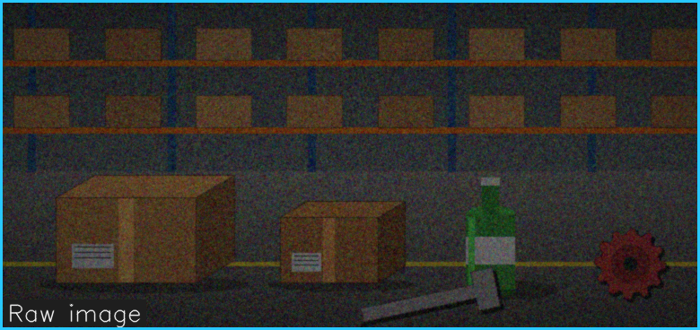
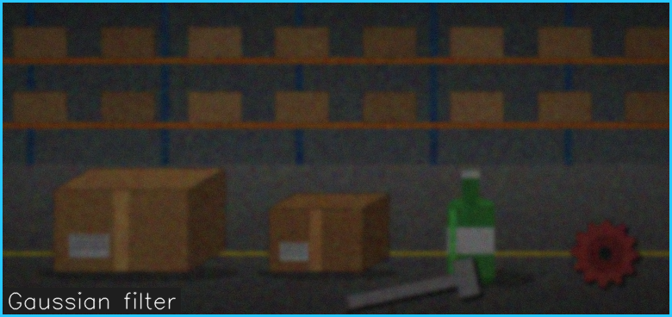
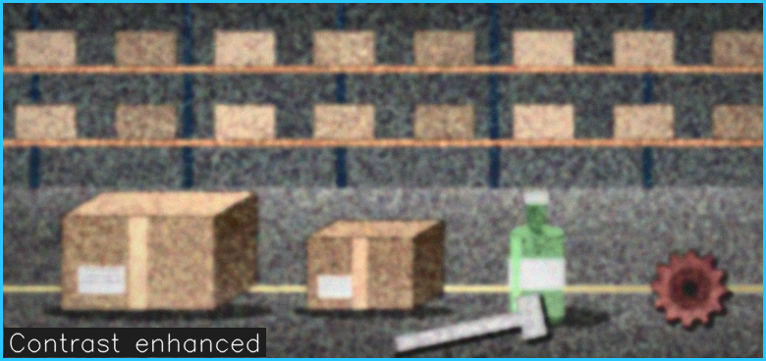
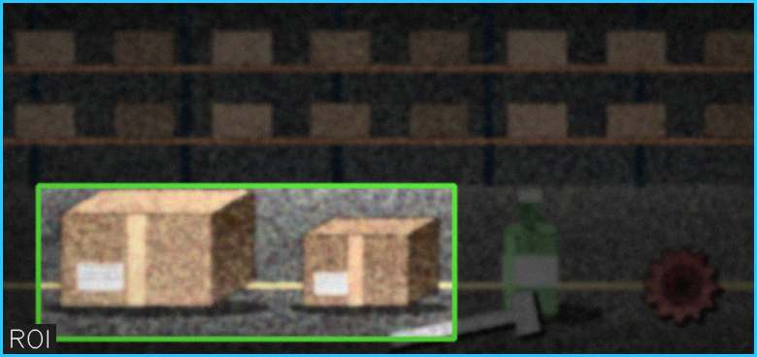
A. IMAGE ACQUISITION & PREPROCESSING
APPLICATIONS
BENEFITS:
• Robot cameras for indoor and outdoor scene capture.
• Preprocessing before object detection and recognition.
• Quality improvement for low-light or noisy images.
• Region-of-interest extraction for faster processing.
• Cleaner and more reliable visual data.
• Reduces noise and irrelevant information.
• Improves detection accuracy.
• Makes later vision algorithms faster and more stable.
Camera → Raw Image → Gaussian Filter → Contrast Enhancement → ROI → Detection
EXAMPLE:
03

Slide 4
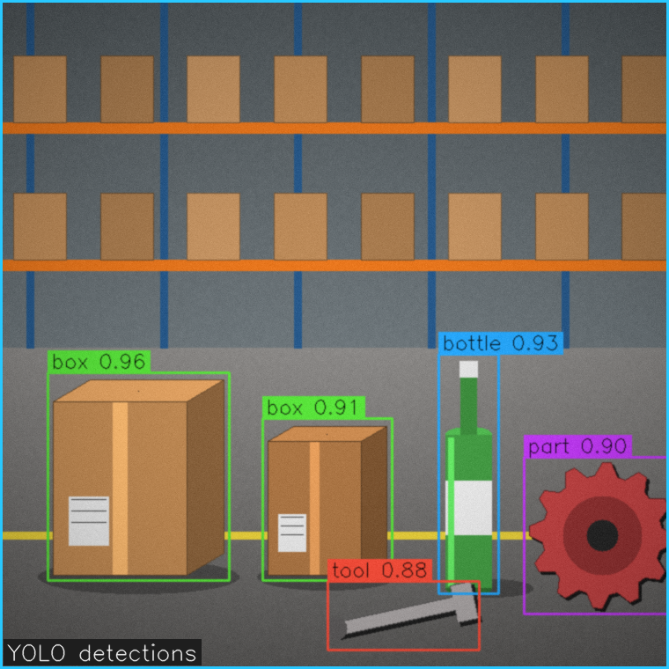
B. YOLO DETECTION & FEATURE MATCHING
Intelligent Robot Vision
DEFINITION:
YOLO detects objects rapidly, while feature matching compares visual features to identify or verify specific objects and their locations.
WORKING PROCESS:
• Image Input – A preprocessed camera frame is supplied to the detector.
• YOLO Detection – YOLO predicts object classes and bounding boxes in real time.
• Object Identification – Detected regions are classified into known object categories.
• Feature Extraction – Local visual features such as edges and keypoints are extracted.
• Feature Matching – Features are compared with reference images to recognize specific objects.
KEY TECHNOLOGIES:
YOLO • Bounding Boxes • CNN Features • SIFT/ORB • Feature Matching
Image
→
YOLO
→
Bounding Box
→
Features
→
Match
→
Object ID
04

Slide 5
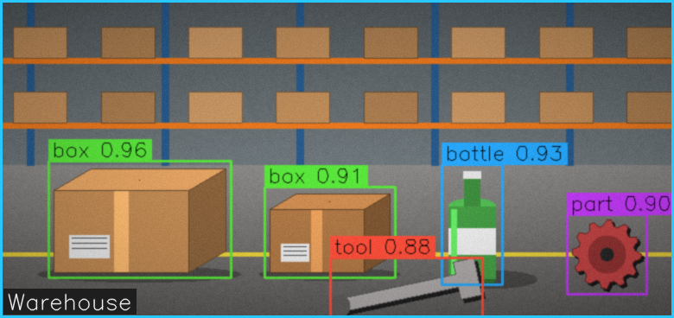
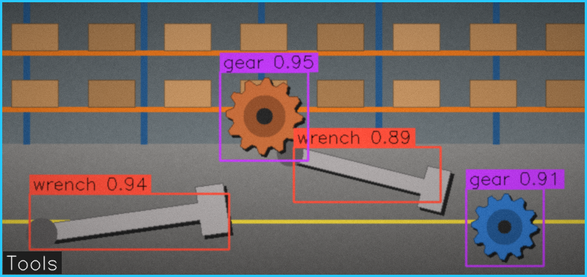
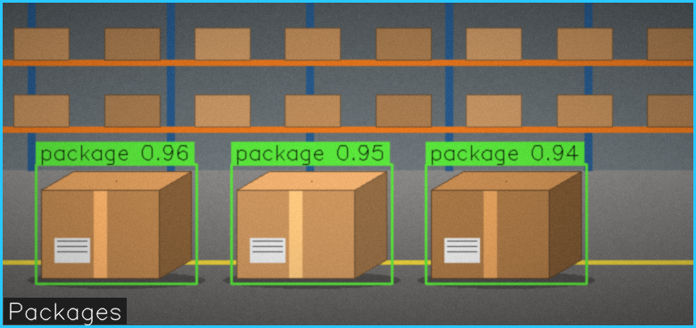
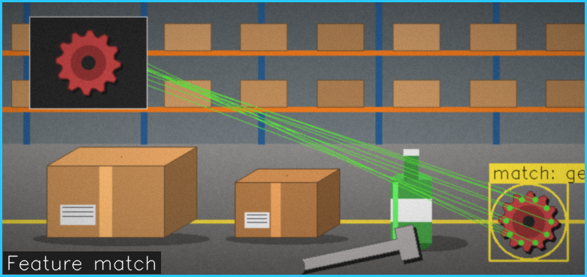
B. YOLO DETECTION & FEATURE MATCHING
APPLICATIONS
BENEFITS:
• Warehouse object detection and sorting.
• Robot identification of tools, packages, and parts.
• Inspection and quality-control systems.
• Recognition of known objects from reference images.
• Fast real-time object detection.
• Identifies multiple objects in one frame.
• Improves object recognition reliability.
• Supports accurate object localization for robot actions.
EXAMPLE:
Camera → YOLO → Detect Box → Extract Features → Match Reference → Identify Object
05

Slide 6
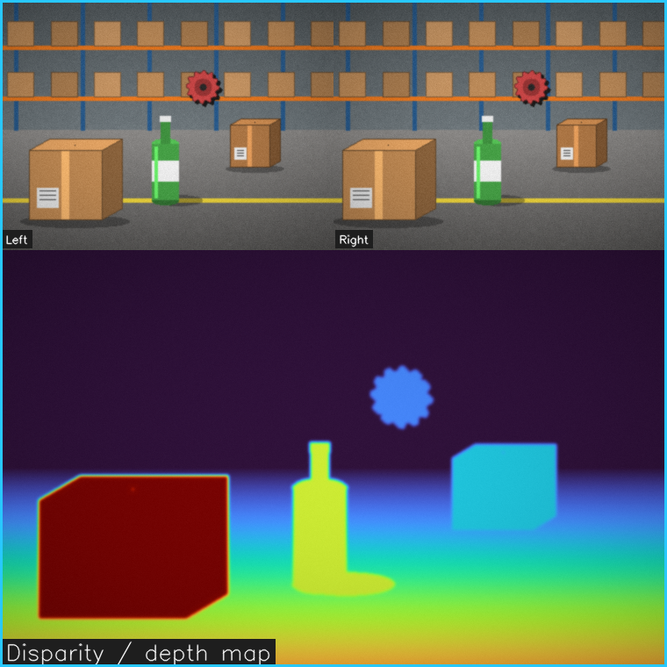
C. STEREO VISION & 3D POSITION ESTIMATION
Intelligent Robot Vision
DEFINITION:
Stereo vision uses two camera views and image analysis to estimate object depth and determine its three-dimensional position.
WORKING PROCESS:
• Stereo Capture – Two cameras capture the same scene from slightly different viewpoints.
• Image Rectification – Align the left and right images for accurate comparison.
• Correspondence – Find matching points between the two camera images.
• Disparity Estimation – Calculate the difference in point positions between views.
• Depth & 3D Position – Convert disparity into depth and estimate X, Y, and Z coordinates.
KEY TECHNOLOGIES:
Stereo Cameras • Rectification • Disparity • Depth Map • 3D Coordinates
Left Image
→
Right Image
→
Match Points
→
Disparity
→
Depth
→
3D Position
06

Slide 7
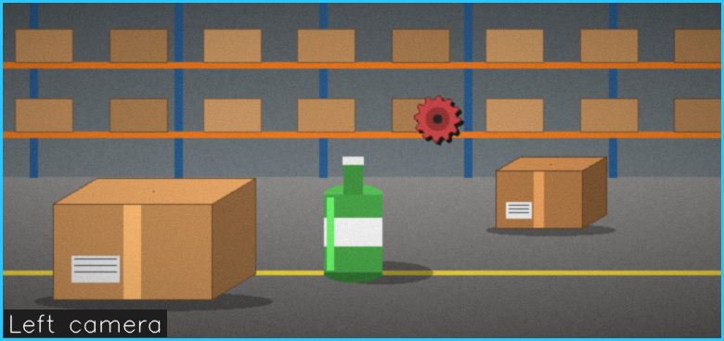
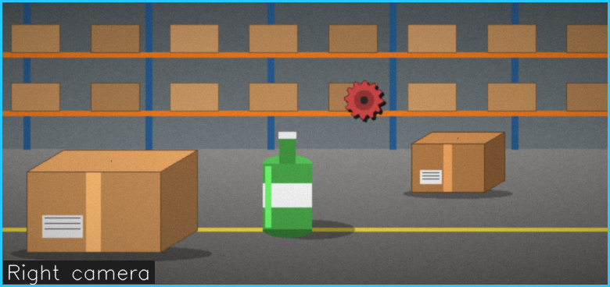
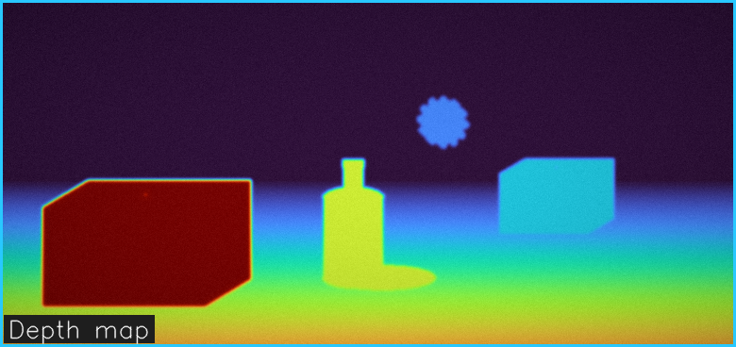
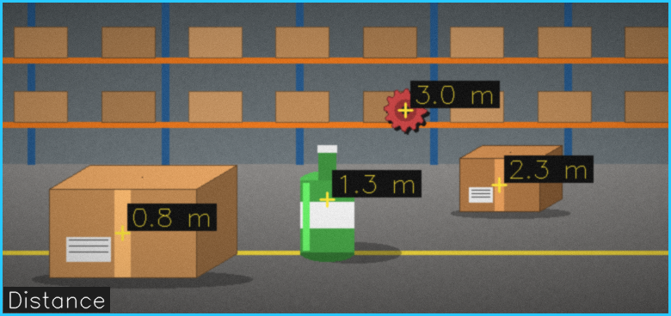
C. STEREO VISION & 3D POSITION ESTIMATION
APPLICATIONS
BENEFITS:
• Robot navigation and obstacle distance estimation.
• Precise grasping of objects at different distances.
• 3D warehouse picking and bin handling.
• Industrial inspection and spatial measurement.
• Provides real-world depth information.
• Improves grasping and positioning accuracy.
• Enables 3D scene understanding.
• Helps robots avoid obstacles and plan safe paths.
Two Cameras → Correspondence → Disparity → Depth Map → X,Y,Z → Robot Position
EXAMPLE:
07

Slide 8
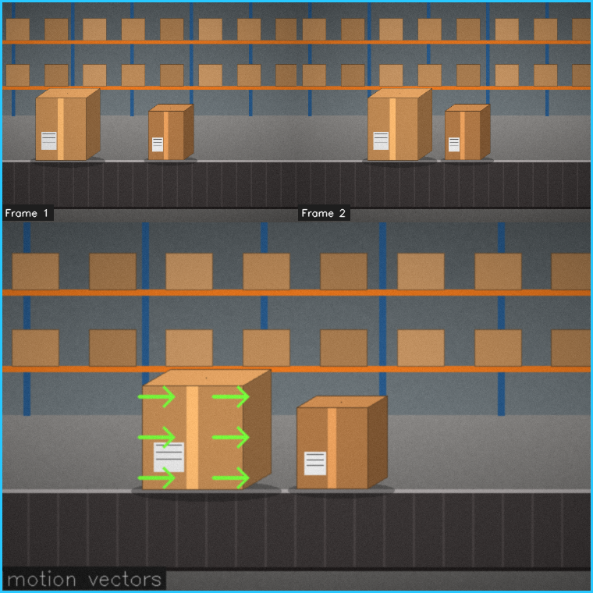
D. OPTICAL FLOW & MOTION ESTIMATION
Intelligent Robot Vision
DEFINITION:
Optical flow estimates how pixels move between consecutive frames to track moving objects and understand changes in the environment.
WORKING PROCESS:
• Frame Capture – Obtain consecutive images from a moving or fixed camera.
• Motion Detection – Compare image features across frames.
• Optical Flow – Estimate the direction and speed of apparent pixel motion.
• Object Tracking – Follow the movement of detected objects over time.
• Environmental Understanding – Detect motion, direction changes, and dynamic obstacles.
KEY TECHNOLOGIES:
Optical Flow • Feature Tracking • Motion Vectors • Frame Analysis • Tracking
Frame 1
→
Frame 2
→
Motion Vectors
→
Track Object
→
Estimate Speed
→
Update Scene
08

Slide 9
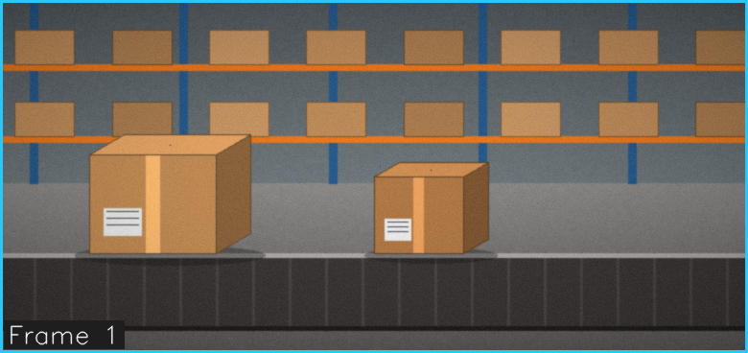
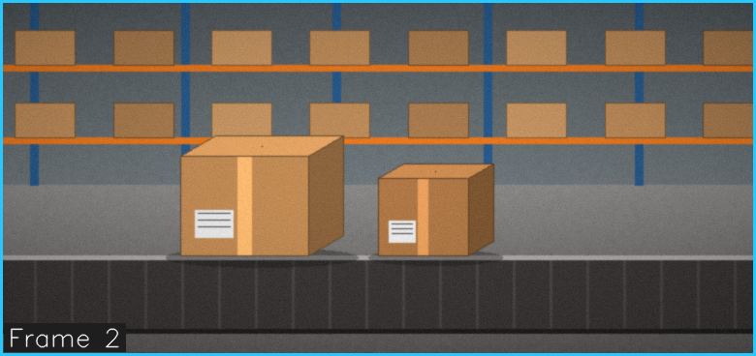
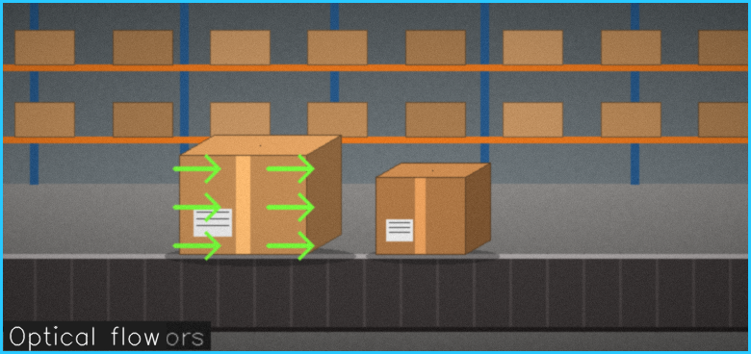
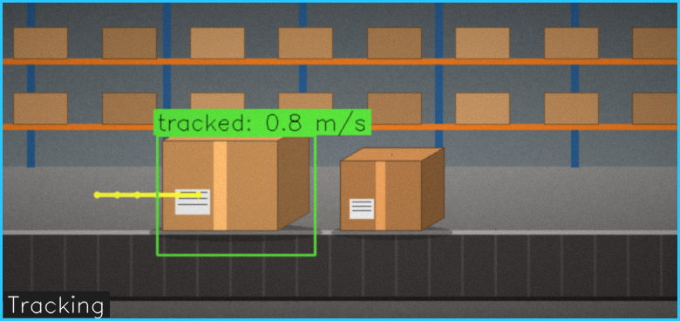
D. OPTICAL FLOW & MOTION ESTIMATION
APPLICATIONS
BENEFITS:
• Tracking people, vehicles, or moving packages.
• Dynamic obstacle detection for mobile robots.
• Monitoring conveyor-belt and production-line movement.
• Robot navigation in changing environments.
• Tracks moving objects continuously.
• Detects environmental changes quickly.
• Supports safer robot navigation.
• Provides motion direction and speed information.
Frame 1 → Frame 2 → Optical Flow → Motion Vector → Object Tracking → Robot Response
EXAMPLE:
09

Slide 10
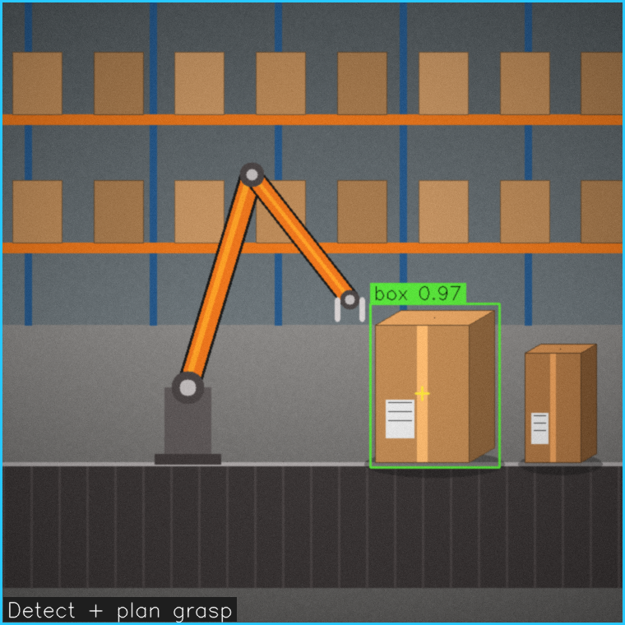
E. VISION-GUIDED ROBOTIC MANIPULATION
Intelligent Robot Vision
DEFINITION:
Vision-guided robotic manipulation uses cameras and computer vision to help robots identify and handle objects accurately.
WORKING PROCESS:
• Image Capture – Camera captures the scene.
• Object Detection – Computer vision identifies objects.
• Position Estimation – Determines the object's location, size, and orientation.
• Motion Planning – Robot calculates the best path to reach the object.
• Grasping & Manipulation – Robot selects, grasps, moves, and places the object.
KEY TECHNOLOGIES:
Computer Vision • Object Detection • Image Processing • Depth Sensing • Robot Control
Camera
→
Detect Object
→
Identify Position
→
Plan Movement
→
Grasp
→
Move
→
Place
10

Slide 11
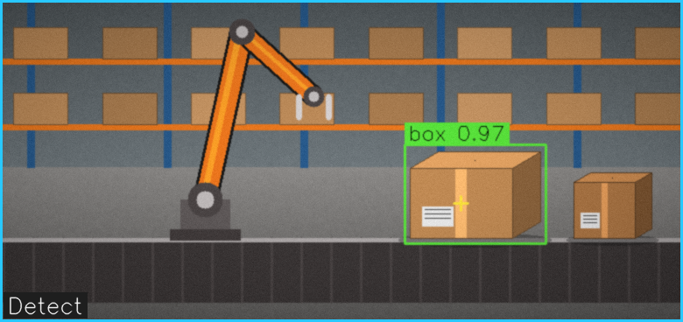
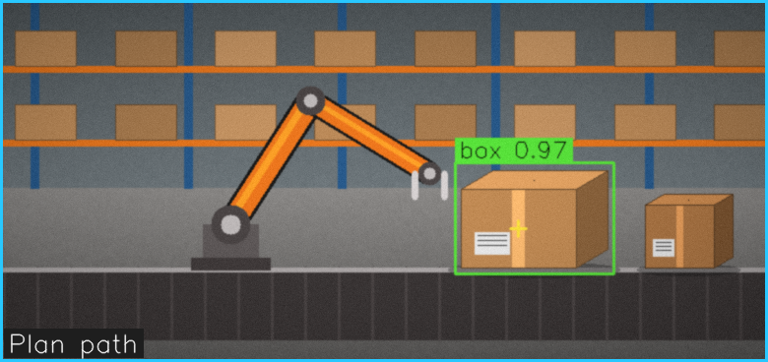
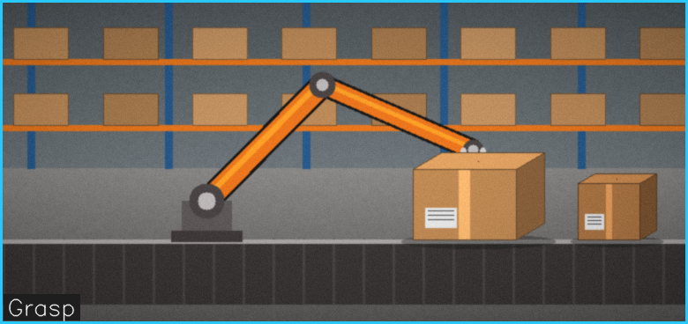
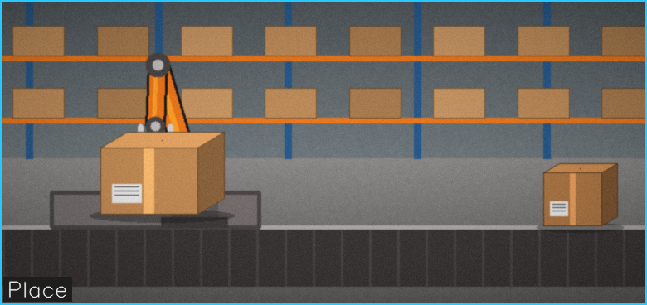
E. VISION-GUIDED ROBOTIC MANIPULATION
APPLICATIONS
BENEFITS:
• Warehouse Automation – Picking, sorting, and packing products.
• Industrial Robotics – Assembly, inspection, and material handling.
• Object Interaction – Picking and placing objects of different shapes.
• Logistics – Automated loading and unloading.
• High accuracy in object handling.
• Faster and efficient operations.
• Precise grasping and positioning.
• Can handle different objects automatically.
• Reduces human effort and errors.
Camera → Detect Object → Identify Position → Plan Movement → Grasp → Move → Place
EXAMPLE:
11

