Slide 1

Project Title - SEASONAL AGRICULTURE PERFORMANCE ANALYSIS
Student Name – HARINI.P
College Name – A.V.C.COLLEGE OF ENGINEERING
AICTE STU ID : STU6a2fc49c4b42e1781515420

Slide 2

PROBLEM STATEMENT
Agricultural activities are influenced by seasonal variations in environmental conditions, farming practices, resource availability and market conditions. As a result, agricultural performance may differ from one season to another.
However, raw agricultural data does not clearly explain how agricultural performance changes across seasons or what patterns can be observed in different seasonal conditions.
The problem is to analyze the given agricultural dataset and investigate seasonal differences in agricultural performance by identifying meaningful patterns, trends, relationships and variations within the available data.

Slide 3
PROJECT DESCRIPTION
Seasonal Agriculture Performance Analysis is a data analysis project that studies agricultural performance in different seasons. The project uses agricultural data to find patterns and trends in crop production. Python tools like Pandas, NumPy, Matplotlib, and Seaborn are used to clean, analyze, and visualize the data. The results help understand which seasons have better agricultural performance and support better farming decisions.

Slide 4

WHO ARE THE END USERS?
Farmers
Agricultural Departments
Agricultural Researchers
Agricultural Planners
Data Analysts
Students and Educational Institutions

Slide 5

TECHNOLOGY USED
Python
Pandas
NumPy
Matplotlib
Seaborn
Jupyter Notebook
Data Visualization
Data Cleaning and Analysis

Slide 6
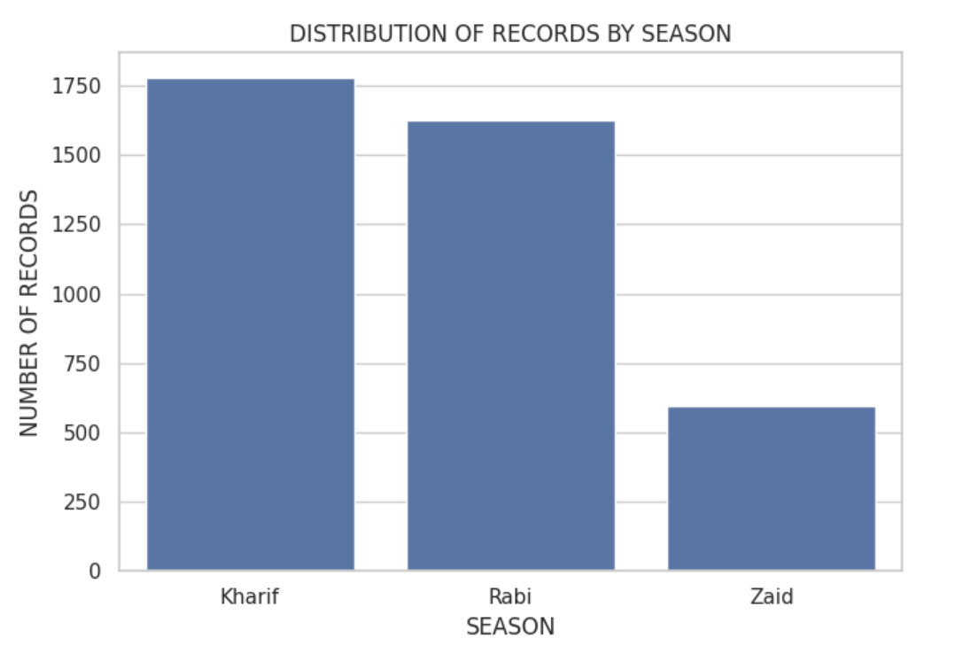
RESULTS

Slide 7
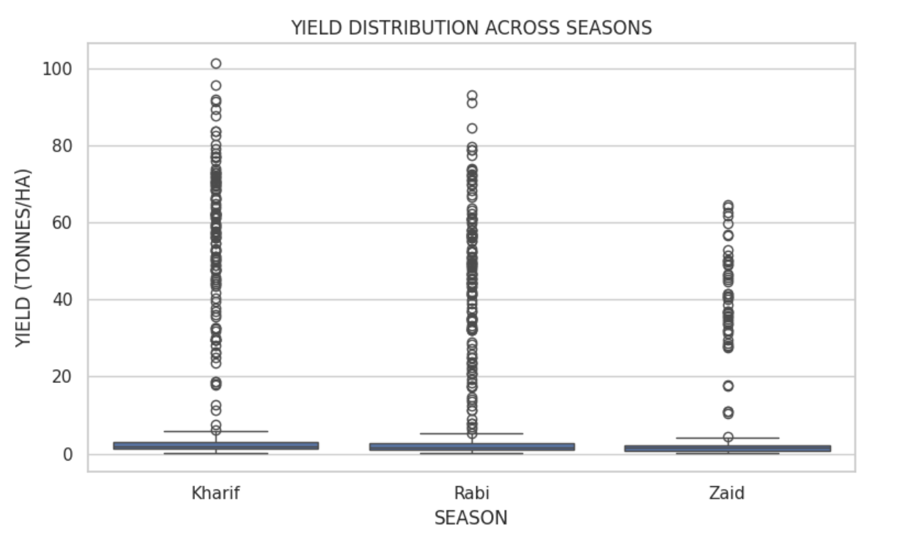
RESULTS

Slide 8
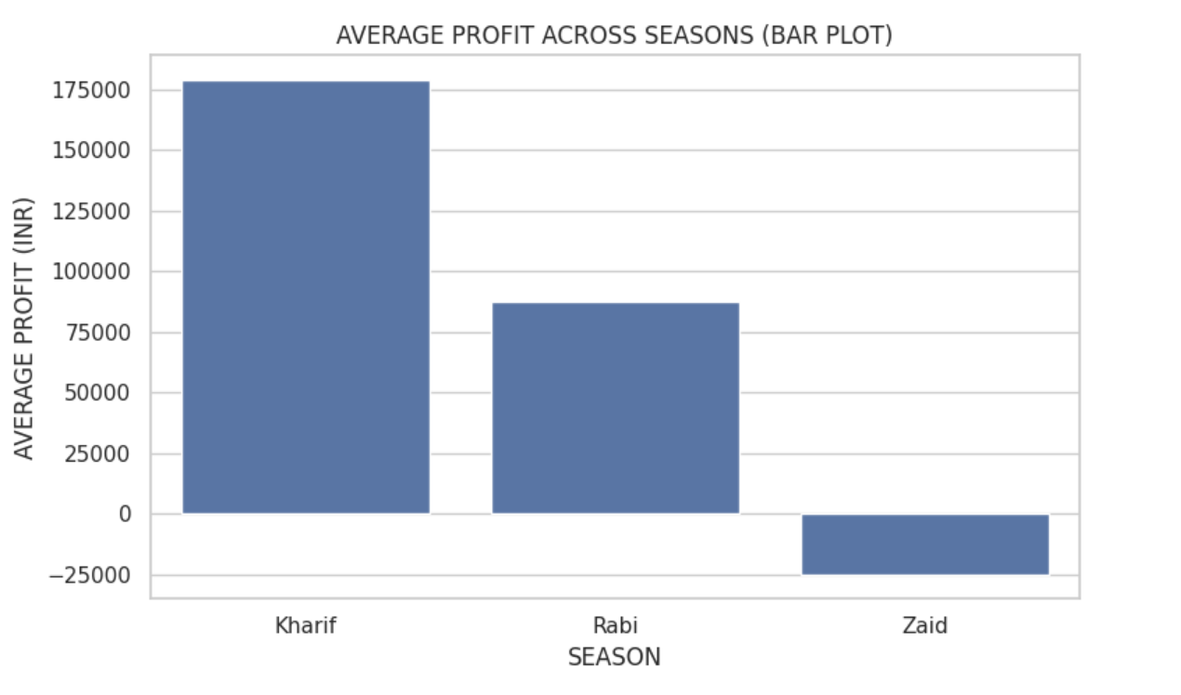
RESULTS

Slide 9
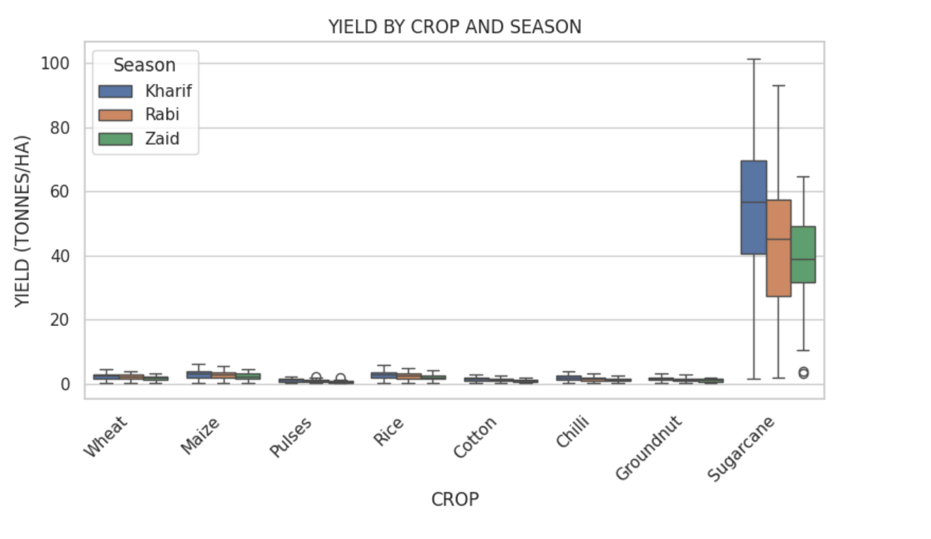
RESULTS

Slide 10
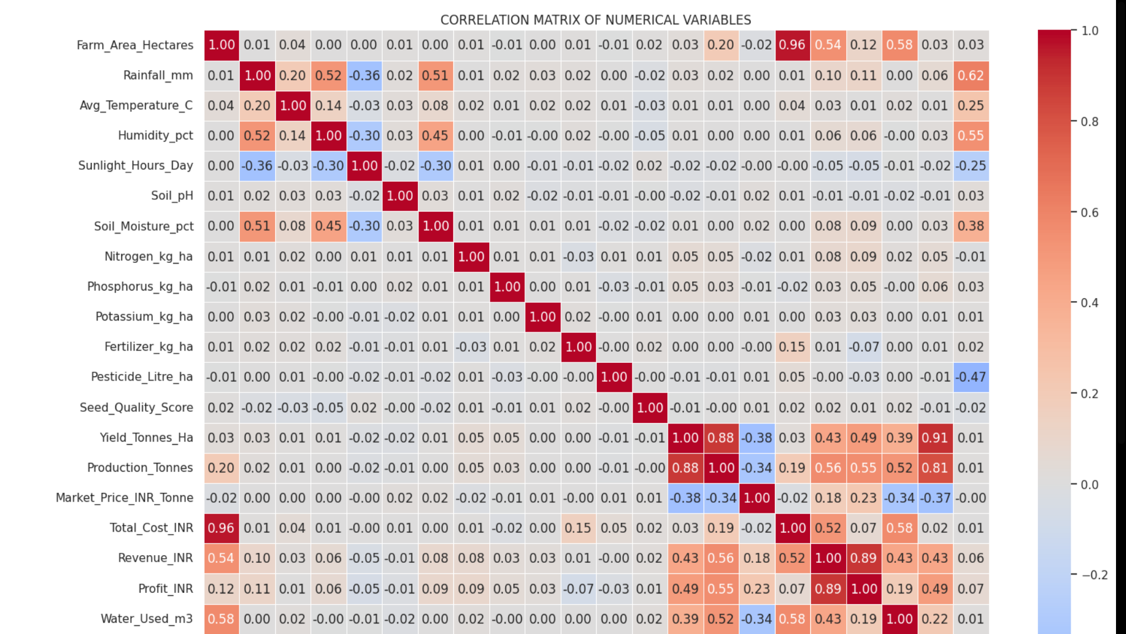
RESULTS

Slide 11
FUTURE SCOPE
Develop a machine learning model to predict crop yield for different seasons.
Use real-time weather data such as rainfall and temperature for better predictions.
Build a dashboard for farmers and agricultural departments to monitor seasonal performance.
Provide crop and irrigation recommendations based on seasonal conditions.
Include data from more regions and multiple years to improve the accuracy of the analysis.
Extend the system to support early identification of low-yield or high-risk seasons.

Slide 12
GITHUB LINK
https://github.com/harinipk/Seasonal_Agriculture_Performance_Analysis.git

Slide 13

VOIS Course completion certificate -
Course name- Data Visualization

Slide 14
THANK YOU
.
.

