Slide 1

Finding a suitable new restaurant location in Manhattan
By Harini Hapuarachchi

Slide 2
Introduction/Business Problem
According to the World Population Review 2019: Manhattan is the most densely populated of the five boroughs in New York
Being heart to several iconic locations such as the Time Square, NASDAQ, the New York Stock Exchange and Wall Street, it is one of the commercial, financial and cultural centers in the world.
This project aims to find a suitable location for the new restaurant.

Slide 3
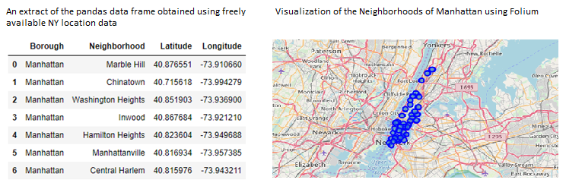
Data Acquisition and Preparation
The two main sources of data include:
New York location data freely available on https://geo.nyu.edu/catalog/nyu_2451_34572
Foursquare API

Slide 4
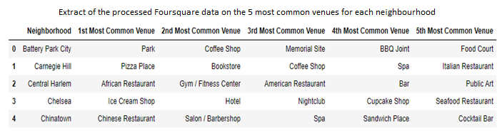
Data Acquisition and Preparation (cont)

Slide 5
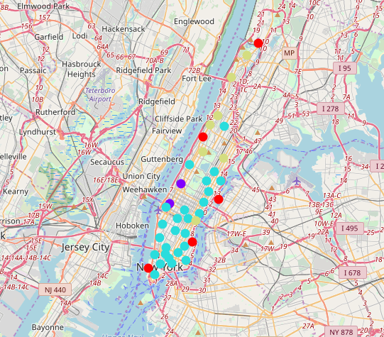
Data Analysis
The visual results of k-means clustering (k=4) analysis based on the venue frequencies of Manhattan neighbourhoods are as follows.
Cluster 1 – Red Cluster 2 – Purple Cluster 3 – Light Blue Cluster 4 – Light Yellow

Slide 6
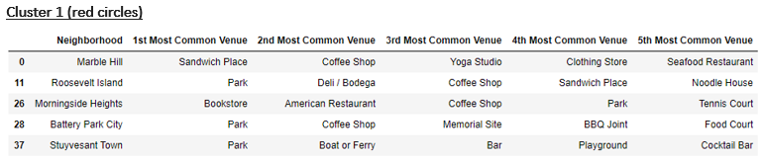
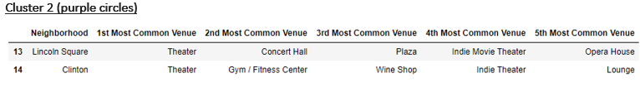
Results
The venue frequency data for the four clusters are as follows:

Slide 7
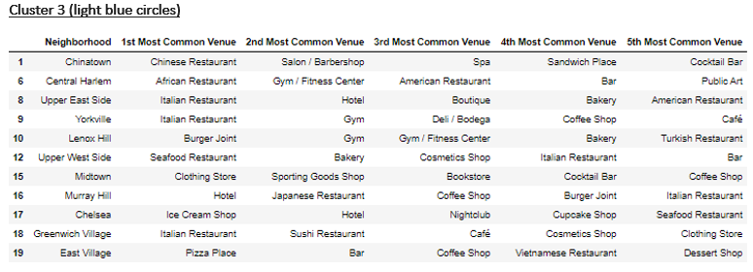
Results (cont)

Slide 8
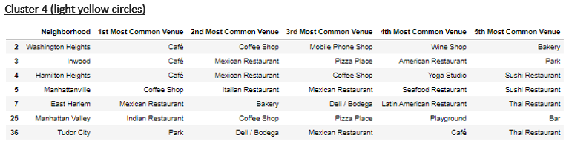
Results (cont)

Slide 9
Conclusion
From the above tabulations, it is evident that the two neighborhoods Lincoln Square and Clinton (in cluster 2) provide the ideal locations for a new restaurant, mainly due to the ample availability in leisure activity locations such as theatres (after visiting which, people are highly likely to dine outside), and due to the lowest competition from other restaurants.

