Slide 1
Web Request Life Cycle
Nagaraj K
nagaraj.kanagaraj@aspiresystems.biz,

Slide 2
Web Request Life Cycle
First a user gives a client a URL, the client builds a request for information (or resources) to be generated by a server.
When the server receives that request, it uses the information included in the request to build a response that contains the requested information.
Once built, that response is sent back to the client in the requested format, to be rendered to the user.

Slide 3
Web Request Life Cycle
You open your browser, the Client, and type in a web address like http://turing.io and hit enter.
The browser takes this address and builds an HTTP Request. It addresses it to the Server located at http://turing.io.
The Request is handed off to your Internet Service Provider (ISP) (like CenturyLink or Comcast) and they send it through the Internet, mostly a series of wires and fiber optic cables, to the Server
The Server reads the Request. It knows how to read it because it is formatted as an HTTP Request.
The Server generates an HTTP Response to that Request.
The server hands the Response off to their ISP and it goes through the internet to arrive at your computer.
Your browser reads the Response. It knows how to read it because it is formatted as an HTTP Response.
Your browser displays the data on your machine.

Slide 4
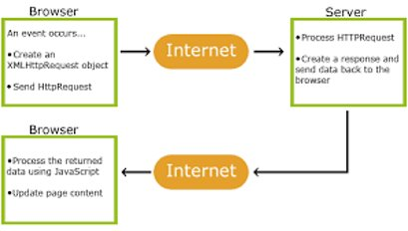
Web Request Life Cycle

Slide 5
Web Request Life Cycle
Verb and Path
Every request needs to be able to tell a server what information is requested and how that information is being requested. The what is the path (also know as a URI), indicating what resource this request is referencing.
Examples of a path:
/tasks
/tasks/4
/items/6/reviews
The how is the verb, indicating what actions the server should take regarding the requested resource. While the path can vary greatly based on the application, the verbs follow common patterns. There are 5 common HTTP verbs:
GET - retrieve some information to be READ by the client/user
POST - CREATE a new resource with information contained in the request
PUT - UPDATE an entire resource with information contained in the request
PATCH - UPDATE a part of a resource with information contained in the request
DELETE - DESTROY a resource, typically indicating that it is removed from the database

Slide 6
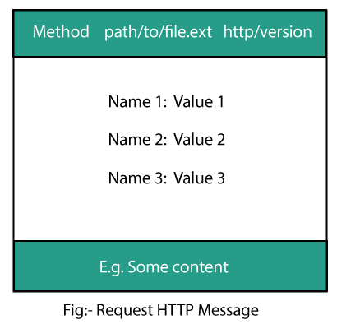
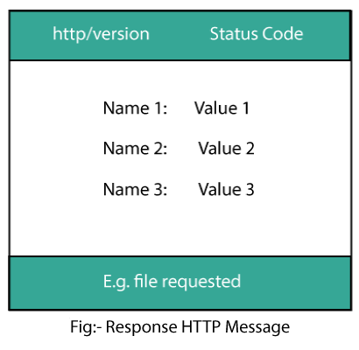
Request and response HTTP message

Slide 7


