Slide 1
Team Genesis
Team Members:
Yoga Dharshini G - dharshini.govind@aspiresystems.biz
Harini R - harini.rajkumar@aspiresystems.biz
Brindha M - brindha.muruga@aspiresystems.biz
Gugan RB - gugan.balamurugan@aspiresystems.biz
Yalapala sekhar - yalapala.jayaram@aspiresystems.biz
Nagaraj K - nagaraj.kanagaraj@aspiresystems.biz
Chitrarasu V - chitrarasu.venugopal@aspiresystems.biz
Ramakrishna P - ramakrishna.ravi@aspiresystems.biz
Kishore Kumar AN - kishore.natrajan@aspiresystems.biz
Dinesh Kumaar B - dinesh.boopathy@aspiresystems.biz

Slide 2
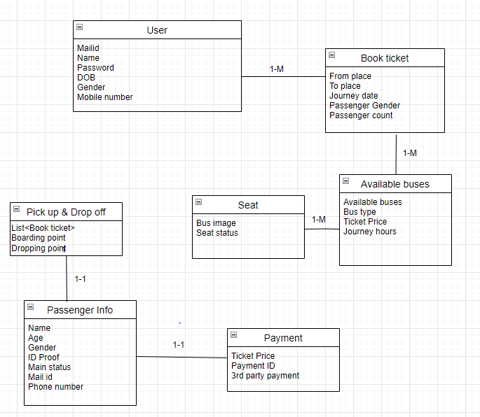
SETC APP – Data Model

Slide 3


