Slide 1

SWAMY VIVEKANANDHA VIDHYA SAMSTHE ®
KUMADVATHI FIRST GRADE COLLEGE SHIKARIPURA
Project on:
Web Based Data Management System
Submitted by
Harini R Raikar
Under the Guidance of
Prashanth Kumar sir
Department of Bachelor of
computer science
Kumadvathi first grade college
Shikaripura

Slide 2
INDEX
1. INTRODUCTION TO PHP
2. HARDWARE & SOFTWARE REQUIREMENTS
3. TOOLS
4. FRONTEND & BACKEND
5. CONNECTION
6. ADVANTAGES & DISADVANTAGES
7. CONCLUSION

Slide 3
Introduction to PHP
PHP (Hypertext Preprocessor) is a free and open-source scripting language used to develop dynamic websites and web applications.
It is easy to use and widely used for web development.
It can connect with databases such as MySQL.
PHP helps in handling user data and backend operations.

Slide 4
HARDWARE AND SOFTWARE REQUIRMENTS
Processor (CPU): It is like the brain of the computer. It processes the instructions given by our PHP program.
Example: When we click the “Add Student” button, the CPU helps the computer process that operation.
RAM: It temporarily holds the programs and data while we are working. More RAM helps the project run smoothly.
Example: When Dreamweaver, XAMPP, Chrome, and HeidiSQL are open at the same time, RAM helps them run together.
Storage (SSD/HDD): It permanently stores our PHP files, database files, images, and other project files.
Example: Our index.php, login.php, CSS files, images, and project folder are stored on the SSD/HDD.

Slide 5
XAMPP – Provides the local server environment, including Apache, to run PHP on the computer.
Dreamweaver – Used to write and edit PHP, HTML, CSS, and JavaScript code.
HeidiSQL – Used to create, manage, and view the MySQL database and tables.
Google Chrome – Used to open, run, and test the web application.

Slide 6
TOOLS
HeidiSQL
Create and manage databases.
Create and manage tables.
View stored data. Insert, update and delete records.
Dreamweaver
Write PHP code.
Write HTML and CSS. Edit JavaScript.
Design and organize webpages

Slide 7
FRONTEND & BACKEND
FRONTEND
Frontend is the part of a web application that the user can see and interact with.
HTML – Structure
HTML (HyperText Markup Language) is used to create the structure of the webpage.
CSS – Design
CSS (Cascading Style Sheets) is used to control the appearance and design of the webpage
BACKEND
Backend is the part of a web application that works behind the screen. It handles processing, application logic and database-related operations.
PHP Process data entered by the user
SQL (Structured Query Language) is used to communicate with and manage the database.

Slide 8
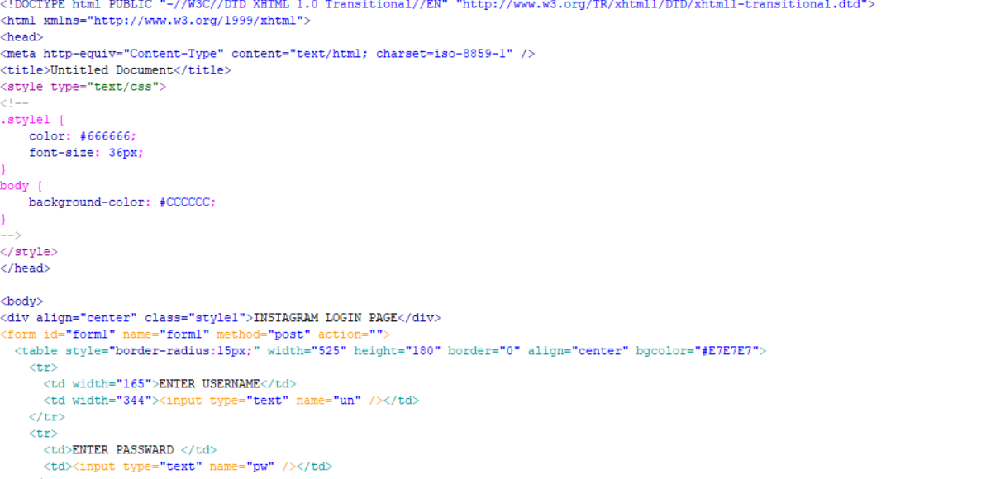
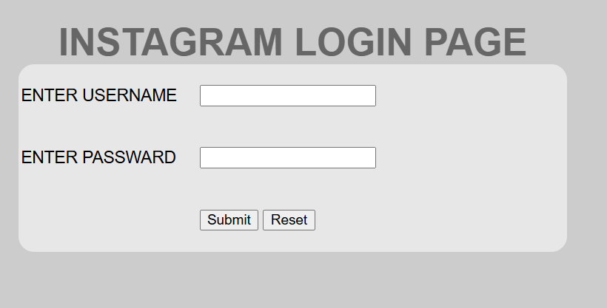
EXAMPLE

Slide 9
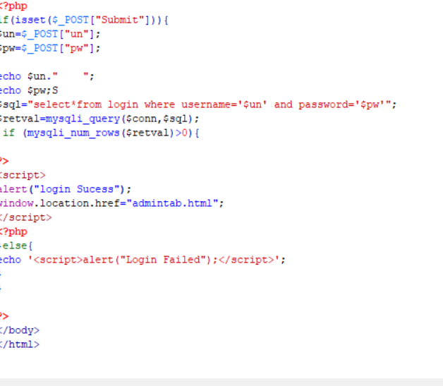

Slide 10



CONNECTION

Slide 11
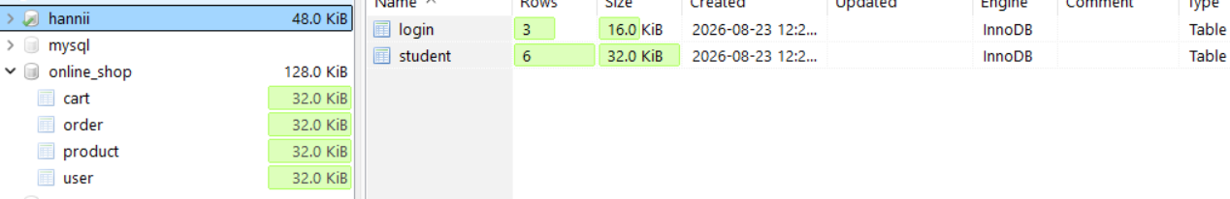
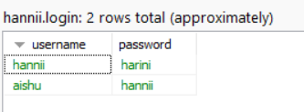
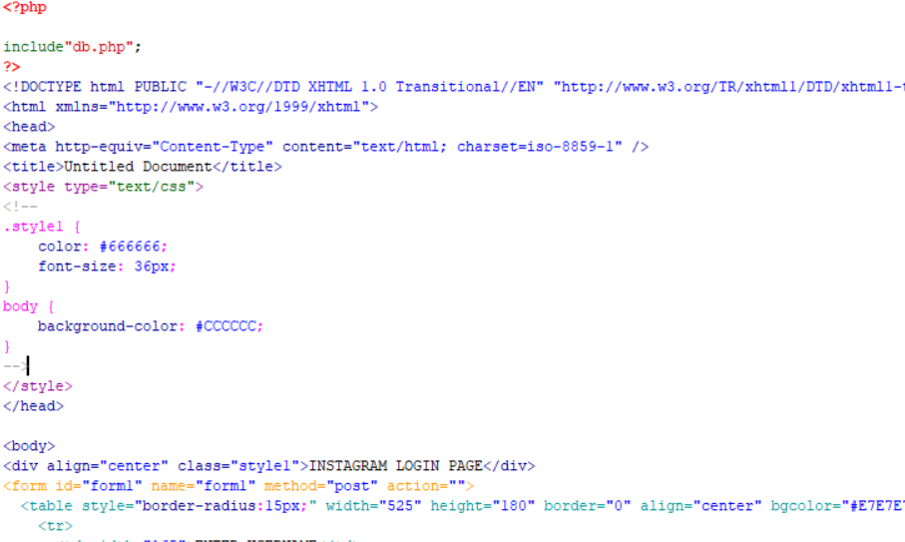
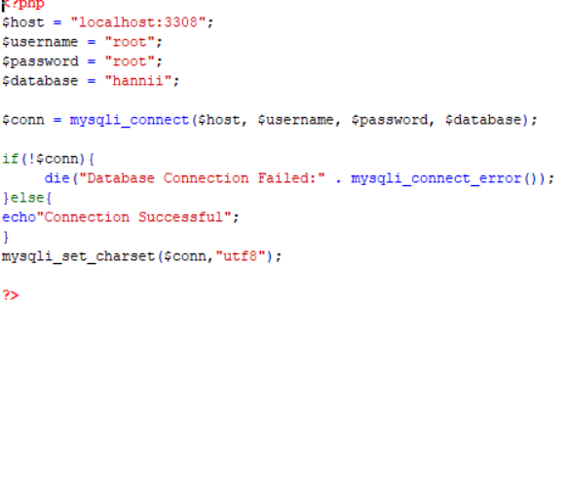
Creating database
Inserted the data
Inclding a db.php to file
db,.php file

Slide 12



Slide 13
ADVANTAGES
DISADVANTAGES
Easy to learn.
Open source. Free to use.
Database support.
Fast development.
Security issues if poorly coded.
Difficult to maintain large projects without proper structure.
Requires a server environment.
Not suitable for every type of application.

Slide 14
CONCLUSION
PHP is a simple and powerful language for developing web applications. In this project, PHP works with MySQL to store, manage, and display data. This project helped us understand how frontend, backend, and database work together to create a web application.

Slide 15
THANK YOU

