Slide 1
Replication of Comparative Studies of Detecting Abusive Language on Twitter
Team Members
Goel, Mayank
Modi, Samarth
Moroney, Aboli
Ram Prasad, Harini
Replication Project GitHub Repository: https://github.com/abolim/Reproducibility-Research-Replication
Original Paper Citation: Lee, Y., Yoon, S., & Jung, K. (2018). Comparative studies of detecting abusive language on twitter. arXiv preprint arXiv:1808.10245. URL: https://arxiv.org/abs/1808.10245

Slide 2
TARGET PAPER
Notes:
We will first talk about the research paper that we tried to reproduce in our project

Slide 3

Target Paper
Need to find the best methods and data for detecting abusive content on social media, flagging it as inappropriate and prohibiting it.
Notes:
With the increasing outreach of social media on the internet, there has been a growing concern about the sharing of abusive statements over platforms like twitter. Such content is often offensive to certain people or groups, and spread hatred. Such malign content ought not be shared to create public discomfort, and hence we chose this topic to research upon. (why you chose it.)
With an interest in mitigating this phenomenon, we sought prior research on identifying the usage of abusive language on social media platforms. The research question that our target paper tries to address is the detection of abusive language on Twitter. (What is the research question?)
Our target paper uses machine learning based supervised learning approaches to classify tweets into three categories: 1. Not offensive 2. Offensive, not hateful 3. Hateful. Precisely, the target paper compares the results obtained from using classical Machine Learning models as well as Neural Network based models. (What methods did they use? )
The authors of the target paper find that among traditional machine learning models, the most accurate in classifying abusive language is the Logistic Regression model. For neural network models, Recurrent Neural Network with Latent Topic Clustering modules have the highest accuracy score(What did they find?)

Slide 4
Target Paper
Need to find the best methods and data for detecting abusive content on social media, flagging it as inappropriate and prohibiting it.
Research Question: Comparing different approaches of detecting abusive language on Twitter
Notes:
With the increasing outreach of social media on the internet, there has been a growing concern about the sharing of abusive statements over platforms like twitter. Such content is often offensive to certain people or groups, and spread hatred. Such malign content ought not be shared to create public discomfort, and hence we chose this topic to research upon. (why you chose it.)
With an interest in mitigating this phenomenon, we sought prior research on identifying the usage of abusive language on social media platforms. The research question that our target paper tries to address is the detection of abusive language on Twitter. (What is the research question?)
Our target paper uses machine learning based supervised learning approaches to classify tweets into three categories: 1. Not offensive 2. Offensive, not hateful 3. Hateful. Precisely, the target paper compares the results obtained from using classical Machine Learning models as well as Neural Network based models. (What methods did they use? )
The authors of the target paper find that among traditional machine learning models, the most accurate in classifying abusive language is the Logistic Regression model. For neural network models, Recurrent Neural Network with Latent Topic Clustering modules have the highest accuracy score(What did they find?)

Slide 5
Target Paper
Need to find the best methods and data for detecting abusive content on social media, flagging it as inappropriate and prohibiting it.
Research Question: Comparing different approaches of detecting abusive language on Twitter
Methods Used: Supervised Learning with Classical Machine Learning (ML) Models as well as Neural Network (NN) models
Notes:
With the increasing outreach of social media on the internet, there has been a growing concern about the sharing of abusive statements over platforms like twitter. Such content is often offensive to certain people or groups, and spread hatred. Such malign content ought not be shared to create public discomfort, and hence we chose this topic to research upon. (why you chose it.)
With an interest in mitigating this phenomenon, we sought prior research on identifying the usage of abusive language on social media platforms. The research question that our target paper tries to address is the detection of abusive language on Twitter. (What is the research question?)
Our target paper uses machine learning based supervised learning approaches to classify tweets into three categories: 1. Not offensive 2. Offensive, not hateful 3. Hateful. Precisely, the target paper compares the results obtained from using classical Machine Learning models as well as Neural Network based models. (What methods did they use? )
The authors of the target paper find that among traditional machine learning models, the most accurate in classifying abusive language is the Logistic Regression model. For neural network models, Recurrent Neural Network with Latent Topic Clustering modules have the highest accuracy score(What did they find?)

Slide 6
Target Paper
Need to find the best methods and data for detecting abusive content on social media, flagging it as inappropriate and prohibiting it.
Research Question: Comparing different approaches of detecting abusive language on Twitter
Methods Used: Supervised Learning with Classical Machine Learning (ML) Models as well as Neural Network (NN) models
Results: Logistic Regression performs best in Classical ML models and Recurrent Neural Network (RNN) with Latent Topic Clustering (LTC) model performs best in NN models.
Notes:
With the increasing outreach of social media on the internet, there has been a growing concern about the sharing of abusive statements over platforms like twitter. Such content is often offensive to certain people or groups, and spread hatred. Such malign content ought not be shared to create public discomfort, and hence we chose this topic to research upon. (why you chose it.)
With an interest in mitigating this phenomenon, we sought prior research on identifying the usage of abusive language on social media platforms. The research question that our target paper tries to address is the detection of abusive language on Twitter. (What is the research question?)
Our target paper uses machine learning based supervised learning approaches to classify tweets into three categories: 1. Not offensive 2. Offensive, not hateful 3. Hateful. Precisely, the target paper compares the results obtained from using classical Machine Learning models as well as Neural Network based models. (What methods did they use? )
The authors of the target paper find that among traditional machine learning models, the most accurate in classifying abusive language is the Logistic Regression model. For neural network models, Recurrent Neural Network with Latent Topic Clustering modules have the highest accuracy score(What did they find?)

Slide 7
SCIENTIFIC CLAIMS

Slide 8
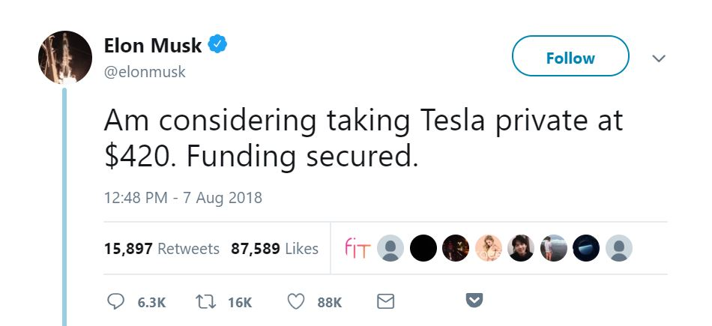
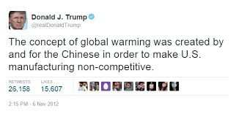
Scientific Claims
Classification of hateful, offensive and normal tweets
Notes:
The specific scientific claims we sought to replicate were the precision, recall and F1 scores of the original project.
We additionally also showed the accuracy of our replication.
We had 3 main categories for classification: hateful, offensive, normal tweets
We chose the logistic regression model (proven to be the most accurate)

Slide 9
Scientific Claims
Classification of hateful, offensive and normal tweets
Logistic regression classification model
Notes:
The specific scientific claims we sought to replicate were the precision, recall and F1 scores of the original project.
We additionally also showed the accuracy of our replication.
We had 3 main categories for classification: hateful, offensive, normal tweets
We chose the logistic regression model (proven to be the most accurate)

Slide 10
Scientific Claims
Classification of hateful, offensive and normal tweets
Logistic regression classification model
Claim to replicate precision, recall and F1 score
Notes:
The specific scientific claims we sought to replicate were the precision, recall and F1 scores of the original project.
We additionally also showed the accuracy of our replication.
We had 3 main categories for classification: hateful, offensive, normal tweets
We chose the logistic regression model (proven to be the most accurate)

Slide 11
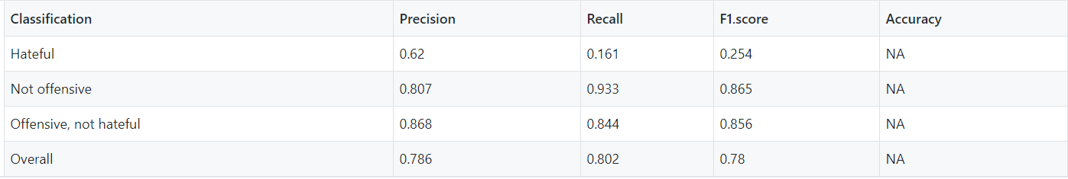
Scientific Claims
Classification of hateful, offensive and normal tweets
Logistic regression classification model
Claim to replicate precision, recall and F1 score
Figure: Original research results (Logistic Regression)
Notes:
The specific scientific claims we sought to replicate were the precision, recall and F1 scores of the original project.
We additionally also showed the accuracy of our replication.
We had 3 main categories for classification: hateful, offensive, normal tweets
We chose the logistic regression model (proven to be the most accurate)

Slide 12
Scientific Claims
Figure: Original research results (Logistic Regression)
Notes:
Precision: ratio of correctly predicted positive observations to the total predicted positive observations
Recall: ratio of correctly predicted positive observations to the all observations in actual class
F1-score: weighted average of precision and recall
Original vs. ours:
For the “Hateful” tweets, we had a higher recall and F1 score
For the “Not offensive” tweets, we had a higher precision and F1 score
For the “Offensive, not hateful” tweets, we had a lower precision, recall and F1 score
Overall: Our model underperformed slightly in comparison to theirs: could be because of smaller dataset
75% accuracy

Slide 13
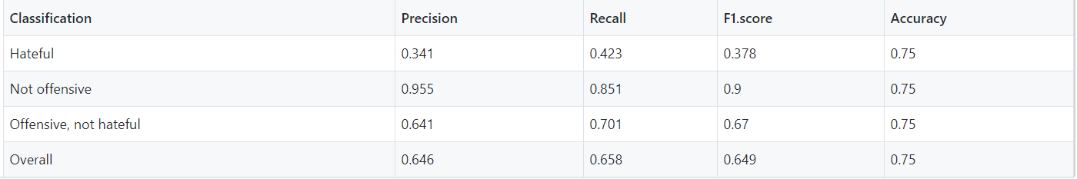
Scientific Claims
Figure: Original research results (Logistic Regression)
Figure: Our replication results (Logistic Regression)
Notes:
Precision: ratio of correctly predicted positive observations to the total predicted positive observations
Recall: ratio of correctly predicted positive observations to the all observations in actual class
F1-score: weighted average of precision and recall
Original vs. ours:
For the “Hateful” tweets, we had a higher recall and F1 score
For the “Not offensive” tweets, we had a higher precision and F1 score
For the “Offensive, not hateful” tweets, we had a lower precision, recall and F1 score
Overall: Our model underperformed slightly in comparison to theirs: could be because of smaller dataset
75% accuracy

Slide 14
TECHNICAL DETAILS

Slide 15



Technical Details
VARIANT | ORIGINAL | REPLICATION | SCIENTIFIC IMPORTANCE
SOFTWARE |  |  | Requirement of the replication project
Leveraged multiple R packages and functions for data processing, machine learning and visualization
Changing the software should not change the results of the replication process.
Notes:
Software: Converted the entire data processing and machine learning algorithms from Python and TensorFlow to R. This involved using different packages and functions in R to process the data as well as build the model and obtain the results.

Slide 16



Technical Details
VARIANT | ORIGINAL | REPLICATION | SCIENTIFIC IMPORTANCE
SOFTWARE |  |  | Requirement of replication project
DATA | 100,000 Tweets | 3000 Tweets Randomly sampled | Limited computational resources available Large data required for complex Neural Networks
Varying the selection of tweets or the number of tweets may not produce the identical results but it should not significantly impact the replication process.
Notes:
Data: The original research was carried out using 100k tweets. We chose a random sample of 3000 tweets due to limited computational resources available. This was not necessary for us as we were not building the complex neural network models which require large amounts of data.

Slide 17
Technical Details
VARIANT | ORIGINAL | REPLICATION | SCIENTIFIC IMPORTANCE
SOFTWARE |  |  | Requirement of replication project
DATA | 100,000 Tweets | 3000 Tweets Randomly sampled | Limited computational resources available Large data required for complex Neural Networks
ALGORITHM | Naive Bayes, SVM, Logistic Regression, Random Forest, GBT, CNNs, RNNs | Logistic Regression | Outperformed all ML models F1-Score comparable to CNNs High precision and accuracy Limited computational resources
LibLinear R package was deployed to build the Logistic Regression Model.
Using different packages from another software should not significantly impact the replication of results.
Notes:
Algorithm: Chose to replicate ‘Logistic Regression’ model using word-level features. This choice was made as the author stated that this model outperformed all the machine learning techniques and had an F1-score which was equivalent to the best CNN model. For our project, we also had limited computational resources due to which execution of other machine learning and deep learning models was out of scope.

Slide 18
Technical Details
VARIANT | ORIGINAL | REPLICATION | SCIENTIFIC IMPORTANCE
SOFTWARE |  |  | Requirement of replication project
DATA | 100,000 Tweets | 3000 Tweets Randomly sampled | Limited computational resources available Large data required for complex Neural Networks
ALGORITHM | Naive Bayes, SVM, Logistic Regression, Random Forest, GBT, CNNs, RNNs | Logistic Regression | Outperformed all ML models F1-Score comparable to CNNs High precision and accuracy Limited computational resources
FEATURES | Word-level Character-level | Word-level | Better accuracy for word-level features
Notes:
Features: The original paper modeled all algorithms at word and character levels separately. But, they stated that character levels models reduced the accuracy for hate and abusive speech data. Therefore, we have chosen only the word-level representation for our replication study.

Slide 19
Technical Details
VARIANT | ORIGINAL | REPLICATION | SCIENTIFIC IMPORTANCE
SOFTWARE |  |  | Requirement of replication project
DATA | 100,000 Tweets | 3000 Tweets Randomly sampled | Limited computational resources available Large data required for complex Neural Networks
ALGORITHM | Naive Bayes, SVM, Logistic Regression, Random Forest, GBT, CNNs, RNNs | Logistic Regression | Outperformed all ML models F1-Score comparable to CNNs High precision and accuracy Limited computational resources
FEATURES | Word-level Character-level | Word-level | Better accuracy for word-level features
Notes:
Software: Converted the entire data processing and machine learning algorithms from Python and TensorFlow to R. This involved using different packages and functions in R to process the data as well as build the model and obtain the results.
Data: The original research was carried out using 100k tweets. We chose a random sample of 3000 tweets due to limited computational resources available. This was not necessary for us as we were not building the complex neural network models which require large amounts of data.
Algorithm: Chose to replicate ‘Logistic Regression’ model using word-level features. This choice was made as the author stated that this model outperformed all the machine learning techniques and had an F1-score which was equivalent to the best CNN model. For our project, we also had limited computational resources due to which execution of other machine learning and deep learning models was out of scope.
Features: The original paper modeled all algorithms at word and character levels separately. But, they stated that character levels models reduced the accuracy for hate and abusive speech data. Therefore, we have chosen only the word-level representation for our replication study.

Slide 20
CHALLENGES & REFLECTION

Slide 21
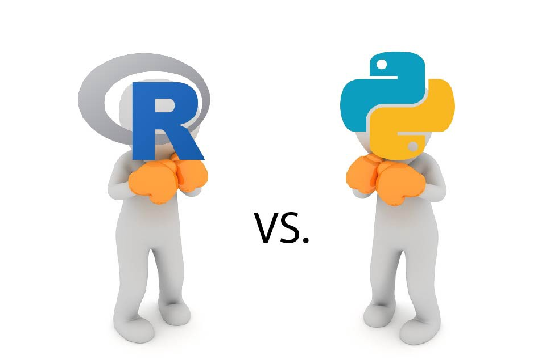
Challenges
Converting Python (Tensorflow) to R
Going through documentation
Trial and error
Notes:
Cleaning libraries were not exact, so need to figure out on our own
Intermediate output reached 26 GB
Number of features reached 21000

Slide 22
Challenges
Converting Python (Tensorflow) to R
Going through documentation
Trial and error
All teammates new to R
Crash course in R
Class activities helped
Notes:
Cleaning libraries were not exact, so need to figure out on our own
Intermediate output reached 26 GB
Number of features reached 21000

Slide 23
Challenges
Converting Python (Tensorflow) to R
Going through documentation
Trial and error
All teammates new to R
Crash course in R
Class activities helped
Processing large datasets on local machines
Took a sample of original data
Notes:
Cleaning libraries were not exact, so need to figure out on our own
Intermediate output reached 26 GB
Number of features reached 21000

Slide 24

Challenges
Converting Python (Tensorflow) to R
Going through documentation
Trial and error
All teammates new to R
Crash course in R
Class activities helped
Processing large datasets on local machines
Took a sample of original data
Working with abusive data
Word cloud generated from our features
Image has been blurred due to inappropriate content
Notes:
Cleaning libraries were not exact, so need to figure out on our own
Intermediate output reached 26 GB
Number of features reached 21000

Slide 25




Reflections
Aboli Moroney
Data understanding
Tweet cleaning and encoding
Visualizations
Core owner for final report
Harini Ram Prasad
Logistic regression
Data modeling
Tweet cleaning
Final report
Mayank Goel
Core owner for paper.rmd
Intermediate output snippets
Code of conduct, citations
Calling external R scripts
Samarth Modi
Data pre-processing
Word cloud generation
External R function
Citations

Slide 26

Reflections
Jan
Getting more context
Aboli Moroney
Data understanding
Tweet cleaning and encoding
Visualizations
Core owner for final report
Harini Ram Prasad
Logistic regression
Data modeling
Tweet cleaning
Final report
Literature survey
Understanding R libraries
Learning ML concepts
Feb
Understanding R vs Python
Reviewed original Python code
Progressed with R code
Learnt more about text analysis
Mar
Progressing with replication
Mayank Goel
Core owner for paper.rmd
Intermediate output snippets
Code of conduct, citations
Calling external R scripts
Samarth Modi
Data pre-processing
Word cloud generation
External R function
Citations
Number of commits crossed 100
Generated first output
Iterated to improve reproducibility

Slide 27
THANK YOU!
QUESTIONS?

