Slide 1

TEAM MEMBERS
Harini Reethika.v- A7AC4F37134976F95D246B438B37BE85
Maheshwari.R- 6BB54255895FF19B5AC475AD41B5943E
Deepika.N- 4E0533EA7C6798D9D134760513BFCCBC
Drisha.j- A05BCD21D36FC11AE3840DA2C6307604

Slide 2
ONLINE LEARNING PLATFORM MERN

Slide 3
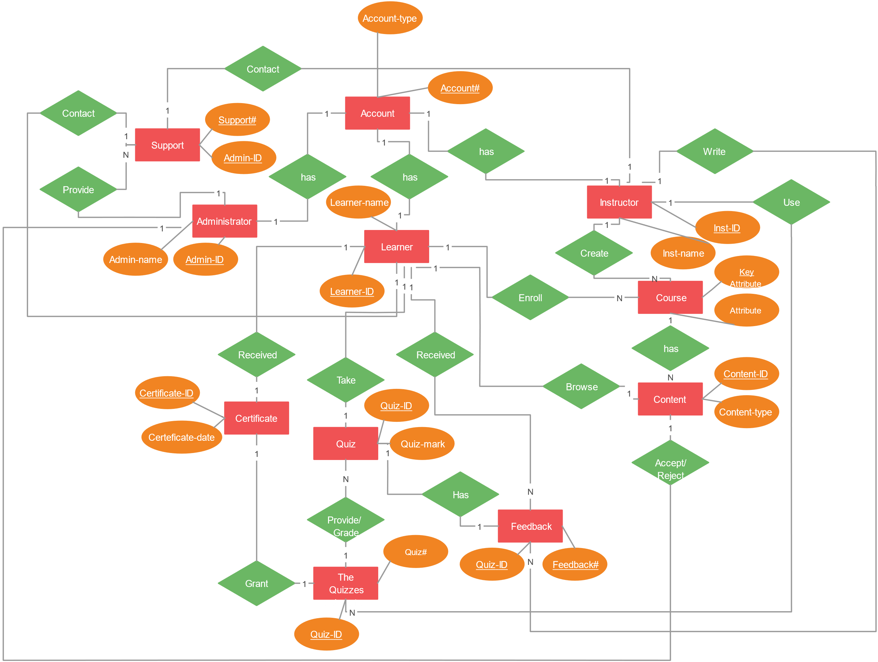
Workflow

Slide 4
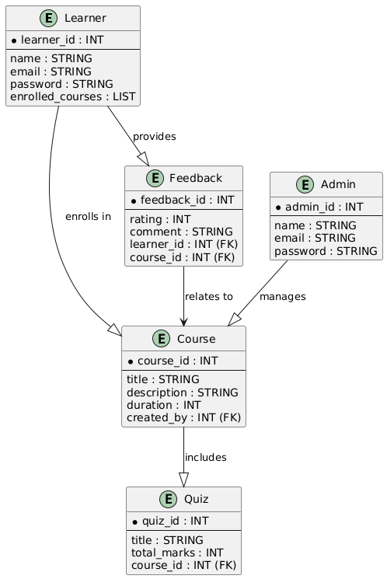
Class Diagram

Slide 5

Table of Content
Abstract
Objective
Technology Stack
Why MERN Stack?
Key Features
Architecture Diagram
User Authentication
Course Management
Screenshots
Learning Process
Payment Integration
Dynamic UI
Database Design
Conclusion

Slide 6
Abstract
Purpose:
"A comprehensive MERN Stack-based online learning platform designed for flexibility and scalability."
Scope:
Features include course management, progress tracking, and interactive learning tools.
Significance:
Revolutionizing online education by making it personalized and accessible.

Slide 7

Objective
Primary Goal:
Develop an online learning platform that simplifies and enhances the education experience.
Specific Objectives:
Enable seamless course creation and management.
Provide interactive learning experiences.
Ensure secure access and smooth user interactions.

Slide 8

Technology Stack Overview
Frontend:
React.js: For building an interactive and responsive user interface.
Backend:
Express.js: For RESTful API development.
Node.js: For a scalable server environment.
Database:
MongoDB: For flexible data storage and retrieval.

Slide 9
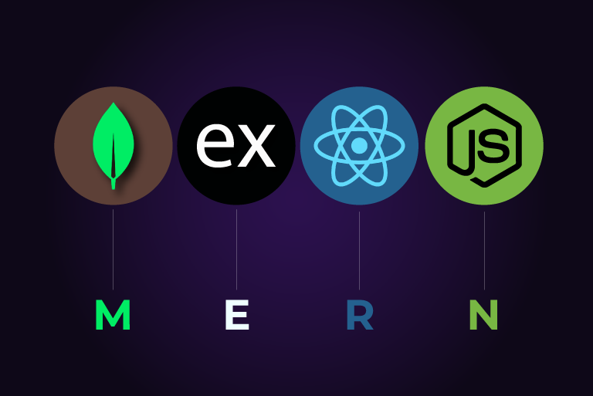
Why MERN Stack?
Full JavaScript-based stack for end-to-end developement.
Fast development cycle due to reusable components.
Scalable and performance-optimized architecture

Slide 10
Key Features
Secure User Authentication: Role-based access control for admin, instructors, and students.
Dynamic Course Management: Easy creation and editing of multimedia courses.
Interactive Learning Tools: Real-time coding exercises, quizzes, and live sessions.
Payment Gateway Integration: Secure subscription-based and one-time payments.
Personalized Dashboard: Track progress and generate performance reports.

Slide 11
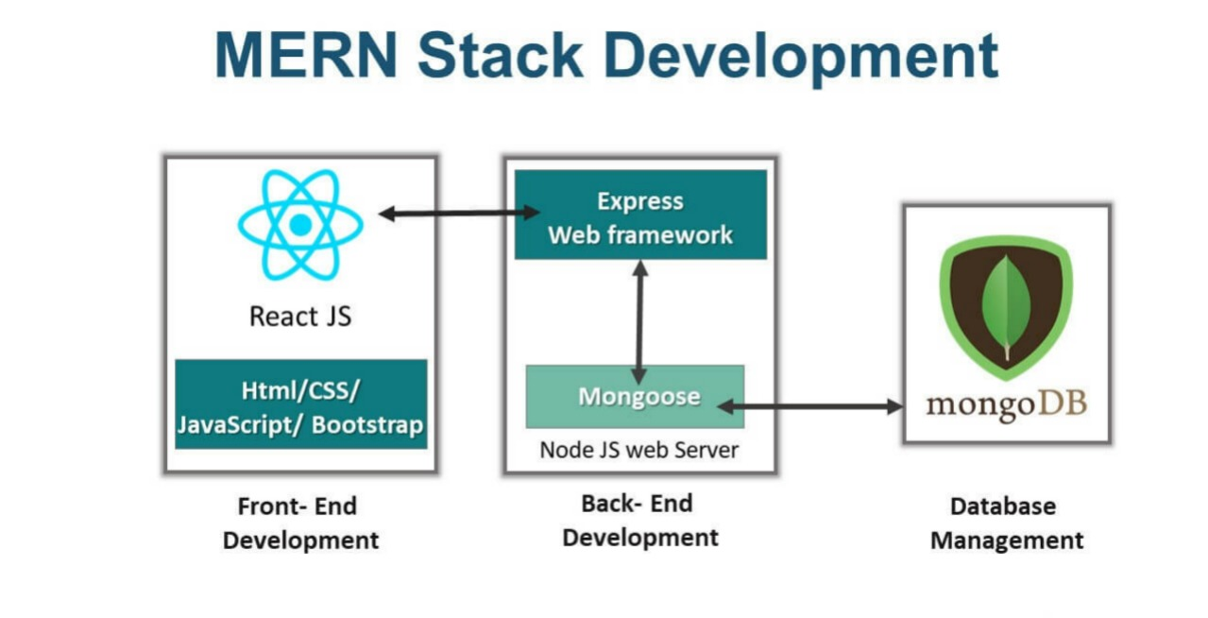
Architecture Diagram
.

Slide 12
User Authentication
User authentication ensures secure access to the platform.
Built using JWT (JSON Web Tokens), it verifies user credentials during login and assigns roles like Admin, Instructor, or Student.
Passwords are encrypted with bcrypt for security and stored in MongoDB.
Role-based access control ensures users can only perform actions specific to their role, like managing courses or enrolling in them.
This system provides a safe, seamless, and personalized experience for all users.

Slide 13
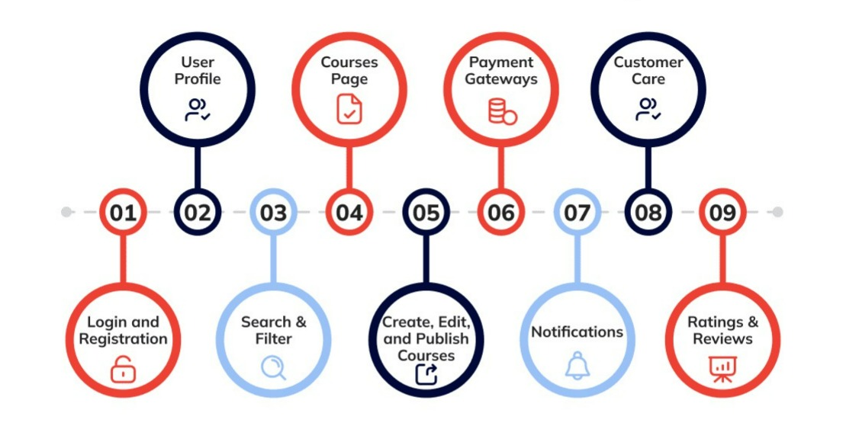
Course Management
Features for Instructors:
Create, update, and delete courses.
Upload multimedia lessons.
Features for Students:
Enroll in courses, complete assignments, and track progress.
Admin Role:
Oversee platform activity
manage users, courses, and platform settings

Slide 14
Learning Process
. Course Enrollment: Students browse, enroll, and access personalized dashboards.
. Content Delivery: Instructors upload multimedia lessons (videos, readings), displayed dynamically via React.js.
. Interactive Learning: Quizzes and coding exercises with real-time feedback.
. Assignments & Projects: Students submit assignments and receive feedback.
. Progress Tracking: Students track their course progress and performance.
. Gamification: Badges and leaderboards to motivate students.
. Certification: Students receive certificates upon course completion.

Slide 15

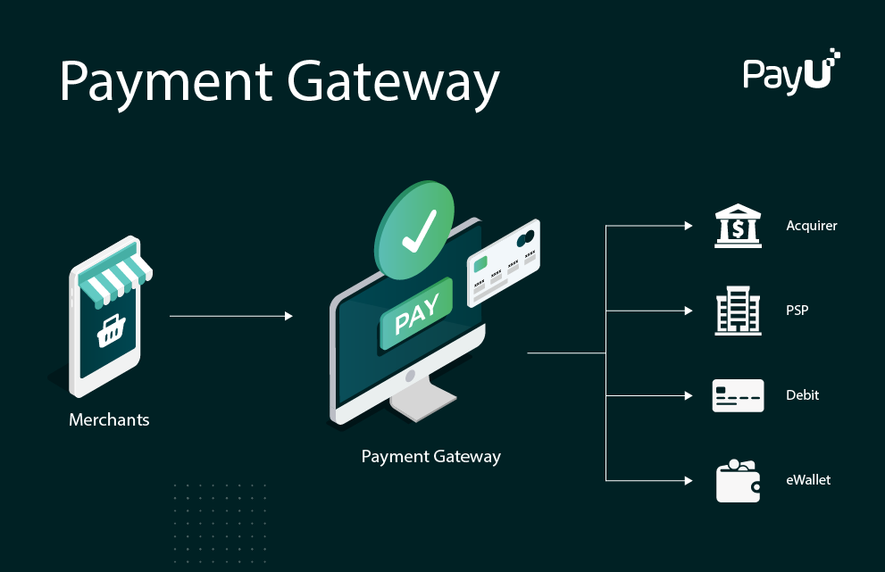
Payment Integration
Supported Gateways:
Stripe and PayPal.
Payment Flow:
Select course → Payment gateway → Enrollment confirmation.
Security Compliance:
PCI DSS standards for safe transactions.

Slide 16
Dynamic UI
Frontend Features:
Responsive Design
Ensures that the platform adapts seamlessly to different screen sizes (desktop, tablet, mobile).
Uses CSS frameworks like Bootstrap for a fluid, mobile-first experience.
Interactive Components
Incorporates interactive elements like quizzes, progress bars, and clickable course sections.
Real-time updates for users, such as instant quiz results or notifications about course updates.
State Management
Uses React's state management (Context API) to manage user interactions , app data seamless navigation.

Slide 17

Database Design
Schema Details:
User Schema: Name, email, role, enrolled courses.
Course Schema: Title, lessons, assignments, enrolled users.
Payment Schema: User, course ID, transaction details.
Relationships:
One-to-Many and Many-to-Many associations.

Slide 18
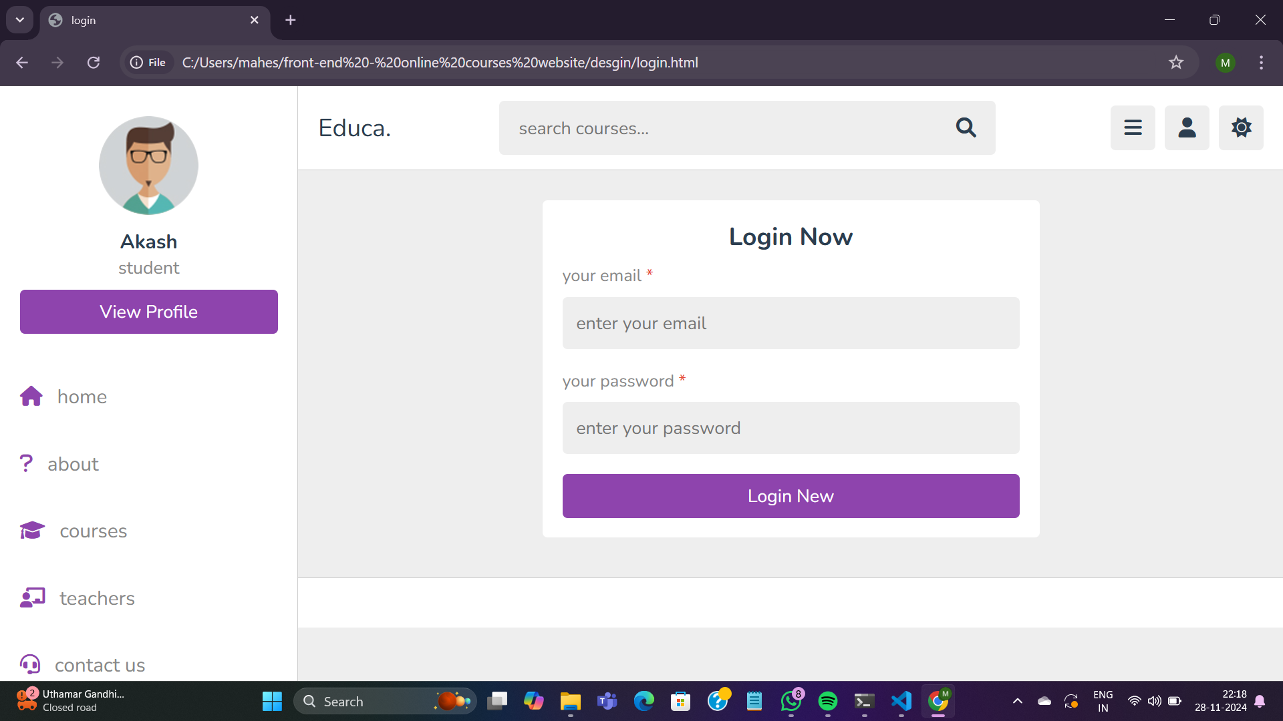
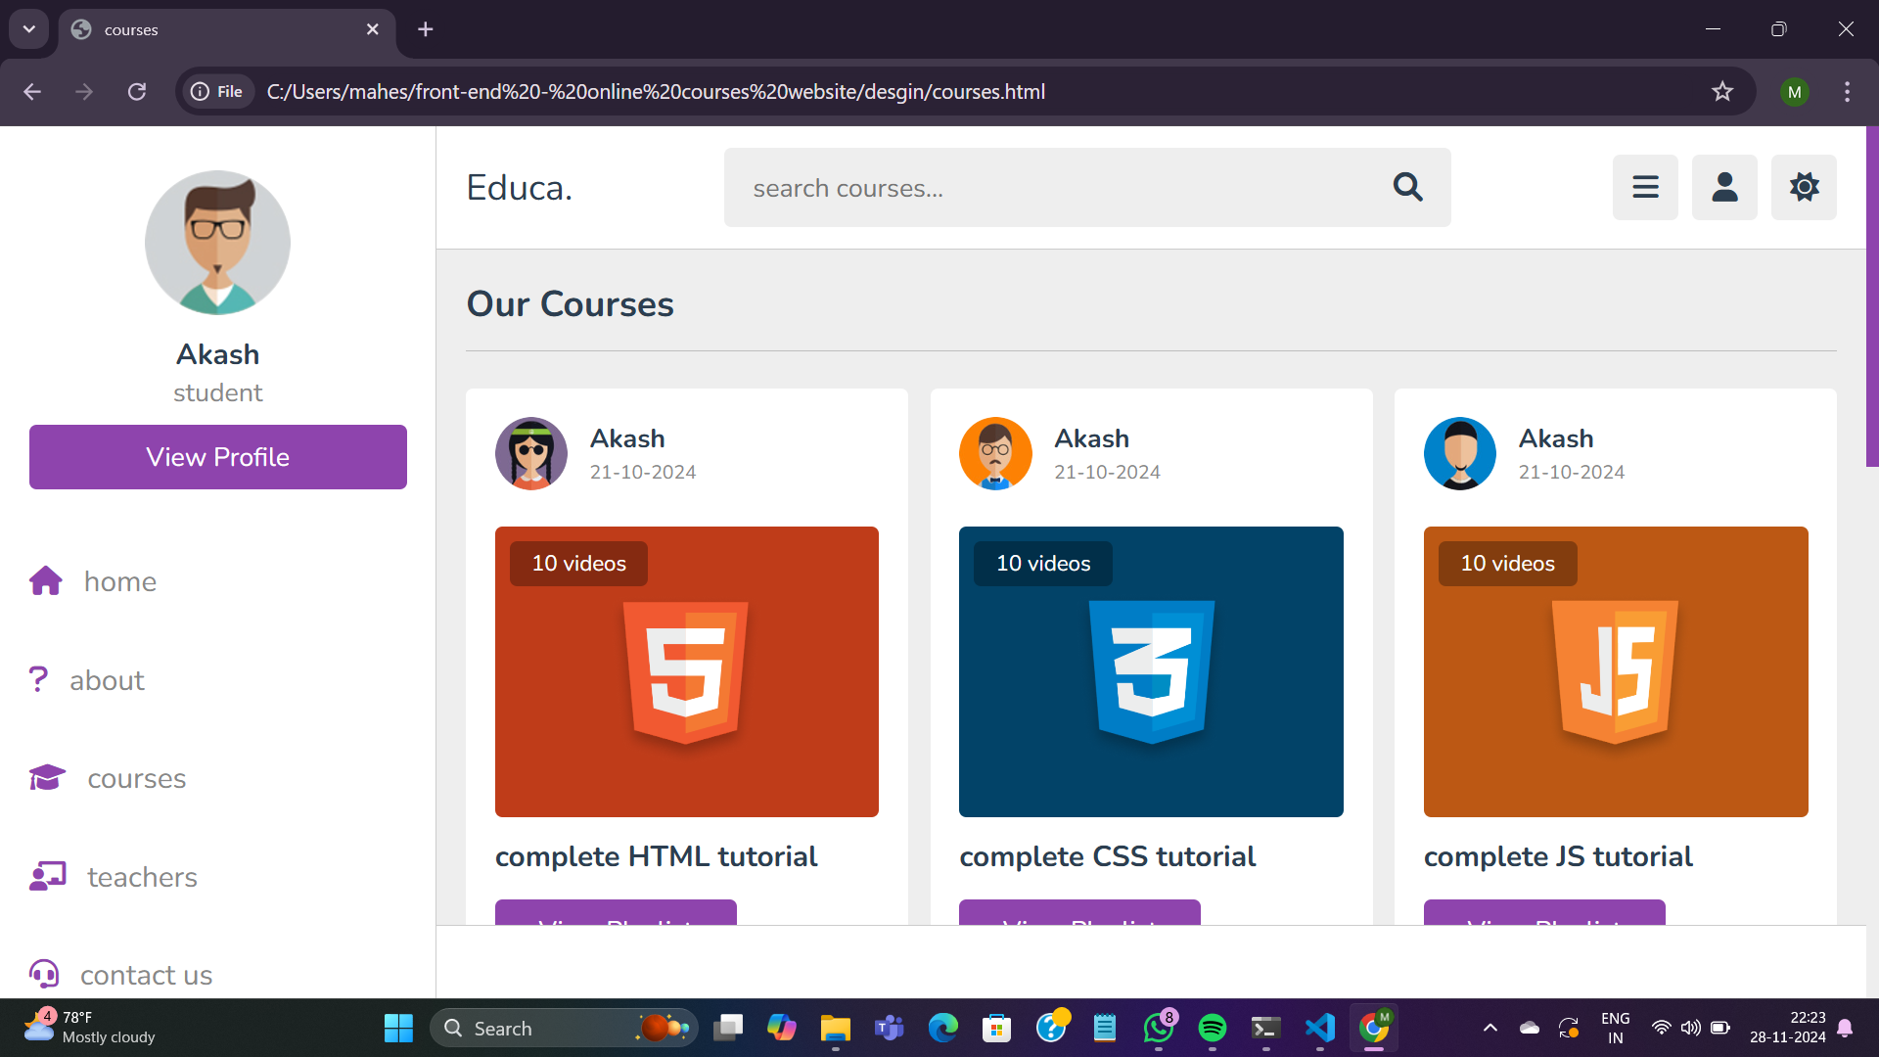
Screenshots
Login Page
Student Dashboard

Slide 19
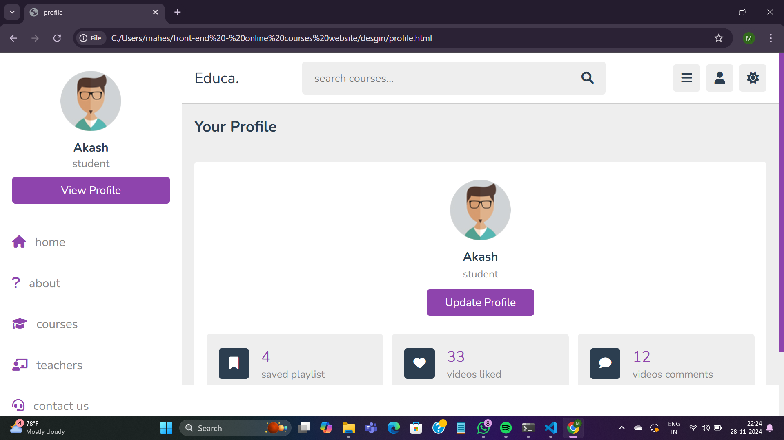
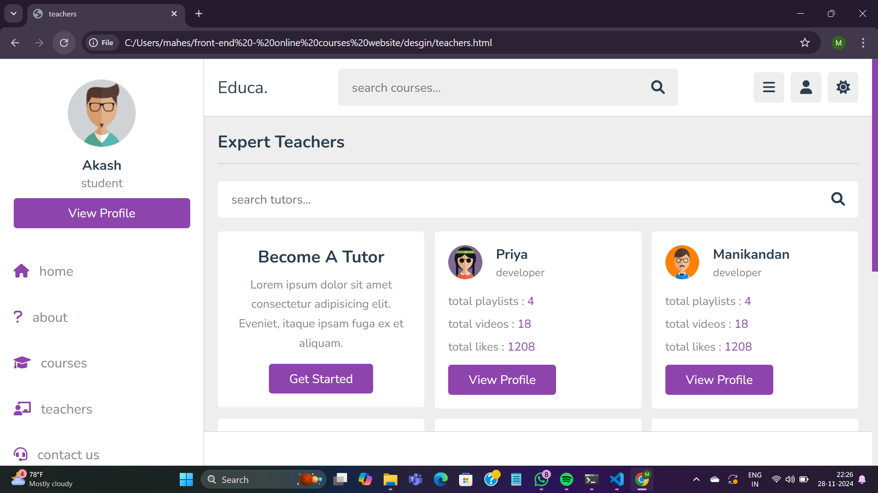
Screenshots
Students Profile
Techers Profile

Slide 20

Conclusion
"A robust MERN-based platform catering to modern education needs."
Future Enhancements:
AI-based learning recommendations.
Mobile application development using React Native

Slide 21
Thank you!!

