Slide 1

DEPARTMENT OF
CSE (ARTIFICIAL INTELLIGENCE AND MACHINE LEARNING)
ACADEMIC YEAR 2025 - 2026
SEMESTER III
ARTIFICIAL INTELLIGENCE LABORATORY
MINI PROJECT REVIEW
N-KNIGHT’S TOUR PROBLEM
REGISTER NUMBER | 2117240030040
NAME | S.HARINI
YEAR | 2
SECTION | A
FACULTY IN-CHARGE | Mrs. M. Divya

Slide 2
PROBLEM STATEMENT
The Knight’s Tour is a classic AI problem where a knight moves on a chessboard and must visit every square exactly once. The project aims to create a Python program that uses the backtracking algorithm to find a valid sequence of moves. The algorithm tries all possible moves, checks if they are valid, and backtracks when a move doesn’t lead to a solution. This project shows how AI search techniques like backtracking can solve complex problems efficiently.

Slide 3
THEORETICAL BACKGROUND
The Knight’s Tour is a classic AI and combinatorial problem where a knight moves on a chessboard and visits every square exactly once. It is a constraint satisfaction problem usually solved using backtracking or heuristic search methods.
Backtracking Algorithm:
Backtracking is a depth-first search (DFS) method that explores all possible paths and backtracks when a move fails. It is used in problems like N-Queens, Sudoku, Maze solving, and the Knight’s Tour. In this problem, the knight tries all valid moves; if a move leads to a dead end, it returns to the previous step until all squares are visited.

Slide 4
JUSTIFICATION FOR CHOOSING BACKTRACKING
The Backtracking algorithm is chosen because:
It is simple and easy to implement for understanding AI search problems.
It guarantees finding a valid tour if one exists (complete search).
It clearly demonstrates recursion, state-space exploration, and decision-making in AI.
It provides a foundational understanding before moving on to heuristic or optimization-based methods.

Slide 5
ALGORITHM EXPLANATION
Algorithm Steps:
Start from the any square (position) and mark it as visited.
Try all 8 possible knight moves from the current position.
For each move, check if the next square is inside the board and unvisited.
If valid, mark it and recursively continue to the next step.
If a dead end is reached, backtrack by unmarking the square and try another path.
Continue until all squares are visited or no valid path remains.
Example (5×5 Board):
The knight starts at (0,0).Moves to (2,1), (4,2), and so on, following the recursive pattern.Once all 25 cells are filled with unique move numbers, the tour is complete.If no solution exists, the algorithm displays “No solution exists”.

Slide 6
IMPLEMENTATION AND CODE
Link to code in Git-hub Repository
List | Git-hub Repository Links
Implementation of Code Link | https://github.com/harinis240040-byte/N-Knight-problem-solver-/blob/main/N-knightProblemSolver
Word Document Report Link | https://github.com/harinis240040-byte/N-Knight-problem-solver-/blob/main/AI_MINIPROJECT%5B1%5D.docx
PPT Link | https://github.com/harinis240040-byte/N-Knight-problem-solver-/blob/main/AI_MINIPROJECT_PPT_HARINIS40.pptx

Slide 7
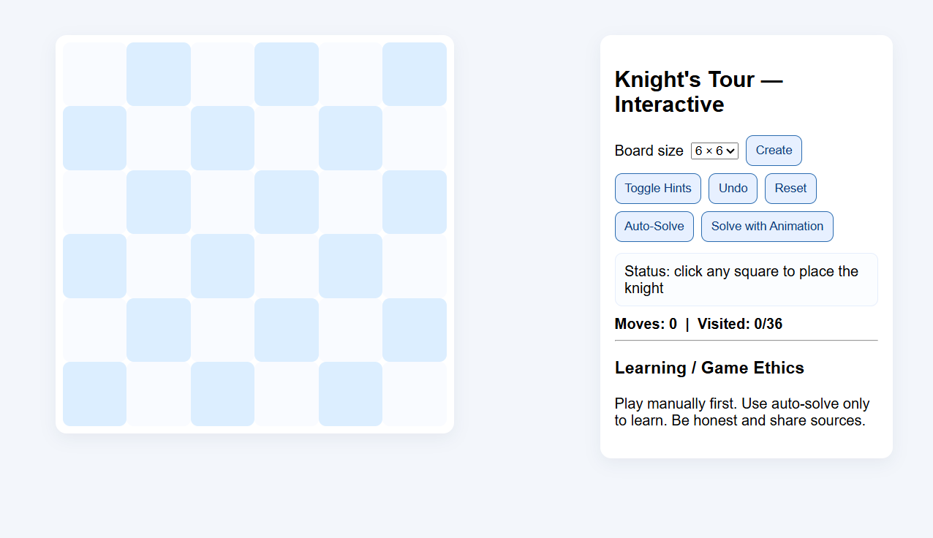
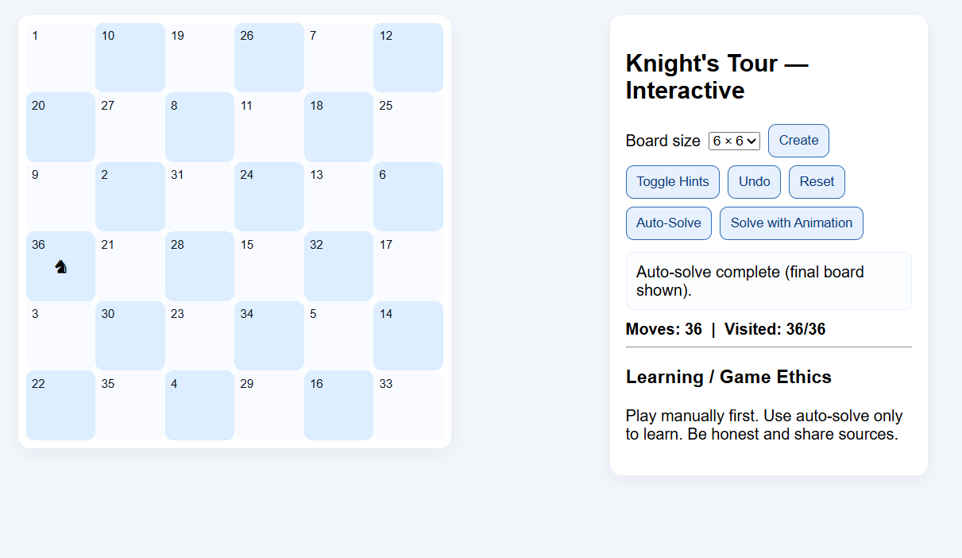

OUTPUT AND RESULTS
OUPUT:
The program prints the chessboard as a matrix where each cell shows the knight’s move number. The knight starts at (0,0) and the numbers 0 to $n^{2}−1$show the move order as it visits every square once. If no tour is possible, it prints: “No solution exists.”

Slide 8
OUTPUT AND RESULTS
RESULT:
The backtracking algorithm solved the Knight’s Tour for several board sizes (e.g., 5×5, 6×6), showing how AI search methods can handle constraint puzzles. The project confirmed that recursive backtracking effectively explores state spaces and reinforced concepts like recursion and depth-first search.
FUTURE ENHANCEMENTS:
Apply Warnsdorff’s heuristic to cut recursive calls and speed up search.
Add a GUI (Tkinter or Pygame) to visualize moves.
Optimize for larger boards (8×8+) for better performance.
Explore AI optimizers (Genetic Algorithms, Simulated Annealing).
Build a real-time animated/interactive learning tool.

Slide 9
REFERENCES
Artificial Intelligence: A Modern Approach – Stuart Russell & Peter Norvig.
GeeksforGeeks – Knight’s Tour Problem using Backtracking (https://www.geeksforgeeks.org)
TutorialsPoint – Backtracking Algorithms in Python
Programiz – Recursion and Backtracking in Python
YouTube: “Knight’s Tour Problem Explained” – Jenny’s Lectures CS/IT

