Slide 1

DEPARTMENT OF CSE (ARTIFICIAL INTELLIGENCE AND MACHINE LEARNING) ACADEMIC YEAR 2025 - 2026 SEMESTER 4 MACHINE LEARNING LABORATORY MINI PROJECT REVIEW HOUSE PRICE PREDICTON
REGISTER NUMBER | 2117240030040
NAME | HARINI S
YEAR | 2
SECTION | A
FACULTY IN-CHARGE | Mrs. M. Divya

Slide 2
PROBLEM STATEMENT
Problem Statement
Traditional real estate pricing relies on manual estimation, which may lead to inaccurate predictions.
House prices depend on multiple factors such as area, number of bedrooms, and location.
Manual analysis is time-consuming and may not capture complex patterns in data.
There is a need for an automated system to predict house prices efficiently and accurately.
GOAL
To develop a machine learning-based system to predict house prices.
To analyze key factors affecting property prices such as area, BHK, and bathrooms.
To provide accurate price predictions for users.
To visualize relationships between features and house prices.
To assist buyers and sellers in making better real estate decisions.

Slide 3
THEORETICAL BACKGROUND
Machine Learning is a branch of Artificial Intelligence that enables systems to learn from data and make predictions.
It identifies patterns from historical data and uses them for future predictions.
In real estate, machine learning helps estimate property prices based on various features.
This project uses the Linear Regression Algorithm, a supervised learning method used for predicting continuous values.
Linear Regression finds the relationship between input variables and output (price).
It assumes a linear relationship between features and the target variable.

Slide 4
THEORETICAL BACKGROUND
ALGORITHM
Load dataset (area, BHK, bathroom, price).
Perform data preprocessing (handle missing values, remove unwanted columns).
Select input features and target variable.
Split dataset into training and testing sets.
Train Linear Regression model.
Predict house prices using trained model.
Evaluate model using metrics such as R² score, MAE, and MSE.
Display results using graphs and charts.
Integrate model into Flask web application.

Slide 5

THEORETICAL BACKGROUND
Example: Linear Regression
Sample Data:
House Data:
Area = 1200 sq.ft
Bedrooms (BHK) = 2
Bathrooms = 2
Model Equation:
$Price=b_{0}+b_{1}\left(Area\right)+b_{2}\left(BHK\right)+b_{3}\left(Bathroom\right)$
Assumed Coefficients (Example):
$b_{0}=500000$
$b_{1}=3000$
$b_{2}=200000$
$b_{3}=150000$
Calculation:
$Price=500000+\left(3000×1200\right)+\left(200000×2\right)+\left(150000×2\right)$
$Price=500000+3600000+400000+300000$
$Price=48,00,000$
Final Prediction:
Predicted House Price = ₹48,00,000

Slide 6
IMPLEMENTATION AND CODE
Link to code in Git-hub Repository
List | Git-hub Repository Links
Implementation of Code Link | https://github.com/harinis240040-byte/house-price-predictor.git
Word Document Report Link
PPT Link

Slide 7
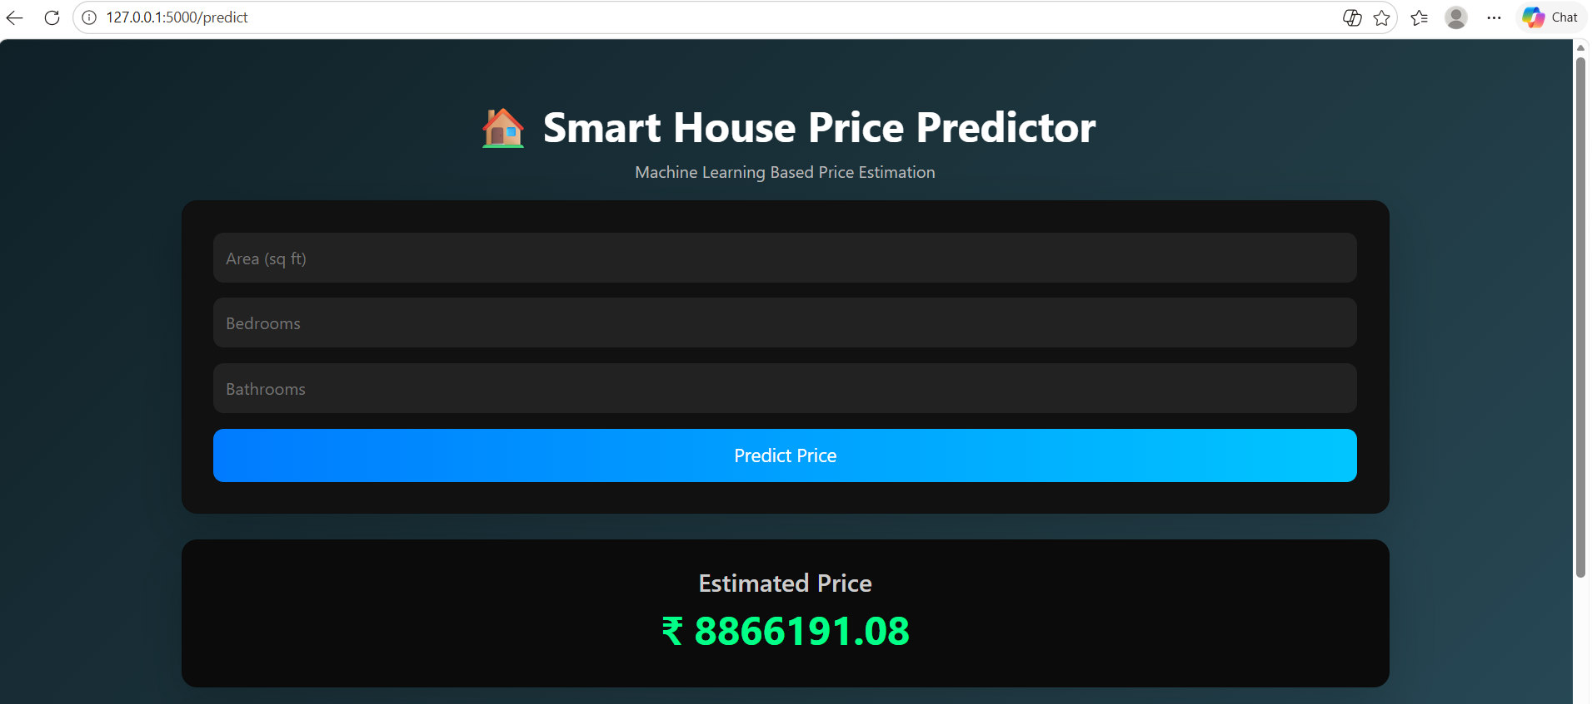
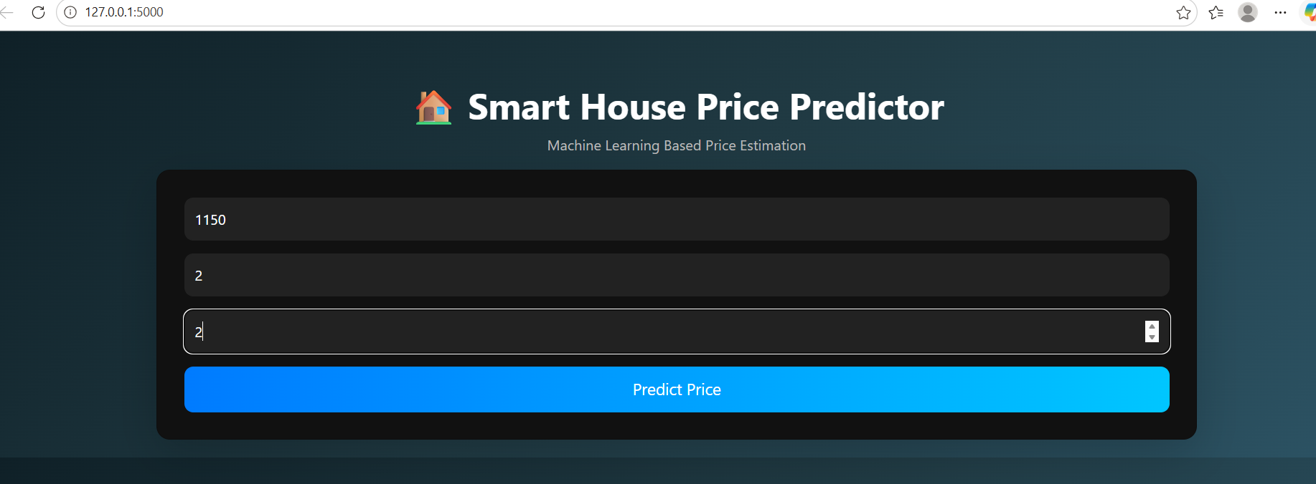
OUTPUT AND RESULTS
The system provides an interactive web interface developed using Flask where users can input house details such as area, number of bedrooms, and number of bathrooms.
After entering the input values, the system processes the data and displays the predicted house price instantly.

Slide 8
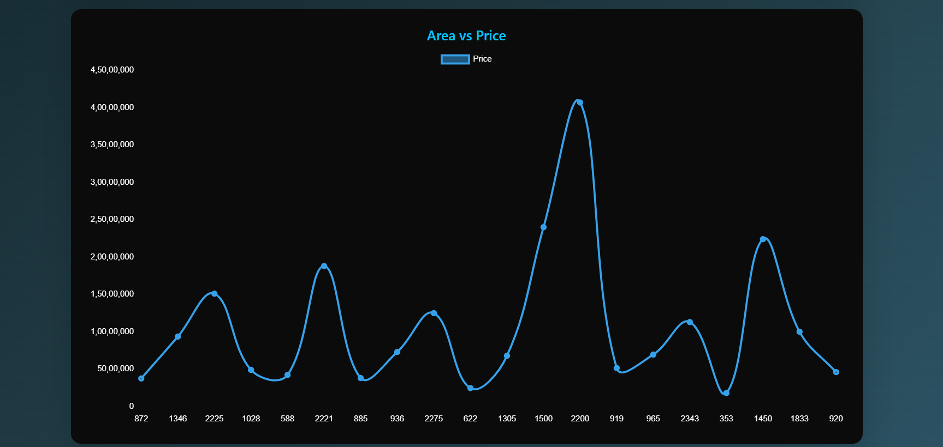
OUTPUT AND RESULTS
Result Dashboard
The system displays:
Predicted house price
Sample dataset visualization
Area vs Price graph
The dashboard provides a clear understanding of how the prediction is generated.
Insights
House price increases significantly with increase in area.
Number of bedrooms and bathrooms also influence the price.
The model captures the linear relationship between features and price effectively.

Slide 9
OUTPUT AND RESULTS
Results
The system successfully predicts house prices based on input features such as area, number of bedrooms (BHK), and number of bathrooms.
The Linear Regression model provides reliable and consistent prediction results.
The relationship between input features and house price is effectively captured.
The Flask-based web application enables real-time user interaction and instant prediction.
Data visualization (scatter plots and regression lines) helps in understanding price trends.
The model evaluation shows good performance using R² score, MAE, and MSE.
Users receive immediate predicted house price along with graphical insights.
FUTURE ENHANCEMENTS
Improve model performance using advanced algorithms such as Random Forest, XGBoost, or Gradient Boosting.
Include additional features such as location, property age, amenities, and nearby facilities.
Integrate real-time data from real estate platforms for better accuracy.
Deploy the application on cloud platforms such as AWS or Azure for wider accessibility.
Add user authentication and personalized dashboards.
Implement AI-based recommendations for buyers and sellers.
Extend the system to support multiple cities beyond Chennai.

Slide 10
REFERENCES
Kaggle Dataset – https://www.kaggle.com/datasets (Used for house price dataset collection)
Scikit-learn Documentation – https://scikit-learn.org/stable/ (Used for implementing Linear Regression model)
Flask Documentation – https://flask.palletsprojects.com/ (Used for backend web application development)
Python Documentation – https://docs.python.org/3/ (Used for Python programming reference)
Pandas Documentation – https://pandas.pydata.org/docs/ (Used for data preprocessing and handling)
GeeksforGeeks (Machine Learning) – https://www.geeksforgeeks.org/machine-learning/ (Used for understanding ML concepts and algorithms)
Towards Data Science – https://towardsdatascience.com/ (Used for real-world machine learning insights)

