Slide 1


PANIMALAR INSTITUTE OF TECHNOLOGY
DEPARTMENT OF COMPUTER SCIENCE AND ENGINEERING
CS8611 - MINI PROJECT
Automation Of Message Sending Process Using Specialized Software
BATCH NO: C20
TEAM MEMBERS:
SUJITHA. S (211519104162)
SRUTHI. B (211519104160)
HARINI. S (211519104051)
PROJECT GUIDE:
Mrs S. LINCY JEMINA, M.E.,
Assistant Professor
Dept of CSE

Slide 2
ABSTRACT
In the modern world, we often face the problem of lack of time. Each person has to do many different things every day. Therefore, sometimes people forget about the important thing: about maintaining a connection with their relatives. The article discusses a method for automating the sending congratulatory messages and images to relatives in the Whatsapp messenger using its web version “WhatsApp Web” due to the lack of an official api for creating bots. Also, a chat bot, which was written with python and can recognize and respond to commands, was implemented. A chatbot is a virtual interlocutor, a program designed to imitate human behavior when communicating with one or more interlocutors. Although they are used less frequently than in other applications, they are convenient tools for business.

Slide 3
AIM OF THE PROJECT
In the modern world, we often face the problem of lack of time. Sometimes people forget about the important thing, about maintaining a connection with their relatives . Because of this, people rarely write to each other, and sometimes they completely forget to congratulate a loved one on an important holiday for him. To get rid of the daily time spent, it was decided to create a program that would send cards to relatives on holidays and could also interact with them using commands.
The main objective of this research project is to propose an end-to-end model for human activity recognition.

Slide 4
EXISTING SYSTEM
When analyzing already existing user it was discovered that there are bots that perform various functions. But no bots were found to send messages based on date and time.
DISADVANTAGE
low performance
Low accuracy

Slide 5
PROPOSED SYSTEM
Nowadays, the popularity of messengers is growing, so it is important to automate processes and create bots.
Using the web version of the messenger does not limit the bot's capabilities, so this method is working for creating bots created for private use.
The file system used in the program works more stable, since the main code does not change.
ADVANTAGES
very accurate
Time saving

Slide 6
HARDWARE REQUIREMENTS
Hard Disk : 500GB and above
RAM : 4GB and above
Processor : I3 and above
SOFTWARE REQUIREMENTS
Operating System : Windows 7,8,10 (64 bit)
Software : Python
Tools : Anaconda (Jupyter notebook IDE)

Slide 7
ARCHITECTURE DIAGRAM
Data Acquisition
Feature generation
Learing
Prediction using KDE
Back Projection
Activity

Slide 8
SYSTEM MODULE
Module 1: Data Collection
Module 2: Data Pre-processing
Module 3: Feature extraction
Module 4: activity

Slide 9
MODULE-I : DATA COLLECTION
UCI Daily and Sports Activities Dataset In this dataset, we follow the same leave-one-subject-out (L1O) cross-validation policy in such that the data of 7 subjects are used for training and the data of the remaining subject are used in turn for validation. This process is repeated 8 times so the data of each subject is used exactly once for validation. The final classification accuracy is estimated by the average results over the above 8 runs.

Slide 10
MODULE-2: DATA PRE-PROCESSING
Data preprocessing is a step in the data mining and data analysis process that takes raw data and transforms it into a format that can be understood and analyzed by computers and machine learning. The aim of pre-processing is an improvement of the image data that suppresses unwilling distortions or enhances some image features important for further processing, although geometric transformations of images (e.g. rotation, scaling, translation) are classified among pre-processing methods here since similar ...
Data Preprocessing Steps
Data quality assessment.
Data cleaning.
Data transformation.
Data reduction.

Slide 11
MODULE-3: FeaTURE EXTRACTION
Feature extraction is then applied to the windowed data to produce feature vector for recognition. Although sensor signals are oscillatory and prone to high fluctuation, they will still exhibit certain statistical behaviors. These behaviors have led many works to adopt statistical features from the time domain of the sensor signal. For example, mean, max, min, standard deviation (std), skewness, kurtosis , median absolute deviation (mad), root mean square (rms), interquartile range (iqr) and spectral entropy have been utilized to form a statistical representation of the sensor signals. In order to handle the periodic signals in human activities, raw sensor signals are also transformed into the frequency domain by Discrete Fourier Transform (DFT) or Discrete Cosine Transform (DCT), and different statistical features have been extracted, such as peak of DFT coefficients, energy, index of the largest frequency component, and signal power in different frequency bands

Slide 12
MODULE-4: ACTIVITY RECOGNITION
Human-activity recognition across multivariate time-series data. Recently, CNNs are also deployed for human-activity recognition using HCI-HAR dataset. In this regard, a detailed analysis of evaluating the HCI-HAR dataset has been performed by using a range of machine learning architectures such as SVM, LSTM, BLSTM, MLP, and CNN [8]. In , authors have proved CNN as the best candidate for human activity recognition using the HCIHAR dataset In addition, CNN-RNN based architectures are taking fewer iterations (epochs) for convergence of model during training. Our deep learning model is inspired by the same techniques, such as we have deployed FCN-LSTM [5] (previously used for time-series classification) for human activity recognition by fine-tuning the kernel sizes and the number of kernels accordingly.

Slide 13
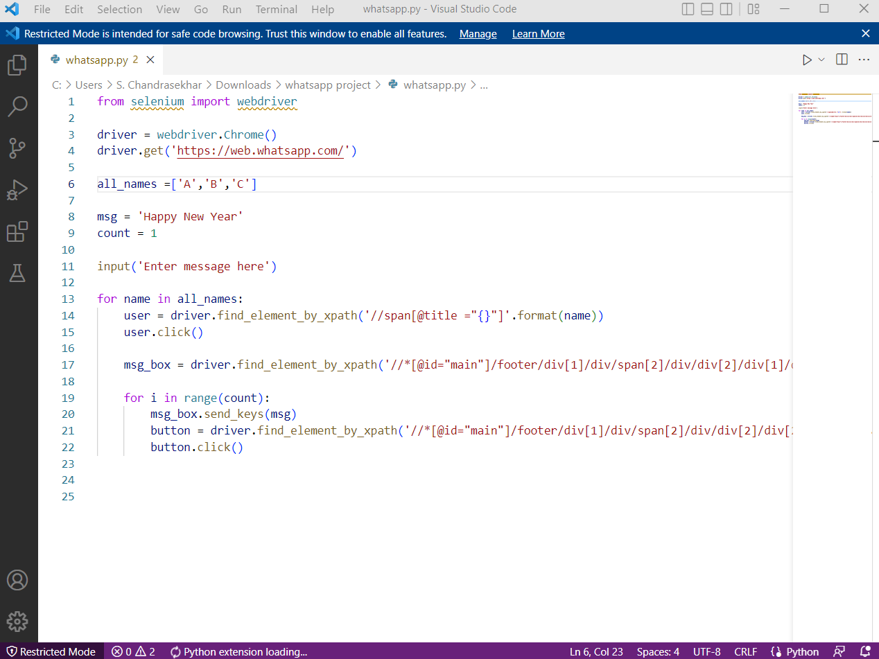
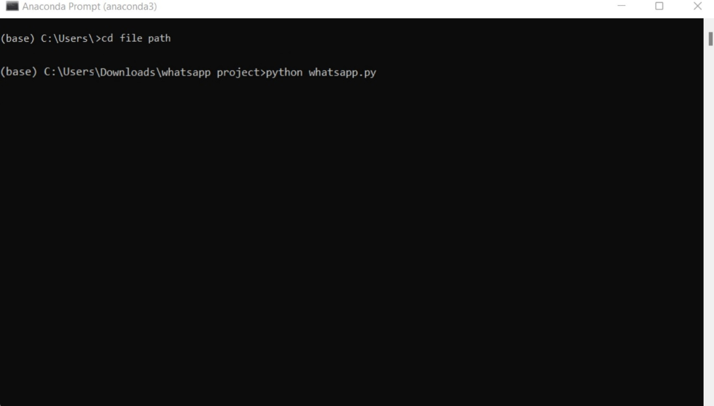
Screenshots

Slide 14
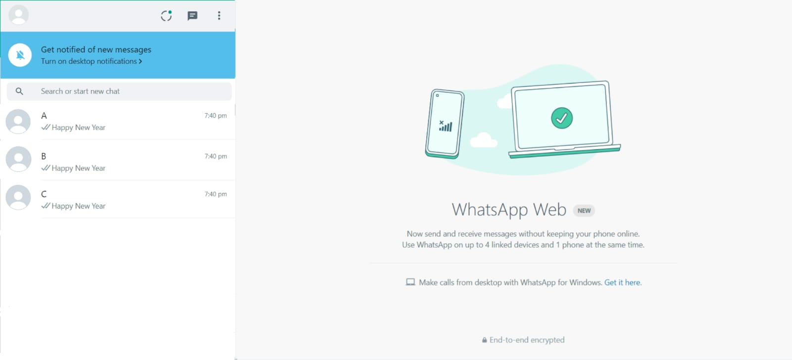

Slide 15
CONCLUSION
Based on the analysis and the results of the experiment, a number of conclusions were drawn, including further areas of research.
1. Nowadays, the popularity of messengers is growing, so it is important to automate processes and create bots.
2. Using the web version of the messenger does not limit the bot's capabilities, so this method is working for creating bots created for private use.
3. The file system used in the program works more stable, since the main code does not change.

Slide 16
Thank you.

