Slide 1
CS23533 • FOUNDATIONS OF ARTIFICIAL INTELLIGENCE
RELIEF NETWORK • CONCEPT VIEW
AI – POWERED RESPONSE INTELLIGENCE & RESOURCE OPTIMIZATION SYSTEM
ZONE
A centralized platform to monitor affected zones,
plan relief supplies and support delivery routes.
ZONE
PROJECT PRESENTATION
Team members
Harsha Vardhini S – 240701180 | Harini Sankar - 240701168
CSE | Rajalakshmi Engineering College
DEPOT
ROAD
Affected zone
Priority zone
Supply route
SMART DISASTER MANAGEMENT
01

Slide 2
01 • WHY THIS PROJECT
Problem Statement
THE SITUATION
01
Slow response
02
Uneven supplies
When flooding affects several neighborhoods at once, relief teams must decide:
Requests, stock verification and transportation planning can take considerable time, delaying the delivery
of emergency supplies to
affected areas.
Some locations may receive excess resources while severely affected areas experience shortages due to inefficient distribution.
1
Which zones need help first?
2
What supplies are required?
03
Unclear demand
04
Road disruption
3
Which depot can provide them?
Without accurate demand estimation, authorities may struggle to determine the required quantities of food, drinking water and medical supplies.
Flooded or blocked roads can interrupt transportation routes, making it difficult for emergency teams to reach affected locations on time.
4
How can teams reach the zone?
SMART DISASTER MANAGEMENT
02

Slide 3
02 • PROPOSED SOLUTION
Approach
MONITOR
ESTIMATE
PRIORITIZE
ALLOCATE
ROUTE
Map affected zones
Calculate resource needs
Identify urgent zones
Match demand to depot stock
Find a shortest path
MAP VIEW
DECISION SUPPORT
DELIVERY SUPPORT
Understand the situation
Choose what to send
Plan how to reach it
Display affected zones, risk levels, depots, shelters, hospitals and road information together.
Compare each zone's demand with available depot stock; identify full, partial or unmet allocations.
Use road distances and Dijkstra's algorithm to calculate a shortest route from a selected depot.
OUTPUT • A dashboard that shows where help is needed, what can be supplied and the route selected.
SMART DISASTER MANAGEMENT
03

Slide 4
03 • EXISTING SYSTEMS
What existing approaches do — and what remains disconnected
APPROACH
MAIN PURPOSE
LIMITATION / GAP
OUR PROJECT'S CONTRIBUTION
GIS mapping
Visualize locations and geographic layers.
A map by itself does not decide how to distribute supplies.
Connects map information with zone demand and allocation.
Flood forecasting
Estimate flood conditions using environmental observations.
Forecasting alone does not coordinate depot inventory and delivery.
Uses zone/risk information as part of relief planning.
Emergency coordination
Share incident information and coordinate response teams.
Resource and route planning may sit in separate workflows.
Presents allocation and route outputs in the same dashboard.
Manual inventory
Track available supplies and incoming requests.
Can become slow and difficult across many zones and depots.
Applies consistent rules to compare demand and stock.
Examples to reference in the report: Bhuvan (geospatial platform), CWC flood forecasting and India Disaster Resource Network.
The project focuses on integrating monitoring, resource allocation and route planning — not replacing forecasting or GIS systems.
SMART DISASTER MANAGEMENT
04

Slide 5
04 • TECHNOLOGY STACK
Tech Stack
APPLICATION STACK
React + Tailwind + Vite
React builds the interface; Tailwind styles it; Vite runs and bundles the frontend.
PRESENTATION
React / Tailwind CSS / Vite
Python + Fast API
API
Fast API
Python handles processing. Fast API exposes endpoints so the frontend can send requests and receive results.
PROCESSING
Python allocation and routing logic
React Leaflet + Recharts
MAP & CHARTS
Leaflet presents locations and routes on a map. Recharts displays demand, supply and allocation summaries.
React Leaflet/ Recharts
DATA
Project data / database
Scikit-learn + data
Scikit-learn is the intended ML library. Use it for demand prediction after a model is trained and integrated.
SMART DISASTER MANAGEMENT
05

Slide 6
05 • ALGORITHMS
Algorithms Used
01
RULE-BASED ALLOCATION
02
DIJKSTRA'S ALGORITHM
03
ML DEMAND PREDICTION
Compare resource demand in each zone with the available depot inventory.
Represent road junctions as nodes and connecting roads as weighted edges.
Train a Machine Learning model using labelled historical disaster and resource-demand data.
Calculate resource shortages and identify the quantity still required.
Assign road distances as weights to calculate travel paths.
Possible inputs: rainfall, population, risk and past demand.
Prioritize affected zones based on flood risk and population impact.
Find the minimum-distance path from depot to zone.
Predict resource demand for a zone.
Select suitable depots and distribute available resources according to demand.
Avoid blocked roads when road-disruption information is available.
Pass predicted demand to the resource allocation module for distribution planning.
EXAMPLE
HOW IT WORKS
IMPLEMENTATION STATUS
Need: 1,000 L water
Stock: 700 L
Allocate: 700 L
Shortage: 300 L
Depot → Junction A → Zone
Compare route distances
Choose the lowest total distance
Planned module
Needs dataset, training and testing
SMART DISASTER MANAGEMENT
06

Slide 7
06 • SYSTEM ARCHITECTURE
Architecture
USER / OPERATOR
Views zones, KPIs, charts and allocation activity
DECISION MODULES
Allocation engine
REACT FRONTEND
Dashboard components / React Leaflet/ Recharts
Compares resource demand with available depot stock.
Routing engine
FASTAPI SERVICE
Receives frontend requests/ returns structured results
Uses Dijkstra to calculate a shortest road path.
PYTHON BACKEND
Prepares inputs /runs allocation and routing logic
Prediction module
Can supply estimated demand after ML integration.
DATA & MODEL INPUTS
Zone data/ depot inventory/ demand / road network / planned ML
DATA FLOW | Operator → React → Fast API → Python engines → API response → Dashboard visualization
SMART DISASTER MANAGEMENT
07

Slide 8
07 • SYSTEM WORKFLOW
Workflow
01
02
03
04
INPUT DATA
MONITOR ZONES
ESTIMATE NEEDS
SET PRIORITY
Zone details, demand, depot stock and road information.
Show affected locations and risk levels on the map.
Calculate or predict water, food and medical demand.
Rank zones using urgency, risk and affected population.
05
06
07
08
CHECK DEPOTS
ALLOCATE
CALCULATE ROUTE
SHOW RESULTS
Find a depot with the required resource stock.
Assign available quantities and record any shortage.
Use Dijkstra on the road network.
Display allocations, routes and dashboard summaries.
EXAMPLE • A zone needs 1,000 L of water → depot has 700 L → allocate 700 L → show 300 L shortage → calculate delivery route.
SMART DISASTER MANAGEMENT
08

Slide 9
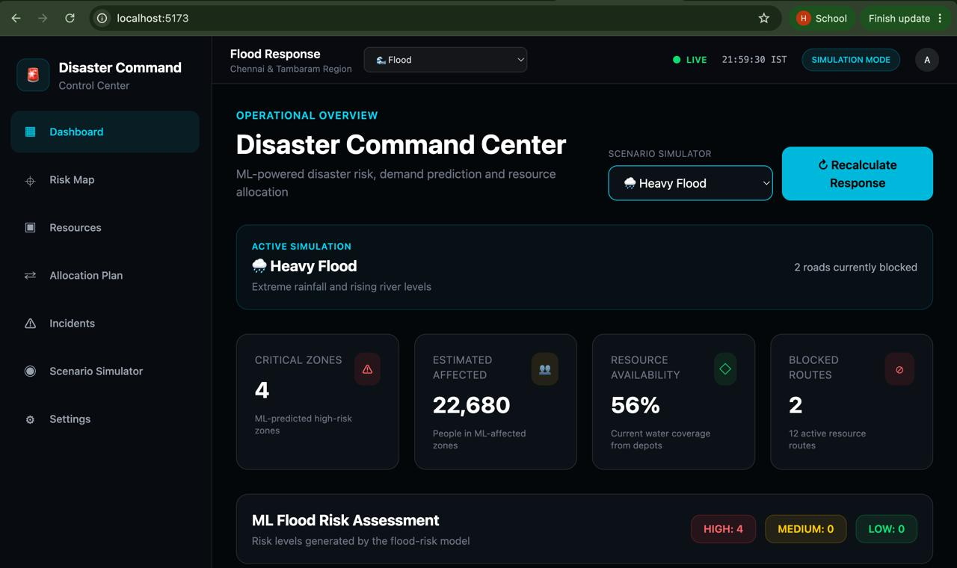
08 • DASHBOARD & FEATURES
Dashboard
WHAT EACH AREA TELLS THE OPERATOR
KPI cards
Summarize critical zones, population and road status.
Map
Shows where zones and response assets are located.
RESOURCE AVAILABILITY
Risk colors
Make higher-priority areas easier to spot.
Stock indicators
Show available resource levels.
Activity feed
Records allocations and exceptions.
Charts
Compare demand, supply and allocation status.
SMART DISASTER MANAGEMENT
09

Slide 10
09 • CONCLUSION & NEXT STEPS
Conclusion
WHAT THE PROJECT BRINGS TOGETHER
NEXT DEVELOPMENT MILESTONES
Visibility
A shared view of affected zones and response assets.
01
Train demand model
Use real historical disaster data; validate prediction quality.
Planning
A structured way to compare resource demand and stock.
Connect live weather
02
Bring rainfall and weather observations into the workflow.
Allocation
Rule-based assignment with shortage visibility.
03
Add flood-risk prediction
Estimate risk using suitable environmental and geographic features.
Routing
Shortest-path support for relief transportation.
04
Improve field operations
Decision support
Maps, indicators and activity summaries in one dashboard.
Add GPS tracking, live road updates and emergency alerts.
FASTER DECISIONS • BETTER RESOURCE USE • MORE COORDINATED RELIEF
SMART DISASTER MANAGEMENT
10

