Slide 1
Digital Portfolio
STUDENT NAME : S.Harini
REGISTER NO AND NMID : 24131061802522022 & autanm106106cs214014
DEPARTMENT: B.sc Computer science (II - Year)
COLLEGE/UNIVERSITY : Shree raghavendra arts and science college,Keezhamoongiladi, Affiliated to Annamalai University,Chidambaram

Slide 2
PROJECT TITLE
“Design and Development of a Digital Portfolio Website”

Slide 3
AGENDA
Problem Statement
Project Overview
End Users
Tools and Technologies
Portfolio design and Layout
Features and Functionality
Results and Screenshots
Conclusion
Github Link
3/21/2024 Annual Review

Slide 4
PROBLEM STATEMENT
In today's digital world, having an online portfolio is essential for students to showcase their skills, projects, and achievements. Traditional resumes are static, whereas digital portfolios allow interactive, visually appealing, and accessible self-presentation.

Slide 5
PROJECT OVERVIEW
•This project is a Digital Portfolio Website designed using HTML, CSS, and JavaScript.
•It highlights personal details, skills, hobbies, and academic projects in a clean, user-friendly design.

Slide 6
WHO ARE THE END USERS?
•Students who want to showcase their academic and project work
•Recruiters & employers looking for candidate profiles
•Teachers & mentors for project evaluation
•General audience exploring student achievements

Slide 7
TOOLS AND TECHNIQUES
HTML5 – Structure of the webpage
CSS3 – Styling and responsive design
JavaScript – Interactivity
GitHub – Hosting and version control
Other Libraries - React-icons, typed.js, AOS animations

Slide 8
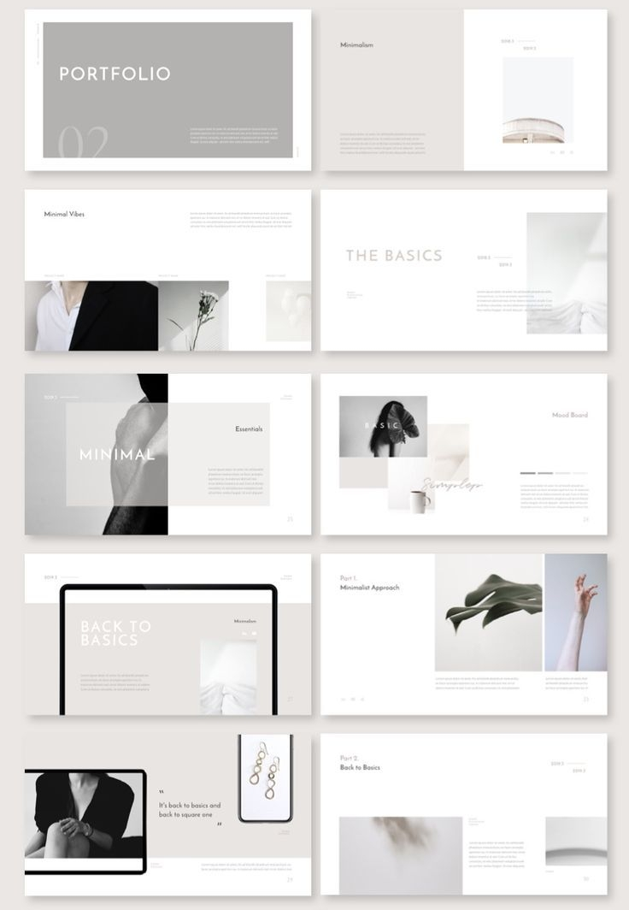
POTFOLIO DESIGN AND LAYOUT
Home (Hero)-> Animated introduction with glowing effects and profile photo.
About->Personal introduction, education details, and career goal.
Skills-> Display of technical skills with logos and animations.
Certificates-> Achievements displayed.
Sports->Section highlighting extracurricular activities with images.
Contact->Direct links to email, GitHub, and LinkedIn.
Footer-> Clean copyright and quick links.
8

Slide 9
FEATURES AND FUNCTIONALITY
• Animated typing effect for introduction.
• Floating glowing decorations for modern design.
• Profile photo with animated circular border.
• Crtificates displayed as cards with pop-up view and download option.

Slide 10
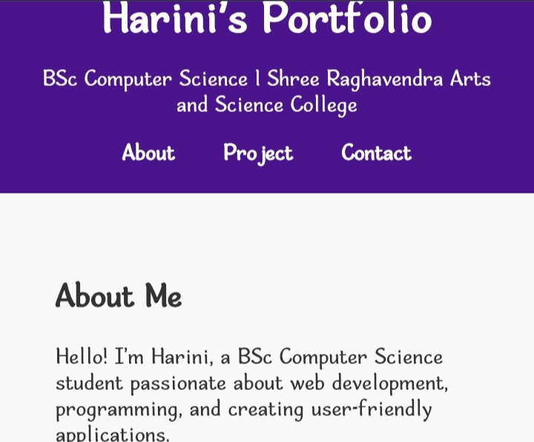
RESULTS AND SCREENSHOTS
3/21/2024 Annual Review
10

Slide 11
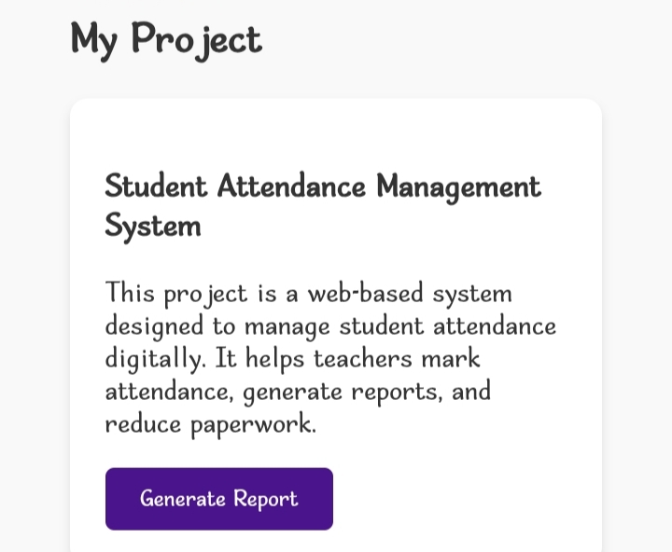
RESULTS AND SCREENSHOTS

Slide 12
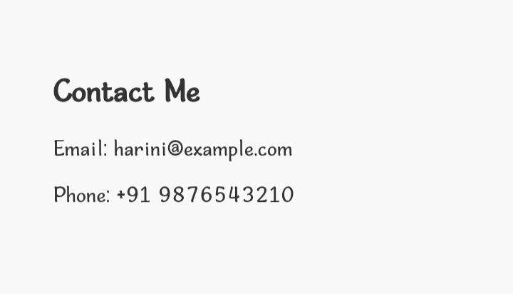
RESULTS AND SCREENSHOTS

Slide 13
CONCLUSION
The project demonstrates how a student can transform a static resume into a dynamic portfolio website. It serves as a platform to showcase technical skills, achievements, and extracurricular activities in a modern, interactive format. This portfolio will help Sankari in her academic growth, internships, and job opportunities.
13

