Slide 1
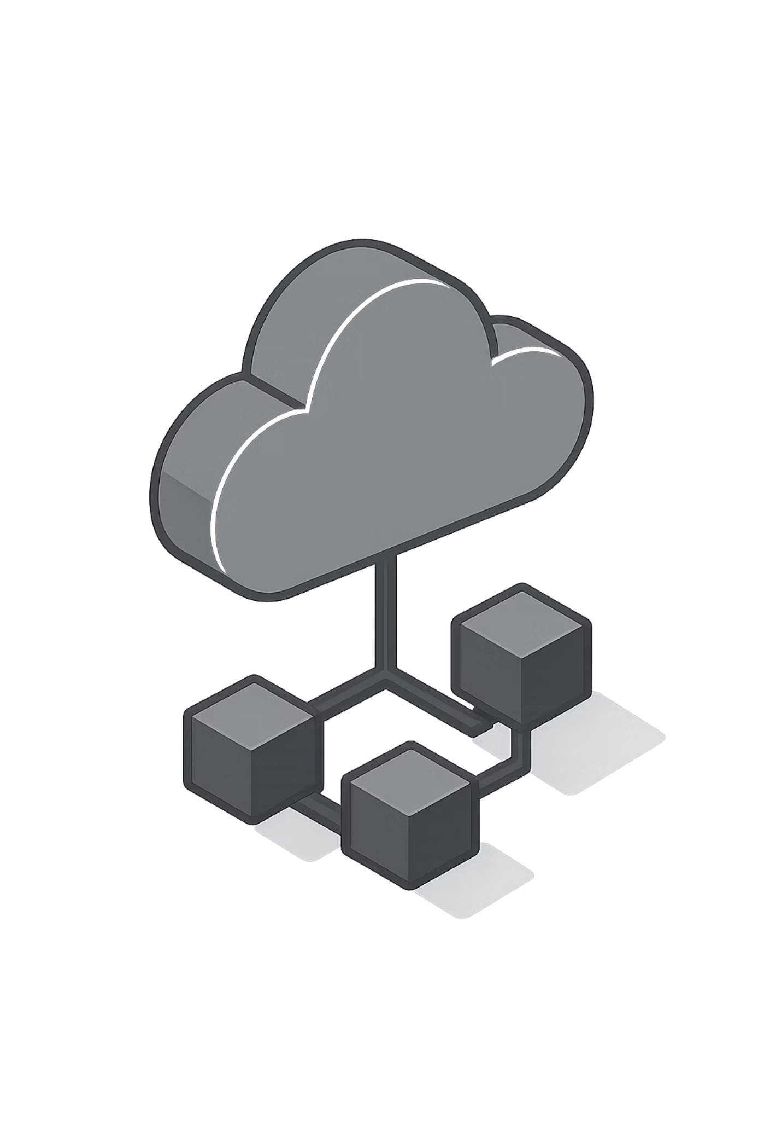
Cloud Computing
Introduction to Cloud & Modern Infrastructure

Slide 2





Traditional Infrastructure (On-Premises)
Traditional IT infrastructure requires organizations to purchase and maintain physical hardware on their own premises. This approach gives complete control but comes with significant overhead and scalability challenges.
Physical Servers
Data Centers
1
Companies purchase hardware and install physical servers in their own facilities
Set up and maintain dedicated facilities with proper infrastructure
2
Staff Requirements
4
Facility Management
Hire and retain engineers for ongoing maintenance and support
3
Handle cooling systems, power supply, and network connectivity
Scaling Challenge
When traffic suddenly increases, companies must purchase new hardware, configure systems, and wait days or weeks before additional capacity is available. This creates bottlenecks during peak demand.

Slide 3

Problems with On-Premises Infrastructure
Traditional infrastructure presents several operational and financial challenges that limit business agility and growth potential.
1
2
3
High Upfront Costs
Slow Scaling Process
Maintenance Overhead
Significant capital expenditure required for hardware purchases, facility setup, and initial deployment
Adding capacity takes days or weeks due to procurement, installation, and configuration requirements
Ongoing hardware maintenance, software updates, and system monitoring consume valuable IT resources
4
5
Downtime Risks
Dedicated Teams
Hardware failures cause service interruptions without expensive redundant systems and backup infrastructure
Requires specialized staff for 24/7 operations, security management, and technical support
Additional concerns include resource wastage during low usage periods, limited flexibility to adapt to changing needs, and complex disaster recovery planning.

Slide 4
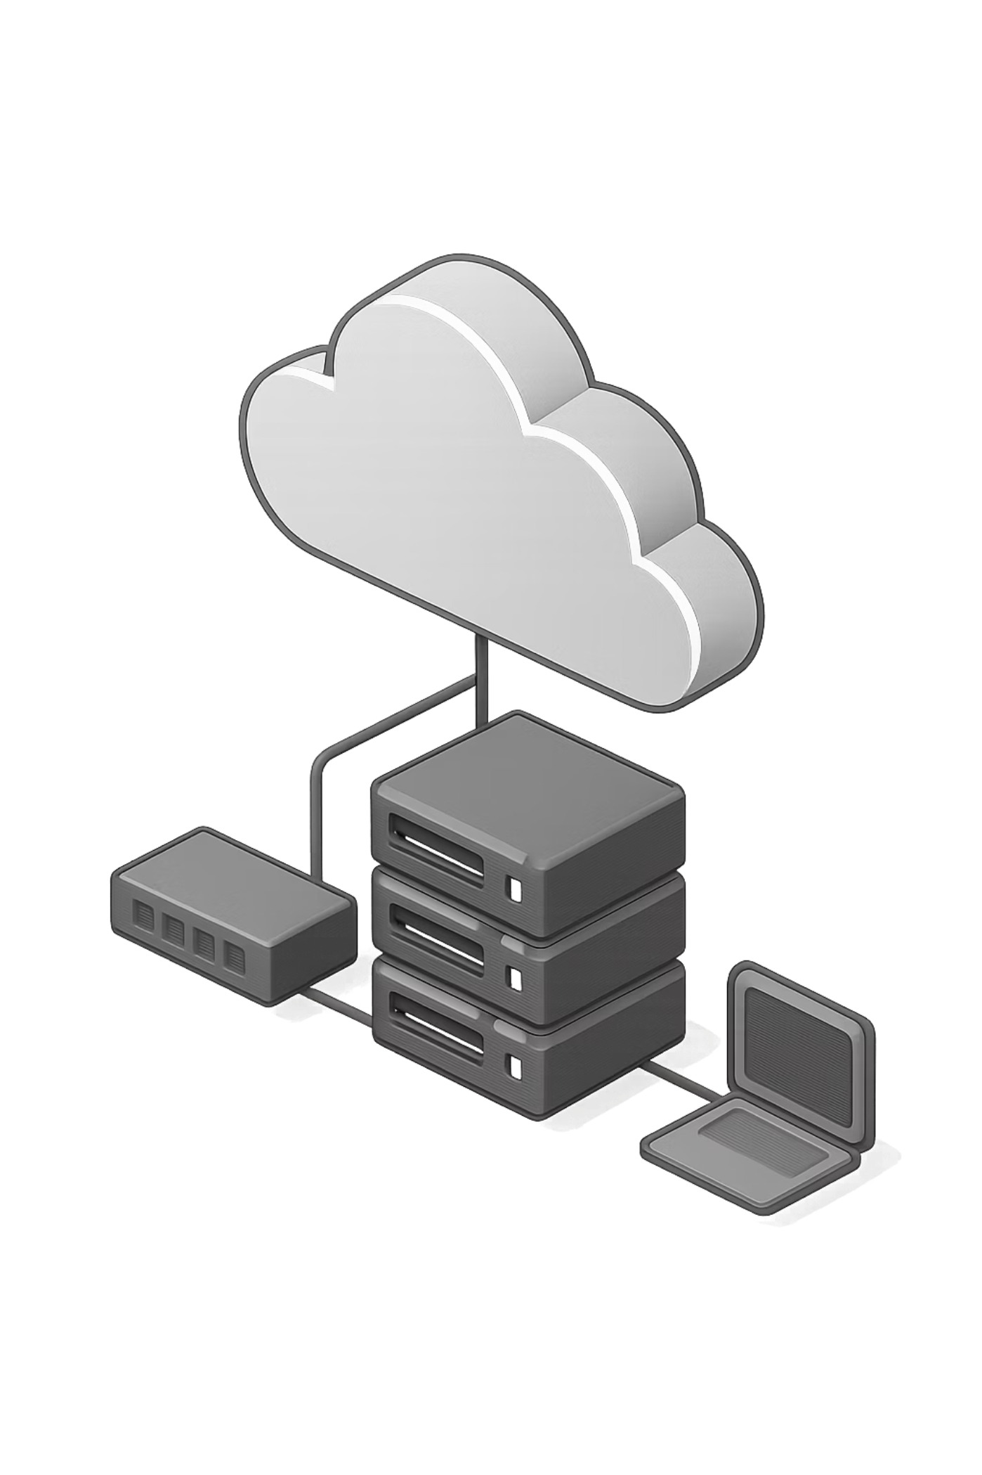
What is Cloud Computing?
Cloud computing is the delivery of computing resources—servers, storage, databases, networking, software, analytics, and intelligence—over the internet on a pay-as-you-go basis.
Instead of owning and maintaining physical infrastructure, organizations rent computing resources from cloud service providers. This fundamental shift transforms IT from a capital-intensive asset to an operational expense that scales with business needs.

Slide 5


Real-Life Analogy
Old Way: Buying a Car
Cloud: Booking an Uber
Large upfront investment, ongoing maintenance costs, insurance, parking, and depreciation. You own it but pay whether you drive daily or rarely.
Pay only when you need it, no maintenance responsibility, always access to latest vehicles, and flexible usage based on demand.

Slide 6
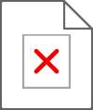
Benefits of Cloud Computing
No Hardware Maintenance
High Scalability
Cloud providers handle physical infrastructure, hardware upgrades, and facility management
Auto-scaling adjusts resources instantly based on traffic, from zero to thousands of servers in minutes
Cost-Efficient
High Availability
Convert capital expenses to operational costs, pay only for what you use, and eliminate idle resources
Global infrastructure with redundancy ensures 99.9% uptime and minimal service disruption
Faster Deployments
Disaster Recovery
Launch new services in minutes instead of weeks, accelerating time-to-market for applications
Built-in redundancy and automated backups across multiple geographic locations ensure data protection

Slide 7
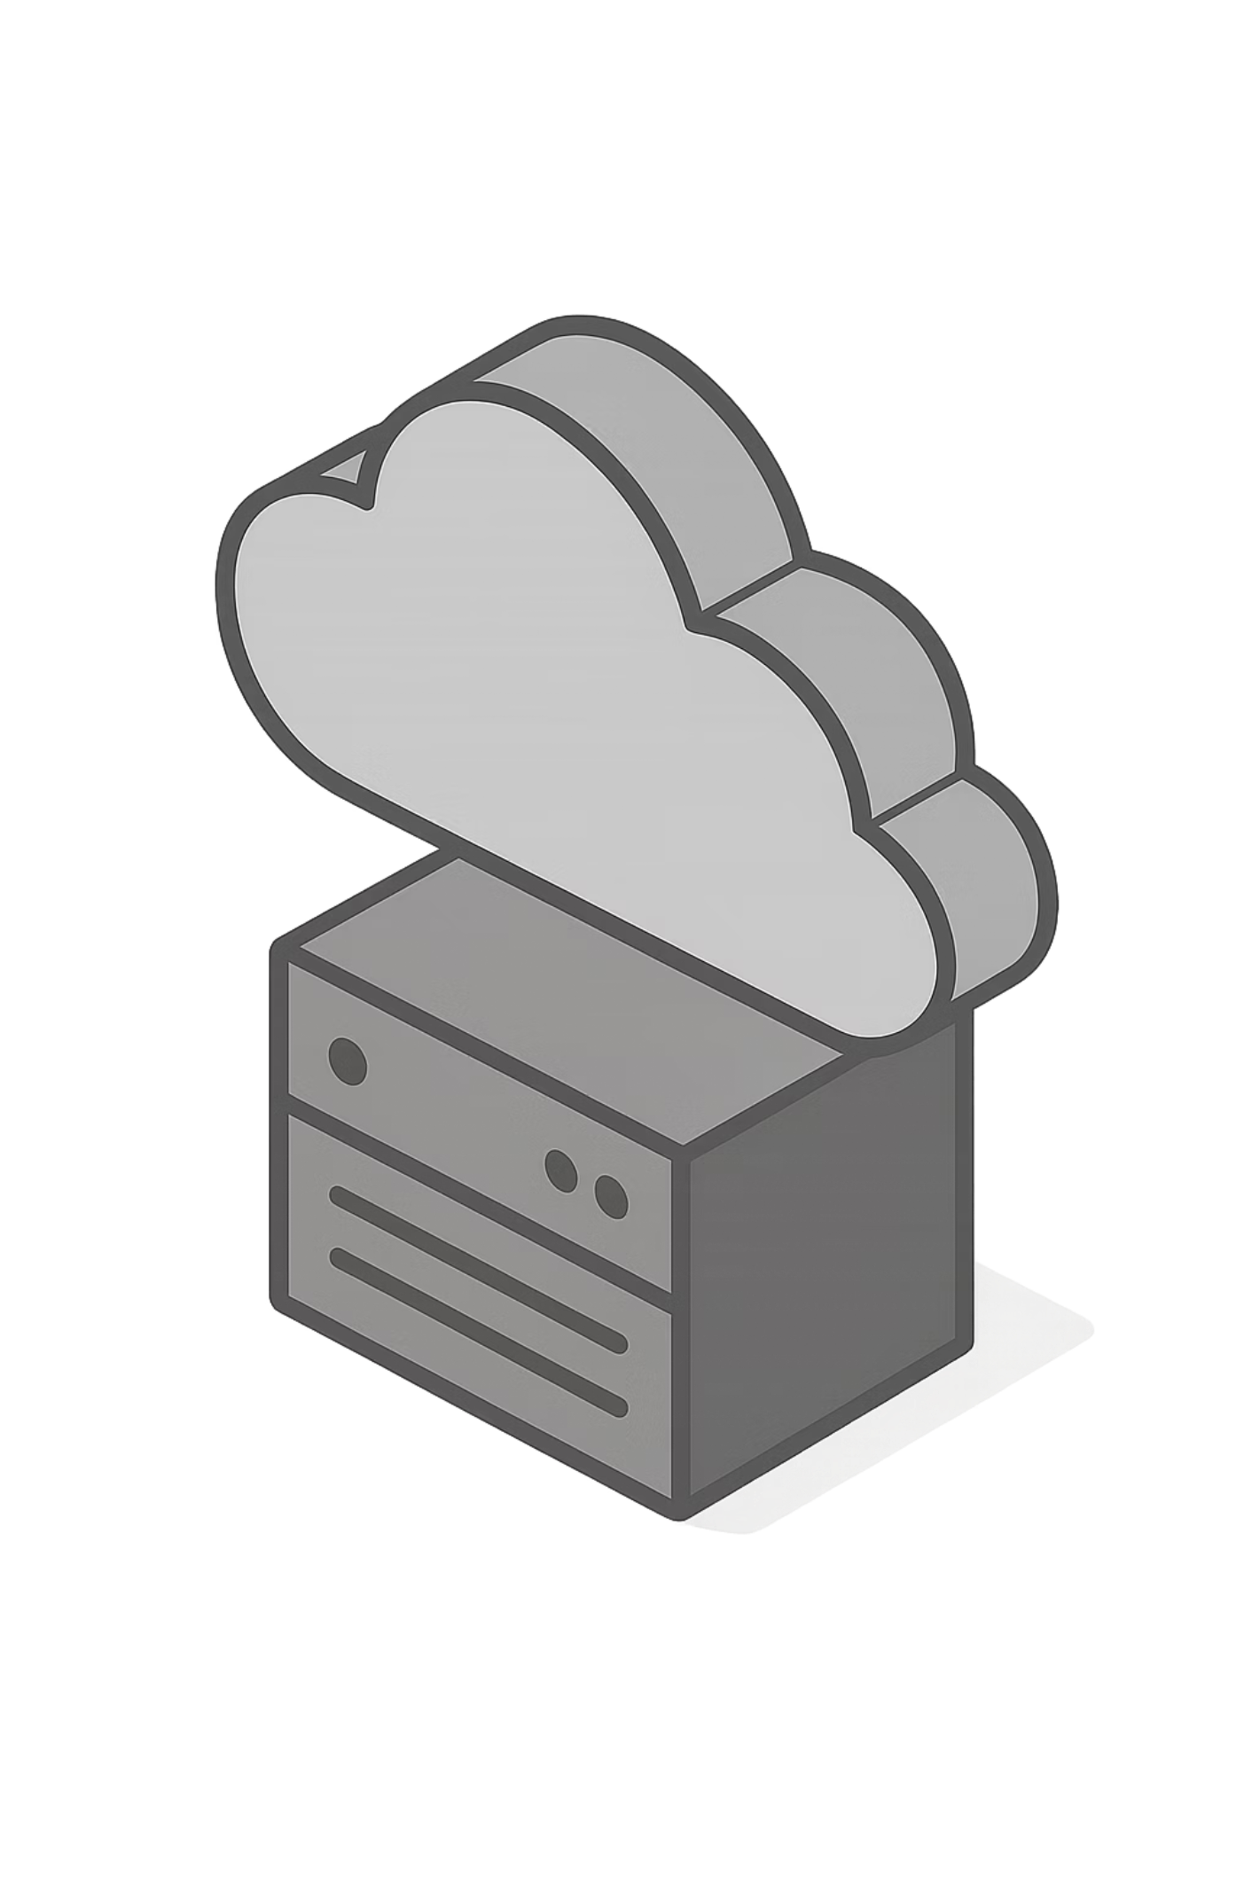


Cloud Providers & Market Leadership
Amazon Web Services
Market leader with the most comprehensive service portfolio and global infrastructure
Microsoft Azure
Strong integration with Microsoft products, growing rapidly in enterprise adoption
Google Cloud Platform
Leading in data analytics, machine learning, and developer-friendly tools
Alibaba Cloud
Dominant player in Asia with expanding global presence and competitive pricing
Market Insight: AWS maintains approximately 30% market share, followed by Azure (~22%) and GCP (~10%). The cloud market continues to grow at 20%+ annually as organizations accelerate digital transformation.

Slide 8

Types of Cloud Services
IaaS, PaaS, SaaS Explained Simply
Cloud computing offers different service models based on how much responsibility you want. Think of it like renting a place to live - you can rent an empty apartment (IaaS), a furnished apartment (PaaS), or a hotel room (SaaS). Each model gives you different levels of control and convenience.
IaaS: Infrastructure as a Service
PaaS: Platform as a Service
SaaS: Software as a Service
You manage applications only
Provider manages everything
You manage applications & data
The right model depends on your needs, expertise, and how much control you want.

Slide 9
What is IaaS (Infrastructure as a Service)?
IaaS provides virtualized computing resources over the internet. You rent servers, storage, and networking - like renting an empty apartment where you design and furnish everything yourself.
You Control:
Provider Controls:
Applications
Data
Runtime environment
Middleware
Operating System
Virtualization
Servers
Storage
Networking
Physical infrastructure
Real-World Example:
AWS EC2 - You get a blank virtual server. You install your own operating system, databases, and applications. Maximum control, maximum responsibility.
Real-Life Analogy:
Like renting an empty house - you own the furniture, decor, and everything inside. You're responsible for maintenance and setup.
Use Cases:
Custom application development
DevOps and automation
Full control over infrastructure
Complex enterprise setups

Slide 10
What is PaaS (Platform as a Service)?
PaaS provides a complete development and deployment environment in the cloud. Like renting a fully furnished apartment - everything is ready, you just need to move in and use it.
You Control:
Provider Controls:
Applications
Data
Runtime environment
Middleware
Operating System
Virtualization
Servers
Storage
Networking
Real-World Example:
Azure App Service - You write your code, upload it, and the platform handles deployment, scaling, and infrastructure. Focus on coding, not infrastructure.
Real-Life Analogy:
Like renting a fully furnished apartment - everything is ready to use. You just bring your belongings and live there. Less responsibility, more convenience.
Use Cases:
Rapid application development
Web application hosting
API development and management
Microservices architecture
Faster time-to-market

Slide 11
What is SaaS (Software as a Service)?
SaaS delivers fully managed applications over the internet. You access software through a web browser - like staying in a hotel where everything is provided and managed for you.
You Control:
Provider Controls:
User accounts
Data (sometimes)
Applications
Data management
Runtime environment
Middleware
Operating System
Virtualization
Servers
Storage
Networking
Real-World Examples:
Gmail - Check email from any browser. No installation, no maintenance. Google handles everything.
Salesforce - CRM software accessible online. No servers to manage.
Google Docs - Create documents online. Automatic saving and sharing.
Real-Life Analogy:
Like staying in a hotel - everything is provided and managed. You just check in, use the services, and check out. Zero responsibility for maintenance.
Use Cases:
Email and communication
Productivity tools
CRM and business applications
Collaboration platforms
No IT expertise needed

Slide 12
Key Takeaways: Choosing the Right Model
Understanding the differences between IaaS, PaaS, and SaaS is crucial for selecting the cloud solution that best fits your needs.
Maximum Control
Best For: Developers who need full control over infrastructure
Example: AWS EC2, Microsoft Azure VMs
Remember: "You manage everything except the physical hardware"
Balanced Approach
Best For: Web developers who want to focus on coding
Example: Heroku, Google App Engine
Remember: "Provider handles infrastructure, you handle applications"
Maximum Convenience
Best For: Business users who want ready-to-use applications
Example: Gmail, Salesforce, Slack
Remember: "Provider handles everything, you just use it"
Choose IaaS if you need maximum control and flexibility. Choose PaaS if you want to focus on development. Choose SaaS if you want simplicity and ease of use.

Slide 13
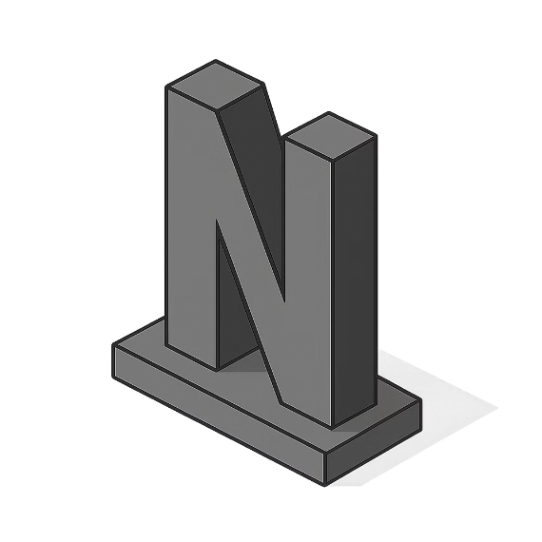
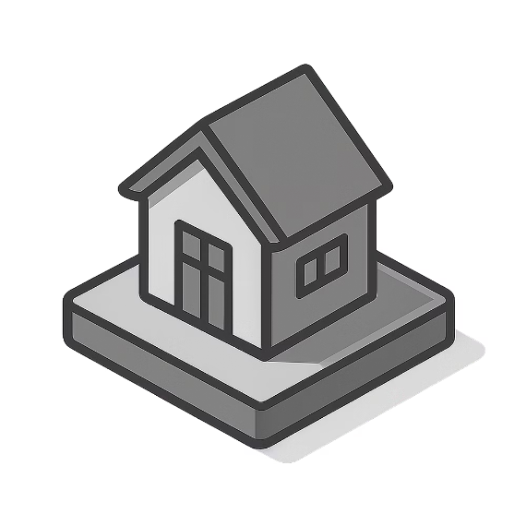


Companies Using AWS
Leading global enterprises trust AWS for mission-critical workloads, demonstrating reliability at scale.
Netflix
Airbnb
Snap Inc.
Meta Platforms
Streams billions of hours monthly using AWS infrastructure for content delivery and analytics
Manages millions of listings and bookings with AWS's scalable platform and global reach
Processes billions of messages and AR filters daily on AWS infrastructure
Runs Facebook, Instagram, and WhatsApp services leveraging AWS for various workloads

Slide 14
Key Takeaways
Cost Optimization
Cloud converts large upfront expenses into predictable operational costs, improving cash flow and budgeting
Scalability
Resources scale automatically with demand, eliminating capacity planning challenges and hardware procurement delays
Operational Efficiency
Global Reach
IT teams focus on innovation rather than infrastructure maintenance, accelerating development and deployment cycles
Deploy applications worldwide with low latency using cloud provider's distributed data centers and CDN networks

Slide 15
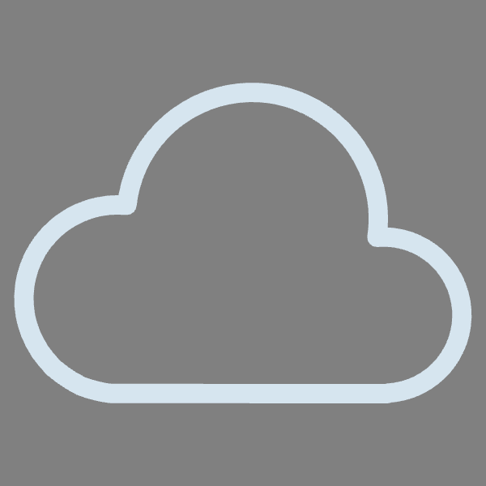


Types of Cloud Deployment Models
Public, Private, and Hybrid Cloud Explained
Public Cloud
Private Cloud
Hybrid Cloud
Key Point: Shared Infrastructure
Key Point: Dedicated Infrastructure
Key Point: Combination Model
Computing resources shared by multiple organizations. You access services over the internet on a pay-as-you-go basis.
Computing resources dedicated exclusively to a single organization. Hosted on-premises or by a third-party provider.
Mix of public and private cloud resources. Organizations use both for flexibility, scalability, and control.
Example: AWS, Microsoft Azure, Google Cloud
Example: VMware, OpenStack, Microsoft Azure Stack
Example: AWS Outposts, Azure Stack, Google Anthos
Like staying in a hotel - shared facilities, managed by provider, cost-effective
Like owning your own house - exclusive, full control, higher maintenance
Like having both a house and a hotel membership - flexibility and choice
Best For: Startups, small businesses, cost-conscious organizations
Best For: Large enterprises, regulated industries, security-sensitive organizations
Best For: Enterprises needing flexibility, data-sensitive + scalable workloads
Characteristics:
Most cost-effective
Highly scalable
Limited customization
Shared security responsibility
Characteristics:
Characteristics:
Maximum control
Enhanced security
Higher costs
Full customization
Best of both worlds
Flexible deployment
Complex management
Balanced cost and control
Choose Public Cloud for cost-efficiency, Private Cloud for security and control, or Hybrid Cloud for maximum flexibility.

