Slide 1


What is EC2 How to launch and connect

Slide 2

Elastic Compute Cloud (EC2)
Elastic Compute Cloud (EC2) is an Amazon web service that provides virtual server hosting in the cloud.
Server is also called as Instance in AWS.
An Amazon Machine Image (AMI) is a template that contains the software configuration (operating system + packages ) required to launch your instance.
A Keypair is used to securely connect to Instance(Virtual Server).
A security group is a set of firewall rules that control the traffic for your instance.
A Port is a communication endpoint to exchange data between devices.
Port range is 0 - 65535

Slide 3
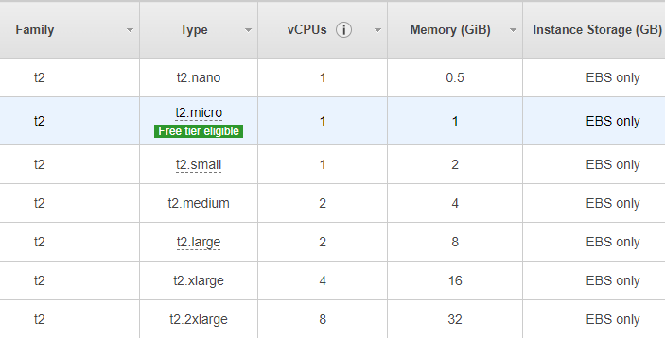
EC2 Instance types

Slide 4
Steps to connect a Linux Server
My Laptop
Instance
Download Putty
ssh
Incoming Traffic
Install Putty
Paste Public Ip ,Private key and user name in Putty
Outgoing Traffic
ssh

