Slide 1

Final Project Learning of Semantically Equivalent Questions
Shreedhar, Harini
Kottapalli, Siva Rama Krishna
CSCI S-89a Deep Learning, Summer 2019
Harvard University Extension School
Prof. Zoran B. Djordjević

Slide 2
Agenda
Problem Statement
Data Source and Papers
Sample Data
Data Preprocessing
Siamese Network
Model Design
Loss Functions
Model Evaluation
Conclusion
What didn’t work
References

Slide 3
Problem Statement
Detecting duplicate questions or semantic equivalence between a pair of sentences.
Implemented Siamese network for Convolutional Neural Network and Bidirectional LSTM with Attention.
Implemented different similarity measures such as Manhattan distance, Euclidean distance, Weighted Euclidean distance, Cosine Similarity etc. to determine the semantic equivalence between pair of sentences/questions.
Explored data augmentation technique to generate more positive samples.

Slide 4
Data Source and Papers
Dataset:
We used Quora dataset to test our models and this can be extended to any other problem if they are in suitable format.
https://www.quora.com/q/quoradata/First-Quora-Dataset-Release-Question-Pairs https://www.kaggle.com/c/quora-question-pairs
Papers:
We built models based on below two recent papers.
Detecting Duplicate Questions with Deep Learning
https://web.stanford.edu/class/archive/cs/cs224n/cs224n.1174/reports/2748045.pdf
Learning Profiles in Duplicate Question Detection
https://ieeexplore.ieee.org/document/8102981

Slide 5
Sample Quora Data
qid1 | qid2 | question1 | question2 | is duplicate
15 | 16 | How can I be a good geologist? | What should I do to be a great geologist? | 1
17 | 18 | When do you use ã‚· instead of ã—? | When do you use "&" instead of "and"? | 0
19 | 20 | Motorola (company): Can I hack my Charter Motorola DCX3400? | How do I hack Motorola DCX3400 for free internet? | 0
21 | 22 | Method to find separation of slits using Fresnel biprism? | What are some of the things technicians can tell about the durability and reliability of Laptops and its components? | 0
23 | 24 | How do I read and find my YouTube comments? | How can I see all my You tube comments? | 1
25 | 26 | What can make Physics easy to learn? | How can you make physics easy to learn? | 1
41 | 42 | Why do rockets look white? | Why are rockets and boosters painted white? | 1

Slide 6
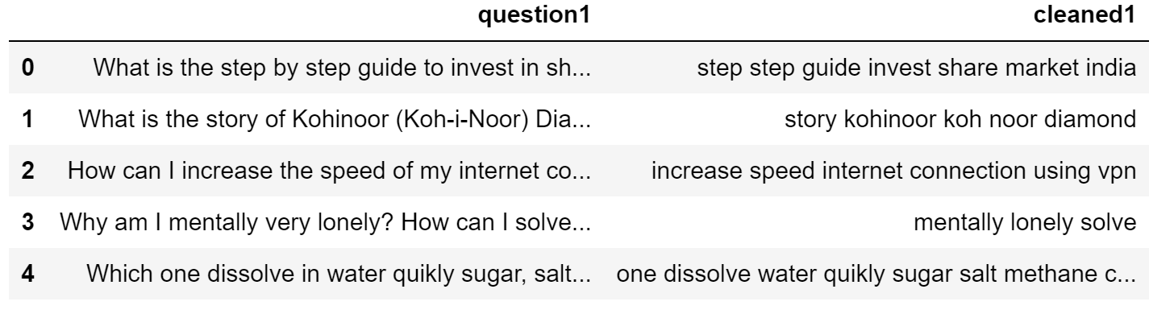
Data Preprocessing
Data Cleaning:
Tokenized and converted all text to lower case.
Converted all words such as “I’m”, “we’ve” to “I am”, “we have” respectively.
Replaced all types of empty characters to a single white space character.
Removed any character other than alphabets from the text.
Removed all stop words from the text.
Added data augmentation process to create more data with duplicate questions.

Slide 7
Siamese Network
Siamese Network consist of two identical subnetworks which share weights while working on two different input vectors to compute comparable output vectors
Output is usually a comparison metric between two inputs such as Euclidean Distance or other similar metrics
Intermediate layers in Siamese Network can be of CNN, LSTM, GRU etc. based on problem and preference.
Different regularization techniques can be employed to improve the model performance and reduce overfitting
Notes:
Source: https://en.wikipedia.org/wiki/Siamese_network

Slide 8
Model Design
Created with two types of RNN and CNN layers. Used LSTM and GRU.
Tested both unidirectional and bidirectional cells.
Used Regularization and drop to avoid overfitting.
We added Bahdanau attention to further improve performance of the model.
Model Tried:
Deep Convolution Network (DCNN)
Single Layer GRU Network
Single Layer LSTM Network
Two Layer GRU Network
Two Layer LSTM Network
Single Layer Bidirectional LSTM Network
Two Layer Bidirectional LSTM Network
* Used only Weighted Manhattan Distance measure as a loss metric in all the above models to check whether question1 and question2 are duplicate.

Slide 9
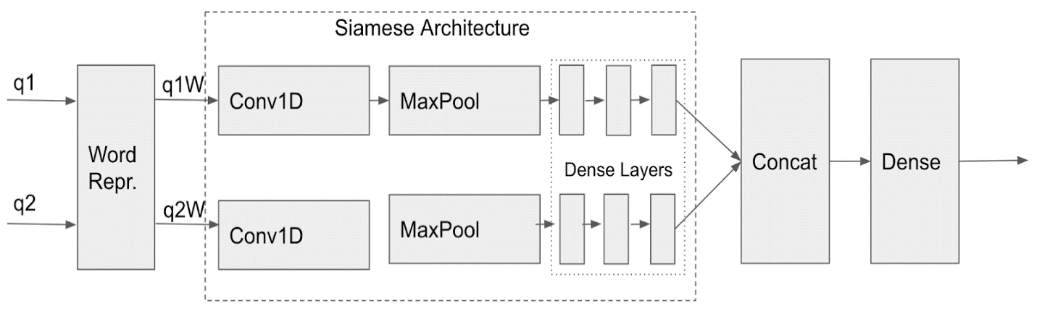
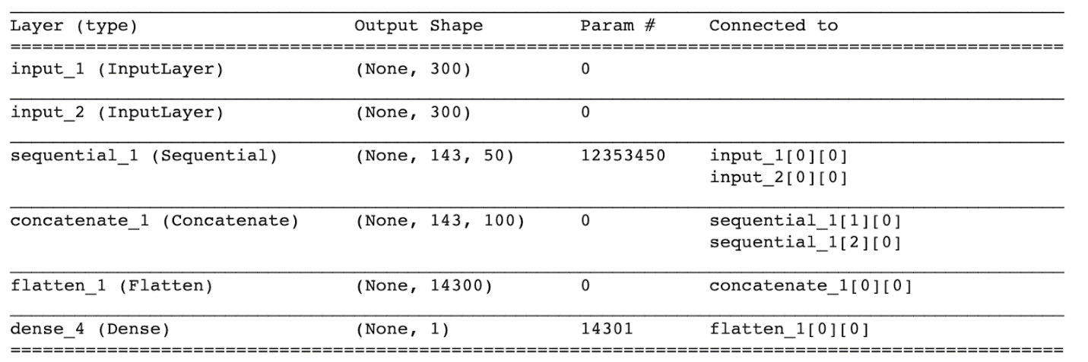
DCNN Siamese Network
Notes:
Source: https://www.semanticscholar.org/paper/A-Deep-Siamese-Neural-Network-Learns-the-Similarity-Rao-Wang/3e16932979250e66cd2cb4d8c9a5411e195273be/figure/0

Slide 10
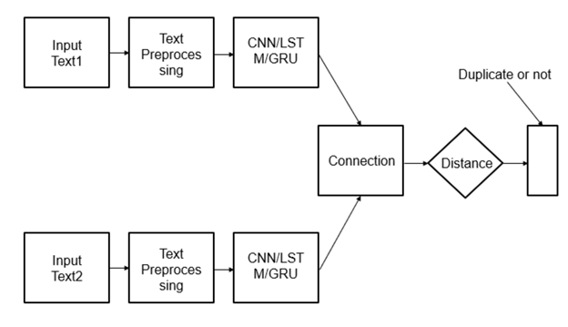
RNN Siamese Network
Notes:
Source: https://www.semanticscholar.org/paper/A-Deep-Siamese-Neural-Network-Learns-the-Similarity-Rao-Wang/3e16932979250e66cd2cb4d8c9a5411e195273be/figure/0

Slide 11
Loss Functions
We tried to create four different loss functions.
Euclidean Distance
Manhattan Distance
Weighted Manhattan Distance
Cosine Similarity
Custom SoftMax Loss Function*
* Tried creating Custom SoftMax Loss function which showed better results when compared to other loss functions. But we couldn’t successfully reproduce the same results for this loss function due to input/output shape compatibility issues. We used Weighted Manhattan Distance in all our models.

Slide 12
DCNN Model Evaluation
DCNN | # 8k pairs | # 20k pairs | # 65k pairs | # 80k pairs | # 140k pairs
# Training parameters | 5,921,750 | 5,927,150 | 14,555,150 | 15,917,750 | 20,426,150
Accuracy | 64.66% | 66.55% | 69.17% | 69.23% | 71.04%

Slide 13
RNN Model Evaluation
 | Model | Accuracy | Precision | Recall | F1 Score
1 | Single Layer GRU Network | 0.88 | 0.86 | 0.96 | 0.91
2 | Single Layer LSTM Network | 0.88 | 0.92 | 0.89 | 0.90
3 | Two Layer GRU Network | 0.89 | 0.88 | 0.96 | 0.91
4 | Two Layer LSTM Network | 0.88 | 0.88 | 0.94 | 0.91
5 | Single Layer Bidirectional LSTM Network | 0.85 | 0.82 | 0.99 | 0.89
6 | Two Layer Bidirectional LSTM Network | 0.88 | 0.93 | 0.88 | 0.90

Slide 14
What didn’t work
Performance would have been better if we had followed word splitting technique used in BERT model.
Validation accuracy increases with increase in training size upto 65k pairs (~4% increase) after which there was only a marginal improvement in accuracy. This is due to overfitting,
The cosine loss function and SoftMax did not provide good results on validation accuracy, as a result a concatenate layer was implemented for the DCNN.
Didn’t change tokens present in glove file to ‘UKN’ token
Custom SoftMax loss function didn’t work due to issues with shape of the input vectors. There is a shape mismatch between some of the layers while creating this custom loss function.
Didn’t work on finding optimal hyper parameters.

Slide 15
References
Topic : Learning of Semantically Equivalent Questions
Team :
Kottapalli, Siva Rama Krishna
Shreedhar, Harini
Two minute (short) video:
https://youtu.be/4VXuwaei38w
Reference Links: (Data, Papers, Pretrained Glove, GitHub, etc.)
https://www.quora.com/q/quoradata/First-Quora-Dataset-Release-Question-Pairs https://www.kaggle.com/c/quora-question-pairs
https://web.stanford.edu/class/archive/cs/cs224n/cs224n.1174/reports/2748045.pdf
https://ieeexplore.ieee.org/document/8102981
https://nlp.stanford.edu/projects/glove/
* Didn’t include complete list of references here. Please see the report for full list of references

