Slide 1









DIGITAL PORTFOLIO
STUDENT NAME: G.HARINISRI NMID:03C238493DFD187B1EA4FA05C087DFE8 DEPARTMENT: BCA-II Year
COLLEGE: GOVERNMENT ARTS COLLEGE
1

Slide 2
PROJECT TITLE
Digital Portfolio
A Digital Portfolio is a personal website that displays an individual’s skills, education, projects, and achievements in a well-organized and attractive format.
It is designed using HTML, CSS, and optionally JavaScript to create a simple and responsive layout.
2

Slide 3



AGENDA
Problem Statement
Project Overview
End Users
Tools and Technologies
Portfolio design and Layout
Features and Functionality
Results and Screenshots
Conclusion
Github Link
3/21/2024 Annual Review
3

Slide 4

PROBLEM
STATEMENT
Problem statement
To design and develop a personal portfolio website for a BCA student that displays details such as profile, education, skills, and contact information in a simple and responsive manner.
The website should:
Provide smooth navigation across sections like Home, About, Skills, Education, and Contact.
Present information clearly with an attractive layout. Work on
4

Slide 5

PROJECT
OVERVIEW
Project Overview – Digital Portfolio Website
Project Title:Personal Digital Portfolio G.HARINISRI BCA Student
Objective: To design and develop a responsive portfolio website to showcase academic background, skills, and contact details professionally.
5

Slide 6

WHO ARE THE END USERS?
Potential Employers / Recruiters
To review your skills, education, and contact information for internships or job opportunities.
College Faculty / Academic Evaluators
To assess your project work, presentation, and technical knowledge.
Peers / Collaborators
Fellow students, developers, or friends who may want to collaborate on projects.
General Visitors
Anyone interested in learning about your background, skills, and academic journey.
8

Slide 7

TOOLS AND TECHNIQUES
Tools Used
HTML5 – Structure and content of the website.
CSS3 – Styling, layout, and visual design.
Font Awesome – Icons for navigation and sections.
JavaScript – Interactivity (menu toggle,
form handling).
Code Editor(codepen/ easy coder web)–
For writing and edit Chrome code.
Web Browser(Chrome)– For testing and running the website.
9

Slide 8
POTFOLIO DESIGN AND LAYOUT
Design
Minimal & Professional Look – Clean and simple interface with a focus on content.
Font Awesome Icons– For visual appeal and navigation clarity.
Color Scheme – Soft background with readable text contrast.
Typography – Clear headings and readable body text.
11

Slide 9
FEATURES AND FUNCTIONALITY
Functionality
Smooth Scrolling between sections using navigation links. Clickable Social Media Buttons to redirect to LinkedIn.
Form Submission to collect visitor messages (can be linked to email or database in future).
Mobile-Friendly Layout ensuring proper alignment across all devices.

Slide 10
RESULTS AND SCREENSHOTS
Results
A fully functional personal digital portfolio website was created.
Showcases profile, education, skills, and contact information in
an interactive layout.
Responsive design works seamlessly on desktop and
mobile devices.
3/21/2024
^{Annual Revie}•^{w} Provides easy navigation and direct LinkedIn integration.
15

Slide 11
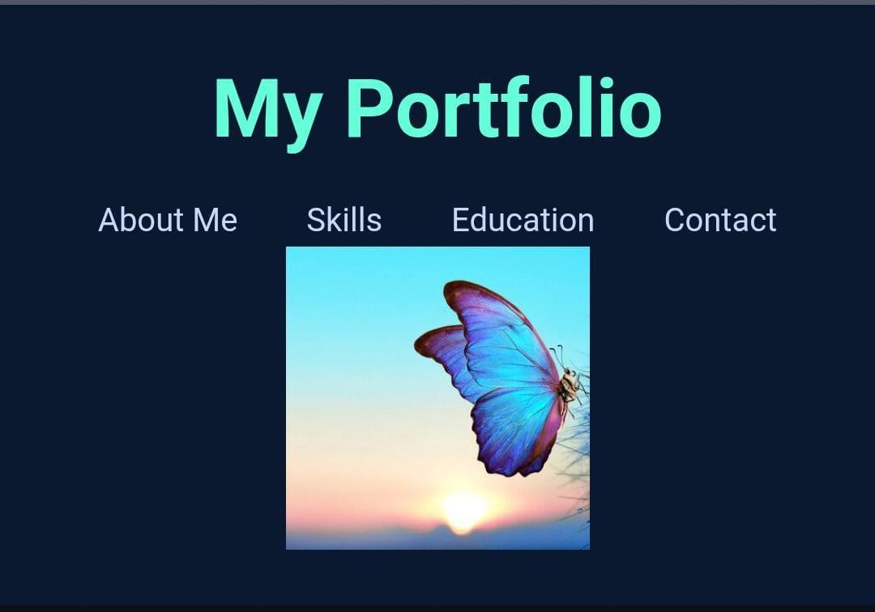
SCREENSHOT
Homepage– Showing name, title, and avatar.

Slide 12
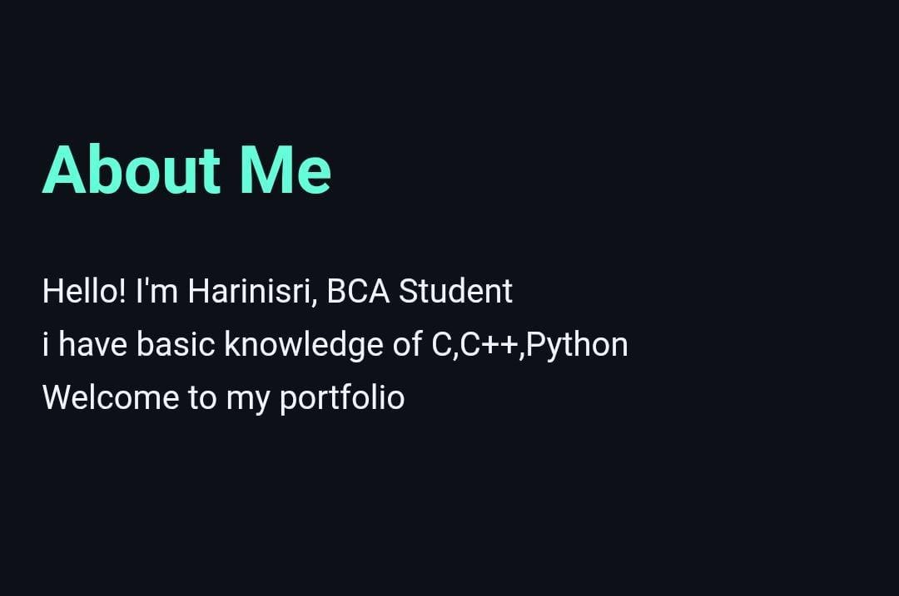
About Section – Displaying bio and highlights.

Slide 13
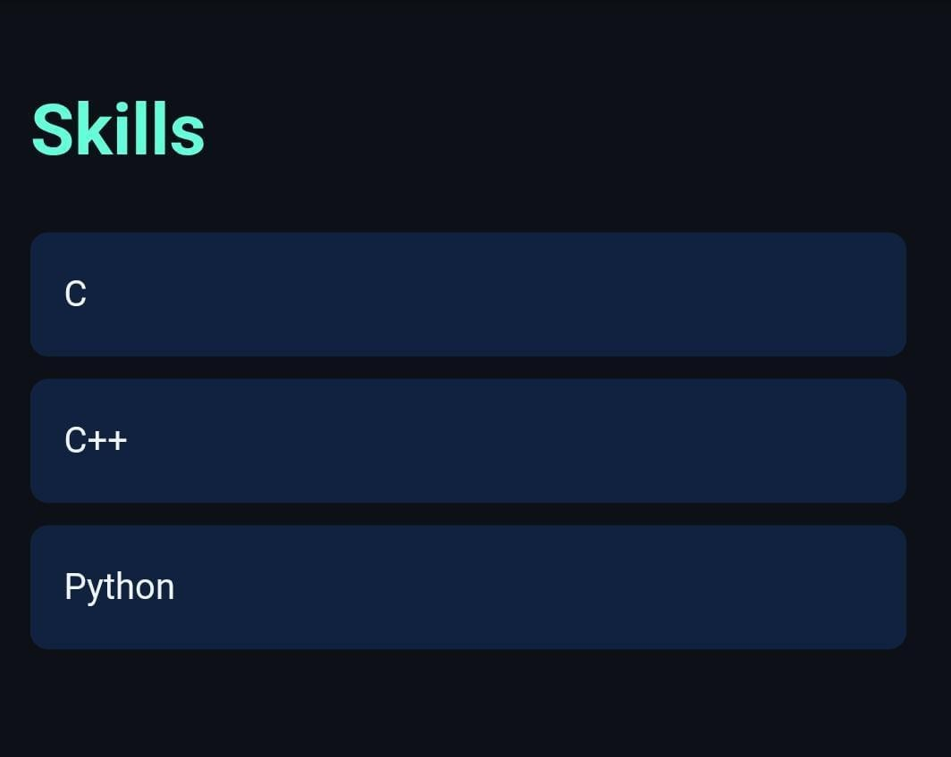
Skills Section – Listing programming languages.

Slide 14
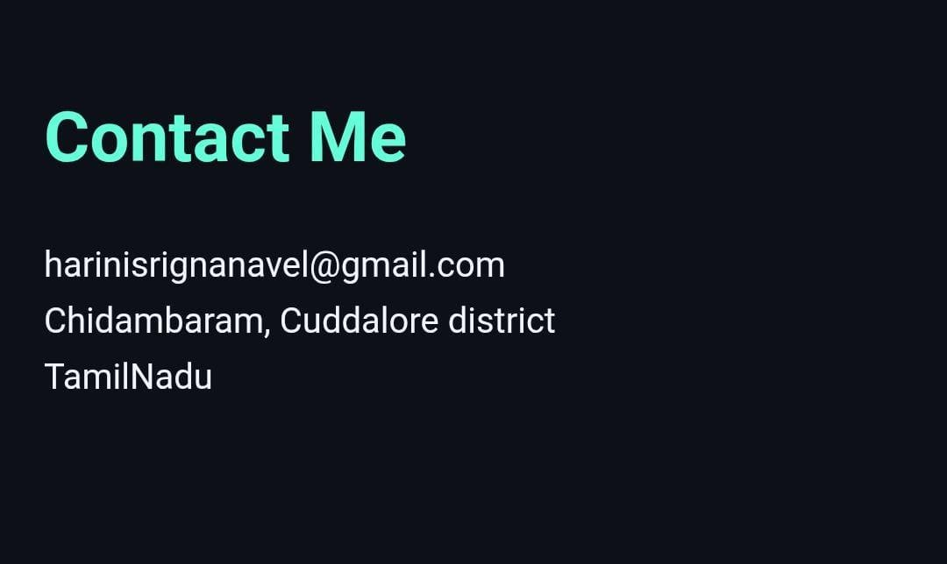
Contact Section – Email, LinkedIn, and contact form.

Slide 15
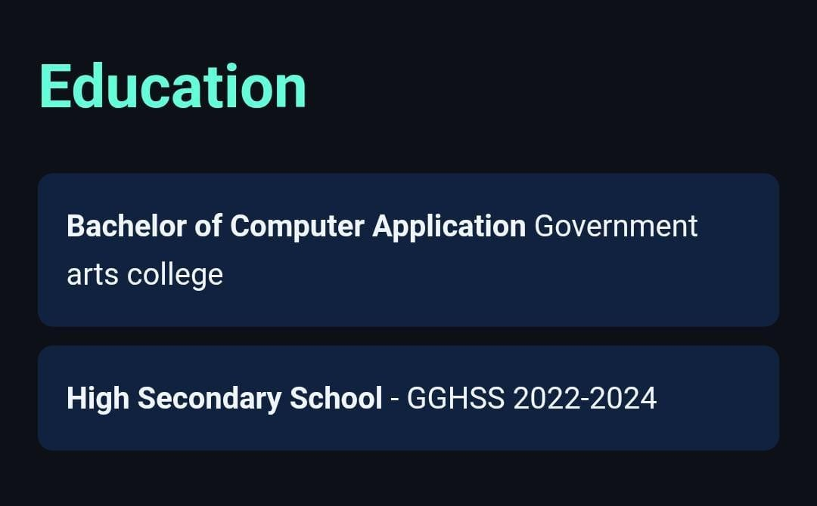
Education Section – College name, course, and highlights.

Slide 16
CONCLUSION
Conclusion for Digital Portfolio Project
“The Digital Portfolio effectively showcases my personal profile, academic background, technical skills, and career aspirations in an organized and visually appealing format. It serves as a professional platform for potential employers, faculty, and collaborators to learn about my abilities and achievements. The project demonstrates my knowledge of web development using HTML, CSS, and JavaScript and highlights my capability to create user-friendly and responsive designs.”
“THANK YOU”
21

