Slide 1
SALES & ORDER MANAGEMENT
ANALYTICS SYSTEM
Data Analytics Project
Student
HARINI.V
Department
AI&DS
Academic Year
2026

Slide 2
Project Objective
Build a relational sales and order management database.
Store customers, products, orders, order items and payment information.
Use SQL to perform CRUD, joins, aggregations and advanced analytics.
Create a Power BI dashboard to communicate sales and order performance.
2

Slide 3
Database & Dataset Overview
Customers
Customer details, city and signup date
Products
Product name, category, price and stock
Orders
Order date, status and total amount
Order Items
Products, quantities and unit prices
Payments
Payment date, amount and payment status
3

Slide 4
Database Relationships
CUSTOMERS
ORDERS
ORDER_ITEMS
PAYMENTS
PRODUCTS
Primary keys and foreign keys connect customers, orders, products, order items and payments.
4

Slide 5
SQL Implementation
CRUD
CREATE, READ, UPDATE and DELETE operations
Joins
Combine related tables for reporting
Aggregations
SUM, COUNT, AVG, GROUP BY and HAVING
Subqueries & CTEs
Build reusable analytical queries
Window Functions
Ranking, running totals and LAG()
Views & Indexing
Reusable reports and query optimization
5

Slide 6
Business Analytics
Monthly revenue analysis using completed orders.
Top products based on quantity sold.
Customer spending and customer ranking.
Order status and payment status analysis.
Month-over-month revenue comparison using LAG().
6

Slide 7
Power BI Dashboard
Page 1 — Sales Overview
Sales amount
Order count
Customer count
Sales trend
Page 2 — Customer & Product Analysis
Customer performance
Payment status
Product category analysis
Order details table
Page 3 — Sales Performance Summary
Order status distribution
Sales by order status
Revenue summary
7

Slide 8
Key Insights from the Dataset
The dataset contains 10 customers and 10 orders.
Orders span January to April 2026.
Completed orders are used for completed-sales trend analysis.
Payment records include PAID, PENDING and REFUNDED statuses.
SQL and Power BI provide both detailed records and visual summaries.
8

Slide 9
Project Outcome & Future Scope
Project Outcome
A structured relational database was created and analyzed using SQL. A Power BI dashboard was developed to present sales, customer, product and order information.
Future Scope
Add more real-world transaction data, automated ETL, scheduled refresh, advanced KPIs, predictive analytics and interactive business reporting.
9

Slide 10
THANK YOU
Sales & Order Management Analytics System
10

Slide 11
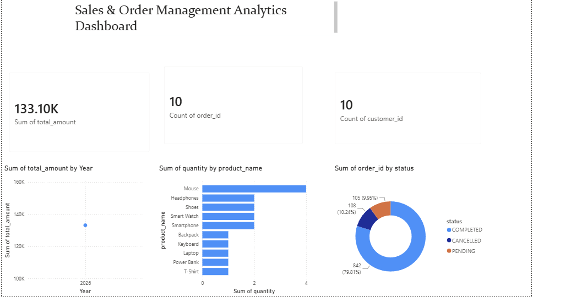
Power BI Dashboard – Page 1

Slide 12
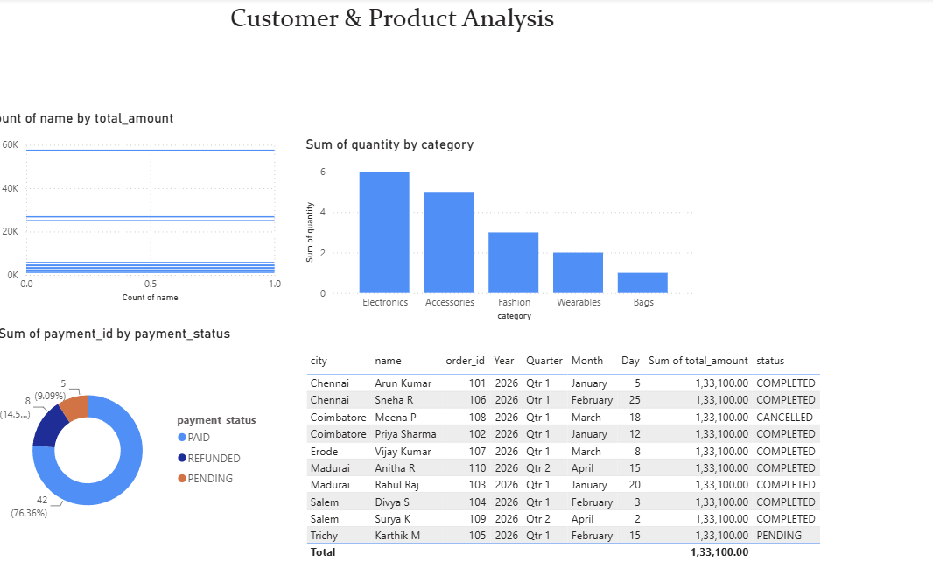
Power BI Dashboard – Page 2

Slide 13
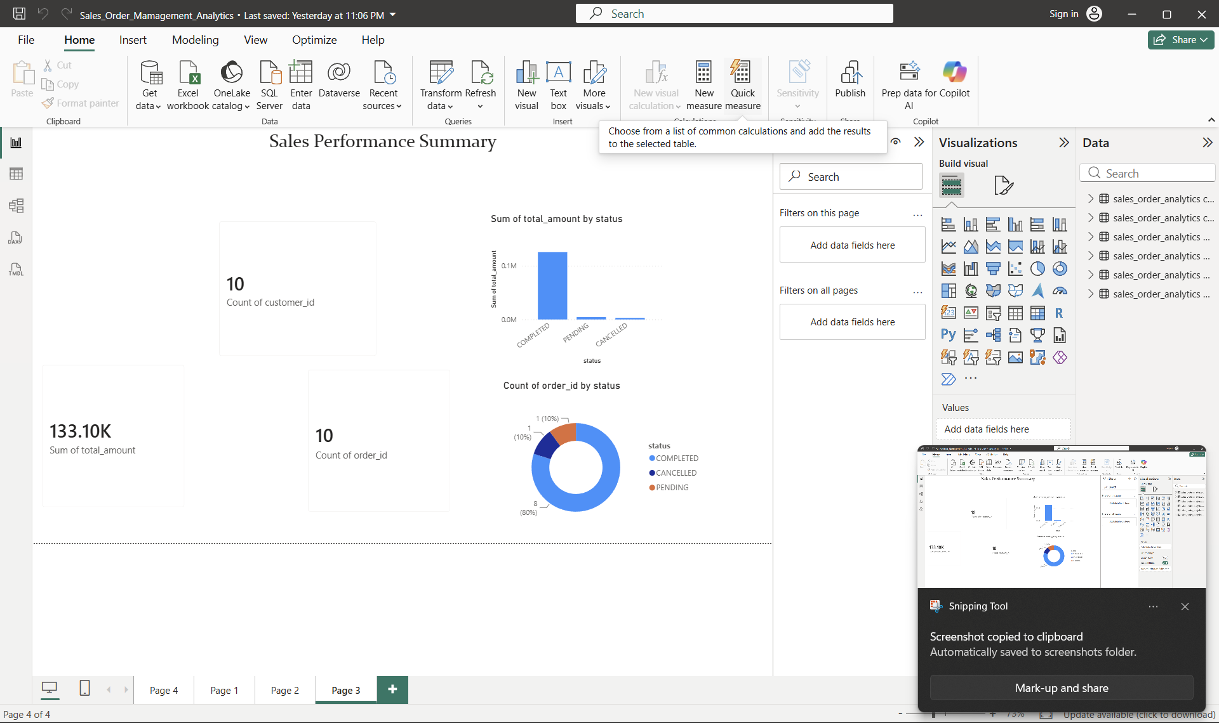
Power BI Dashboard – Page 3

