Slide 1
LIST OF CHANGES
Slide 10,11,12,13 – Results for Classification added along with testing time
Slide 16 – Results for edge detection added

Slide 2
Student Distillation for high-end compute-intensive DL process to run on low-end GPU
- CS6350 – TPA - 14
Suryaa Thirumurugan (EE23B077)
Shree Hari MG (ME23B201)

Slide 3
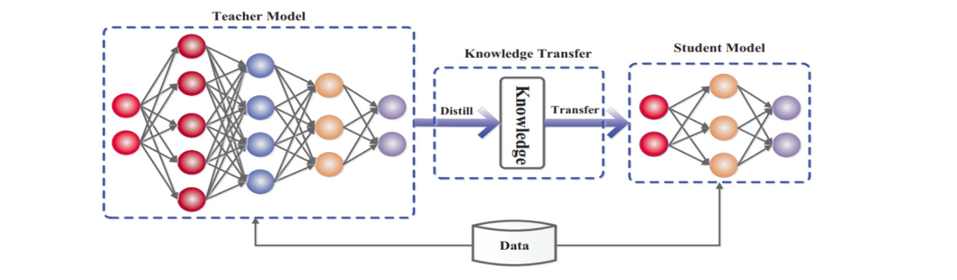
Problem Statement
  Deep learning models (ResNet101, HRNet) achieve high accuracy but are too large for edge devices
  Deploying these large models on mobile and embedded edge devices is difficult due to:
    Limited memory
    Low compute power
    Power constraints
  Core Trade-off
High Accuracy ⟺ Model Efficiency
Need a way to compress models without losing performance.

Slide 4
What is Student Distillation?
Teacher Network
A large, highly accurate, pre-trained model.
Student Network
A much smaller, efficient model designed for deployment.
Soft Knowledge Transfer
The teacher generates soft targets (probabilities with temperature scaling), which contain richer information than hard labels.
Goal
Train the student to mimic the teacher’s decision boundaries, improving accuracy compared to training from scratch.

Slide 5
Architecture Diagram :
Teacher Model → Soft Targets
  Outputs probability distribution softened using temperature T
  Contains inter-class relationships
Student Model → Learns From
  Soft targets from Teacher
  Hard labels from dataset
Loss Function Illustration:
Where:
  : Knowledge distillation loss
  : Cross-entropy loss (hard labels)
  : Balance factor (0–1)

Slide 6
LOSSES
Task 1: Standard Knowledge Distillation with ResNet101 Teacher (Classification)
Loss functions used:
  Distillation Loss (KL Divergence): Measures the divergence between teacher and student softened outputs (temperature-scaled).
  Cross-Entropy Loss: Standard hard-label loss on student predictions.
Combined Loss:
where , .
Task 2A: Image Restoration Through Knowledge Distillation (Super-Resolution)
Loss functions used:
  L1 Reconstruction Loss: Pixel-wise distance between student output and ground truth.
  Teacher Feature Matching Loss: distance between intermediate teacher and student feature maps.
  Perceptual Loss: Distance between VGG feature representations to capture perceptual similarity.
Combined Objective:
Task 2B: Edge Detection Through Knowledge Distillation
Loss functions used:
  Hard Target Loss: Weighted binary cross-entropy with position weight (e.g., 10.0) to handle class imbalance.
  Soft Target Loss: Mean squared error (MSE) between sigmoid-activated teacher and student probability maps.
Combined Objective: Balanced with between hard and soft supervision losses.

Slide 7
Task 1 - Image Classification (CIFAR-100)
Setup:
  Teacher: ResNet101 (44.5M params, 79.91% acc)
  Student: MobileNetV2 (3.5M params)
  Training: T=4.0, α=0.9, 200 epochs
Key Result:
  Student achieves 69.02% (vs. 60-65% baseline)
  12.7× compression ratio
  ~5-9% improvement with KD
Model | Accuracy | Params | Compression
ResNet101 | 79.91% | 44.5M | 1×
MobileNetV2 | 69.02% | 3.5M | 12.7×

Slide 8
Task 3: Progressive Multi-Generation Distillation
Recursively applies the combined distillation loss from Task 1 across generations
Multi-stage compression: Instead of distilling once from a huge teacher → tiny student, knowledge is transferred gradually through several smaller intermediate models.
Reduced capacity gap: Each student is only slightly smaller than its teacher, making learning easier and reducing the risk of information loss.
Improved stability: Smaller steps between generations improve convergence and reduce training instability common in single-stage distillation.
Better knowledge retention: Each generation preserves the teacher’s decision boundaries more effectively, enabling the final tiny student to maintain higher accuracy.
Extreme compression possible: By repeating distillation over multiple stages, the model can be shrunk to a very small size while still keeping useful performance.
Each smaller student is trained using combined from its immediate teacher.
Hyperparameters match Task 1: mostly KL divergence plus cross-entropy with temperature and .

Slide 9
Progressive Distillation Results — Key Observations
Generation 1 (Teacher → Student)
  Accuracy: 79.91%
  Parameters: 44.5M
  Acts as the strong baseline model before compression.
Generation 2 (Student of Gen-1 = Teacher for Gen-3)
  Accuracy drops to 69.02%, but
  Model shrinks dramatically to 2.35M parameters
  Achieves 19× compression with still usable performance.
Generation 3 (Final Tiny Student)
  Accuracy remains relatively high at 67.87%
  Model size reduced to 0.82M parameters
  Achieves 54× compression compared to the original.
Overall Insight
  Despite extreme compression (from 44.5M → 0.82M), accuracy decreases only ~12%.
  Progressive distillation enables massive size reduction with controlled accuracy loss.

Slide 10
Results - (Time and Accuracy)
----------------------------------------------------------------------------
Model Name | Accuracy | Time (s) | FPS
----------------------------------------------------------------------------
Teacher (ResNet101) | 85.43 % | 11.91 | 840
Student (MobileNetV2 1.0x) | 69.02 % | 0.93 | 10729
Tiny Student (MobileNetV2 0.5x)| 67.86 % | 0.55 | 18050
-----------------------------------------------------------------------------
Note : The results are based on test dataset of 1000 images from cifar-100
Results shown in the next slide

Slide 11
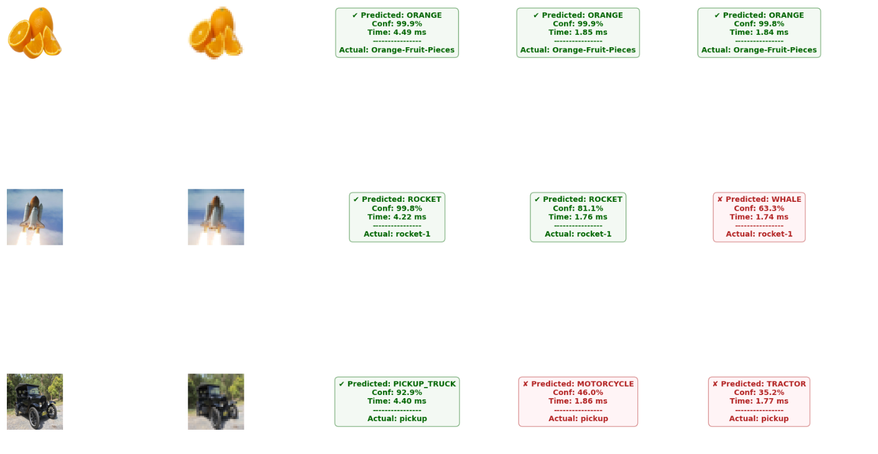

Slide 12
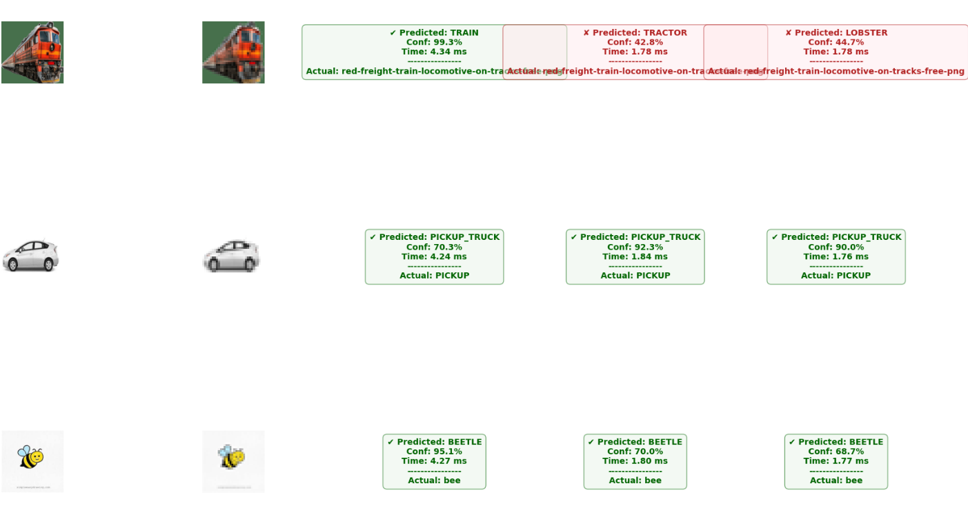

Slide 13
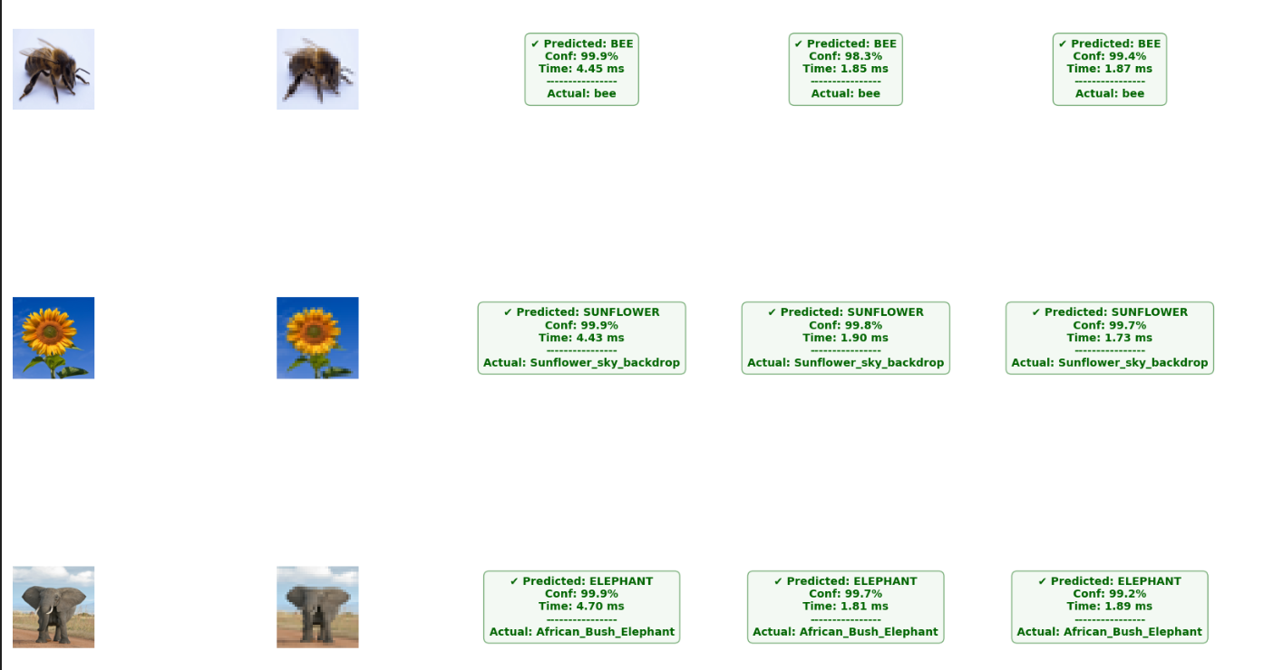

Slide 14
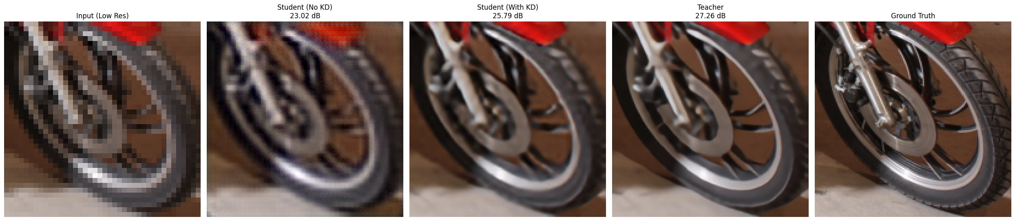
Task 2A - Image Restoration
Image Super-Resolution (4× Upscaling) – Dataset DIV2K
Setup:
  Teacher: SwinIR (transformer-based)
  Student: AttentionStudentSRNet (compact)
  Loss: L1 + Feature matching + Perceptual
Key Result:
  Student: 25.79 dB (+2.76 dB vs. baseline)
  86% gap closed to teacher (27.26 dB)
  5.4% performance loss with significant compression

Slide 15
Task 2B - Edge Detection
Method description left, qualitative results + Dice score comparison right
Dataset - BSDS500 (Berkeley Segmentation Dataset)
Setup:
  Teacher: U-Net + ResNet34 backbone
  Student: U-Net + MobileNetV2 (50-60% smaller)
  Loss: Weighted BCE + Soft target MSE
Key Result:
  Student: 0.7226 Dice (99.4% of teacher)
  +2.54% improvement vs. baseline (0.7047)
  Handles class imbalance effectively

Slide 16
