Slide 1

WELCOME TO
THE PROJECT ON
“LIBRARY MANAGEMENT SYSTEMS.”
PREPARED BY:
HARIOM NATHANI
(IT 2nd yr)
MANMAY GHOSH
(IT 2nd yr)
In the guidance of:
Abhishek Agnihotri Sir
Lecturer,Dr. AITH, Kanpur

Slide 2

CONTENTS OF THE PROJECT
HISTORY
INTRODUCTION
PURPOSE
MODULES
DETAILS ABOUT ALL THE FUNCTION USED IN THE PROJECT
ADVANTAGES
DISADVANTAGES
SNAPSHOT OF OUTPUT RESULT
CONCLUSION

Slide 3
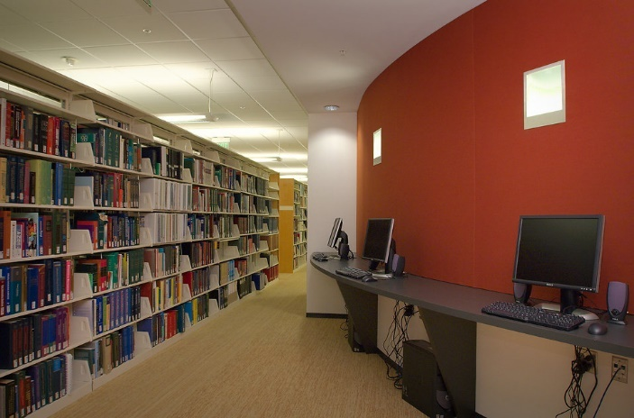
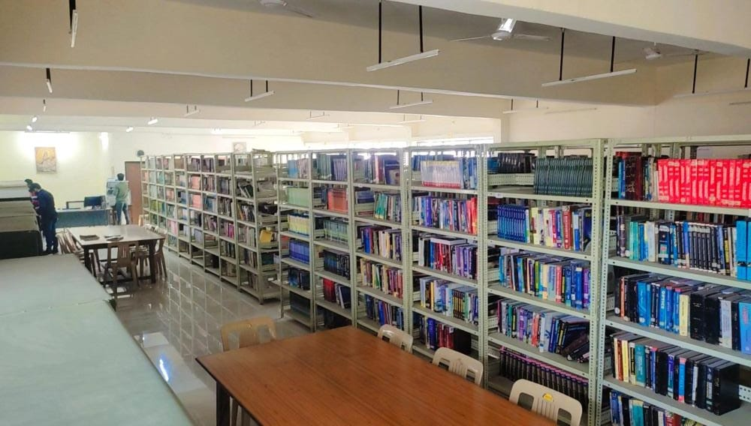
When libraries began developing in India during the early nineteenth century, they were a western product. In 1808, the Government of Bombay proposed to register libraries, which were to be given copies of books published from the “funds for the encouragement of literature”.
Library is a building or room containing collections of books, periodicals, and sometimes films and recorded music for use or borrowing by the public or the members of an institution.

Slide 4
INTRODUCTION TO LIBRARY MANAGEMENT SYSTEM
A library management system is software that is designed to manage all the functions of a library.
It helps librarian to maintain the database of new books and the books that are borrowed by members along with their due dates.
This system completely automates all your library's activities

Slide 5
Purpose To Build Library Management System
The system helps both students and library manager to keep a constant track of all the books available in the library.
It allows both the admin and the student to search for the desired book.
It becomes necessary for colleges to keep a continuous check on the books issued and returned and even calculate fine.

Slide 6
MODULES
Borrow books: A person can borrow the books for particular days. All the information will be entered in the system. If the person does not return the books before due date, fine will be added in the visitor's information.
Login registration: The username and password will be provided to the librarian.

Slide 7
Use of add_books and view_books function
add_books function opens the binary file in append mode and writes the book and its details. Once you enter a detail it stores in the file but did not delete the previous record.
view_books function opens the file in reading mode and read and display all the stored book details. If there is no book available in the records, then it displays the message record is empty.

Slide 8
Use of Search Books case
Search Books case opens the binary file in reading mode and asks the user to enter either the book id or book name which user wants to search.
If the book is available in the list, it will show the details of the book.

Slide 9
Use of issue_books function
issue_books function opens the binary file in append mode and writes the book and student details.
Once you enter a detail it stores in the file but did not delete the previous record.
Once the book is issued it tells that when the books is to be return and rent for the book to be issued.

Slide 10
Use of update_books function
update_books function opens the binary file in read mode and display the book name and student details.
If you choose to reissue the book it will also display return date and rent to be paid for next issue(reissue).
If you choose to submit the book it will clear all the details from the file so tha next some one else can issue it.

Slide 11
Use of students_details function
students_details function opens the binary file in read mode and display the book and student details.
Since it is open in read mode no change in detail is allowed in this function keeping the rest record as same as it was earlier without any change and display specific results.

Slide 12
Use of change_password function
change_password function opens the file in rb+ mode (reading and writing). It asks the user for the new password.
After taking the password it stores the password in another file to make it more secure.
Now user can use the application with a new password and original username.

Slide 13
Use of tested function
Tested function returns the date of the computer system itself.
This also help in returning the value of return date.
In this function we basically use structure to get day, month and year.
The returning date helps the librarian to now when the issuer has to return the book.

Slide 14
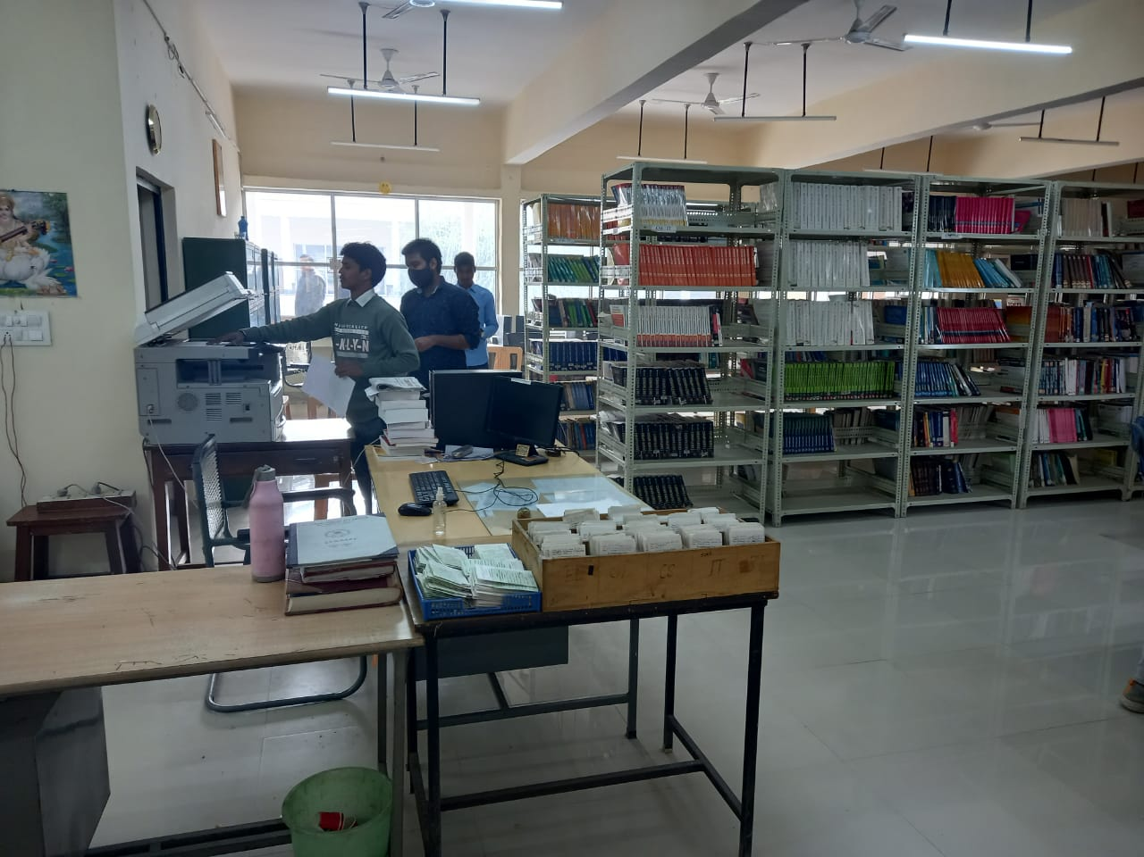
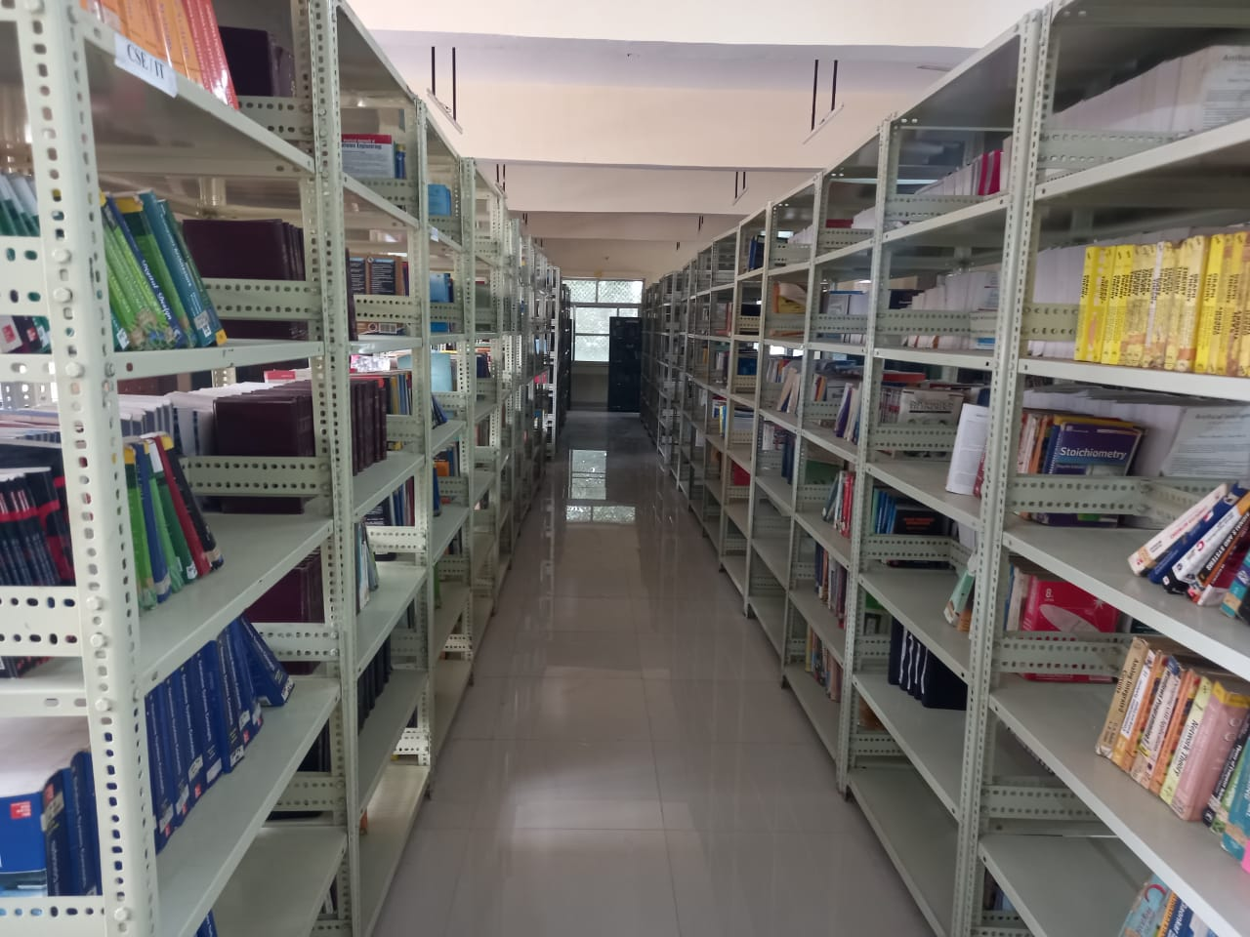
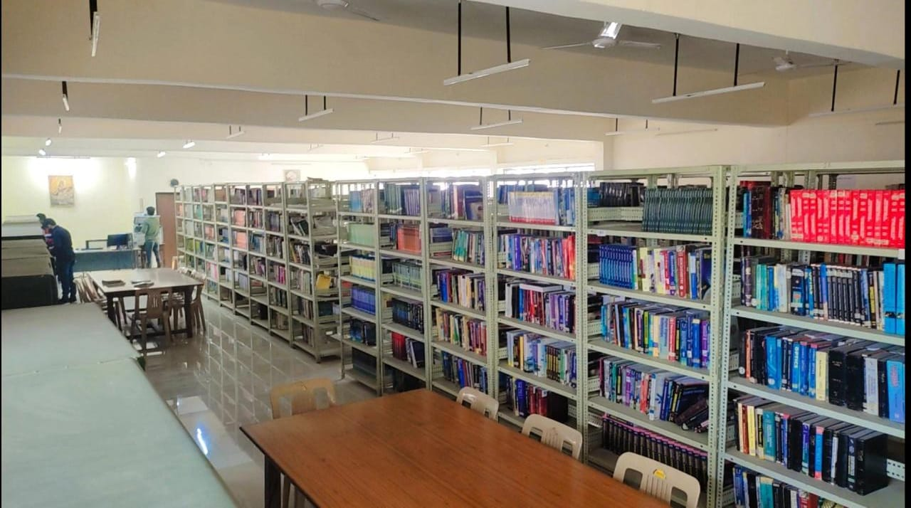
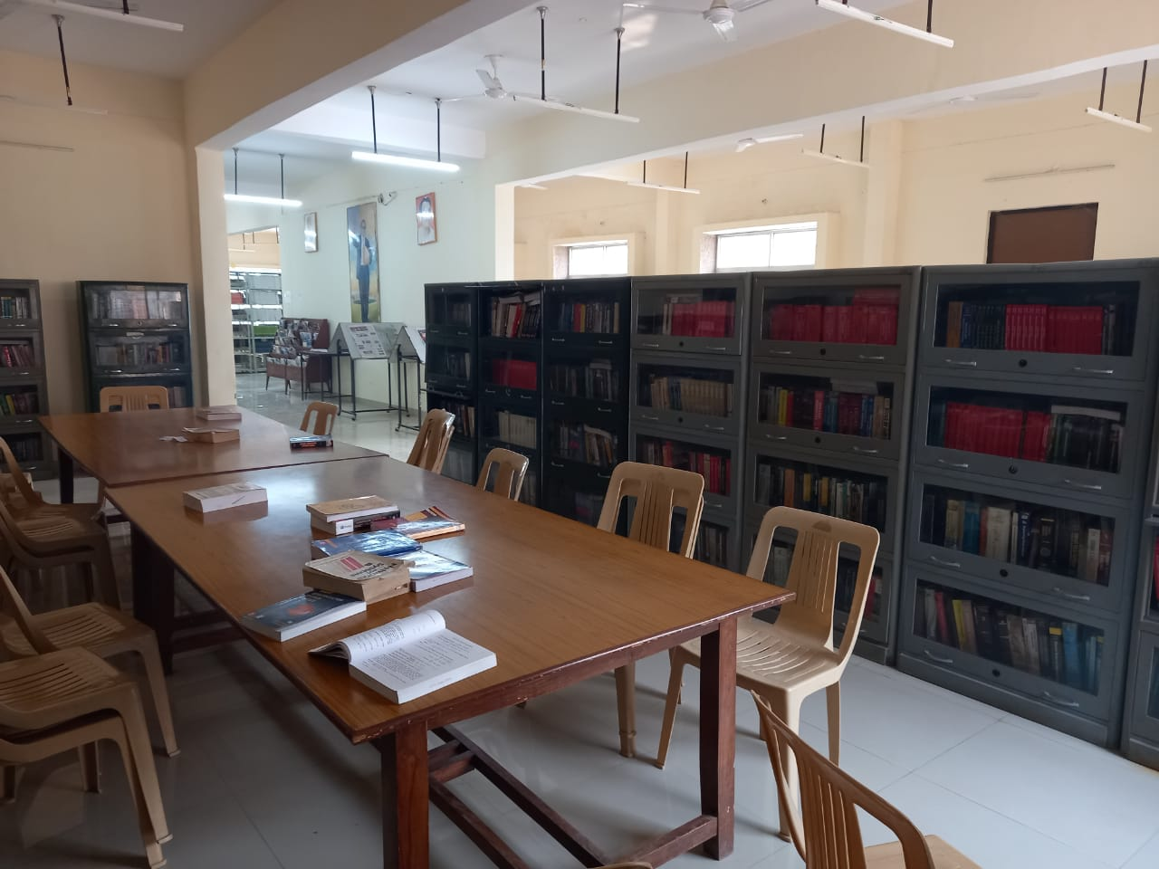

Slide 15
ADVANTAGES
Simple & Easy to Use
Increased Library Engagement
Dynamic Reports
Highly Secure, Scalable & Reliable
Innovation
Fully Customizable
Cost-effective

Slide 16
Disadvantage
The data stored is prone to cyber hacks.
Complicated to operate
Risk of computer virus
Requires manual action to perform operations
No remote accessibility
Risk of manipulation

Slide 17
SOME SNAPSHOT
OF
OUTPUT RESULT

Slide 18
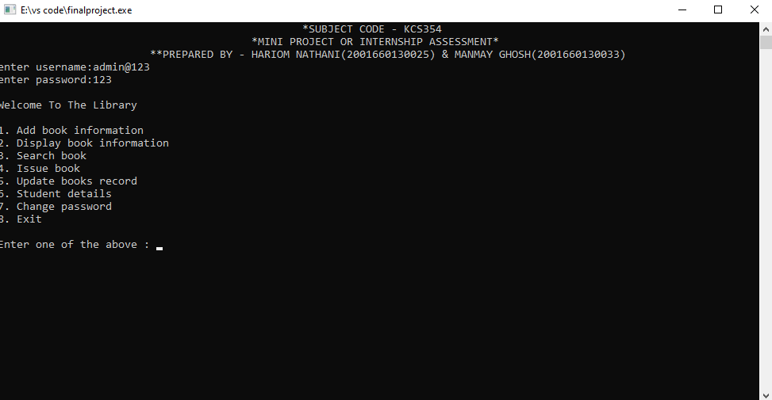

Slide 19
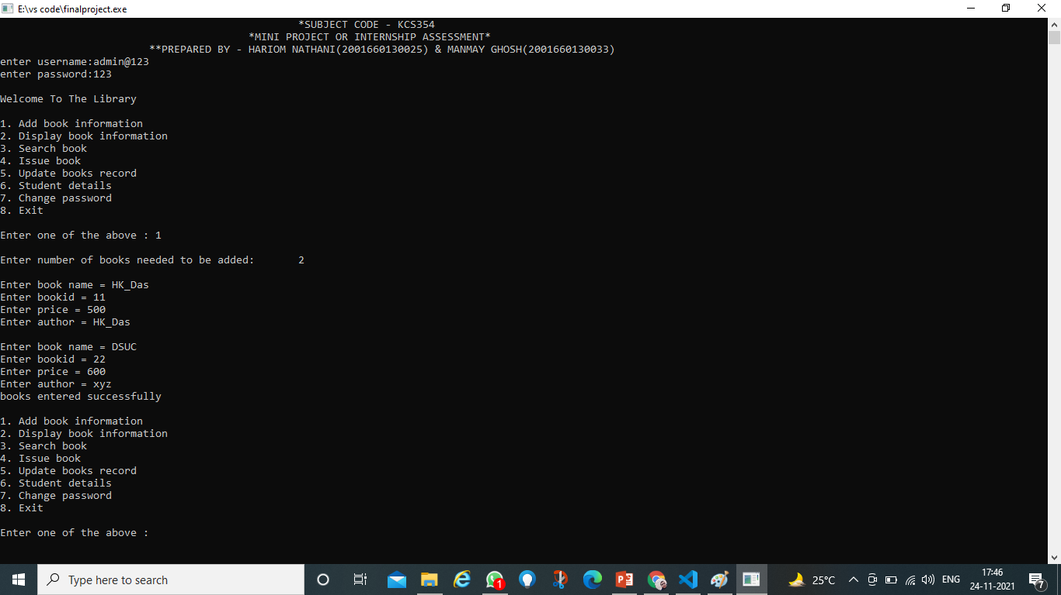

Slide 20
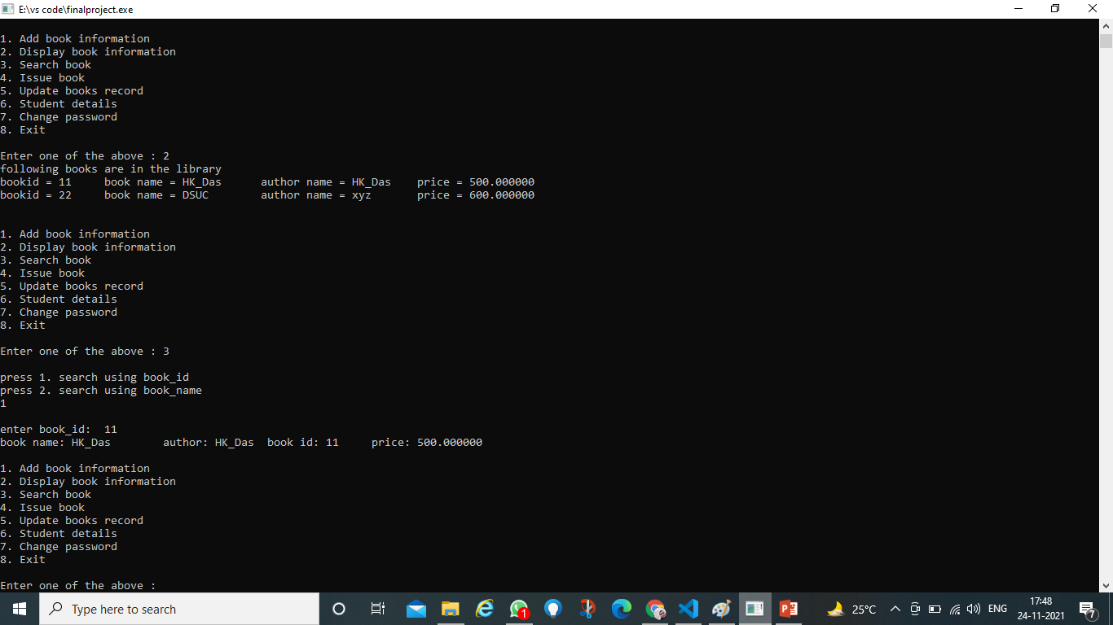

Slide 21
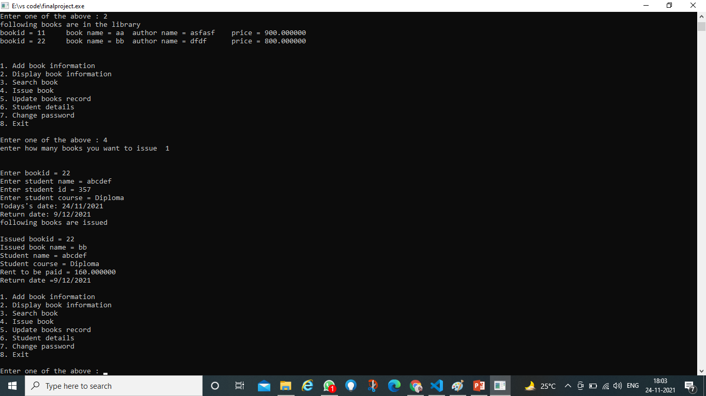

Slide 22


Slide 23
CONCLUSION
The Library Management System allows the user to store the book details and the person's details.
This software allows storing the details of all the data related to library.
The implementation of the system will reduce data entry time and provide readily calculated reports.

Slide 24
Thank you

