Slide 1

ONLINE COURSE REGISTRATION SYSTEM A project submitted in partial fulfillment of the requirements for the degree
of MASTER OF COMPUTER APPLICATION (MCA) OF
TEZPUR UNIVERSITY 2022
Presented by:
Ananya Saikia (CSM20007)
Hari om jee (CSM20010)
Harshita Yadav(CSM20041)
MCA 4TH SEMESTER
Guided by:
Dr. Ram Charan Baishya
Assistant Proffessor

Slide 2
Session Activity:
Faculties Enter Grades
Course are offered
A new session Starts
Students view their results
Grades are processed and Results are declared
New Students are admitted
Students Register courses

Slide 3
Drawback of Manual System:
Usual drawbacks of manual system such as
INCONVENIENTT
POOR EFFICENY
CHANCES OF ERROR
TIME CONSUMING
POOR SECURITY

Slide 4
Overview:
We provide through our system an online portal for any institutes or universities where Admin , faculty and students can participate in different academic activities throughout an academic session.
With this portal
Add student , faculty , courses by administration.
Course Registration by students
Grade submission by Faculties

Slide 5
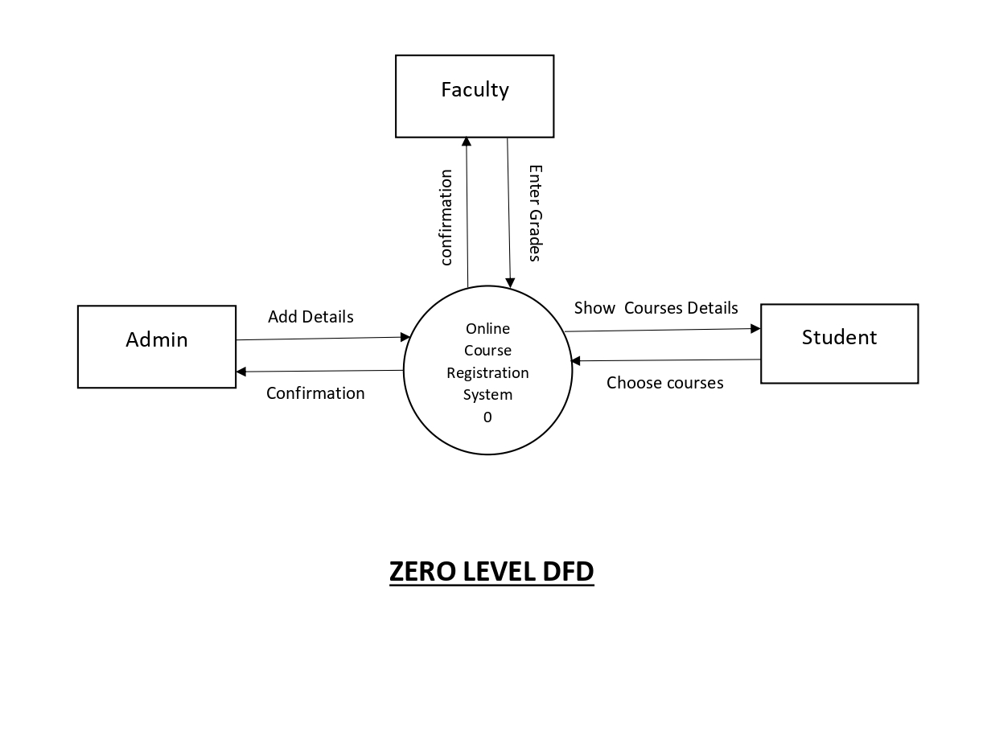
System Design: DFD

Slide 6
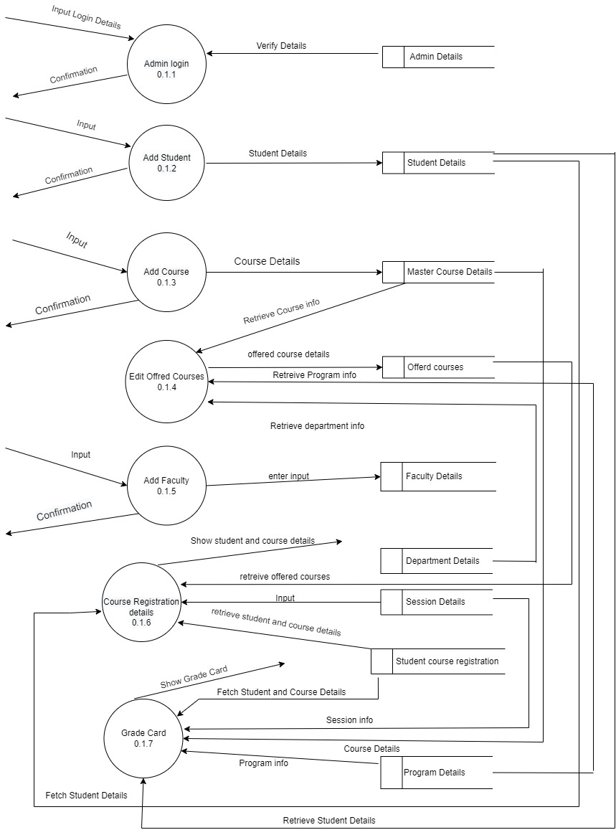
DFD LEVEL 1 FOR ADMIN

Slide 7
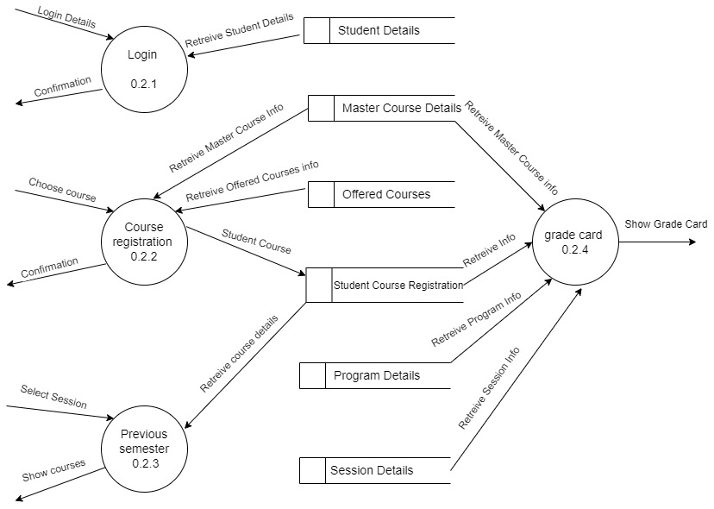
DFD LEVEL 1 FOR STUDENT

Slide 8
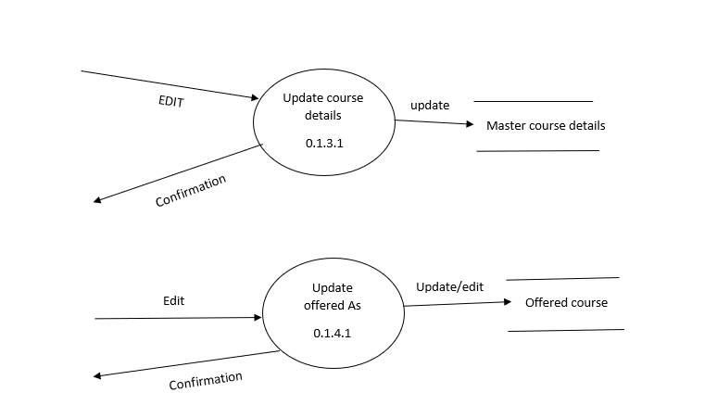
LEVEL 2 FOR ADMIN

Slide 9
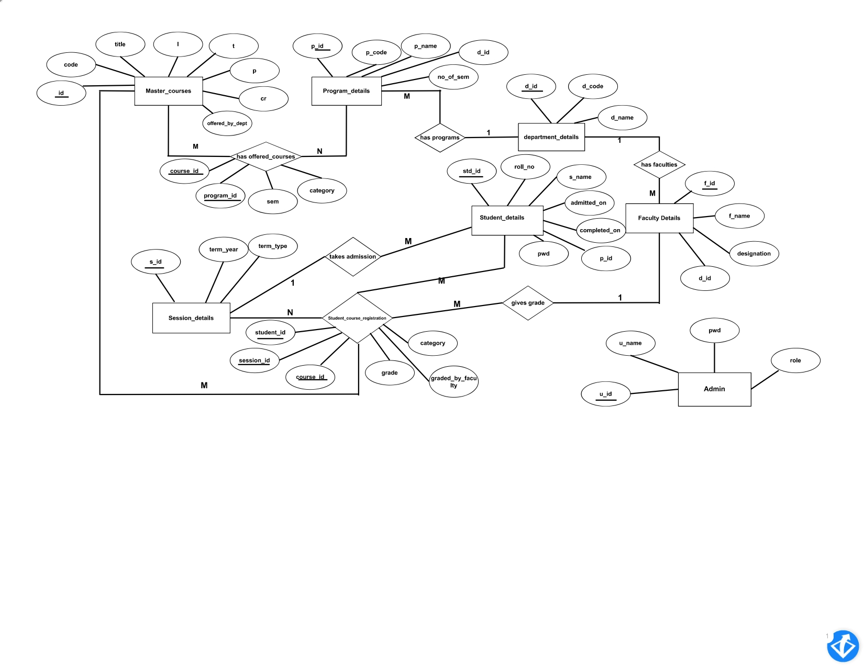
ER DIAGRAM

Slide 10
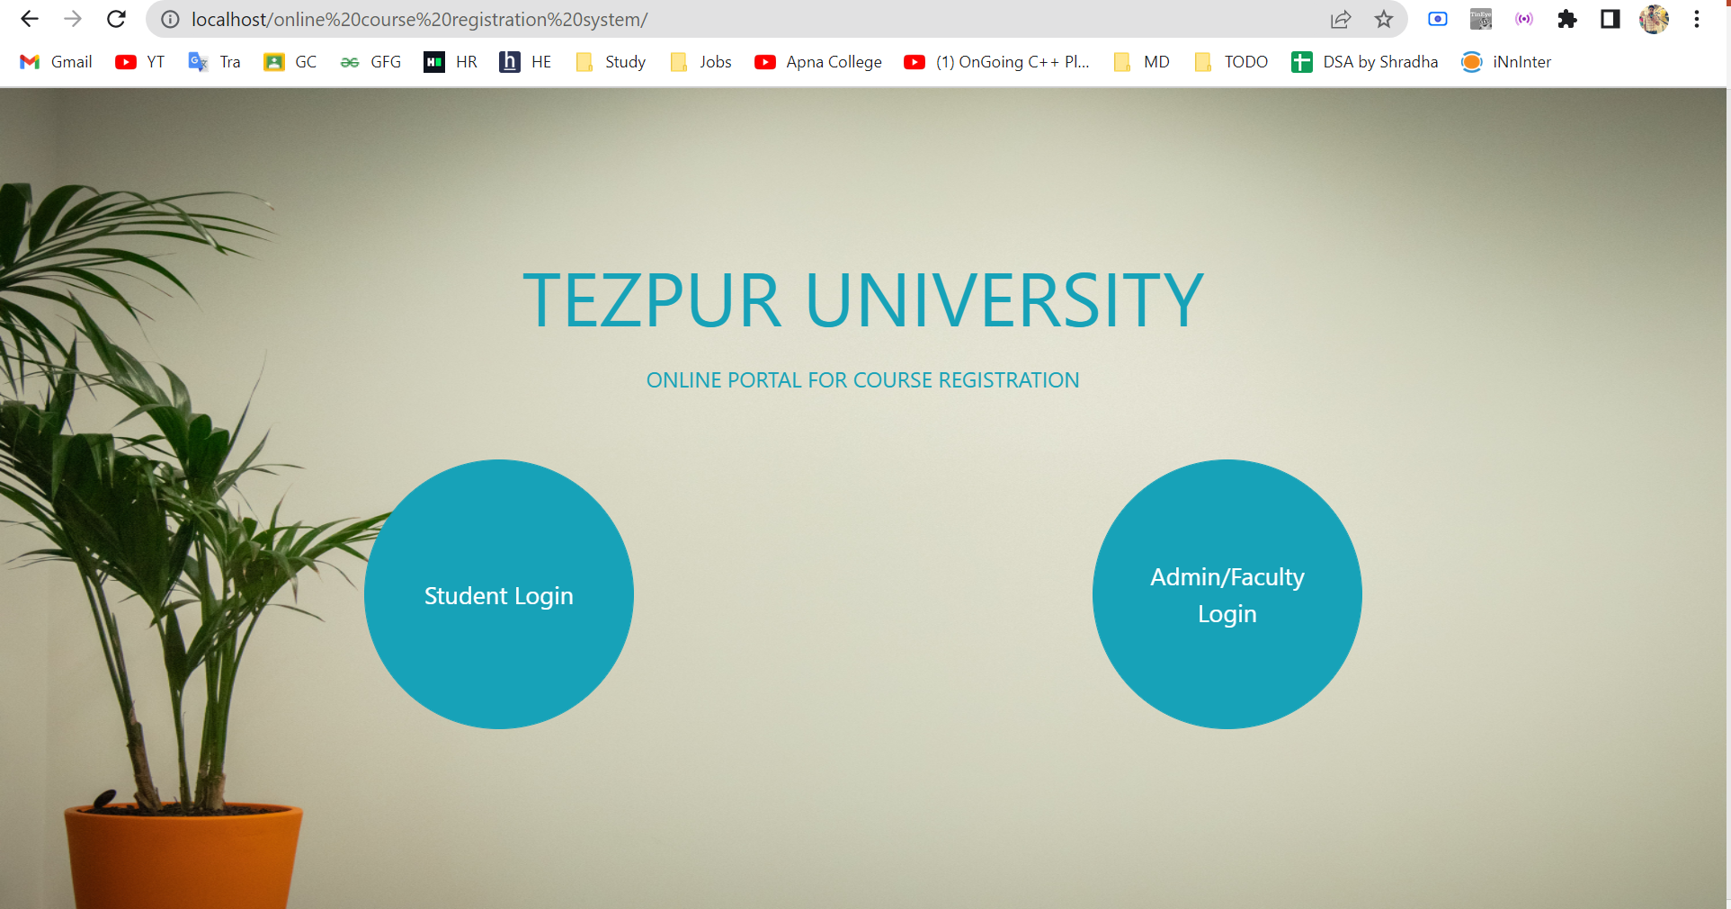
Demonstration:
Index Page:

Slide 11
Thank You!

