Slide 1

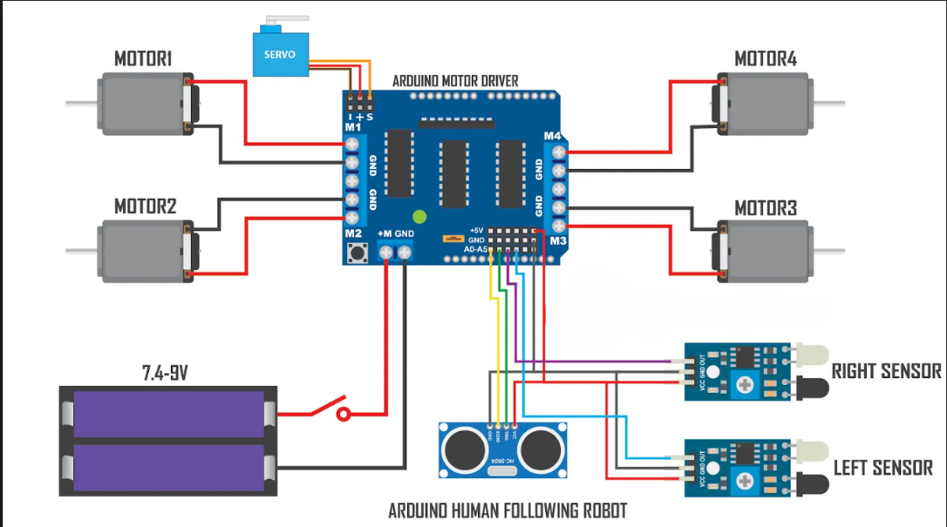
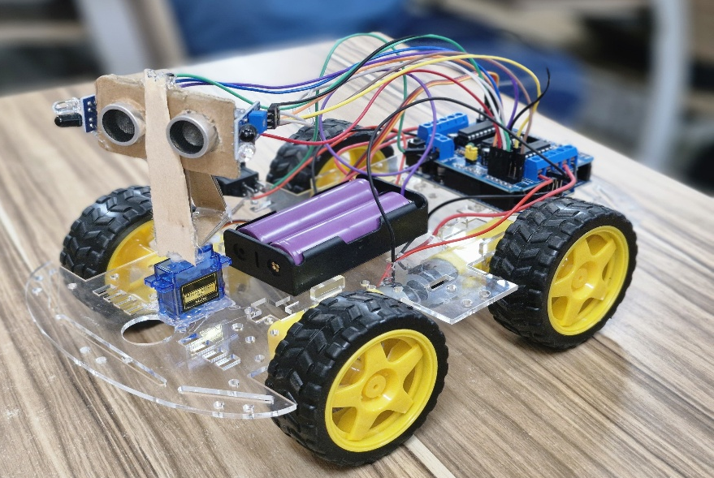




UE22CS251B: MPCA <Human-Following Robot>
<This project presents the design and development of a low-cost, Arduino-based human-following robot capable of autonomous navigation using a combination of ultrasonic and infrared sensors. The robot is engineered to track and follow a human target while detecting and avoiding obstacles in real-time. Built on an acrylic chassis powered by 18650 Li-ion batteries, it employs TT gear motors controlled via a Motor Driver Shield for smooth movement. The integration of one ultrasonic sensor for distance measurement and two IR sensors for surface detection enables adaptive, environment-aware navigation. With potential applications ranging from personal assistance and home automation to security and retail services, this robot serves as a foundational platform for learning and future innovations in robotics and embedded systems.
>
Block Diagram or Circuit Diagram
<Hariom Khonde > <PES1UG23CS229>
<Harshavardhana M > <PES1UG23CS237>
<Pranav Gudagi > <PES1UG24CS818>
<CHITRA N S>

