Slide 1
CodiBook
online bookstore app
by team 4

Slide 2



Our Team
Hario Tri Wibowo
as team leader and also responsible for backend work
Dila Rofika
as a team member who is responsible for working on the cms frontend
Nurul
as a team member who is responsible for working on the User Buyer frontend

Slide 3
About the App
What
When
This application is e-commerce with products in the form of books
Anytime, because the online bookstore is open 24 hours
Who
Where
Anyone who wants to buy a book online because they don’t have time to go directly to an offline bookstore
Anywhere as long as there is a computer and internet
CodiBook
How
Why
More time efficient in shopping for books without having to go to an offline bookstore
We built this application by dividing the work in one team.
We worked on it from 25 May 2022 – 6 June 2022 and met virtually with the team.
We merged our project via GitHub.

Slide 4






Tech in this App
Backend
NodeJs
ExpressJs
Postgres SQL
Sequelize and Sequelize-cli
Bcrypt
Json Web Token
Cors
Multer
Frontend
Bootstrap
Axios
React
React-dom
React-router
React-router-dom
Redux
Sweetalert2

Slide 5
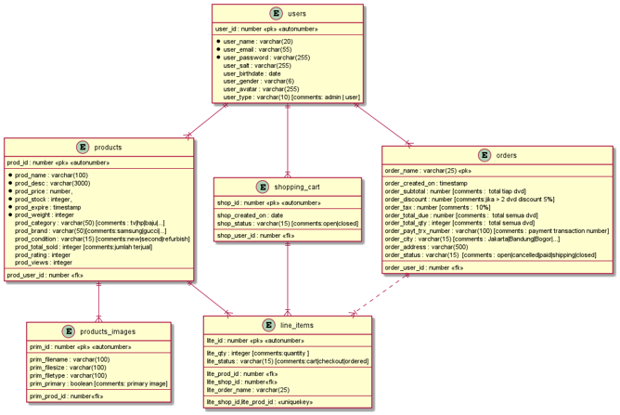
Diagram Relationship

Slide 6
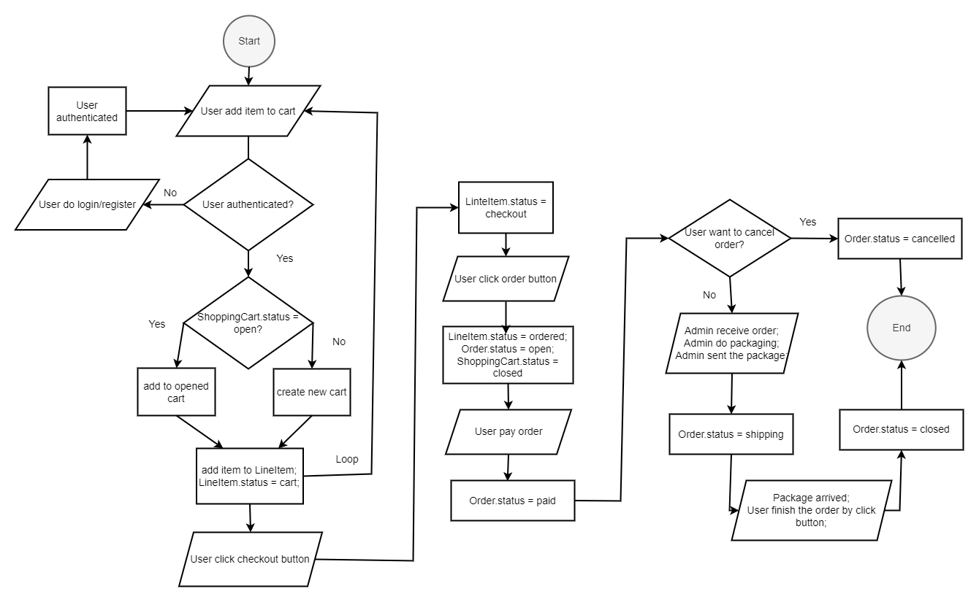
Flowchart Diagram

Slide 7
API Endpoints
01
Registrasi User [POST]
localhost:port/api/register
02
Login User [POST]
localhost:port/api/login
03
Logout User [POST]
localhost:port/api/logout

Slide 8
API Endpoints
01
List Semua Produk [GET]
localhost:port/api/admins/products/lists
02
Create Produk [POST]
localhost:port/api/admins/products/create
03
Tampil Produk Berdasarkan Id [GET]
localhost:port/api/admins/products/show/:id
04
Edit Produk [GET AND POST]
localhost:port/api/admins/products/update
localhost:port/api/admins/products/edit/:id
05
Hapus Produk [POST]
localhost:port/api/admins/products/delete

Slide 9
API Endpoints
1 | localhost:port/api/katalog/all | [GET]
2 | localhost:port/api/checkout | [GET]
3 | localhost:port/api/order | [GET]
4 | localhost:port/api/payment/:trxNumber | [GET]
5 | localhost:port/api/AddItemToCart | [POST]
6 | localhost:port/api/checkoutCart | [POST]
7 | localhost:port/api/orderCart | [POST]
8 | localhost:port/api/payOrder | [POST]
9 | localhost:port/api/finishOrder | [POST]
10 | localhost:port/api/cancelOrder | [POST]

Slide 10
Demo Apps

Slide 11
Thank You
For your attention

