Slide 1

Web scraping to gain company insights
07/03/2025

Slide 2
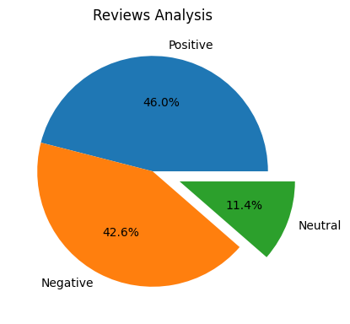
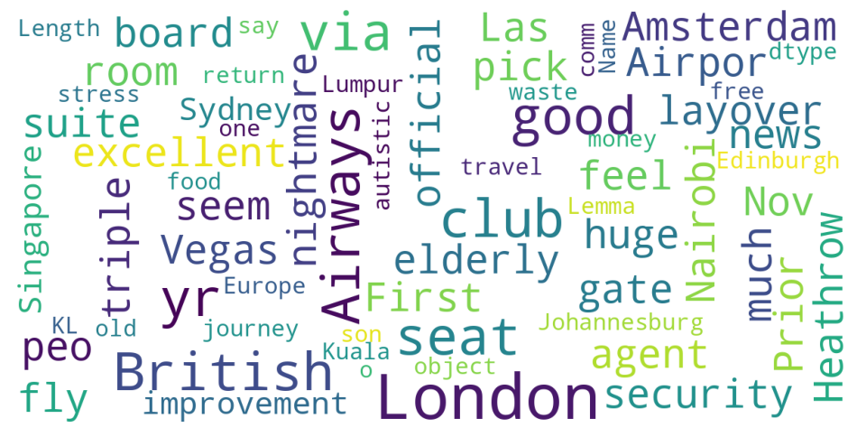
INSIGHTS FROM CUSTOMER REVIEWS
From cleaning 1000 reviews given by the customers, we obtained
Positive Reviews - 460
Negative Reviews - 426
Neutral Reviews – 114
Word cloud of keywords used in reviews

