Slide 1

Predicting customer buying behavior
07/03/2025

Slide 2
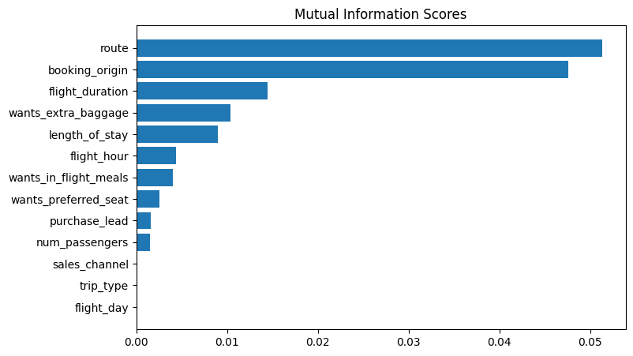
predictive model to understand factors that influence buying behavior
Random Forest Classifier was the model used and the final scores are:
Accuracy : 85.37
AUC Score: 0.568
Top 5 Features
route
booking_origin
flight_duration
wants_extra_baggage
length_of_stay

