Slide 1
Digital Portfolio
STUDENT NAME: Hari G REGISTER NOAND NMID:astvu30030024U18017 DEPARTMENT:Bsc.computer science COLLEGE: Thiruvalluvar University

Slide 2
PROJECT TITLE
Personal Digital Portfolio Website Using front end web develop

Slide 3
AGENDA
1. Problem Statement 2. Project Overview 3.End Users 4.”ools and Technologies 5. Portfolio design and Layout 6. eatures and Functionality 7. Results and Screenshots 8. Conclusion 9. Github Link

Slide 4
PROBLEM STATEMENT
In today’s digital era, students and professionals need an effective way toshowcase their skills, projects, and achievements beyond traditional paperresumes. A static resume often fails to highlight interactive elements such asproject demonstrations, contact forms, and responsive design for mobileusers. Therefore, there is a need for a digital portfolio website thatprovides an engaging, accessible, and professional platform where in a studentcan present their personal information, technical skills, academicbackground, and project work in an organized manner. This portfolio willserve as a personal brand identity and a medium to connect with recruiters,teachers, or collaborators.

Slide 5
PROJECT OVERVIEW
The Digital Portfolio Website is a personal web-based application developed using HTML CSS, and JavaScript. It is designed to provide an interactive platform for showcasingan individual’s academic details, technical skills, projects, and contact informationin a professional manner.The website consists of multiple sections such as About Me, Skills, Projects, andContact Form, making it easy for visitors to navigate and learn more about the student. The use of CSS ensures an attractive and responsive layout, while JavaScript adds interactivity, such as form validation and dynamic features like downloading a resume.

Slide 6
WHO ARE THE END USERS?
Students/The Portfolio owner Recruiters / Employers Teachers / Academic Mentors General Visitors / Peers

Slide 7
TOOLS AND TECHNIQUES
HTML (HyperText Markup Language)- for creating the structure ofthe website (sections like About, Skills, Projects, Contact). CSS (Cascading Style Sheets)- for styling, layout design, colors, fonts,and making the site visually attractive and responsive. JavaScript – for adding interactivity, such as form validation,Resume download button, and dynamic behavior. Code Editor (VS Code / Sublime / Notepad++)- used to write and manage the code files.
NOTE: hosting platform by the github pages

Slide 8
POTFOLIO DESIGN AND LAYOUT
Header Section
Contains the student’s name, a short tagline (e.g.,”Web Development Learner”), and a Resume Download button. Positioned at the top of the page with a highlighted background for visibility.
About Me Section
Provides a brief introduction about the student. Includes details like academic background, interest in web development, and career goals.
Skills Section
Displays a list of technical skills (HTML, CSS, JavaScript, etc.). Presented in a bullet-point or grid layout for easy readability.
Projects Section
Highlights The student’s completed projects with titles and short descriptions. Each project is placed inside a card-style layout with proper spacing.
Contact Section
Contains a contact form (name, email, message fields) for visitors or recruiters to connect. Includes a “Send” button with JavaScript handling the form submission.
Footer Section
Displays copyright information.Can include social media or GitHub/Linkedln links.

Slide 9
FEATURES AND FUNCTIONALIT
Personal Branding – Displays student’s name, introduction, and career interests.
About Me Section – Provides details about education, passion for web development, and goals.
Skills Showcase – Lists technical skills (HTML, CSS, JavaScript, etc.) in an organized way.
Projects Section – Highlights completed projects with descriptions.
Contact Form – Allows visitors or recruiters to send messages directly.
Resume Download Option – Provides a button to download the student’s resume.
Responsive Design – Works seamlessly on desktops, tablets, and smartphones.
Clean UI/UX – Simple, user-friendly, and professional interface.

Slide 10
RESULTS AND SCREENSHOTS
Screenshorts of each section Before vs after (plain HTML—with css&js)

Slide 11
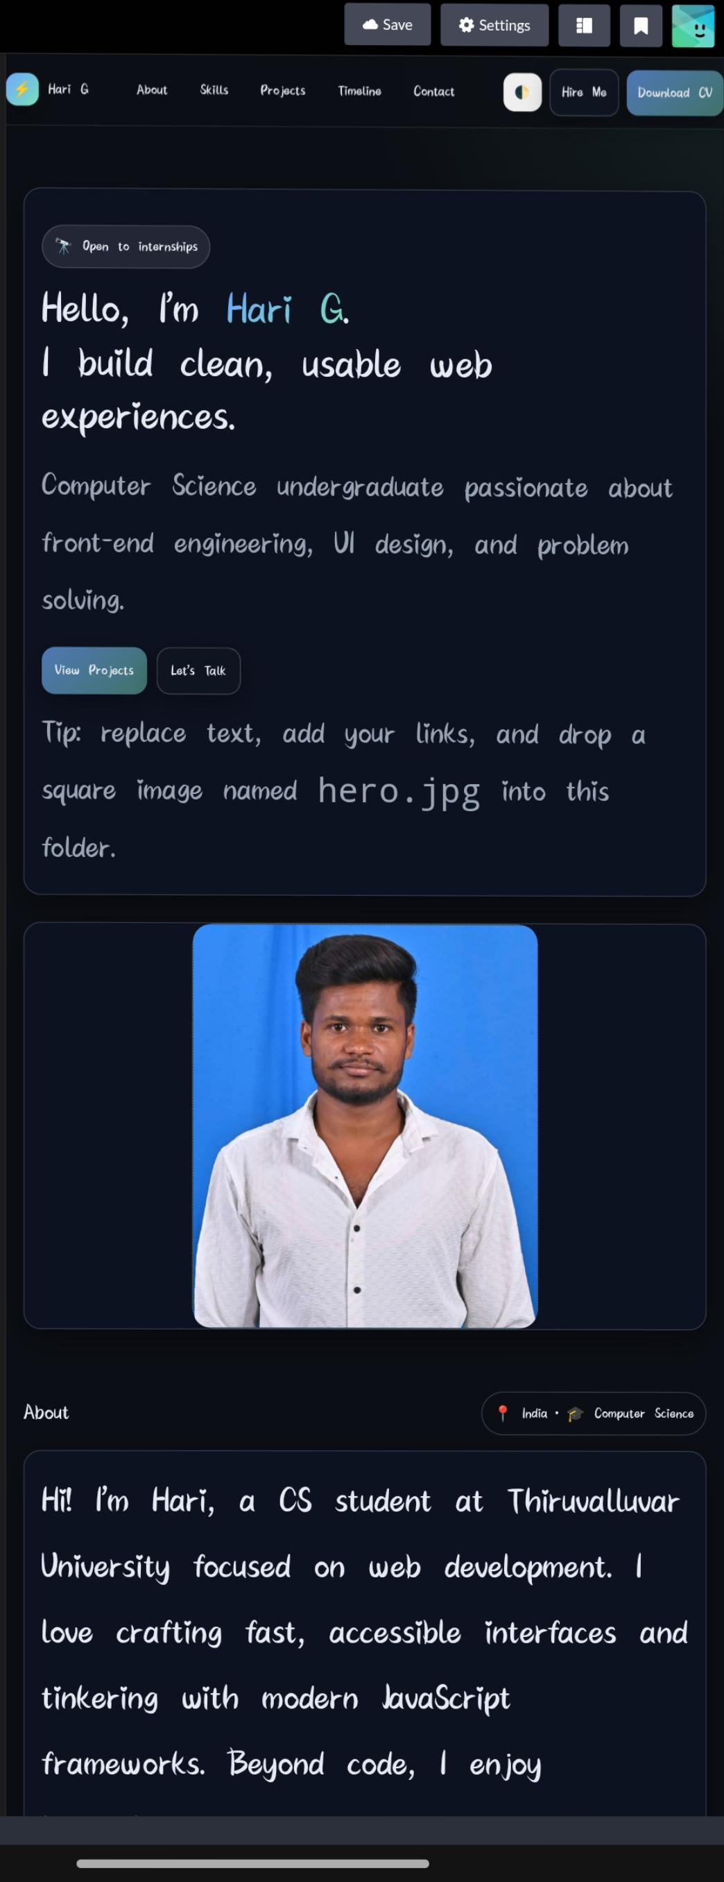
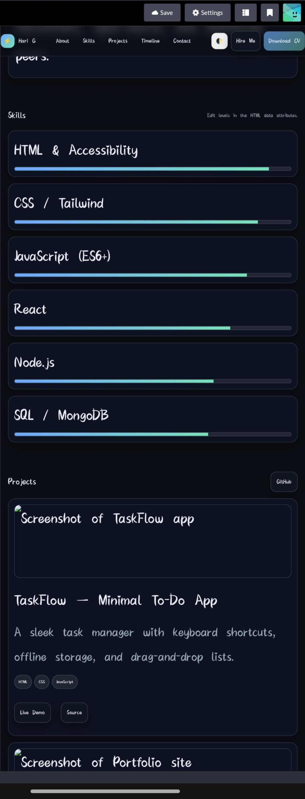

Slide 12
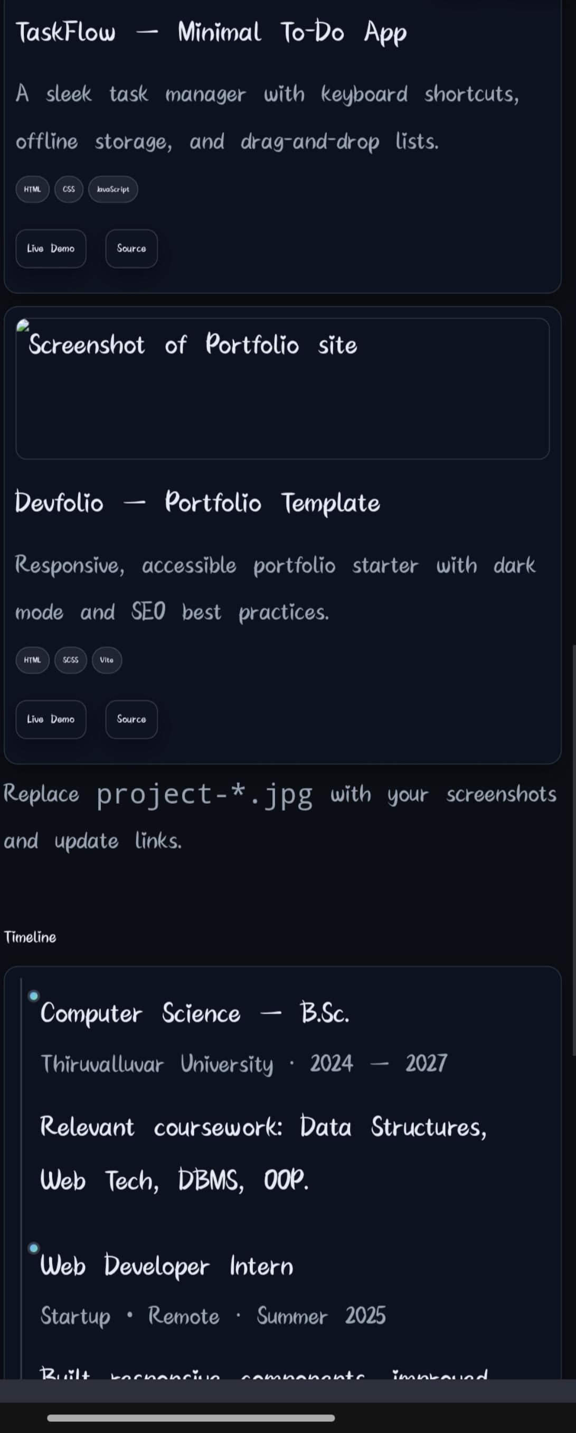
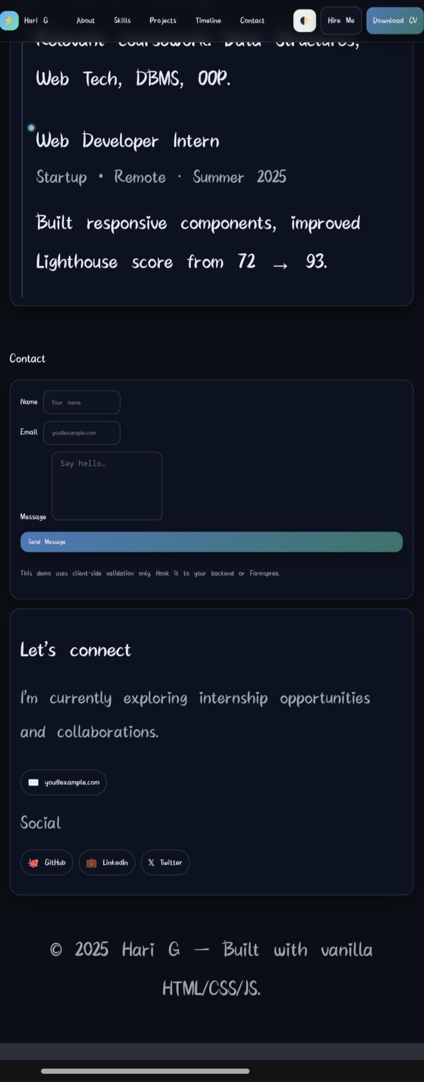

Slide 13
CONCLUSION
The Digital Portfolio Website successfully demonstrates the application of HTML,CSS, and JavaScript in building a responsive and interactive personal website.It provides a structured platform for showcasing an individual’s academic background. Skills, projects, and contact details in a professional and visually appealing manner. Through this project, the student has gained practical knowledge of front-end webdevelopment, responsive design principles, and basic interactivity using JavaScript. Thewebsite not only acts as a modern replacement for a traditional resume but also enhancesthe student’s online presence, making it easier for recruiters, mentors, and peers to evaluate their skills and connect with them.

