Slide 1

Responsible AI
Harippriya S,
Access Manager

Slide 2
We will talk about…
Power of AI
Challenges with AI
Elements of Responsible AI
Implementing Responsible AI (Interset’s approach)

Slide 3
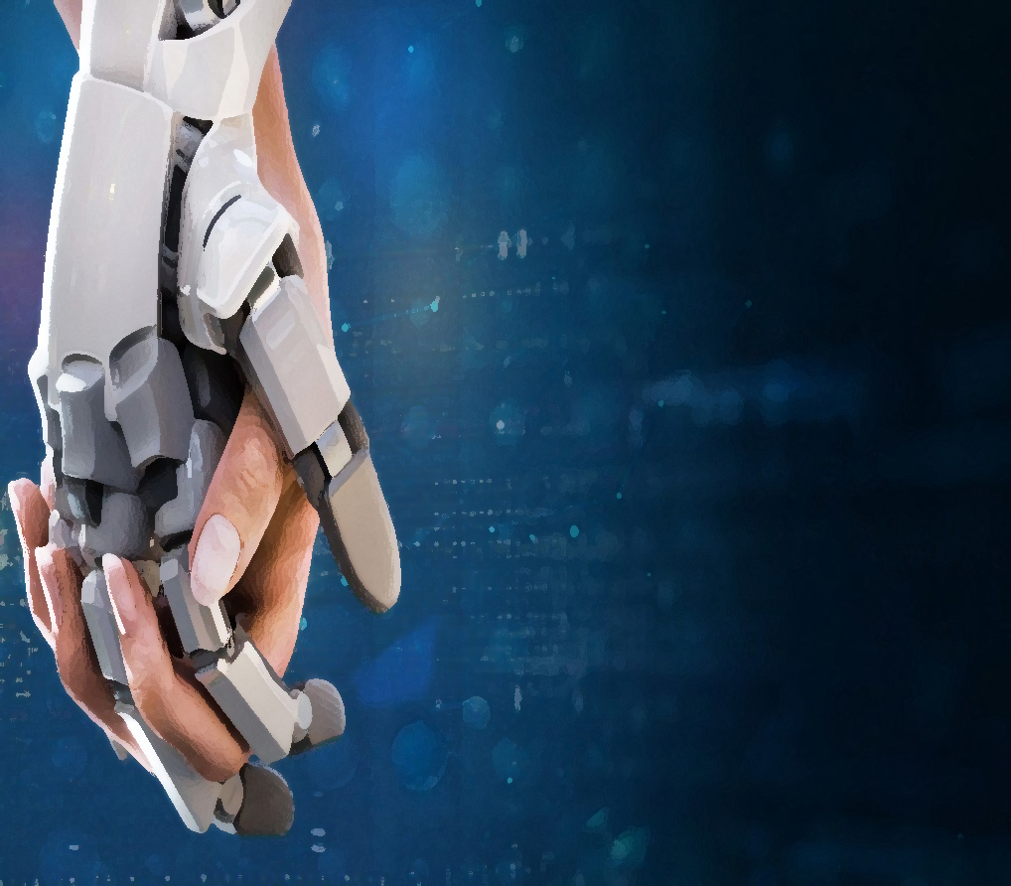
AI is Everywhere
Traditional Approach
Define rules to detect risks.
Eg. User login after midnight is risky behavior.
AI Based Approach
No rules! Automatic risk detection.
AI is simple and effective!

Slide 4
Responsible AI
Human Centric
Explainable
Fair/Unbiased
Ethical
Security and Privacy
Sustainable
Notes:
© Copyright PresentationGO.com – The free PowerPoint and Google Slides template library

Slide 5

Human Centric AI
Will AI replace us?
Should it work without human oversight?
Can it account for context?
Is it binary – risky or safe user?
Interset’s Solution
Human in the loop approach
Risk is given as a probability rather than yes/no
Final decision and hence final responsibility is with humans.

Slide 6
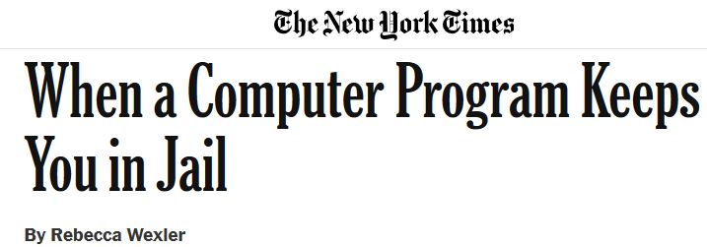

Explainable AI
Black box AI is unacceptable for some industries due to ethical, legal and regulations.
Why is this user high risk?
What were his activities?
How long before this alert was triggered?
10+ years of model behavior, but denied parole due to high risk assessment by Black box proprietary AI.
Interset’s Solution
Human readable risk analysis
Algorithms selected to allow explainability.

Slide 7
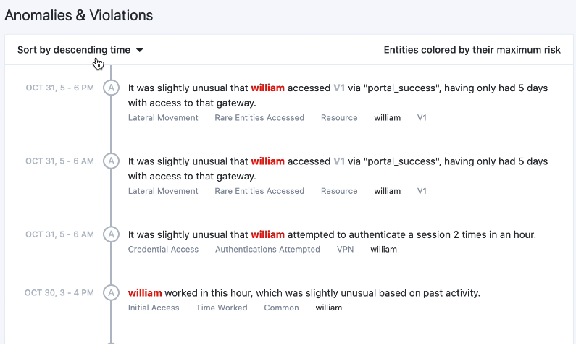

Slide 8
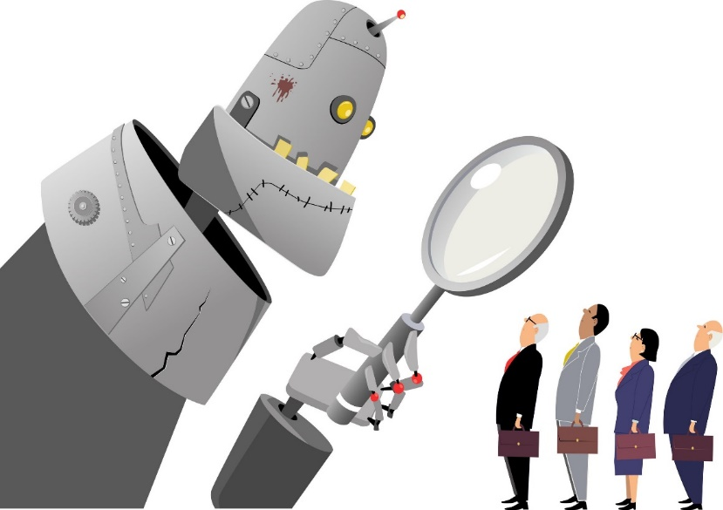
Fair/Unbiased AI
Human biases should be kept out of future technology
Bias in Training Data. Bias in Algorithm.
Gender Bias in Amazon’s Recruiting AI Tool
Racial and Gender Bias in Facial Recognition
Racial Bias in Criminal Risk Assessment
Interset’s Solution
ML performed “online” at customer site
Unsupervised learning with real data
Fine tuned for user specific behavior and not corporate level rules

Slide 9

Ethical AI
China’s Social Credit System
Ranks citizens’ behavior to determine their social and credit worthiness.
The score will impact their social and economic rights.
ML to make healthcare decisions
AI as 3rd-party actor in physician patient relationship
Influences tests given, diagnosis, etc.

Slide 10
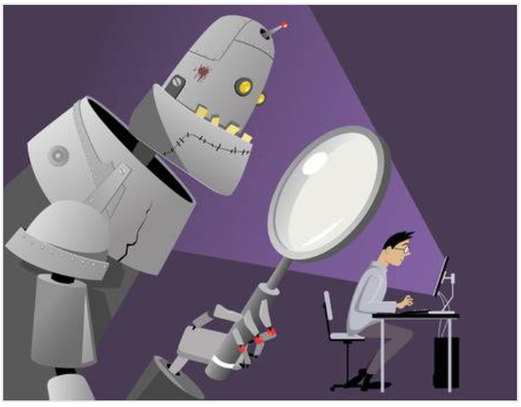
Security and Privacy
Risk of users gaming the system.
Risk of uncovering Personally Identifiable Info (PII)
Interset’s Solution
100s of models, hence mimicking “normal” behavior requires full knowledge of Interset
User data is anonymized and profile is redacted
Noise introduced into profile data
Reveal PII only for confirmed insider threats.
GDPR compliant

Slide 11
Sustainable AI
Environmental Impact
Collaboration to create common reusable algorithms
Collaboration with humans

Slide 12
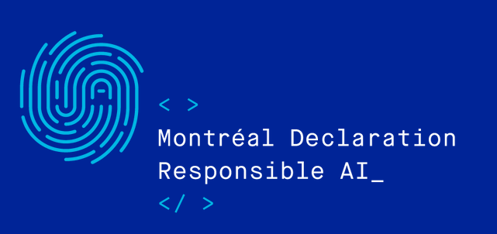

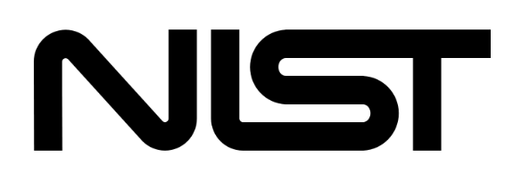
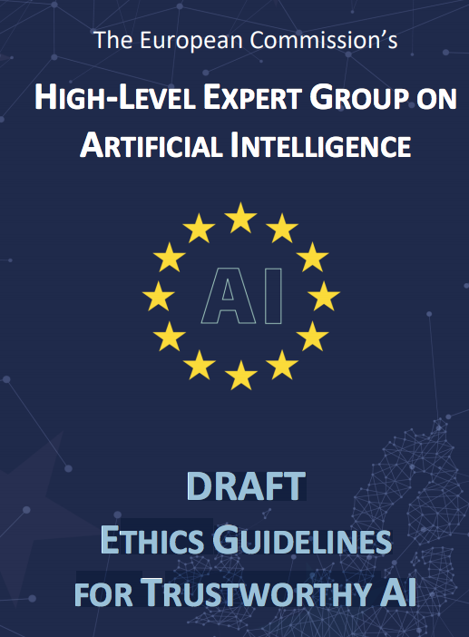




Standards and Frameworks
Responsible AI Toolkit
AI Fairness 360, AI Explainability 360 Toolkits

Slide 13
Responsible AI is a framework to ensure ethical, transparent and accountable use of AI technologies in a manner consistent with organizational values and societal laws and norms.

Slide 14
Summary
AI development goes beyond solving the problem and should consider:
Which algorithm will result in transparency?
Can the data be used while maintaining user privacy?
How to prevent bias? Is it fair?
How to collaborate with humans?

Slide 15
Thank You.

Slide 16
References
Fairness in AI
Cybersecurity
Accelerating innovation through responsible AI
AI and Cybersecurity
UC Berkeley
McKinsey Insights
Microsoft
Google Responsible AI

Slide 17
Fairness
Reliability & Safety
Privacy & Security
Inclusiveness - empower everyone and engage people
Transparency
Accountability - People should be accountable for AI systems
Don’t bring a knife to a gunfight
In other parts of the enterprise, many organizations may choose to go slow on AI, but in cybersecurity there’s no holding back: Attackers will use AI, so defenders will have to use it too. If an organization’s IT department or cybersecurity provider isn’t already using AI, it has to start thinking immediately about AI’s short- and long-term security applications. Sample use cases include distributed denial of service (DDOS) pattern recognition, prioritization of log alerts for escalation and investigation, and risk-based authentication.
Cybersecurity may speed up AI’s acceptance
Since even AI-wary organizations will have to use AI for cybersecurity, cyberdefense will be many enterprises’ first experience with AI. We see this fostering familiarity with AI and willingness to use it elsewhere. A further spur to AI acceptance will come from its hunger for data: The greater AI’s presence and access to data throughout an organization, the better it can defend against cyberthreats. Some organizations are already building out on-premise and cloud-based “threat lakes,” that will enable AI capabilities.

