Slide 1
Service Mesh
Harippriya Sivapatham

Slide 2
Agenda
What is a Service Mesh
How it works
Features
Comparison of Service Meshes
Common questions
Service Mesh vs Kubernetes functionalities
Service Mesh vs API Gateway

Slide 3
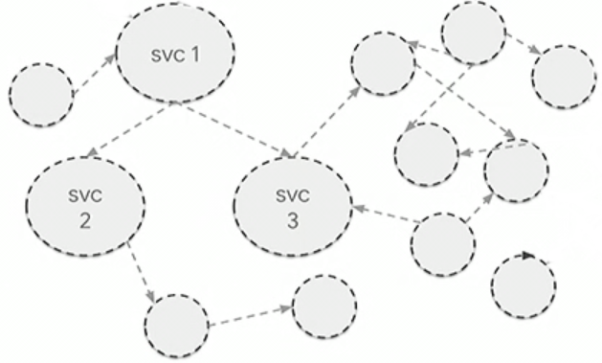

What is a Service Mesh?
Service Mesh helps manage services and the communication between them.
Advanced Authentication Appliance
MicroFocus SaaS
01.
Secure
Secure the inter service communication.
AA Core Service
02.
Connect
HTTP
Control flow of traffic between services
mTLS
mTLS
90%
10%
X
03.
Control
Apply policies to control access to services.
Risk Engine Service
Risk Engine Service v1
Risk Engine Service v2
04.
Observe
End to end view of the distributed system.

Slide 4
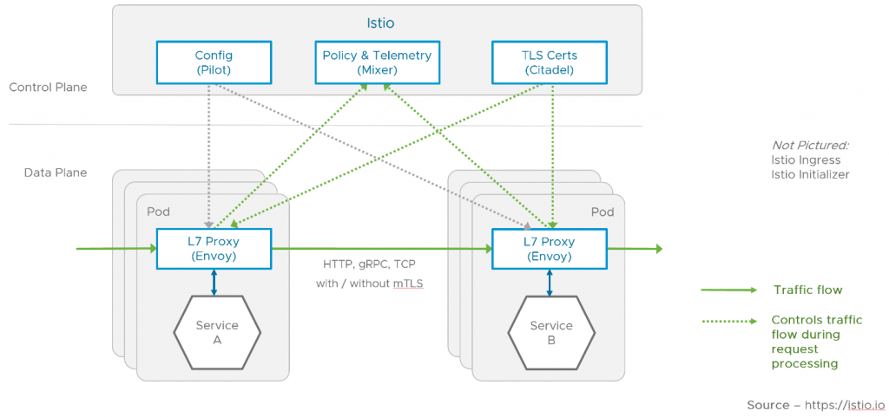
How Service Mesh works
Side car proxy to inject functionality without any modification to our code.
Works with polyglot services.

Slide 5
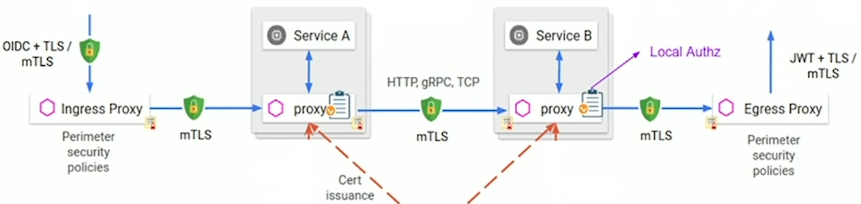
Service Mesh Features
Securing Services
Connecting Services
Advanced Load balancing based on service load, headers sent, etc.
Traffic splitting for release control (Canary releases or A/B testing)
Service Discovery
Circuit breaker
Baseline reliability (retries, timeouts, health checks)
Fault injection (Chaos monkey style)
Certificate management
Service to service authn.
Encrypted communication
Notes:
Load balancing destination rules based on algorithms: “round robin,” “random,” or “least requests.”
Noticing when messages take too long to get to their destination, and take other routes to compensate.

Slide 6
Service Mesh Features
Control
Access control – which services can talk to one another. Granular – allow GET but not POST.
Rate limiting
Gateway for control access to services from external clients
Egress rules to limit outbound communication for the services.
Observability
End to end distributed tracing of services and control flow
Troubleshooting tool to debug application bottlenecks, incorrect service interactions.
Integrates with other open source products like Fluentd, Promethus, Jaeger, etc.

Slide 7

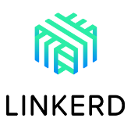

Comparison of Open Source Service Meshes
Backed By | Google, IBM, RedHat | CNCF | HashiCorp
Integrations/Community | Very High | Medium | Medium
Workloads | Kubernetes + VMs | Kubernetes only | Kubernetes + VMs
Secure Communication | Yes | Yes | Yes
Blue/Green Deployments | Yes | Yes | Yes
Circuit Breaking | Yes | No | Yes
Fault Injection | Yes | Yes | Yes
Rate Limiting | Yes | No | Yes
Chaos Monkey Testing | Yes | Limited | No
Monitoring | Yes | Yes | Yes
Distributed Tracing | Yes | Some | Yes
Multicluster | Yes | No | Yes
Deployment | Helm and Operator | Helm | Helm
Complexity | High | Low | Medium

Slide 8
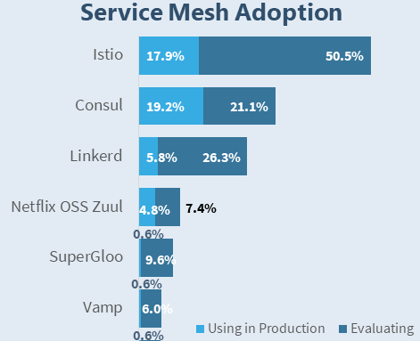
CNCF Survey 2019 Statistics
Kubernetes: 78% are using in production, 21% are evaluating.
Service Mesh: 18% are using in production, 47% are evaluating.

Slide 9
Is Service Mesh mandatory?
Not mandatory for an MVP with a limited number of trusted containers.
Can use functionalities from Kubernetes + Cloud provider instead.
Service Mesh Feature | Kubernetes support
Secure communication | No. Cloud providers provider perimeter security.
Traffic routing, Load Balancing | Limited
Traffic splitting (canary, blue/green) | Limited
Service Discovery | Yes
Access control policies | Yes, but not as flexible
Chaos Monkey | No. Use other open source for it.
Rate limiting | No
Ingress gateway | Yes
Tracing/Observability | No. Use other open source solutions for it.
Notes:
Canary/Blue green – Istio can inspect header and direct to specific pod types.
In short, don’t use a Service Mesh if you’re:
– not running highly sensitive services (PKI, PCI)
– not running untrusted workloads
– not running multi-tenant workloads

Slide 10
What is involved in using Service Mesh?
Can be easily added into an existing infrastructure.
YAML files to configure all the rules. Infrastructure as code methodology.
Increases the number of containers.
Additional infrastructure to configure and manage.
Can it be added later?
Yes. Simple commands available to enable basic configuration.
Which Service Mesh to choose?
Istio is widely used and has the backing of major companies.
Can change from one option to another – operations team effort, not engineering effort.

Slide 11
Do we need API Gateway if there is Service Mesh?
Depends on the API Gateway functionalities needed.
Complimentary. Core difference is in the intent of these technologies:
API Gateway helps manage APIs that are exposed to external clients.
Service Mesh helps manage the services and their internal communication
API Gateway Functionalities | Service Mesh Support
Reverse Proxy, Load balancing | Supported
Authentication, Access Control, TLS termination/origination | Supported
Rate limiting, Request routing | Limited
Productize, Consolidate, transform APIs | Not supported
API Self service for developers | Not Supported
Monitoring/Reporting/Analysis for API Economy | Not Supported
Malicious content filtering | Not supported
Notes:
Caching, IP black/whitelisting, Transform APIs
The primary assumption of a Service Mesh is we don’t trust the cluster, so we must secure each container.
We could instead treat the entire cluster as trusted, and focus on securing the cluster boundary.

Slide 12
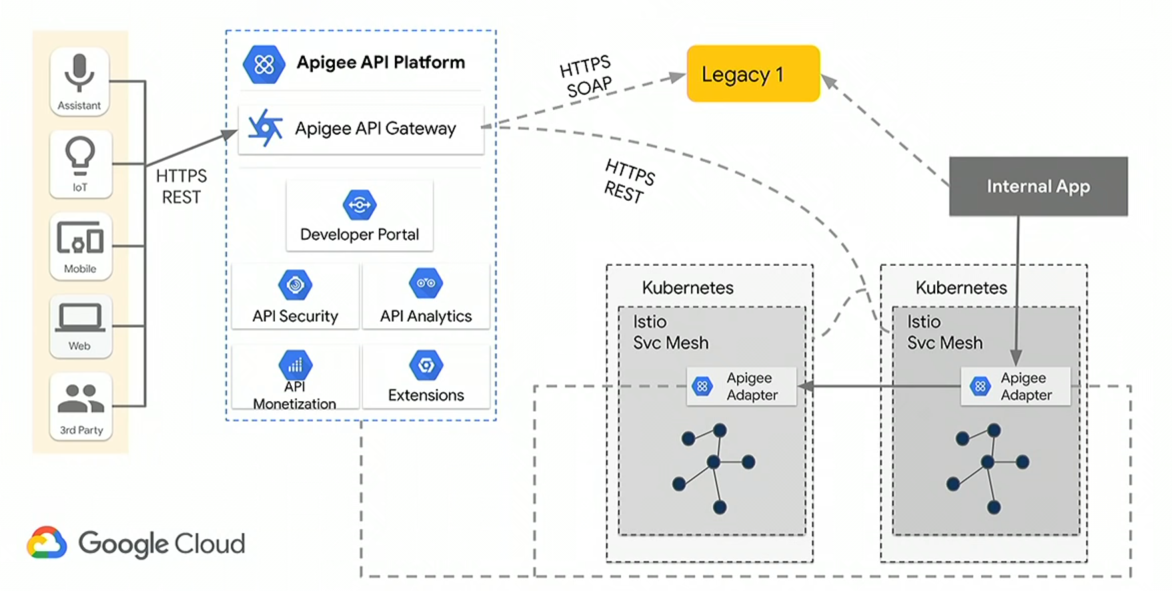
API Gateway + Service Mesh Deployment

Slide 13
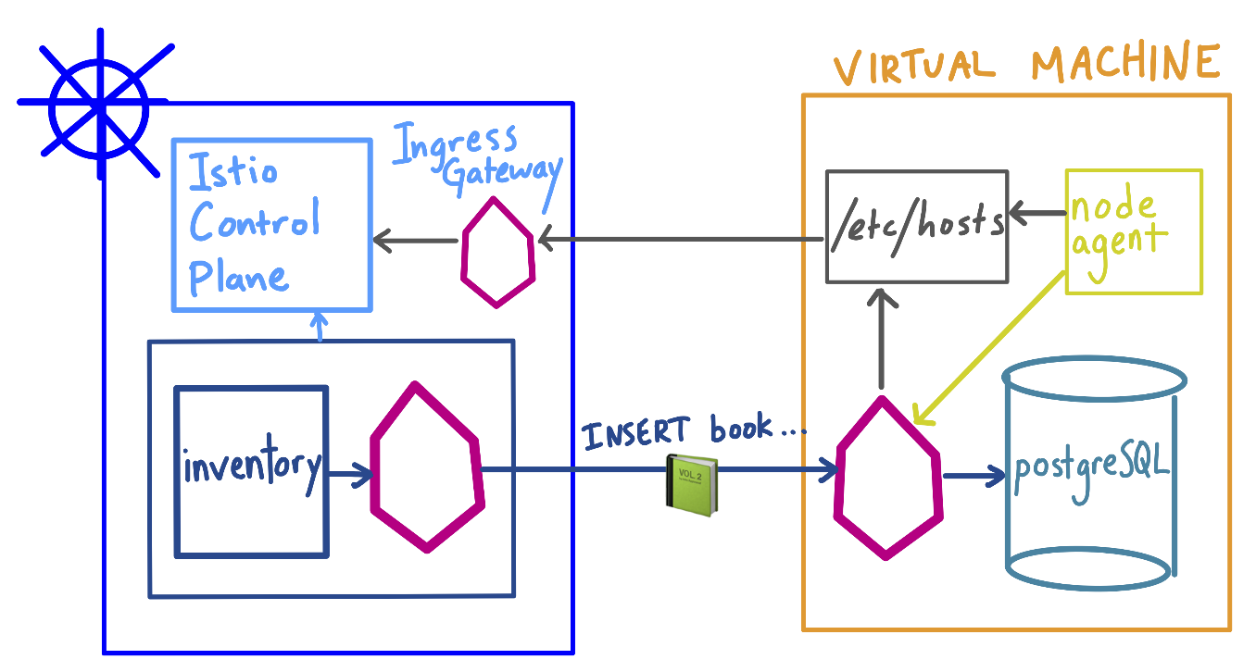
Can Service Mesh work in hybrid environment?
Yes, can be used to connect legacy apps and K8S containers.
Not commonly used.

Slide 14
Summary
Service Mesh helps developers focus on business concerns.
Particularly suited for managing large number of services.
Shifts effort from engineers to operations.
AA SaaS
Istio is the chosen one. Not for initial release.
Next steps for this work group?

