Slide 1
DocOps IAM Hackfest 2017
Archana Tiwary
Deepak Ruhil
Javeria Begum
Liza Abraham
Parakh Saikia
Neha Sapru
Idea & Concept by Harippriya

Slide 2
What is DocOps?
Documentation platform that matches the speed of DevOps software model.

Slide 3
Use Case: Upgrade of a Micro service
RISK Engine 1.0
RISK Engine 1.1
Risk Rule 1
Risk Rule 1
Continuous Deployment
Risk Rule 2
Risk Rule 2
Rolling Upgrade
Risk Rule 3
Risk Rule 3
Risk Rule 4
Requirement: Update Documentation in sync with the update of Risk micro service.

Slide 4
Challenges of the Current Documentation Model
Adding information about a single new rule requires:
Update of the entire doc and PDF Generation
Multiple writers working on single file
Peer review of the generated document
Publishing the content (with help of external team)
Localization (if needed)
Time Consuming!
In short, current doc process cannot work at the speed of DevOps model.

Slide 5
Solution: DocOps
DocOps is “wiki++”.
Maintain style and quality of English.
Example: Acrolinx
Doc Ops Platform
Handles documentation of various versions.
Keep wiki to document latest version.
Older versions as PDF.
Automated Editing
Version Control
Core Component.
Example: Confluence Wiki, Google Docs
Continuous update at the speed of agile.
Seamless publishing
Collaborative authoring
Publishing
Translation Management
Automated translator that handles 80% of text.
Example: Lingotek

Slide 6
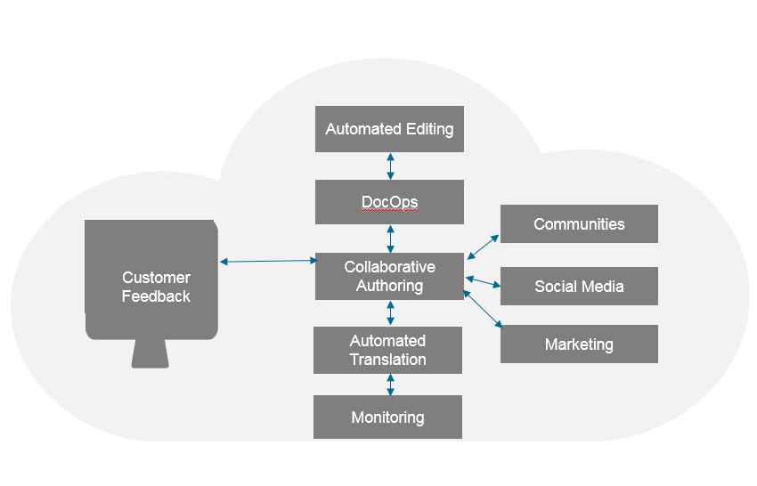
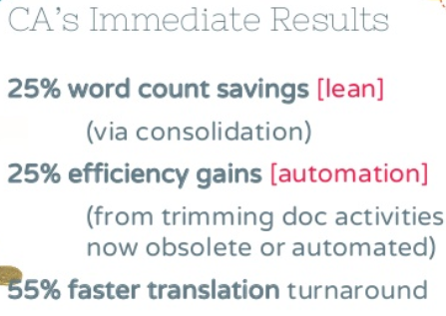
Advantages
Beyond the obvious real time update, other advantages are:
Granular feature based documentation instead of a monolith.
No separate Help files
Integration with Google Analytics
Increased productivity
CA’s DocOps Platform
Notes:
In the interest of time, just say that “CA Technologies pioneered Doc Ops and found immediate results.” Don’t go into this further.

Slide 7
Demo

Slide 8
www.microfocus.com

