Slide 1

Department of Computer Science and Engineering
SRM University, AP

Slide 2
Student Result Management system
Presented by
P. Hari Prakash - AP19110010210
Ch. Bhanu Prakash - AP19110010155
P. Sai Sandeep – AP19110010293

Slide 3
Outline
Introduction
Abstract
Objectives of the Project
UML Diagrams
Technologies used
System Requirements
Proposed System
Results
Conclusions
References

Slide 4
Introduction
SRMS(Student Result Management System) is a web application that manages the records of the student regarding Results and their class details.

Slide 5
Objectives of the project
Easy Registration Process
Easy to manage student result
Make Automatic Transcript
Provide Transcript and certificate within short time

Slide 6
Existing System
Existing process of the getting information for the student is done manually.
All the wanted information need to be provided by the administration.
If the students want to know the results of the particular subject so their should wait for long time because work done manually.
The information about their courses , results and other information accessing is not possible.

Slide 7
System Requirements:-
Hardware Requirements:-
Processor: Intel p4 processor with minimum 2GHZ speed
RAM : Minimum 1GB
Hard Disk : Min 20 GB

Slide 8
SOFTWARE REQUIREMENTS:-
Operating System : WINDOWS 8/10
Front End : PHP with bootstrap
Back End : MYSQL
Tools : XAMPP(cross-platform, apache, MYSQL,PHP)

Slide 9



Frontend Comprised with these following technology

Slide 10


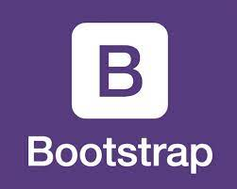

Backend comprised with these following technology

Slide 11
Proposed System
We have successfully proposed the “STUDENT RESULT MANAGEMENT SYSTEM” for replacing the manual work of the administration.
By this application student can easily access the modules like student results and courses other information required to student.
This application is flexible and can easily access by the student .
So the time taken for getting the information will be reduces.

Slide 12
Modules:-
1.Register/Login Module
2.Student Module
3.Admin Module

Slide 13
1.Resgister/login Module:-
The Home page of the “STUDENT RESULTS MANAGEMENT SYSTEM”.
It consists of Two portal about student and admin..
Login page is used to login to the admin portal
2.Student Module:
students can view the results.
student can download the results..

Slide 14
3.Admin Module:
Create and manage the subjects , classes and can add the students and their results of the students.
Reports for various modules
Update or deleting the admin information

Slide 15
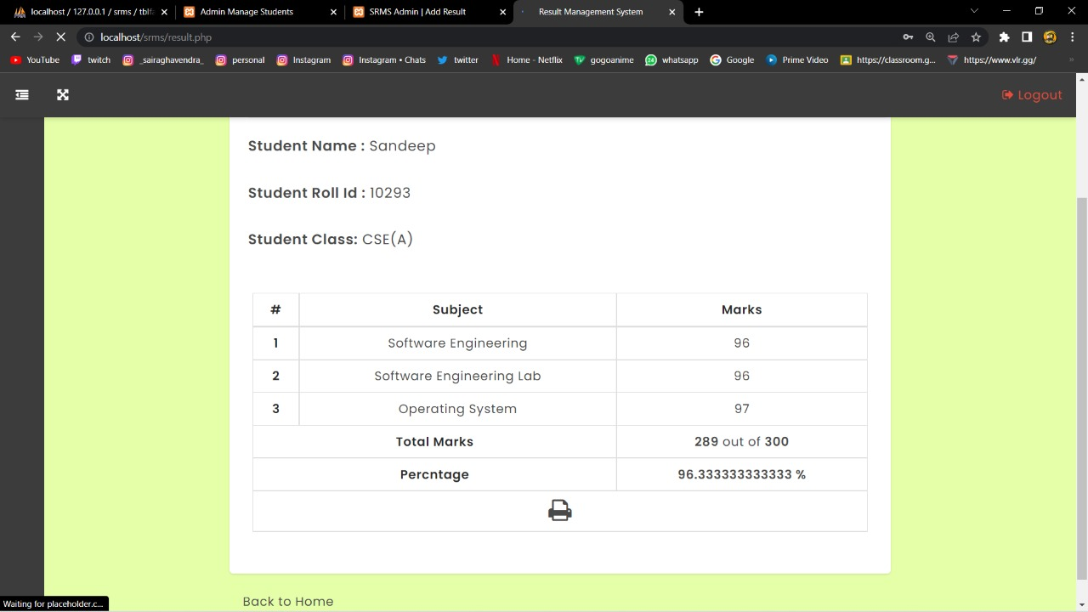
Results/Performance

Slide 16
Conclusion
Student result management system has been designed to replace the manual storing of data.
Helpful to perform paperless work and manages all data.
Provides easy, accurate, faster access to data.

Slide 17
References
https://projectworlds.in/free-projects/php-projects/student-result-management-system-project-in-php/
https://codeastro.com/simple-student-result-management-system-in-php-with-source-code/

