Slide 1

MCA Major Project End Term Evaluation
Deep Learning Based Approach to Diagnose Alzheimer’s Using MRI Images
Submitted By
Hariprasad JP
Reg No. 23FS20MCA00017
Under the guidance of
Dr. Linesh Raja, Associate Professor
Department of Computer Applications
Manipal University Jaipur
Rajasthan, India

Slide 2
Outline
Introduction
Motivation
Objective
Process Model
Software Requirement
Software Development Model
Data Flow Diagram (DFD)
Comparison of models
Conclusion
Future Scope

Slide 3
Introduction
Alzheimer’s Disease (AD) is a progressive neurodegenerative disorder characterized by memory loss, cognitive decline, and disruption of daily functioning.
It is the most common cause of dementia and poses significant challenges in early diagnosis.
Traditional diagnostic methods, while useful, are subjective and time-consuming, which delays effective intervention.
The proposed project leverages combining 3 models Convolutional Neural Networks (CNNs), Efficient-Net B1 and the Res-Net50 to automate and improve diagnostic accuracy through MRI scan analysis.

Slide 4
Motivation
Global Impact: Over 55 million individuals are affected worldwide, with numbers expected to triple by 2050.
Diagnostic Challenges: Conventional methods (e.g., PET scans, clinical assessments) are expensive and inconsistent.
Technological Advancements: Deep learning and CNNs provide a promising avenue for automated, objective analysis.
Early Intervention: Early detection can significantly improve treatment outcomes and slow disease progression.

Slide 5
Objective
To study subtle brain changes in MRI scans using CNN, Efficient-Net and Res-Net models.
To compare classification precision over manual methods.
To develop a scalable and user-friendly application for Alzheimer’s detection.

Slide 6
Process Model
Dataset Collection: Utilize publicly available MRI datasets from sources such as Kaggle.
Preprocessing: Apply techniques like Gaussian filtering, rotation, flipping, skull-stripping, and intensity normalization.
Model Architecture i. Custom CNN (Baseline Model)
15-layer deep CNN built from scratch
Layers include: 3 Convolutional Blocks + BatchNorm + MaxPooling
Dense layers: 128 units + Dropout(0.5)
Optimizer: Adam (lr = 0.001)
Output: Sigmoid for binary classification / Softmax for multi-class
Accuracy: ~87%, moderate training time

Slide 7
Process Model
ii. Fine-Tuned CNN (EfficientNetB1)
Used pretrained EfficientNetB1
Top layers replaced with:
GlobalAveragePooling
Dense(256, ReLU) + Dropout(0.5)
Dense(4, Softmax)
Fine-tuned top layers
Accuracy: ~75.2% test accuracy (on its own)
Best used as part of ensemble model
iii. ResNet50 + Custom Head
Pretrained ResNet50 as feature extractor
Added custom head with:
GlobalAveragePooling
Dense(128, ReLU) + Dropout(0.4)
Dense(4, Softmax)
Accuracy: ~90%
Strong performance and stability

Slide 8
Process Model
Training & Validation: Use stratified 5-fold cross-validation to ensure robustness.
Ensures each fold has the same proportion of classes.
Provides a more reliable estimate of model performance.
Helps detect overfitting and underfitting.
Performance Matrix
Used multiple metrics to assess model accuracy:
Accuracy: Overall correct predictions
Precision, Recall, F1-Score: Especially important for class imbalance
Confusion Matrix: Class-wise error analysis
AUC (Area Under Curve): Measures model’s ability to separate classes
Deployment: Implement a Flask-based web application to deliver real-time diagnostic predictions, enhanced with Grad-CAM for interpretability.

Slide 9

Software Requirement
Hardware:
Processor: i5 or higher
RAM: 4GB (for inference; cloud GPUs for training)
Software:
Python 3.8, TensorFlow 2.10, Flask 2.2, OpenCV for image processing

Slide 10
Software Development Model
Model Name:
Iterative Prototyping Model (Hybrid of Prototype + Agile)
Why this model?
Deep learning requires trial-and-error, so building and testing multiple models (prototypes) was essential.
Allowed iterative improvement — models were refined based on metrics like accuracy, AUC, and F1-score.
Quick validation through prototypes — each model was trained, evaluated, and improved before final ensemble.
Handled real-world challenges — such as class imbalance, overfitting, and model generalization.
Supported fast deployment — the final ensemble was integrated into a Flask-based web app for real-time use.
Enabled continuous performance tuning — feedback from results (confusion matrix, ROC) guided changes.
Flexible for future updates — new models or better data can be integrated without restarting from scratch.

Slide 11

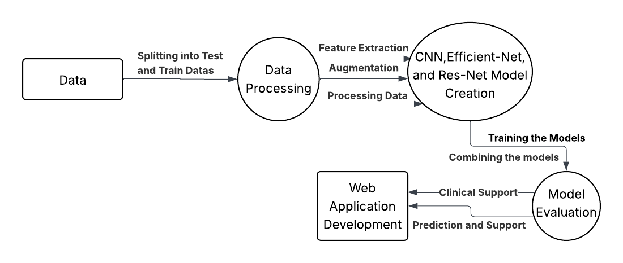
Data Flow Diagram
Level 0

Slide 12
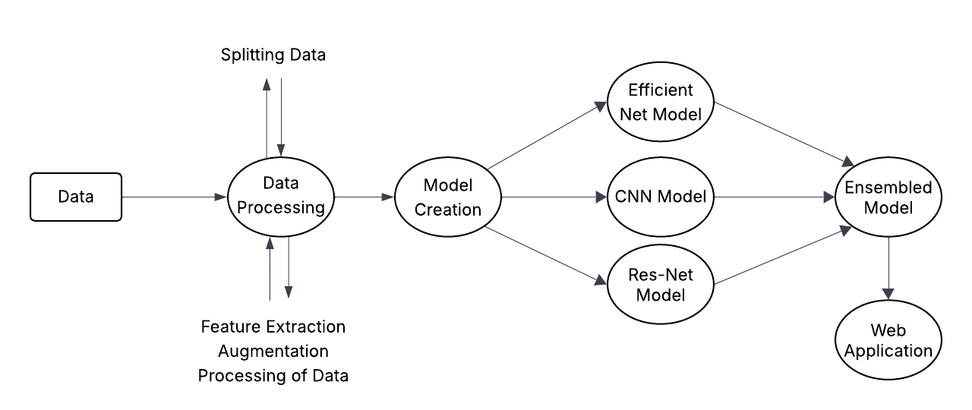
Data Flow Diagram
Level 1

Slide 13
Comparison of Models
Model | Architecture | Accuracy | Overfitting | Time per Epoch | Remarks
Custom CNN | 15-layer CNN | ~87% | Low | Medium | Good Performance
Efficient Net B1 | Efficient-Net Pretrained + Custom Head | ~78 | Medium | Medium | Baseline
ResNet50 | Res-Net Pretrained + Custom Head | ~90% | Low | Medium | Robust generalization

Slide 14
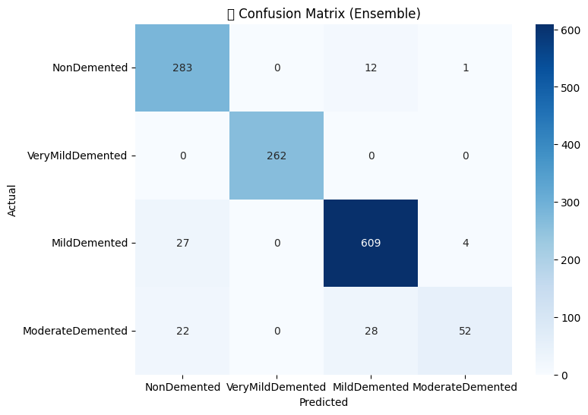
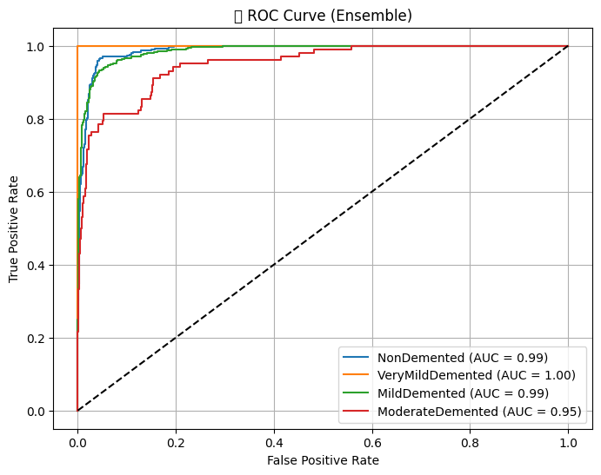
Outputs
Fig 2: ROC curve of the ensembled model
Fig 1: Confusion matrix of the ensembled model

Slide 15
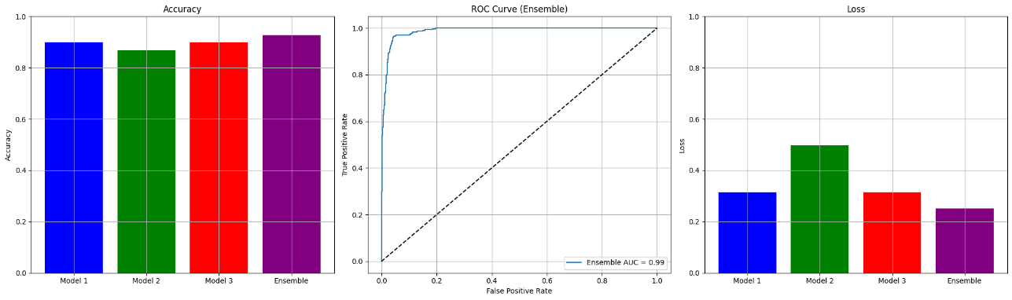
Outputs
Fig 3: Accuracy, Loss and ROC plots

Slide 16
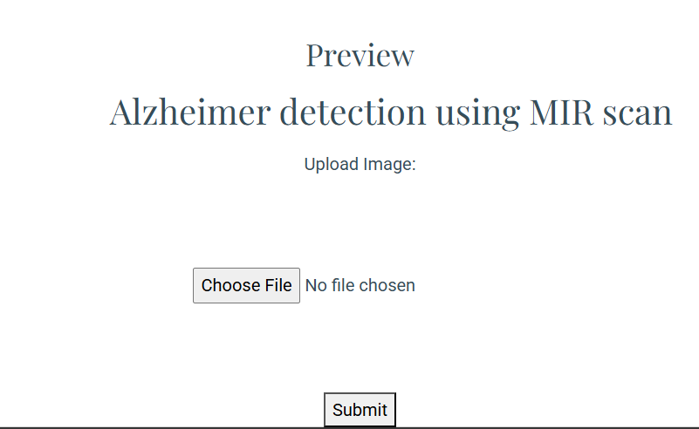
Outputs
Fig 3: Small part of the website were uploading the image

Slide 17

Conclusion
This work introduces the efficient application of deep learning networks, such as CNN-structured networks and pre-trained networks such as ResNet50 and EfficientNetB1, in classifying Alzheimer's disease from MRI scans. By combining several models in an ensemble, we managed to enhance the diagnostic accuracy and minimize classification errors, especially for the more difficult levels of AD, for example, Moderate Demented. In spite of some challenges, such as dataset class imbalance, the models performed satisfactorily with an overall test accuracy of 92.85%.

Slide 18
Future Scope
Multi-modal Integration: Combine MRI, PET, and CSF biomarker data for a more comprehensive diagnosis.
Explainable AI: Implement XAI methods (e.g., Grad-CAM, SHAP) to enhance model transparency.
Real-Time Deployment: Develop cloud-based and mobile applications for instant diagnostic feedback.
Clinical Validation: Collaborate with hospitals to validate and refine the system in real-world settings.
Transfer & Federated Learning: Leverage transfer learning for efficiency and federated learning to safeguard patient data.
Data Expansion: Enrich training datasets with diverse, well-annotated imaging data to improve model robustness.

