Slide 1
VUE
Interns training

Slide 2
WHAT IS VUE ?
An approachable, performant and versatile framework for building web user interfaces.
It's a JavaScript framework for building user interfaces. It builds on top of standard HTML, CSS, and JavaScript and provides a declarative and component-based programming model that helps you efficiently develop user interfaces
Similar to libraries like React
In simple terms - A JavaScript framework which makes building UI simple, fast and easier

Slide 3
PROJECT SETUP
Install nvm: curl -o- https://raw.githubusercontent.com/nvm-sh/nvm/v0.38.0/install.sh | bash
curl -sL https://raw.githubusercontent.com/nvm-sh/nvm/v0.35.0/install.sh -o install_nvm.sh
Update bash_profile: open ~/.bash_profile
export NVM_DIR="$HOME/.nvm"
[ -s "$NVM_DIR/nvm.sh" ] && \. "$NVM_DIR/nvm.sh" # This loads nvm
[ -s "$NVM_DIR/bash_completion" ] && \. "$NVM_DIR/bash_completion" # This loads nvm bash_completion
source ~/.bash_profile
nvm –version
nvm install --lts
npm create vue@latest

Slide 4
STATE
State(s) are parts of a website which can change
These changes are mostly triggered by user interactions or though backend response completion
Unlike in plain JavaScript where we focus on creating/updating the DOM, in Vue we just identify these stateful parts of website and tell Vue how the website html/css should look based on these 'states'. This is called declarative rendering
Official definition of Declarative Rendering: Vue extends standard HTML with a template syntax that allows us to declaratively describe HTML output based on JavaScript state.

Slide 5
VUE COMPONENTS
Components allow us to split the UI into independent and reusable pieces, and think about each piece in isolation
It's common for an app to be organized into a tree of nested components.

Slide 6
SFCs(Single File Components)
Each component is defined in a separate .vue file
A .vue file has 3 parts - <template>, <script>, <style>
<template> defines the HTML content that needs to be displayed in the page based on the 'state'
<script> defines the core logic of the component, including state creation and state updation after user interaction
<style> defines the css which will be applied to the HTML. scoped attribute is set to avoid conflicts of class name between components
Each component can be imported and inserted into another component's <template>

Slide 7
WEBSITE LIFECYCLE
Initial load(DOM mount)
DOM updates caused by user interactions/backend response
DOM removal

Slide 8
VUE COMPONENT LIFECYCLE
Initial render(component mount)
Re-renders/Component updates due to change/mutation in 'state'
Component unmount

Slide 9
setup()
The 'state' variables are created here
Functions to update the state are declared here
Backend api calls required for initial render are made here
Lifecycle hooks are registered here
The setup() returns an object which wraps the state and functions
After setup() is invoked, the Vue component instance is created which has access to all the properties returned in the setup()
These properties can be used in the <template>(data binding)

Slide 10
STATE DECLARATION/CREATION
ref(initialValue)
Function which creates and returns an object with a key called 'value' and object.value = initialValue
InitialValue of the state can be anything - string, number, object, array
eg:- const count = ref(0) creates a state called count with initialValue 0

Slide 11
STATE DECLARATION/CREATION
reactive(objectWithInitialValues)
Function which takes an object as parameter which has keys with initialValues
eg:- const inputState = reactive({ value: '', isValid: true }) creates a state called inputState with inputState.value = '', inputState.isValid = true as initialValues

Slide 12
STATE DECLARATION/CREATION
ref() vs reactive()
For String, Number and Boolean states, only ref() can be used since reactive() doesn't accept primitive value as argument
If multiple String, Number and Boolean states are very closely related, wrapping them in an object and using reactive() is better
For arrays, ref() is preferred and for other objects, use reactive()

Slide 13
STATE UPDATION/MUTATION
ref()
The state should be updated using the value property
eg:- count.value++
reactive()
Directly update the values of the object by using keys
eg: inputState.value = 'new input'; inputState.isValid = false;

Slide 14
Event Handling
Vue provides v-on 'directive', which we typically shorten to the @ symbol, to listen to DOM events and run some JavaScript when they're triggered.
<div v-on:click="handler"/> or with the shortcut, <div @click="handler"/>
eg: <button @click="updateCount"> in <template>
const updateCount = () => count.value++ in <script> setup()

Slide 15
DATA BINDING IN TEMPLATE
The most basic form of data binding is text interpolation using the "Mustache" syntax (double curly braces):
ref()
Eg: <div>The count is {{count}}<div>
{count.value}} would give error -> refs are 'unwrapped' while being passed to <template>, so no .value
reactive()
Eg: <div>The input is {{inputState.value}}<div>

Slide 16
EVENT HANDLING FOR <input>
<input @input="onInputChange" :value="enteredValue"> in <template>
const enteredValue = ref('') and const onInputChange = event => enteredValue.value = event.target.value in <script> setup()
v-model
The v-model directive helps us simplify above code to just: <input v-model="enteredValue"> in <template>
Applicable on @input and :value for text type <input> elements, @change and :checked for "radio" and "checkbox" <input> types, @change and :value for <select> elements

Slide 17
PROPS
Props are custom attributes you can register on a component
State of parent component can be passed to child component as 'prop'

Slide 18
REGISTERING A PROP IN CHILD COMPONENT
ChildComponent.vue <script>
export default {
props: {
propName: {
type: String,
default: '' // required: true
}
},
setup(props) {
console.log(props.propName)
}
}

Slide 19
PASSING PROP VALUE FROM PARENT TO CHILD
ParentComponent.vue
For String props
<template>
<ChildComponent propName="propValue"/>
</template>
For non-static props, including Boolean/Number, use ":" before prop name
<template>
<ChildComponent :propName="propValue"/>
</template>

Slide 20
CONDITIONAL RENDERING
Vue provides <template> directives v-if, v-else-if and v-else which conditionally renders/displays the HTML content based on the state
Syntax:
<div v-if="condition1">Condition 1 is true</div>
<div v-else-if="condition2">Condition 2 is true</div>
<div v-else>Both conditions are false</div>
eg:- <div v-if="count % 2 === 0">Count is even</div>
A v-else element must immediately follow a v-if or a v-else-if element

Slide 21
COMPUTED
Computed state is also known as derived state – state which is derived from other independent state(s)
computed(function)
creates a computed state whose value is equal to the return value of the function
computed state is cached and therefore has performance advantages – they are only evaluated on initial render and then only if the dependent state changes

Slide 22
COMPUTED
complex expressions used in <template> and in js file can be made as computed for better readability
eg:- const isEvenCount = computed(() => count.value % 2 === 0) in <script>
like ref, it also returns an object with 'value' property
Use isEvenCount.value inside <script> or js file and sEvenCount in <template>

Slide 23
COMPUTED DONT'S
Dont make api calls inside computed
Dont change/update the state inside computed
Avoid using computed for deriving from non-state objects, eg: window. Such values aren't 'state'. Use regular const for that

Slide 24
LIFECYCLE HOOKS
During the component lifecycle, Vue also runs functions called lifecycle hooks, giving users the opportunity to add their own code at specific stages.
onMounted(callback)
runs the provided callback after initial render(mount)
DOM can be accessed only from this part of the component cycle
eg:- access an element's height

Slide 25
LIFECYCLE HOOKS
onBeforeUnmount(callback)
runs the provided callback just before component unmount
unmount happens when user navigates away from the page
onUnmounted(callback)
runs the provided callback just after component unmount
used to cleanup timers, DOM event listeners, etc

Slide 26
TEMPLATE REFS
ref is a special attribute which allows us to obtain a direct reference to a specific DOM element or child component instance after it's mounted.
It can be used to access the properties of the element like height, width, or autofocus the element, etc
Eg: in <script>
const inputRef = ref(null)
onMounted(() => inputRef.value.focus())
In <template>
<input ref="inputRef ">

Slide 27
LIST RENDERING
Vue provides v-for directive which can be used to render a list of elements based on an array.
While using v-for, it's mandatory to pass :key prop as an identifier of each element. If no unique 'id' exists, array index can be used as key.

Slide 28
LIST RENDERING
Eg:- const todos = ref(['Learn vue', 'Complete project']) in <script>
<div v-for="(todo, todoIndex) in todos" :key="todo">{{todo}}</div>
will render
<div>Learn vue</div>
<div>Complete project</div>
We get access to todo which is the element in array and the todoIndex which is the array index
todo and todoIndex are accessible for all the child content of the wrapped <div>

Slide 29
WATCH
triggers a callback whenever a piece of reactive state changes
The callback receives the new state and old state values as arguments
Api calls can be made in watch
syntax:
1) for watching ref state
const count = ref(0)
watch(count, (newCount, oldCount) => {
console.log(`count changed from ${oldCount} to ${newCount}`)
})

Slide 30
WATCH
2) for watching any changes in reactive object
const count = reactive({value: 0})
watch(count, (newCount, oldCount) => {
console.log(`count changed from ${oldCount.value} to ${newCount.value}`)
})
* double backticks (``) are used to denote a template literal.

Slide 31
WATCH
3) for watching changes in particular property of reactive object or prop or store/route state change
const count = reactive({value: 0})
watch(() => count.value, (newCount, oldCount) => {
console.log(`count changed from ${oldCount} to ${newCount}`)
})
watch(() => props.propName, (newPropValue, oldPropValue) => {
console.log(`prop changed from ${oldPropValue} to ${newPropValue}`)
})

Slide 32
WATCH
An array of 1), 2), 3)
watch([count, () => props.propName],
([newCount, newPropValue], [oldCount, oldPropValue]) => {
console.log(`count changed from ${oldCount} to ${newCount}`)
console.log(`props changed from ${oldPropValue} to ${newPropValue}`)
})

Slide 33
EVENT EMITTING
While props allow parent component to communicate to/control the child component's behaviour, event emitting allows a child component to communicate to the parent component
Emitting event from child component
export default {
emits: ['customEvent'],
setup(props, context) {
const callParent = () => context.emit(''customEvent'', "dataFromChild")
}
}

Slide 34
EVENT EMITTING
Listening to event emitted from child in Parent component
<template>
<Child @customEvent="handleEventFromChild"/>
</template>
In <script> setup
const handleEventFromChild = (dataFromChild) => {}

Slide 35
OPTIONS API
Before Vue 3.0, there was another syntax which was used by default known as the Options API
Composition API helps to organise code better which is why it's the recommended syntax to use from Vue 3.0

Slide 36
Vue Directives: Built-in Directives
Most used directives in vue:
v-model
v-for
v-show
v-if, v-else, v-else-if
v-bind

Slide 37
Vue Router
Websites typically have multiple pages accessible with different urls
Vue Router is used for routing(navigating) over the application without page reload.
Allows to map the components to a specific route.
npm install vue-router@4

Slide 38
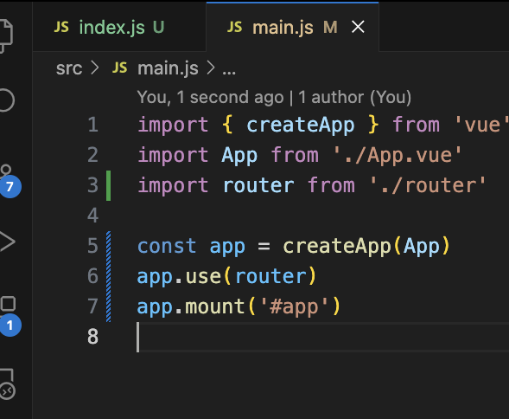
Add router to main.js

Slide 39
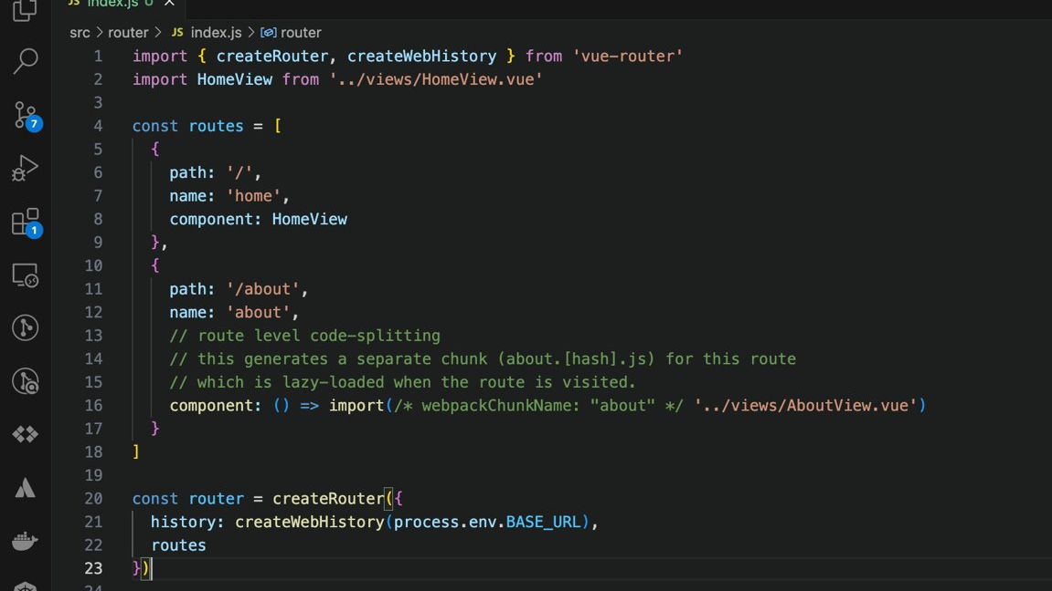

Slide 40
RouterView and RouterLink
The <RouterView/> component tells Vue Router where to render the current route component.
<RouterLink to="/products">Products</RouterLink> is similar to <a :href="/products">Products</a> but vue router handles the navigation without any reload

Slide 41
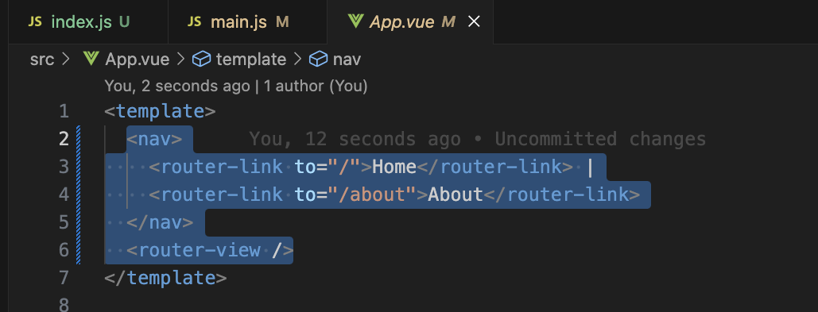
<router-link> and <router-view> example

Slide 42
Navigation using vue router
router.push('/products') - navigates to a page with path '/products'
router.push({ name: 'ProductDetail', params:{ productId : 'a29893kwwe' } }) - navigates to a page with name 'ProductDetail' and replaces the id in route url with 'a29893kwwe'. Eg:- 'ProductDetail' page with path /products/:productId will become /products/a29893kwwe
router.push({ name: 'Products', query:{ category: 'clothing'} }) - naviagtes to /products?category=clothing
router.go(-1) - go back in history by one, the same as router.back()
router.push('/products/a29893kwwe?action=cart')

Slide 43
State Management with Pinia
Pinia is a store library for Vue.
Pinia allows you to share a state across components/pages.
A store should contain data that can be accessed throughout your application. It hosts global state.
npm install pinia

Slide 44
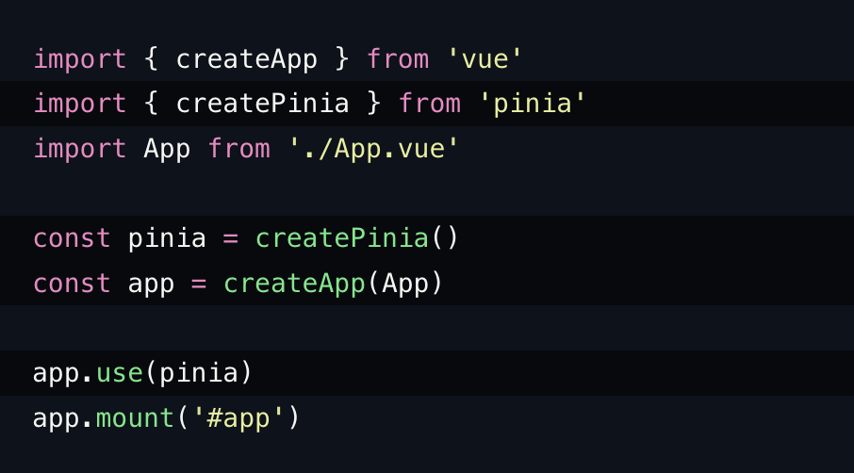

Slide 45
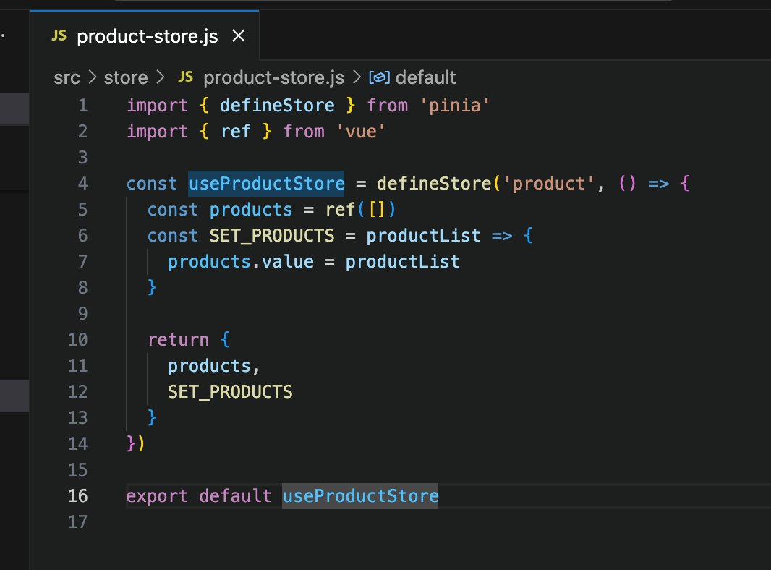

Slide 46
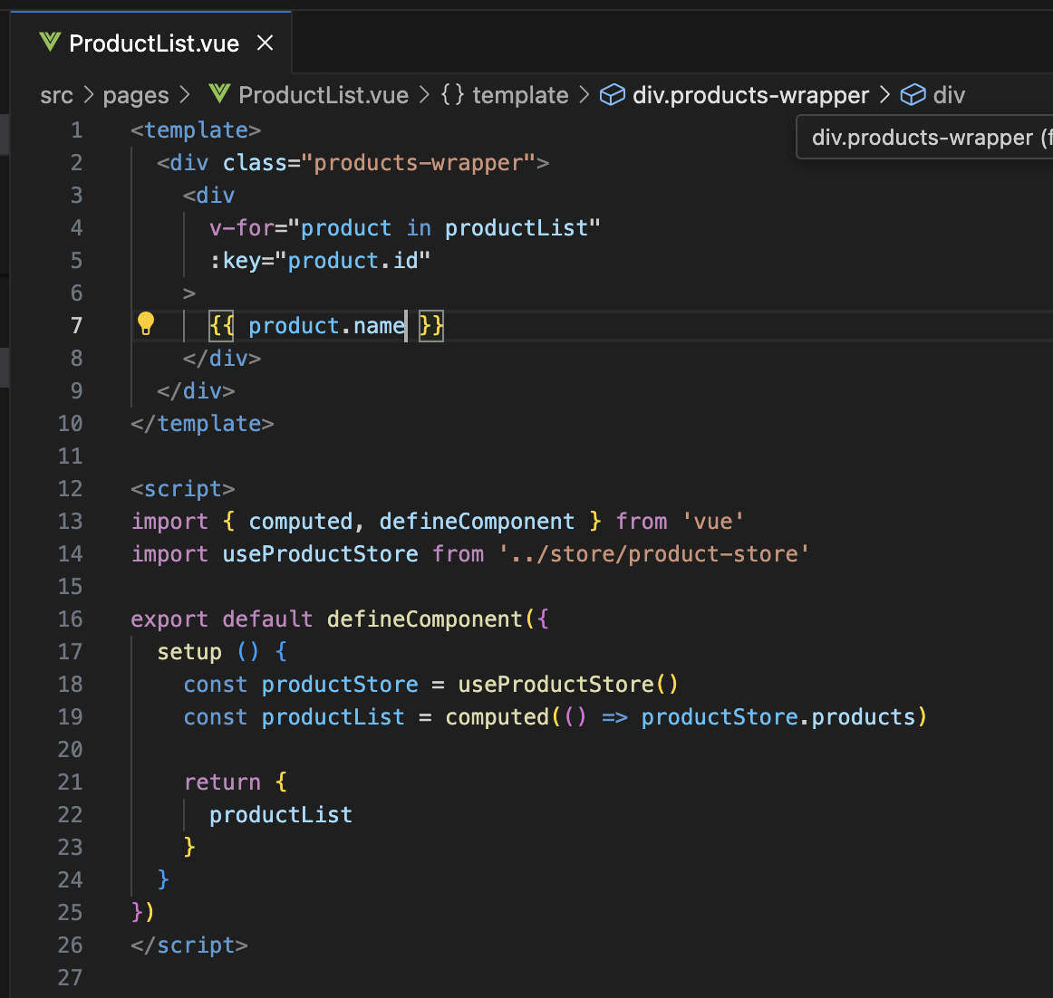

Slide 47
API Calls with Vue - FETCH
setup() { const products = ref(null); fetch(‘API_END_POINT’) .then(response => response.json()) .then(data => products.value = data);
}
The Fetch API provides a JavaScript interface for making HTTP requests and processing the responses.

Slide 48
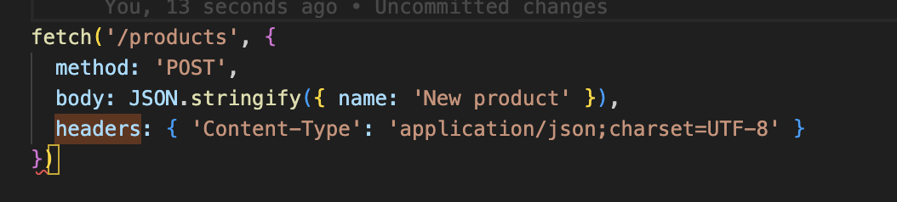
FETCH
With the Fetch API, you make a request by calling fetch(), which is available as a global function in both window and worker contexts.
POST request using fetch

