Slide 1
Introduction to javascript

Slide 2
Table of contents
What is Javascript?
Variables
Data types
Functions
Objects
This keyword
Arrays
Callbacks
Promises
JSON
Fetch
Async await
Cookies
Web Storage - Local storage, Session storage
DOM

Slide 3
What is Javascript?
A high-level, interpreted, synchronous programming language.
Used to create interactive effects within web browsers.
Essential for web development alongside HTML and CSS.
Can be used for both frontend and backend development (Node.js).
Dynamically typed, prototype-based, and event-driven.

Slide 4
Variables
Use meaningful names.
Declared using let, const or var.
should not start with digit.
Can have special character like $ and _.

Slide 5
Let, const and var
var: Function-scoped.
let and const: Block-scoped (only accessible within the block they are defined)
var and let can create variables that can be reassigned.
const cannot be reassigned.
Var can be redeclared, unlike const or let.
Let, const are preferred.

Slide 6
Task

Slide 7
Data types
Primitive Types: String, Number, Boolean, Undefined, Null, Symbol, BigInt.
Non-Primitive: Objects [Arrays, functions..etc]

Slide 8
Functions
Functions are reusable blocks of code designed to perform specific tasks. They allow you to encapsulate logic and execute it wherever needed, promoting code reusability and modularity.
Functions are Objects.

Slide 9
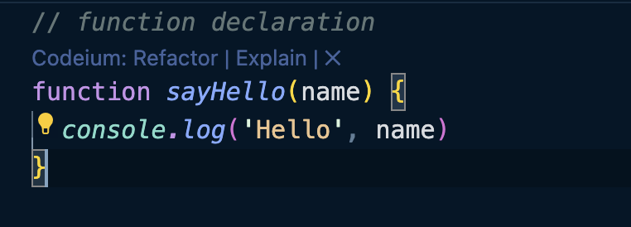
Types of function
Function Declarations

Slide 10
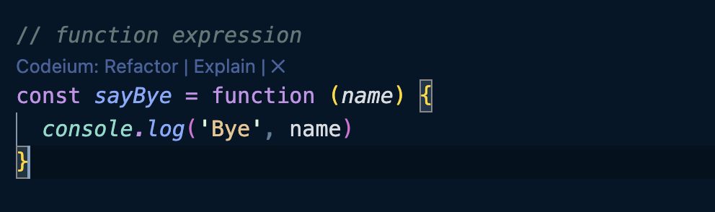
Function Expression

Slide 11
Difference Between Function expression and Function Declaration
-function declaration can be called before initialization
-function expression can be called after initialization
In general it is recommended to use function declaration. However it could vary depending on the use case

Slide 12
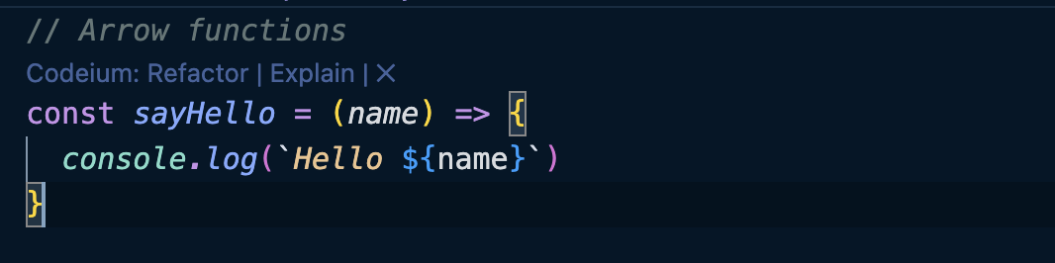
Arrow Functions

Slide 13
Task
Function Declaration
Create a function named findMax that takes five numbers as a parameter and returns the largest number
Function Expression
Define a function expression named sum that takes five numbers and returns the sum of all the numbers
Arrow Function
Create a function to multiply 2 numbers.

Slide 14
Objects
Objects are collections of key-value pairs where each key is a string (or symbol) and each value can be any data type. Objects are fundamental for organizing and storing related data and functions in JavaScript.
Object are copied by reference whereas primitives are copied by value.
Property of object can be keyword.

Slide 15
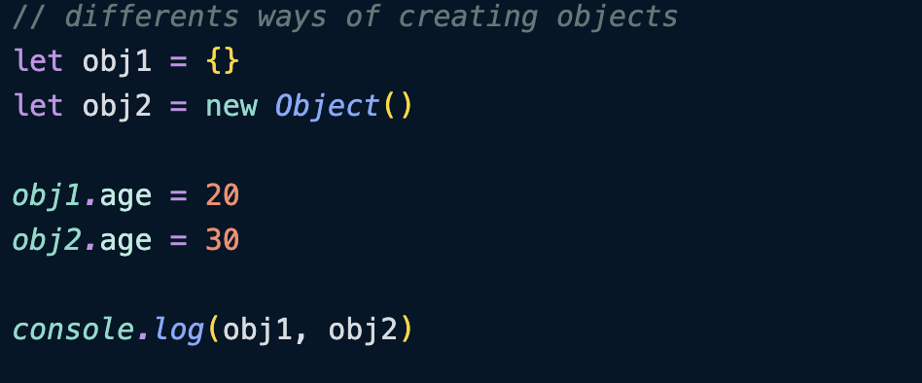

Slide 16
This keyword
The this keyword refers to the object that is currently executing the code.
In the global scope (outside of any function), this refers to the global object (window in browsers, global in Node.js).
When a function is called as a method of an object, this refers to the object that the method is a property of.
In a regular function, this refers to the global object. However, in strict mode, this is undefined.
Arrow functions do not have their own this. Instead, this is lexically bound, meaning it refers to the this value from the enclosing context.

Slide 17
Task
create a simple inventory management system for a small bookstore. The system should help the bookstore keep track of the books available in the store.
Create a Book Object:
Define a Book object that includes the following properties:
title (string)
author (string)
price (number)
isAvailable (boolean)

Slide 18
Create an Inventory Object:
Define an Inventory object that includes the following:
A property books which is an object to store books with titles as keys and Book objects as values.
A method addBook(book) that adds a new book to the inventory by title.
A method removeBook(title) that removes a book from the inventory based on the title.
A method findBook(title) that returns the details of a book by its title.
A method listAvailableBooks() that returns a string of titles of all books that are currently available.

Slide 19
Test the Inventory System:
Create a few Book objects and add them to the inventory using the addBook method.
Test removing a book and finding a book by title.
Finally, list all available books in the inventory.

Slide 20
Arrays
Arrays in JavaScript are objects used for storing multiple values in a single variable. They are ordered collections of values.
They can store values of any type.
Arrays can be created using the [] syntax or the Array constructor.
let arr1 = [1, 2, 3, 4, 5]
let arr2 = new Array()

Slide 21
Array Methods
push()
Purpose: Adds one or more elements to the end of an array.
Return Value: Returns the new length of the array.
pop()
Purpose: Removes the last element from an array.
Return Value: Returns the removed element. If the array is empty, it returns undefined.

Slide 22
shift()
Purpose: Removes the first element from an array.
Return Value: Returns the removed element. If the array is empty, it returns undefined.
unshift()
Purpose: Adds one or more elements to the beginning of an array.
Return Value: Returns the new length of the array.

Slide 23
splice()
Purpose: Adds or removes elements from an array at a specified index.
Parameters:
start: The index at which to start changing the array.
deleteCount (optional): The number of elements to remove.
item1, item2, ... (optional): Elements to add to the array.
Return Value: An array of the removed elements

Slide 24
slice()
Purpose: Creates a copy of a portion of an array into a new array object.
Parameters:
start: The beginning index of the slice (inclusive).
end (optional): The end index of the slice (exclusive).
Return Value: A new array containing the extracted elements.

Slide 25
map()
Purpose: Creates a new array with the results of calling a provided function on every element in the array.
Parameters:
callback: A function that is called for each element in the array.
Return Value: A new array containing the results of the function

Slide 26
filter()
Purpose: Creates a new array with all elements that pass a test implemented by a provided function.
Parameters:
callback: A function that is called for each element in the array, returning true to keep the element or false to discard it.
Return Value: A new array containing the elements that pass the test.

Slide 27
reduce()
Purpose: Executes a reducer function on each element of the array, resulting in a single output value.
Parameters:
callback: A function that takes an accumulator and the current value.
initialValue (optional): The initial value for the accumulator.
Return Value: The final value after applying the reducer function.

Slide 28
sort()
Purpose: Sorts the elements of an array in place and returns the sorted array.
Parameters:
compareFunction (optional): A function that defines the sort order.
Return Value: The sorted array.

Slide 29
Task
const students = [
{ name: "Alice", age: 20, grade: 85 },
{ name: "Bob", age: 22, grade: 90 },
{ name: "Charlie", age: 19, grade: 78 },
{ name: "John", age: 21, grade: 82 }
]
Expected Output
Updated array with two new students added.
Updated array with the last student removed.
Array of students older than 18.
Array of grades.
Average grade of all students.
Array of students sorted by grades in descending order.
Array with the first 3 students.

Slide 30
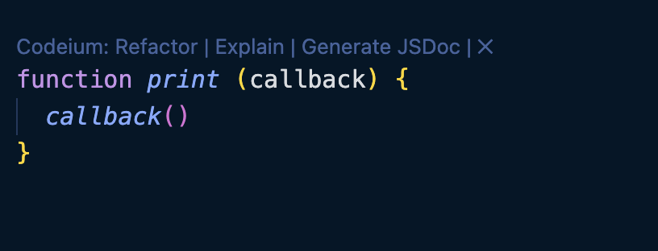
Callback function
we can pass functions as parameters to other functions and call them inside the outer functions.
Useful in asynchronous programming

Slide 31
Callback hell
Assume we have to achieve a task say D.
To achieve task D, we need to execute a series of dependent tasks ranging from A to C asynchronously.
First we execute task A, we get the result and task B need to depend on result A to start its execution.
Similarly, unless result B is produced we can't execute task C.
This leads to the chaining of tasks from A to D, which creates a set of nested callbacks.

Slide 32
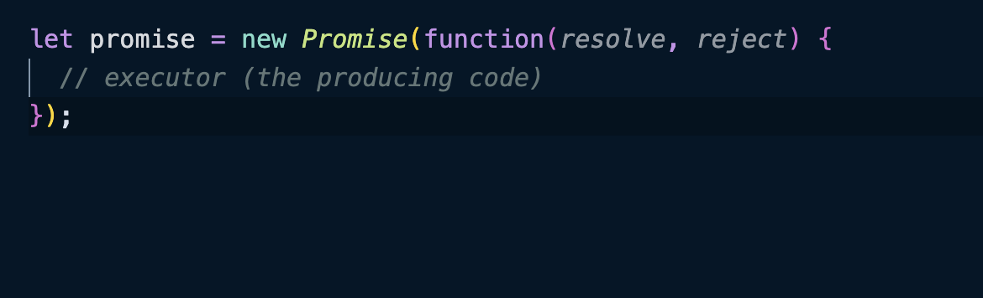
Promises
A Promise in JavaScript is an object that represents the eventual completion (or failure) of an asynchronous operation and its resulting value.
Executor function is automatically called when promise is constructed.
resolve and reject are callbacks, which gets executed when executor obtains the result,

Slide 33
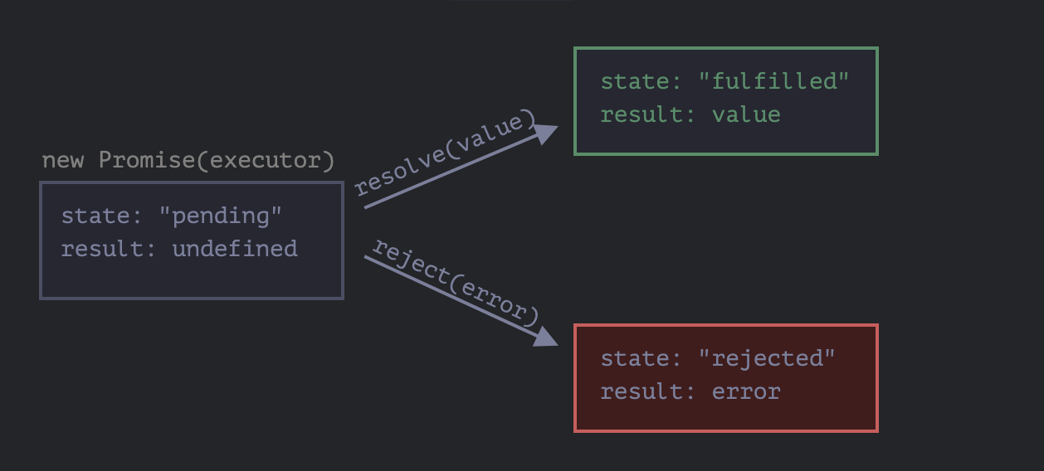

Slide 34
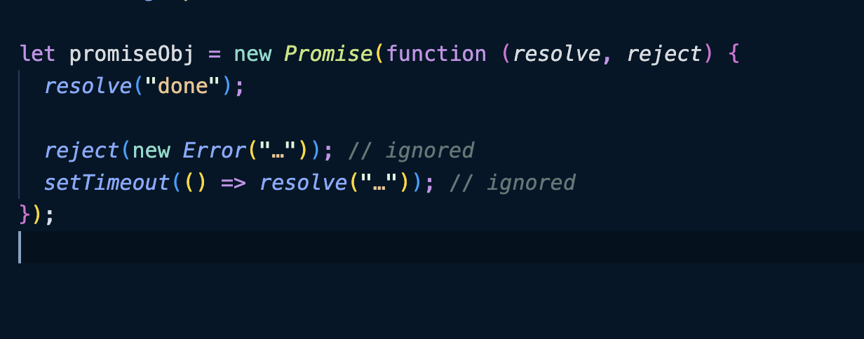

Slide 35
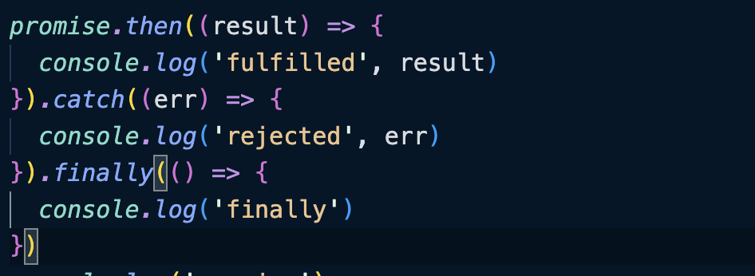
Consumers (then, catch, finally)

Slide 36
Task
You need to simulate a delay in executing a function using Promises.
Your task is to write a function “delayedExecution” that:
Takes a callback function “fn “ and a delay time in milliseconds delay as input, and a message to be printed in callback fn.
Returns a Promise that resolves after the specified delay, then calls the callback function.
Requirements:
Use setTimeout to simulate the delay.
The function should return a Promise.
The Promise should resolve only after the specified delay and then execute the callback function.

Slide 37
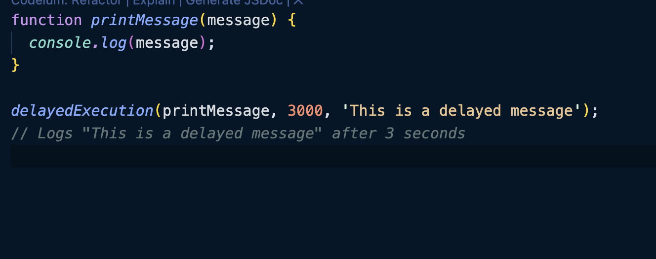
Example:

Slide 38
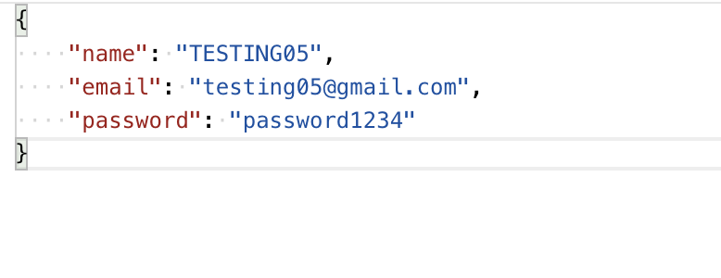
Working with REST APIs
RESTful APIs typically use JSON (JavaScript Object Notation) or XML to format the data being exchanged.
JSON represents data as key-value pairs. It is text-based and structured in a way that resembles JavaScript objects.

Slide 39
Parsing and Stringifying
Parsing: Converting a JSON string into a JavaScript object. In JavaScript, this is done using JSON.parse().
Stringifying: Converting a JavaScript object into a JSON string. This is done using JSON.stringify().

Slide 40
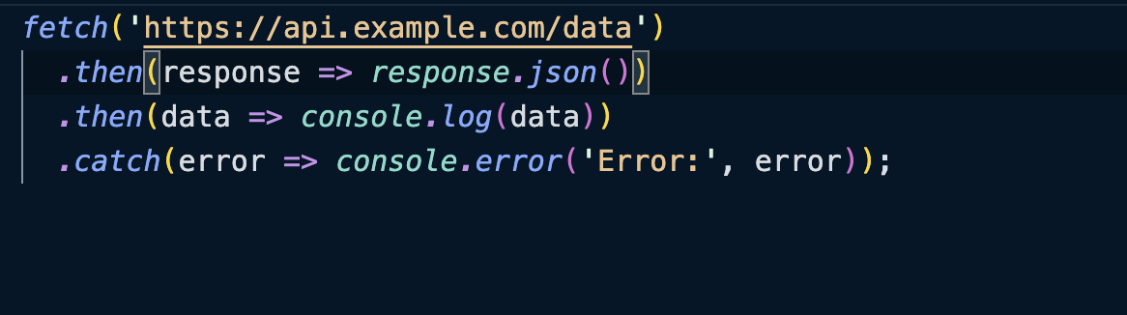
Fetch
Interface for making HTTP requests to servers.
Fetch uses Promises, making it easier to handle asynchronous operations and providing a cleaner, more readable syntax.

Slide 41
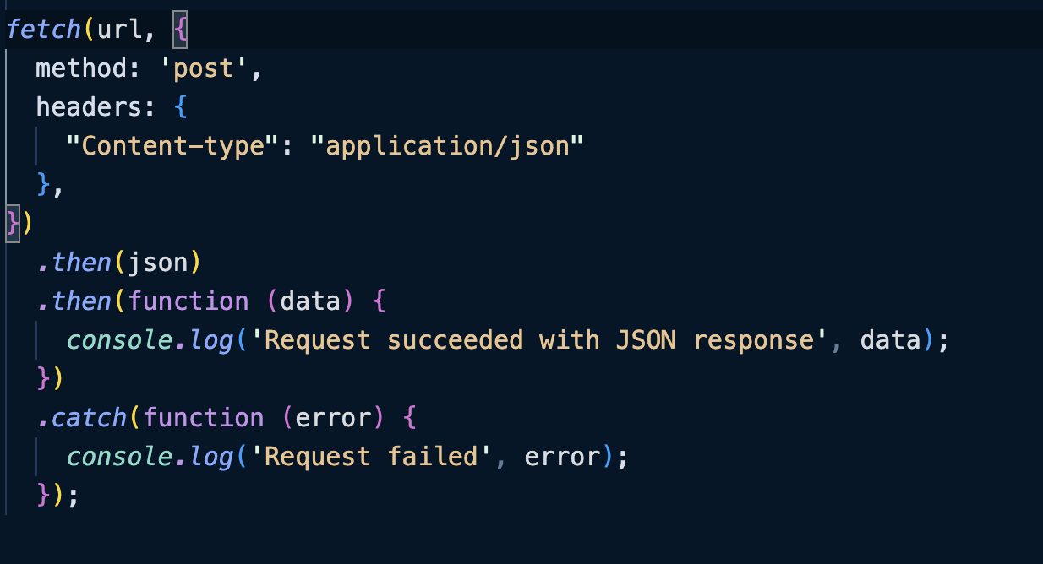
Making Post request:

Slide 42
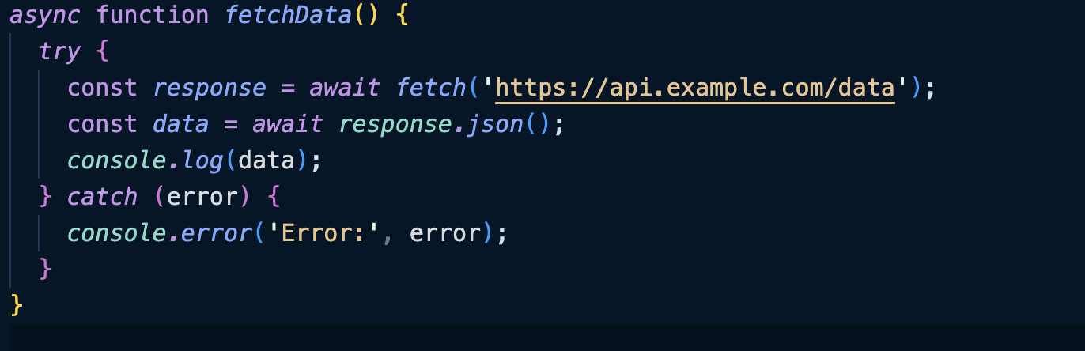
Async await

Slide 43
Cookies
Strings of data stored in web browser which has an expiry date.
Usually set by web server using http response header “Set-Cookie”
Browser automatically sends these cookies for every network request made from client.
Can be accessed by “document.cookie”.
Maximum size: 4kb.
Cookie cannot be accessed from different domain,

Slide 44
Web Storage
Local Storage
Data persist even after closing browser or rebooting OS.
Max size: 5MB
Cannot be manipulated by HTTP headers. Some methods:
setItem(key, value) – store key/value pair.
getItem(key) – get the value by key.
removeItem(key) – remove the key with its value.
clear() – delete everything.

Slide 45
Session storage
It exists only for the current tab,
Cannot be shared with different tab.
Maximum size is same as local storage.
Has similar methods like local storage.(get, set..)

Slide 46
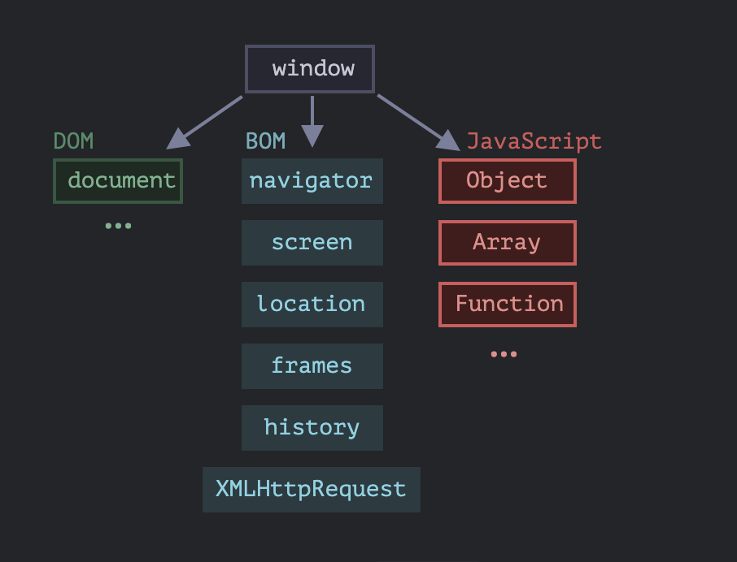
DOM
The Document Object Model, or DOM for short, represents all page content as objects that can be modified.

Slide 47
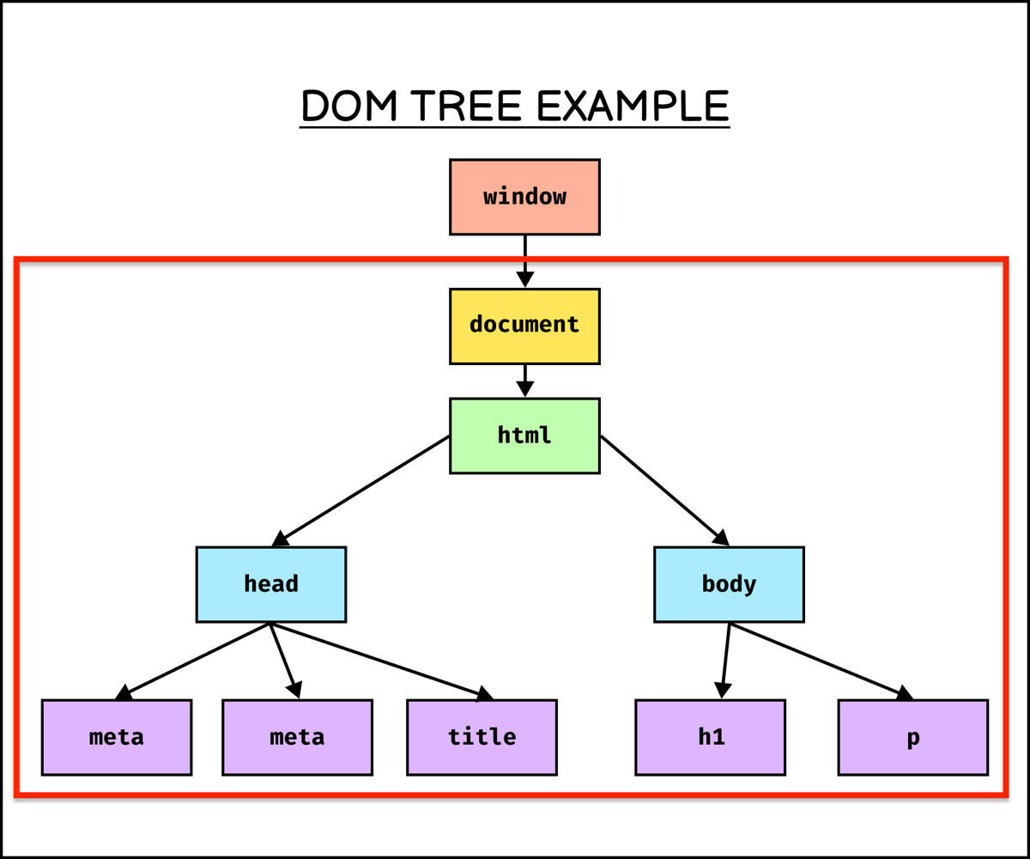
DOM Tree
DOM represents HTML as a tree structure of tags.
Every tag is an object.

Slide 48
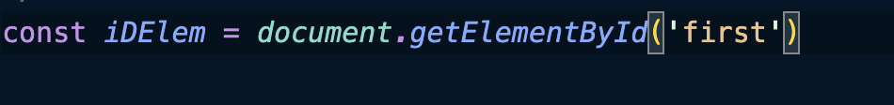
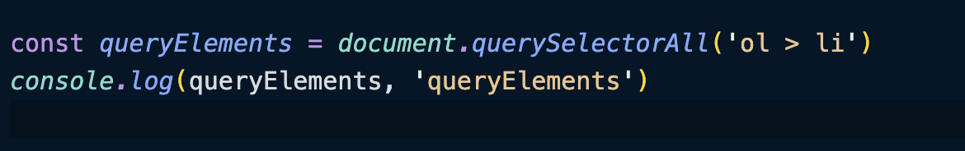
Searching Element
document.getElementById(id) - looks for the given id in the whole document
document.querySelectorAll(css) - returns an array of elements which matches css selector

Slide 49
Modifying document
Some useful methods in modifying the DOM
document.createElement('div')
document.body.appendChild(ele)
elem.insertAdjacentHTML(where, html)
where: 'beforebegin', 'afterbegin', 'beforeend', 'afterend'

Slide 50
Task
Dynamically fill a list using Prompt
Take all input from user using prompt method
Add it to <li> tag
Text should have font-size to be 16px
Display the content

Slide 51
Assignment
Create a web application using HTML, CSS, and vanilla JavaScript that allows users to browse through meal categories, search for specific categories, view meals within a category, and see detailed information about each meal
Home Page
->List All Meal Categories as Grid view with associated info like thumbnail, name etc.
-> Implement a search bar that allows users to search for meal categories by name.
Category Page
->When a user clicks on a meal category from the home page, navigate to a new page that lists all the meals available in that category.
->When a user clicks on a specific meal, display a popup that shows:
-The recipe for the meal.
-A YouTube link to a video related to the recipe.
-Other relevant details about the meal

Slide 52
APIs to be used:
To list all categories
-www.themealdb.com/api/json/v1/1/categories.php
To get meal by category
-www.themealdb.com/api/json/v1/1/filter.php?c={category name}
To get recipe of each meal
-https://www.themealdb.com/api/json/v1/1/search.php?s={meal name}

