Slide 1
FINAL RESEARCH PROJECT DEFENSE • PREPRINT WORKING PAPER
Autonomic Cloud Resilience Through
Brownout-Based Graceful Degradation
A Simulation-Based Evaluation of Brownout-Aware Load Balancing (BALB)
Hari Prasad L
Lead Author & System Architect
Core Balancer Architecture, DEC-010 Formulation & Paper Writing
Yeruva Mahesh Reddy
Evaluation & Statistical Analysis
360-Run Factorial Benchmark, Paired Tests & Sensitivity Sweep
K. Ram Charan
Controller Design & Implementation
Velocity-Form PI Controller, Multi-Stream PRNG & Telemetry Engine
Tushar (23BCS130)
Research Team Member
Department of Computer Science and Engineering, IIIT Dharwad
Department of Computer Science and Engineering and Department of Data Science and AI Engineering
Indian Institute of Information Technology Dharwad (IIIT Dharwad), Karnataka, India
Preprint Working Paper • Target Venues: IEEE Transactions on Cloud Computing / ACM TAAS • November 2026

Slide 2
CONTEXT & PROBLEM
The Cloud Resilience Challenge: Unpredictable Shocks
Stochastic traffic surges and compute instance crash-stops induce non-linear queuing collapse
Demand-Side Shocks (Flash Crowds)
• Sudden traffic surges where arrival rate λ doubles from nominal 70 to 140 req/s (140% cluster capacity).
• Driven by breaking news events, viral spikes, flash sales, or coordinated client retries.
• Arriving request rate exceeds aggregate processing capacity of operational worker instances.
Capacity-Side Shocks (Server Crashes)
• Abrupt hardware faults, hypervisor evictions, memory exhaustion, or unhandled software crashes.
• Half the cluster compute capacity vanishes simultaneously (Workers 1 & 2 drop offline at t = 300s).
• Available processing capacity instantly drops from 100 req/s to 50 req/s while traffic persists.
The Non-Linear Queuing Tipping Point
• In multi-server queueing systems, waiting delay W_i scales non-linearly with traffic intensity ρ.
• Finite FIFO buffers (Q_max = 50) rapidly saturate, causing severe Head-of-Line (HOL) blocking.
• Client timeout deadline (200 ms) breached, causing widespread queue dropouts and SLA breakdown.
CRITICAL IMPLICATION: CATASTROPHIC UNMANAGED FAILURE
Under unmanaged operation (CFG-A), SLA failure rate escalates from 26.54% (nominal) to 44.04% (flash crowd) and 47.70% (compound stress). Dropped requests consume network bandwidth, waste upstream compute resources, and deliver zero value to end users.
CloudRescue Research • IIIT Dharwad • November 2026
Slide 2 of 15

Slide 3
CONTEXT & MOTIVATION
Breakdown of Conventional Cloud Resilience Defenses
Hardware over-provisioning is economically wasteful; reactive auto-scaling is dangerously slow
Static Hardware Over-Provisioning
• Mechanism: Maintain redundant pools of hot-standby instances provisioned for theoretical peak load.
• Economic Inefficiency: Massive capital and operational expenditures; servers sit idle under nominal load (Welsh & Benkhelifa [1]).
• Fragility to Compound Shocks: Completely defeated when correlated compound shocks exceed provisioned ceilings.
Reactive Horizontal Auto-Scaling
• Mechanism: Monitor threshold breaches (e.g. CPU > 80%) to dynamically spawn new VM/container instances.
• The Critical Provisioning Gap: Virtual machine allocation, container pull, OS boot, and runtime warmup require 60 to 300+ seconds (Cartlidge & Sriram [5]).
• Cascading Failure: Ingress queues saturate in 5–10s, triggering client timeouts before new instances become operational.
The Paradigm Shift: Graceful Degradation
• Software-Level Autonomic Adaptation: Real-time capacity expansion within existing physical infrastructure.
• Brownout Paradigm: Temporarily sheds optional microservice features (recommendations, analytics) to preserve core business transactions.
• Sub-Second Response: Adapts instantly (< 1.0s) without incurring hardware allocation latency.
CORE RESEARCH MOTIVATION
Modern cloud systems cannot rely solely on physical scaling to survive sudden shocks. An effective resilience mechanism must act instantaneously at the application layer to guarantee bounded response latency and high availability during extreme stress.
CloudRescue Research • IIIT Dharwad • November 2026
Slide 3 of 15

Slide 4
PROBLEM FORMULATION
The Join-Shortest-Queue (JSQ) Pathology Under Brownout
Uncoordinated brownout controllers and agnostic load balancers create destructive load skew
THE DESTRUCTIVE JSQ FEEDBACK LOOP
1. Local Congestion
A worker experiences elevated response latency; its local PI controller reduces dimmer θ → 0.
2. Rapid Queue Clearing
Degraded worker executes only mandatory code (10 ms vs 40 ms), clearing its queue 4× faster.
3. Misguided Agnostic Dispatching
Agnostic JSQ proxy sees the short queue and dumps MORE traffic onto the already degraded worker!
4. Severe Starvation & Load Skew
Healthy workers at full fidelity (40 ms) retain longer queues and are starved of incoming requests.
EMPIRICAL PATHOLOGY & RESEARCH GAP
• Severe Load Skew: In CFG-B (Brownout + JSQ), Jain's fairness index collapses to J = 0.607 (Nominal) and 0.646 (Crash), violating workload equity.
• Delayed Recovery: Repaired workers take up to 323s to recover or suffer permanent right-censoring because incoming load is unfairly steered.
• Prior Literature Gap: Foundational works (Klein et al. [2, 3], Tomas & Tordsson [8]) deployed brownout controllers in isolation or with naive heuristics.
• Research Opportunity: Co-designing an ingress load balancer that coordinates with local brownout elasticity states to restore fairness and accelerate recovery.
CloudRescue Research • IIIT Dharwad • November 2026
Slide 4 of 15

Slide 5
PROPOSED ARCHITECTURE
CloudRescue: Co-Designed Autonomic Resilience
Decentralized local PI controllers combined with centralized Brownout-Aware Load Balancing
Pillar 1: Velocity-Form PI Controller
• Deployed locally on every worker node.
• Monitors empirical 95th-percentile response latency r_95,w(t) at 1.0s epochs.
• Setpoint r_target = 80 ms provides a 20 ms safety margin below the 100 ms SLA threshold.
• Intrinsic anti-windup clamping [0.0, 1.0] eliminates integrator windup without reset heuristics.
Pillar 2: Brownout-Aware Balancing (BALB)
• Deployed at cluster ingress reverse proxy.
• Computes multi-attribute dispatch score: Score = α*θ - β*(q/Q_max) - γ*U.
• Decouples buffer backlog risk from historical CPU utilization.
• Anti-overloading penalty with soft-overload fallback (α = 0 when q_w ≥ Q_soft).
Pillar 3: Graceful Degradation Model
• Admitted requests execute mandatory core logic (10 ms) unconditionally.
• Optional computation (30 ms) dynamically modulated by worker dimmer θ_w ∈ [0, 1].
• Throughput expands up to 4× (100 → 400 req/s) under full degradation.
• Eliminates client drops while preserving critical transaction integrity.
ARCHITECTURAL SYNERGY: THE POWER OF CO-DESIGN
By pairing local velocity-form PI feedback with global elasticity-aware routing, CloudRescue guarantees that degraded workers are not unfairly overloaded, healthy workers are utilized effectively, and tail latency remains strictly bounded under extreme stress.
CloudRescue Research • IIIT Dharwad • November 2026
Slide 5 of 15

Slide 6
SYSTEM DESIGN
Cluster Topology & Dual-Stage Execution Pipeline
Multi-worker microservice cluster with closed-loop telemetry and dynamic capacity expansion
LOGICAL ARCHITECTURE TOPOLOGY
• Ingress Proxy Layer:
Accepts stochastic client requests. Routes via CFG-A (JSQ), CFG-B (JSQ), or CFG-C (BALB scoring).
• M = 4 Independent Workers:
Each maintains an independent FIFO queue (capacity Q_max = 50). HOL timeout threshold W_i > 200 ms.
• Local Control Loop:
Worker controllers sample completed request latencies every Δt_ctrl = 1.0s and broadcast [θ_w, q_w, U_w] telemetry.
• Failure Injection Module:
Deterministically triggers crash-stop and restoration events (e.g. Workers 1 & 2 down at t=300s, restored at t=450s).
DUAL-STAGE EXECUTION & CAPACITY EXPANSION
• Stage 1: Mandatory Service (S_mand):
Exponentially distributed, mean μ_mand = 10 ms. Core financial transaction, order persistence, authentication.
• Stage 2: Optional Service (S_opt):
Exponentially distributed, mean μ_opt = 30 ms. Executed iff U_opt ≤ θ_w(t). Recommendations, analytics, rich styling.
• Full Fidelity Execution (θ = 1.0):
Expected service duration E[S] = 40 ms. Individual worker throughput: 25 req/s. Aggregate cluster capacity: 100 req/s.
• Degraded Execution (θ = 0.0):
Expected service duration E[S] = 10 ms. Individual worker throughput: 100 req/s. Aggregate cluster capacity: 400 req/s.
• Instantaneous 4× Expansion:
Shedding optional features expands compute capacity by 400% without spawning new hardware or incurring VM boot lag!
CloudRescue Research • IIIT Dharwad • November 2026
Slide 6 of 15

Slide 7
ALGORITHMIC FOUNDATION
Local Velocity-Form Discrete PI Controller
Continuous dimmer modulation, intrinsic anti-windup clamping, and telemetry safeguards
1. Error Formulation & Sign Convention
• Feedback Metric: Empirical 95th-percentile response latency r_95,w(t) evaluated over completed requests in preceding 1.0s window.
• Error Definition: e_w(t) = r_target - r_95,w(t)
• Setpoint Selection: r_target = 80.0 ms (enforces a 20 ms safety buffer below r_SLA = 100.0 ms).
• Sign Physics: Overload (r_95 > 80ms) yields negative error (e < 0) driving dimmer downward; underload (e ≥ 0) restores dimmer upward.
2. Velocity-Form Incremental Update
• Mathematical Recurrence: Δθ_w(t) = K_p*(e_w(t) - e_w(t-1)) + K_i*e_w(t)*Δt_ctrl
• Tuned Parameters: K_p = 0.001, K_i = 0.0005, control period Δt_ctrl = 1.0s.
• Raw Dimmer Adjustment: θ_raw_w(t) = θ_w(t-1) + Δθ_w(t)
• Stability: Operates purely on error differences, eliminating cumulative error drift and dampening oscillation.
3. Anti-Windup Clamping & Guard
• Intrinsic Output Clamping: θ_w(t) = min(1.0, max(0.0, θ_raw_w(t)))
• Integrator Windup Prevention: Clamping the velocity output prevents the internal integrator from saturating during sustained overload.
• Data Sufficiency Guard: If completed requests N_ctrl < N_min_ctrl = 5, skips PI update and holds θ_w(t) = θ_w(t-1).
• Prevents stochastic estimation noise from causing false degradation during low-traffic windows.
MATHEMATICAL CONTROL LAW SUMMARY
e_w(t) = 80.0 ms - r_95,w(t) ==> Δθ_w(t) = 0.001*(e_w(t) - e_w(t-1)) + 0.0005*e_w(t)*1.0 ==> θ_w(t) = clamp(θ_w(t-1) + Δθ_w(t), 0.0, 1.0)
CloudRescue Research • IIIT Dharwad • November 2026
Slide 7 of 15

Slide 8
ALGORITHMIC FOUNDATION
Brownout-Aware Load Balancing (BALB)
Composite elasticity scoring, anti-overload bounds, and soft-overload fallback
MULTI-ATTRIBUTE ROUTING SCORE
Score_w(t) = α*θ_w(t) - β*(q_w(t) / Q_max) - γ*U_w(t)
• Term 1: Dimmer Elasticity (α = 1.0):
Provides positive preference for workers operating at higher service fidelity. Encourages optional feature execution when capacity allows.
• Term 2: Normalized Backlog (β = 2.0):
Penalizes queue occupancy (q_w / Q_max). Prevents buffer overflow and protects queuing delay headroom.
• Term 3: Historical CPU Utilization (γ = 0.5):
Penalizes cumulative CPU busy time U_w. Prevents dispatching ping-pong thrashing between workers.
• Routing Decision:
Request dispatched to: w* = argmax_w Score_w(t). Ties broken via uniform random selection.
ANTI-OVERLOAD PENALTY & FALLBACK
• Soft-Overload Threshold (Q_soft = 40):
Defined at 80% of buffer capacity (Q_soft = 0.8 * Q_max = 40 requests). Acts as an early congestion circuit-breaker.
• Elasticity Clamping (α = 0 when q_w ≥ Q_soft):
When a worker's queue reaches Q_soft, its dimmer elasticity bonus is instantly zeroed (α ← 0).
• Preventing High-Dimmer Trap:
Guarantees that a worker retaining a high dimmer cannot attract requests when its queue buffer is dangerously saturated.
• Soft-Overload Fallback:
If all operational workers have saturated queues (q_w ≥ Q_soft) or negative scores, BALB reverts to pure queue minimization: w* = argmin_w q_w.
• Headroom Guarantee:
Ensures the cluster never drops requests due to score distortion under extreme compound stress.
CloudRescue Research • IIIT Dharwad • November 2026
Slide 8 of 15

Slide 9
EXPERIMENTAL METHODOLOGY
Multi-Stream PRNG Isolation & Factorial Design
Deterministic Common Random Numbers (CRN) stream isolation across 360 primary simulation runs
Multi-Stream PRNG Architecture
• The Confounding Problem: In stochastic simulation, shedding optional tasks draws fewer random numbers, desynchronizing baseline vs treatment arrival streams.
• CloudRescue PRNG Solution: 3 independent PCG64 bit-generator streams derived deterministically from master seed S:
• - Stream 1: Request Arrival Schedules (Poisson timestamps).
• - Stream 2: Mandatory Processing Times (Exp, 10 ms).
• - Stream 3: Optional Processing Times (Exp, 30 ms).
• Confounding Eliminated: All configurations process identical arrival timestamps and service demands!
Three-Way Factorial Matrix
• Ablation Matrix evaluates 3 core configurations:
• - CFG-A (Baseline): Unmanaged Baseline (No Brownout + JSQ). Industry default.
• - CFG-B (Ablation): Local Brownout Adaptation (Brownout + JSQ). State-of-the-art literature.
• - CFG-C (Proposed): Full CloudRescue (Brownout + BALB). Co-designed architecture.
• 4 Operational Scenarios: Nominal, Flash Crowd, Server Crash, and Compound Stress.
• Sample Scale: 4 Scenarios × 3 Configurations × 30 Matched Seeds = 360 Primary Runs.
Statistical Battery Rigor
• Normality Pre-Testing: Shapiro-Wilk test on paired differences (D_k) at α = 0.05.
• Paired Testing Battery: Paired Student's t-test for normal distributions; Wilcoxon signed-rank test for non-normal distributions.
• Effect Sizes: Standardized Cohen's d_z effect sizes across all matched pairs.
• Multiple Testing Corrections: Bonferroni adjustment (m = 114 family tests) and Benjamini-Hochberg False Discovery Rate (FDR q-values).
• Full Reproducibility: Pre-registered scripts, deterministic seeds (1001-1030).
METHODOLOGICAL DISTINCTION: CONTROLLED COMPARABILITY
Through deterministic multi-stream PRNG isolation and paired seed matching, every observed difference between CFG-A, CFG-B, and CFG-C is strictly attributable to architectural and algorithmic treatments—not stochastic simulation noise.
CloudRescue Research • IIIT Dharwad • November 2026
Slide 9 of 15

Slide 10
EXPERIMENTAL METHODOLOGY
Four Standardized Stress Scenarios
Standardized operating profiles isolating stationary load, traffic surges, and crash outages
1. Nominal Scenario
Stationary Load Baseline
• Arrival rate λ = 70.0 req/s constant (70% cluster capacity).
• All 4 worker nodes active (M = 4) across entire 600s horizon.
• Cluster traffic intensity: ρ = 0.70.
• Evaluates steady-state stability, nominal latency, and unperturbed dimmer equilibrium.
2. Flash Crowd Scenario
Demand-Side Surge Shock
• Phase 1 (0–200s): Nominal load λ = 70 req/s.
• Phase 2 (200–400s): Instantaneous surge to λ = 140 req/s (140% cluster capacity, ρ = 1.40).
• Phase 3 (400–600s): Returns to nominal λ = 70 req/s.
• Evaluates speed of dimmer degradation and queue overflow prevention.
3. Server Crash Scenario
Capacity-Side Crash Shock
• Arrival rate λ = 70.0 req/s constant throughout 600s horizon.
• Outage Event: Workers 1 & 2 crash at t = 300s (capacity drops 50%, ρ jumps from 0.70 to 1.40).
• Restoration Event: Workers 1 & 2 repaired and rejoin cluster at t = 450s.
• Evaluates capacity loss tolerance and post-restoration recovery speed (DEC-010).
4. Compound Stress
Correlated Simultaneous Crisis
• Demand Shock: Flash crowd (λ = 140 req/s) active from t = 200s to 400s.
• Capacity Shock: Workers 1 & 2 offline from t = 300s to 450s.
• Crisis Overlap (300–400s): λ = 140 req/s on 2 workers ==> ρ = 2.80 (280% overload!).
• The ultimate resilience test: Evaluates graceful survival under extreme correlated failure.
CloudRescue Research • IIIT Dharwad • November 2026
Slide 10 of 15

Slide 11
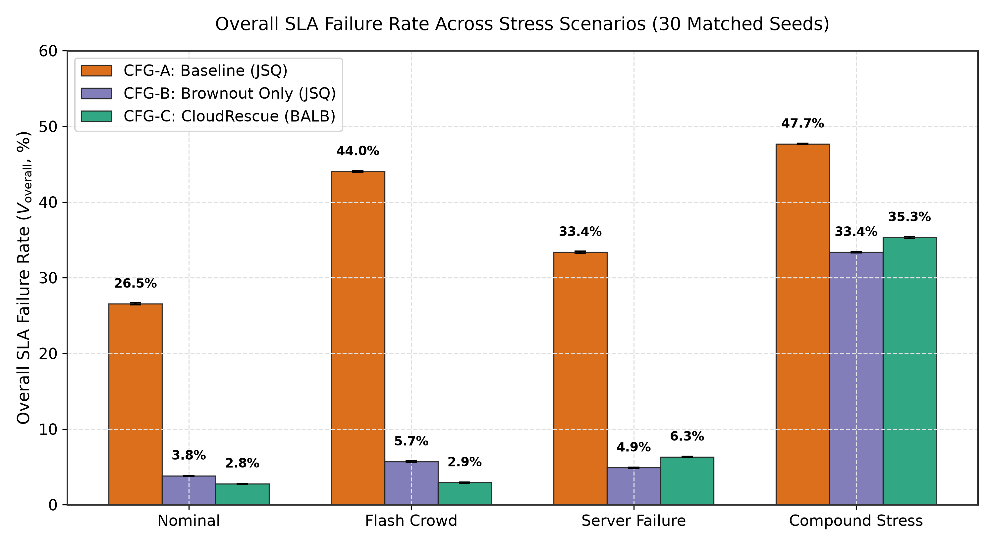
RESULTS & EVALUATION
SLA Compliance & Latency Bounds Across Scenarios
Brownout decisively bounds tail latency and reduces overall SLA failures by up to 41.10 percentage points
CERTIFIED EXPERIMENTAL BENCHMARKS
Flash Crowd SLA Failure (V_overall):
• CFG-A (Baseline): 44.04% ± 0.16%
• CFG-B (Brownout+JSQ): 5.69% ± 0.17%
• CFG-C (CloudRescue): 2.94% ± 0.17%
• Reduction: -41.10 percentage points (p = 3.01 × 10^-62, Cohen's d_z = -121.71)
Compound Stress SLA Failure (V_overall):
• CFG-A (Baseline): 47.70% ± 0.24% (Catastrophic collapse)
• CFG-B (Brownout+JSQ): 33.38% ± 0.24%
• CFG-C (CloudRescue): 35.33% ± 0.34%
• Reduction vs Baseline: -12.37 percentage points (p = 1.05 × 10^-42)
Latency Tail Reduction (P_95) & Compliance:
• Latency Violations (V_lat): Drops from 32.83% (CFG-A) to 2.89% (CFG-C) under Flash Crowd (-29.94 pp, p < 10^-45).
• 95th-Percentile Latency (P_95): CFG-A 184.34 ms ==> CFG-C 82.87 ms (reduction of -101.47 ms, strictly inside SLA setpoint!).
Overall SLA Failure Rates (V_overall) and Latency Violation Rates (V_lat) across 360 runs. CFG-C drastically suppresses failures across all stress regimes.
CloudRescue Research • IIIT Dharwad • November 2026
Slide 11 of 15

Slide 12
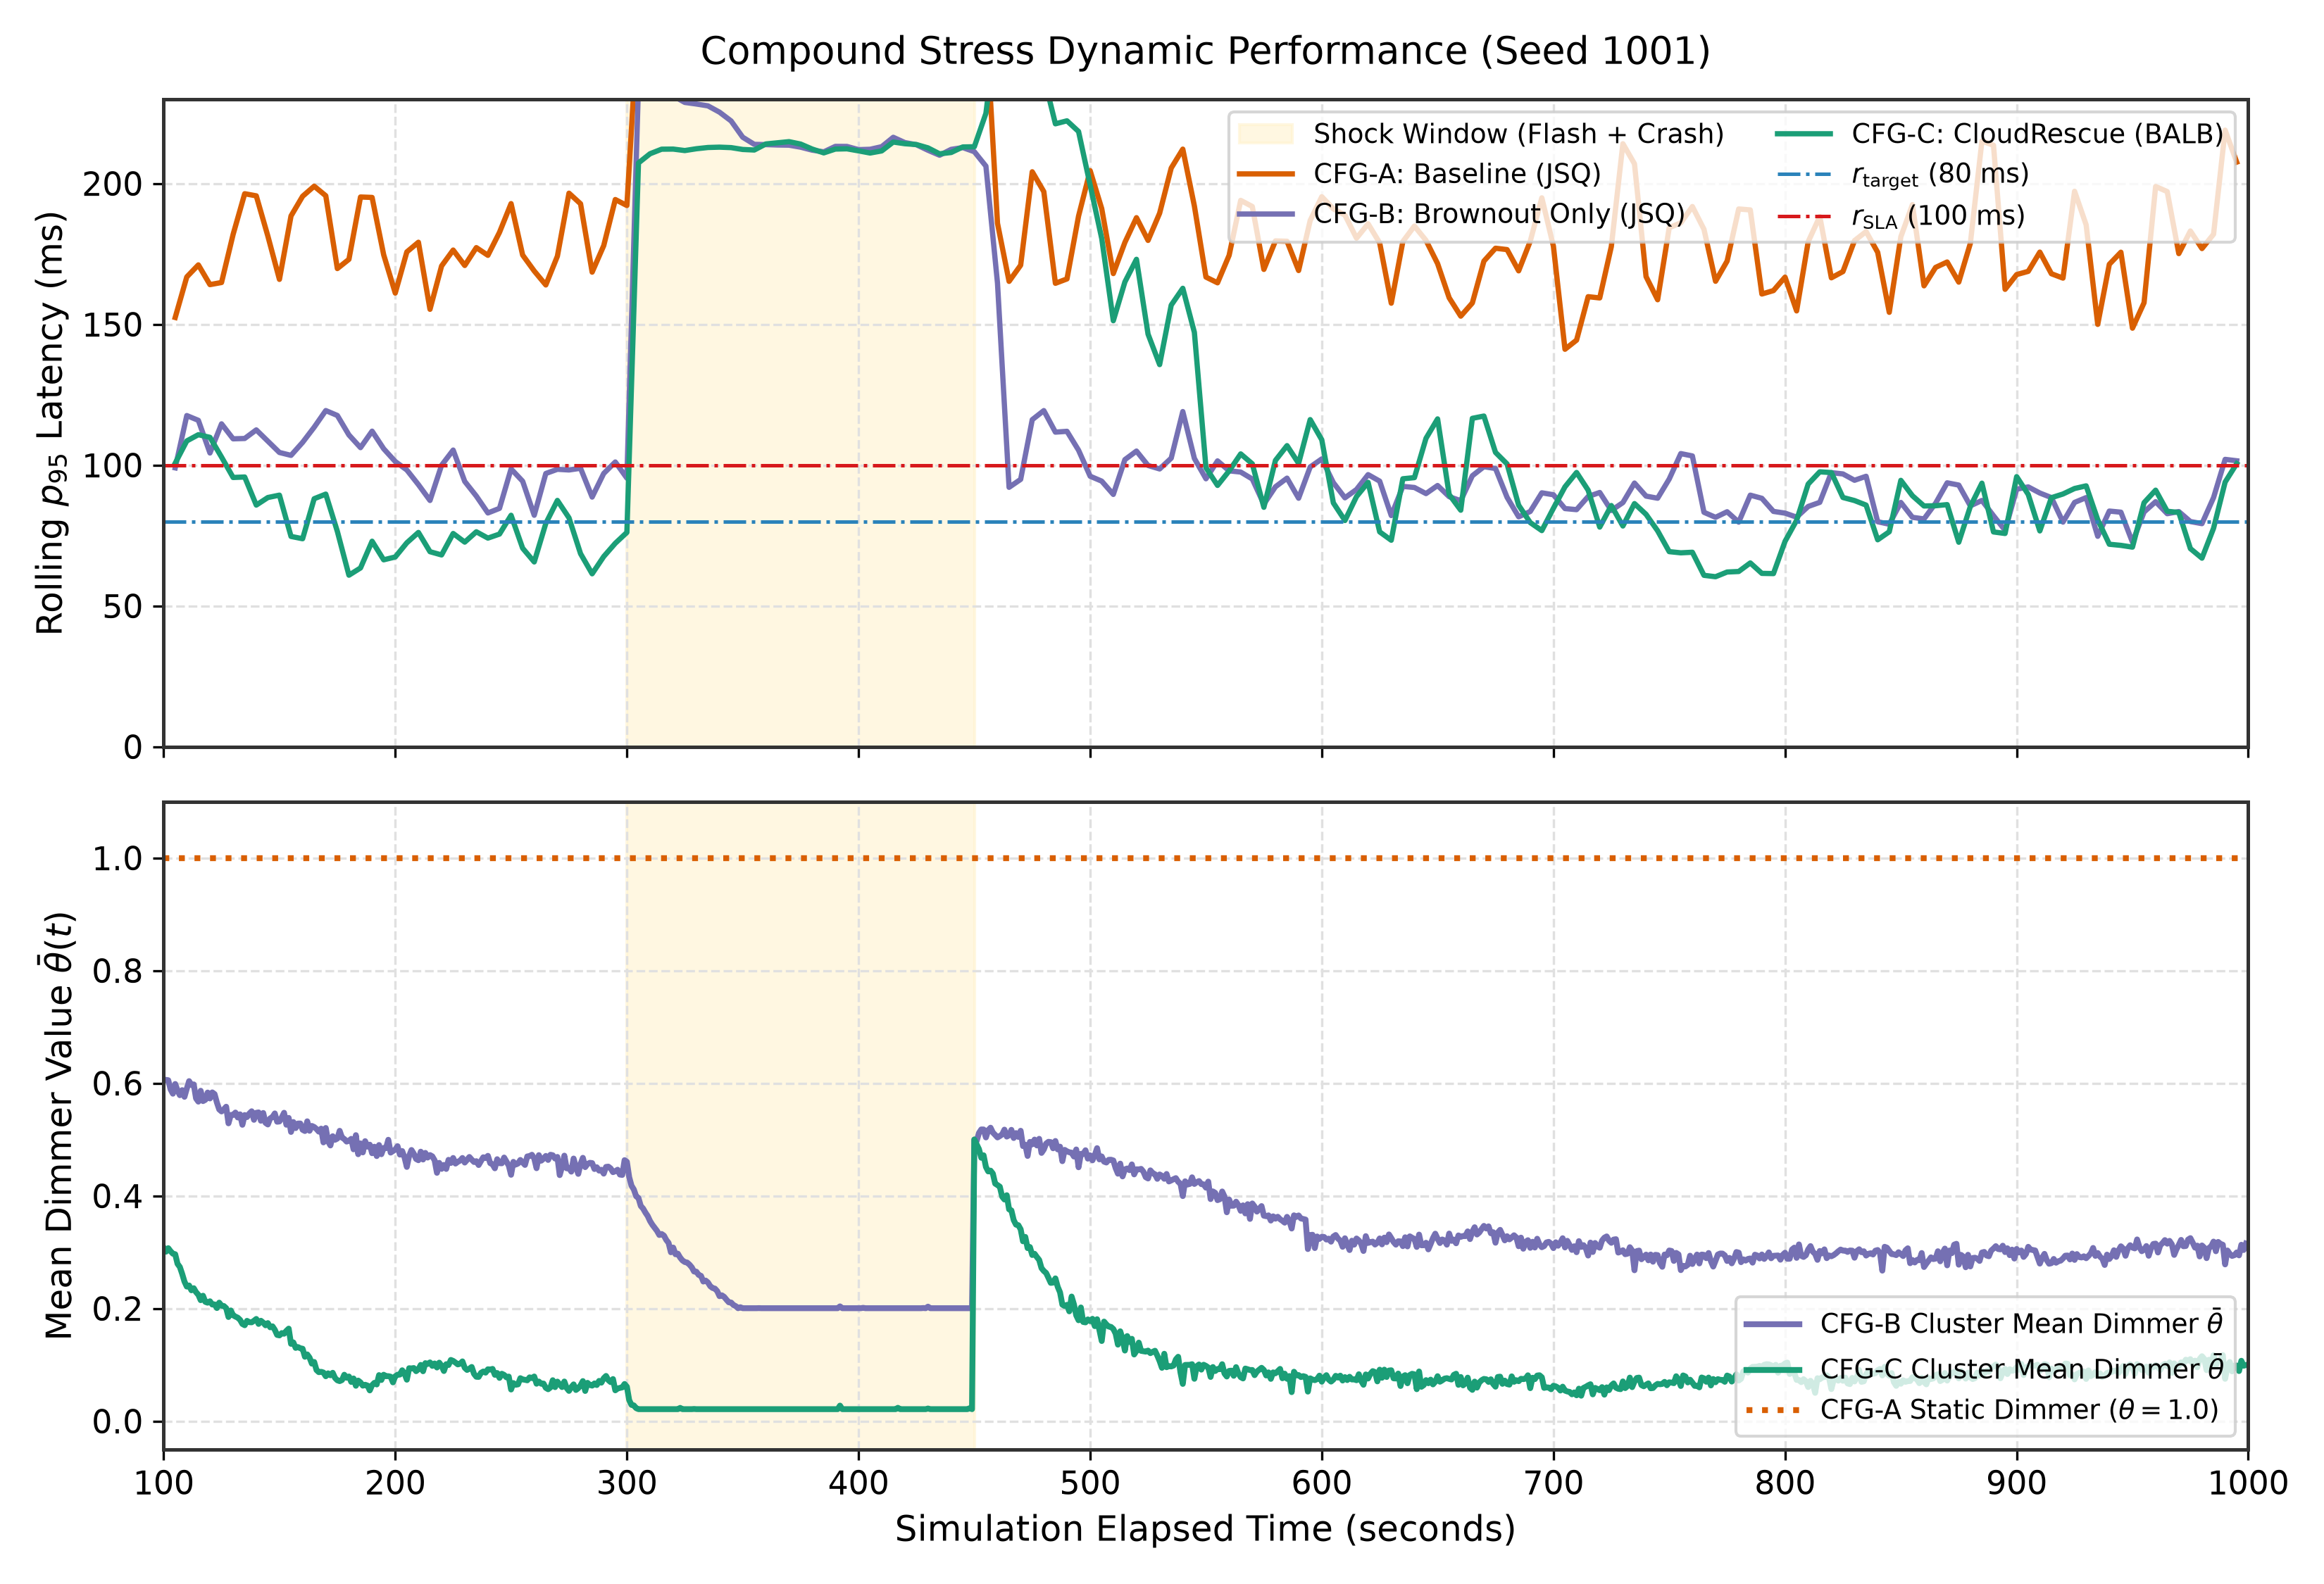
RESULTS & EVALUATION
Recovery Dynamics & DEC-010 Methodology
Accelerating adaptation up to 28.4× and resolving right-censoring via empirical nominal baselines
DYNAMIC ADAPTATION & RECOVERY BENCHMARKS
Real-Time Adaptation Speed (T_adapt):
• Flash Crowd: CFG-B requires 56.73s to stabilize; BALB accelerates stabilization to 2.50s (22.7× faster, p = 2.85 × 10^-24).
• Server Crash: CFG-B takes 56.80s; BALB stabilizes in 2.00s (28.4× faster, p = 1.81 × 10^-5).
• Mechanism: BALB incorporates dimmer state in routing, pre-emptively directing load without waiting for local queues to saturate.
DEC-010 Post-Restoration Recovery:
• The Right-Censoring Trap: Demanding static recovery (θ ≥ 0.8) fails because unperturbed nominal equilibrium naturally stabilizes at θ ≈ 0.70.
• DEC-010 Solution: Establishes seed- and worker-specific nominal baselines (θ_nom,w,s ± 0.05) to eliminate artificial right-censoring.
• Recovery Time (T_restore): CFG-B 323.47s ==> CFG-C 151.63s (2.13× speedup, p = 2.03 × 10^-5).
• 30-Seed Full Restoration Rate: Jumps from 46.7% in CFG-B to 100.0% in CFG-C (zero censored seeds!).
Detailed time-series telemetry (seed 1001) under Compound Stress, depicting dimmer shedding, queue buffer stability, and rapid post-restoration recovery.
CloudRescue Research • IIIT Dharwad • November 2026
Slide 12 of 15

Slide 13
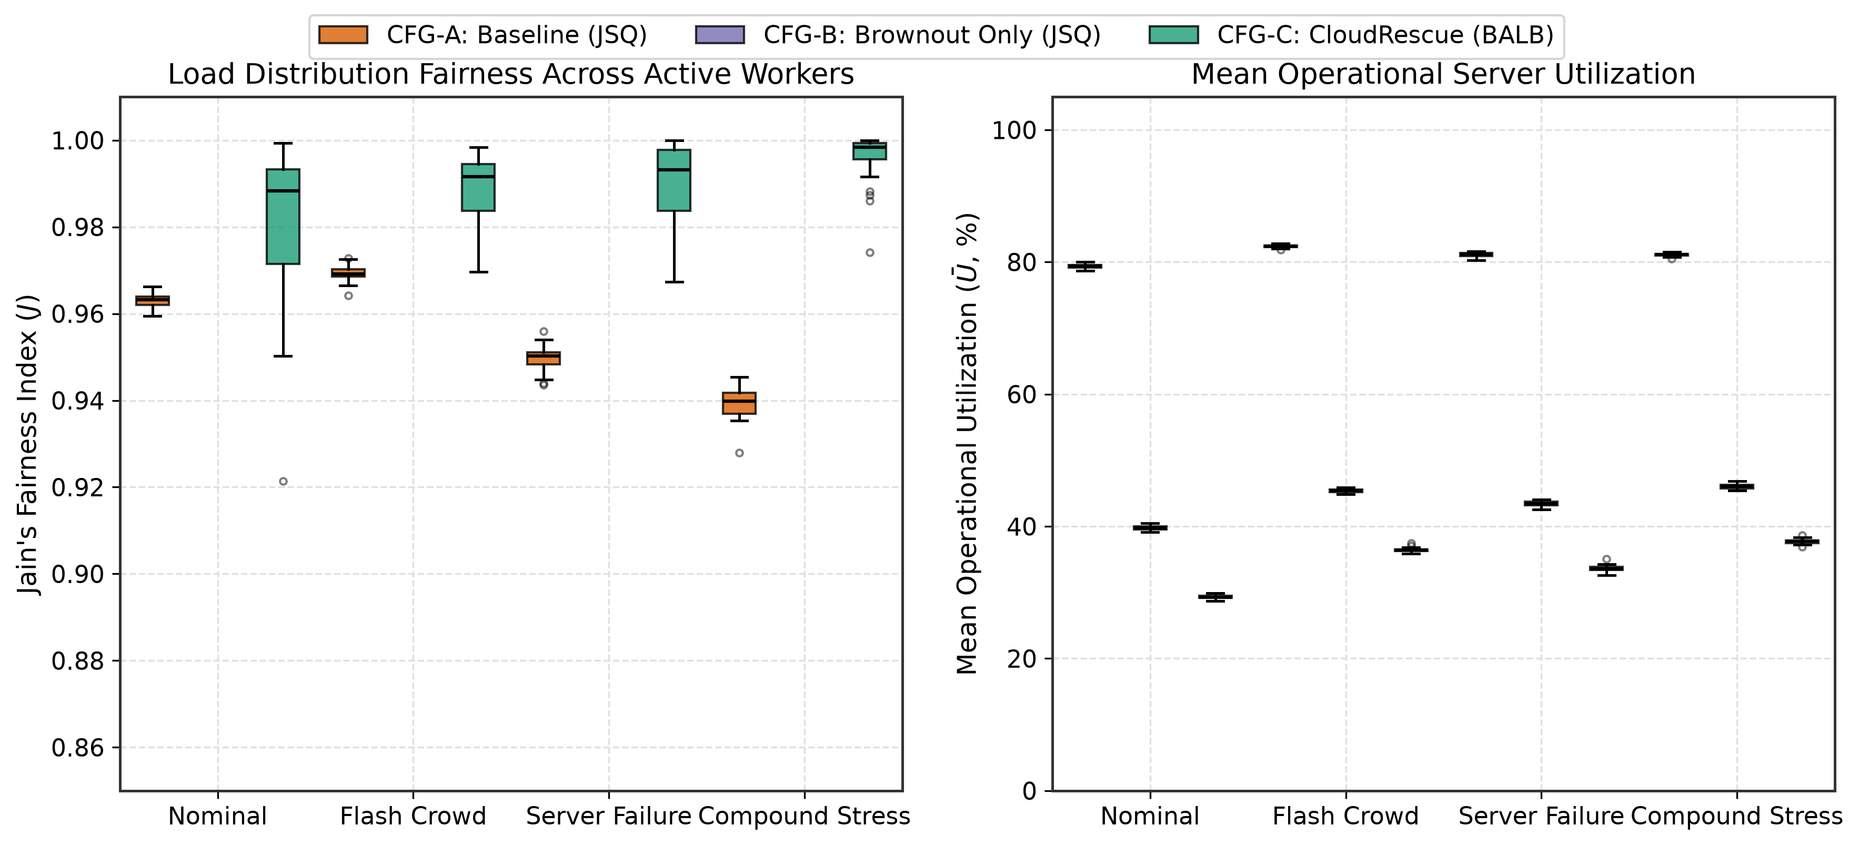
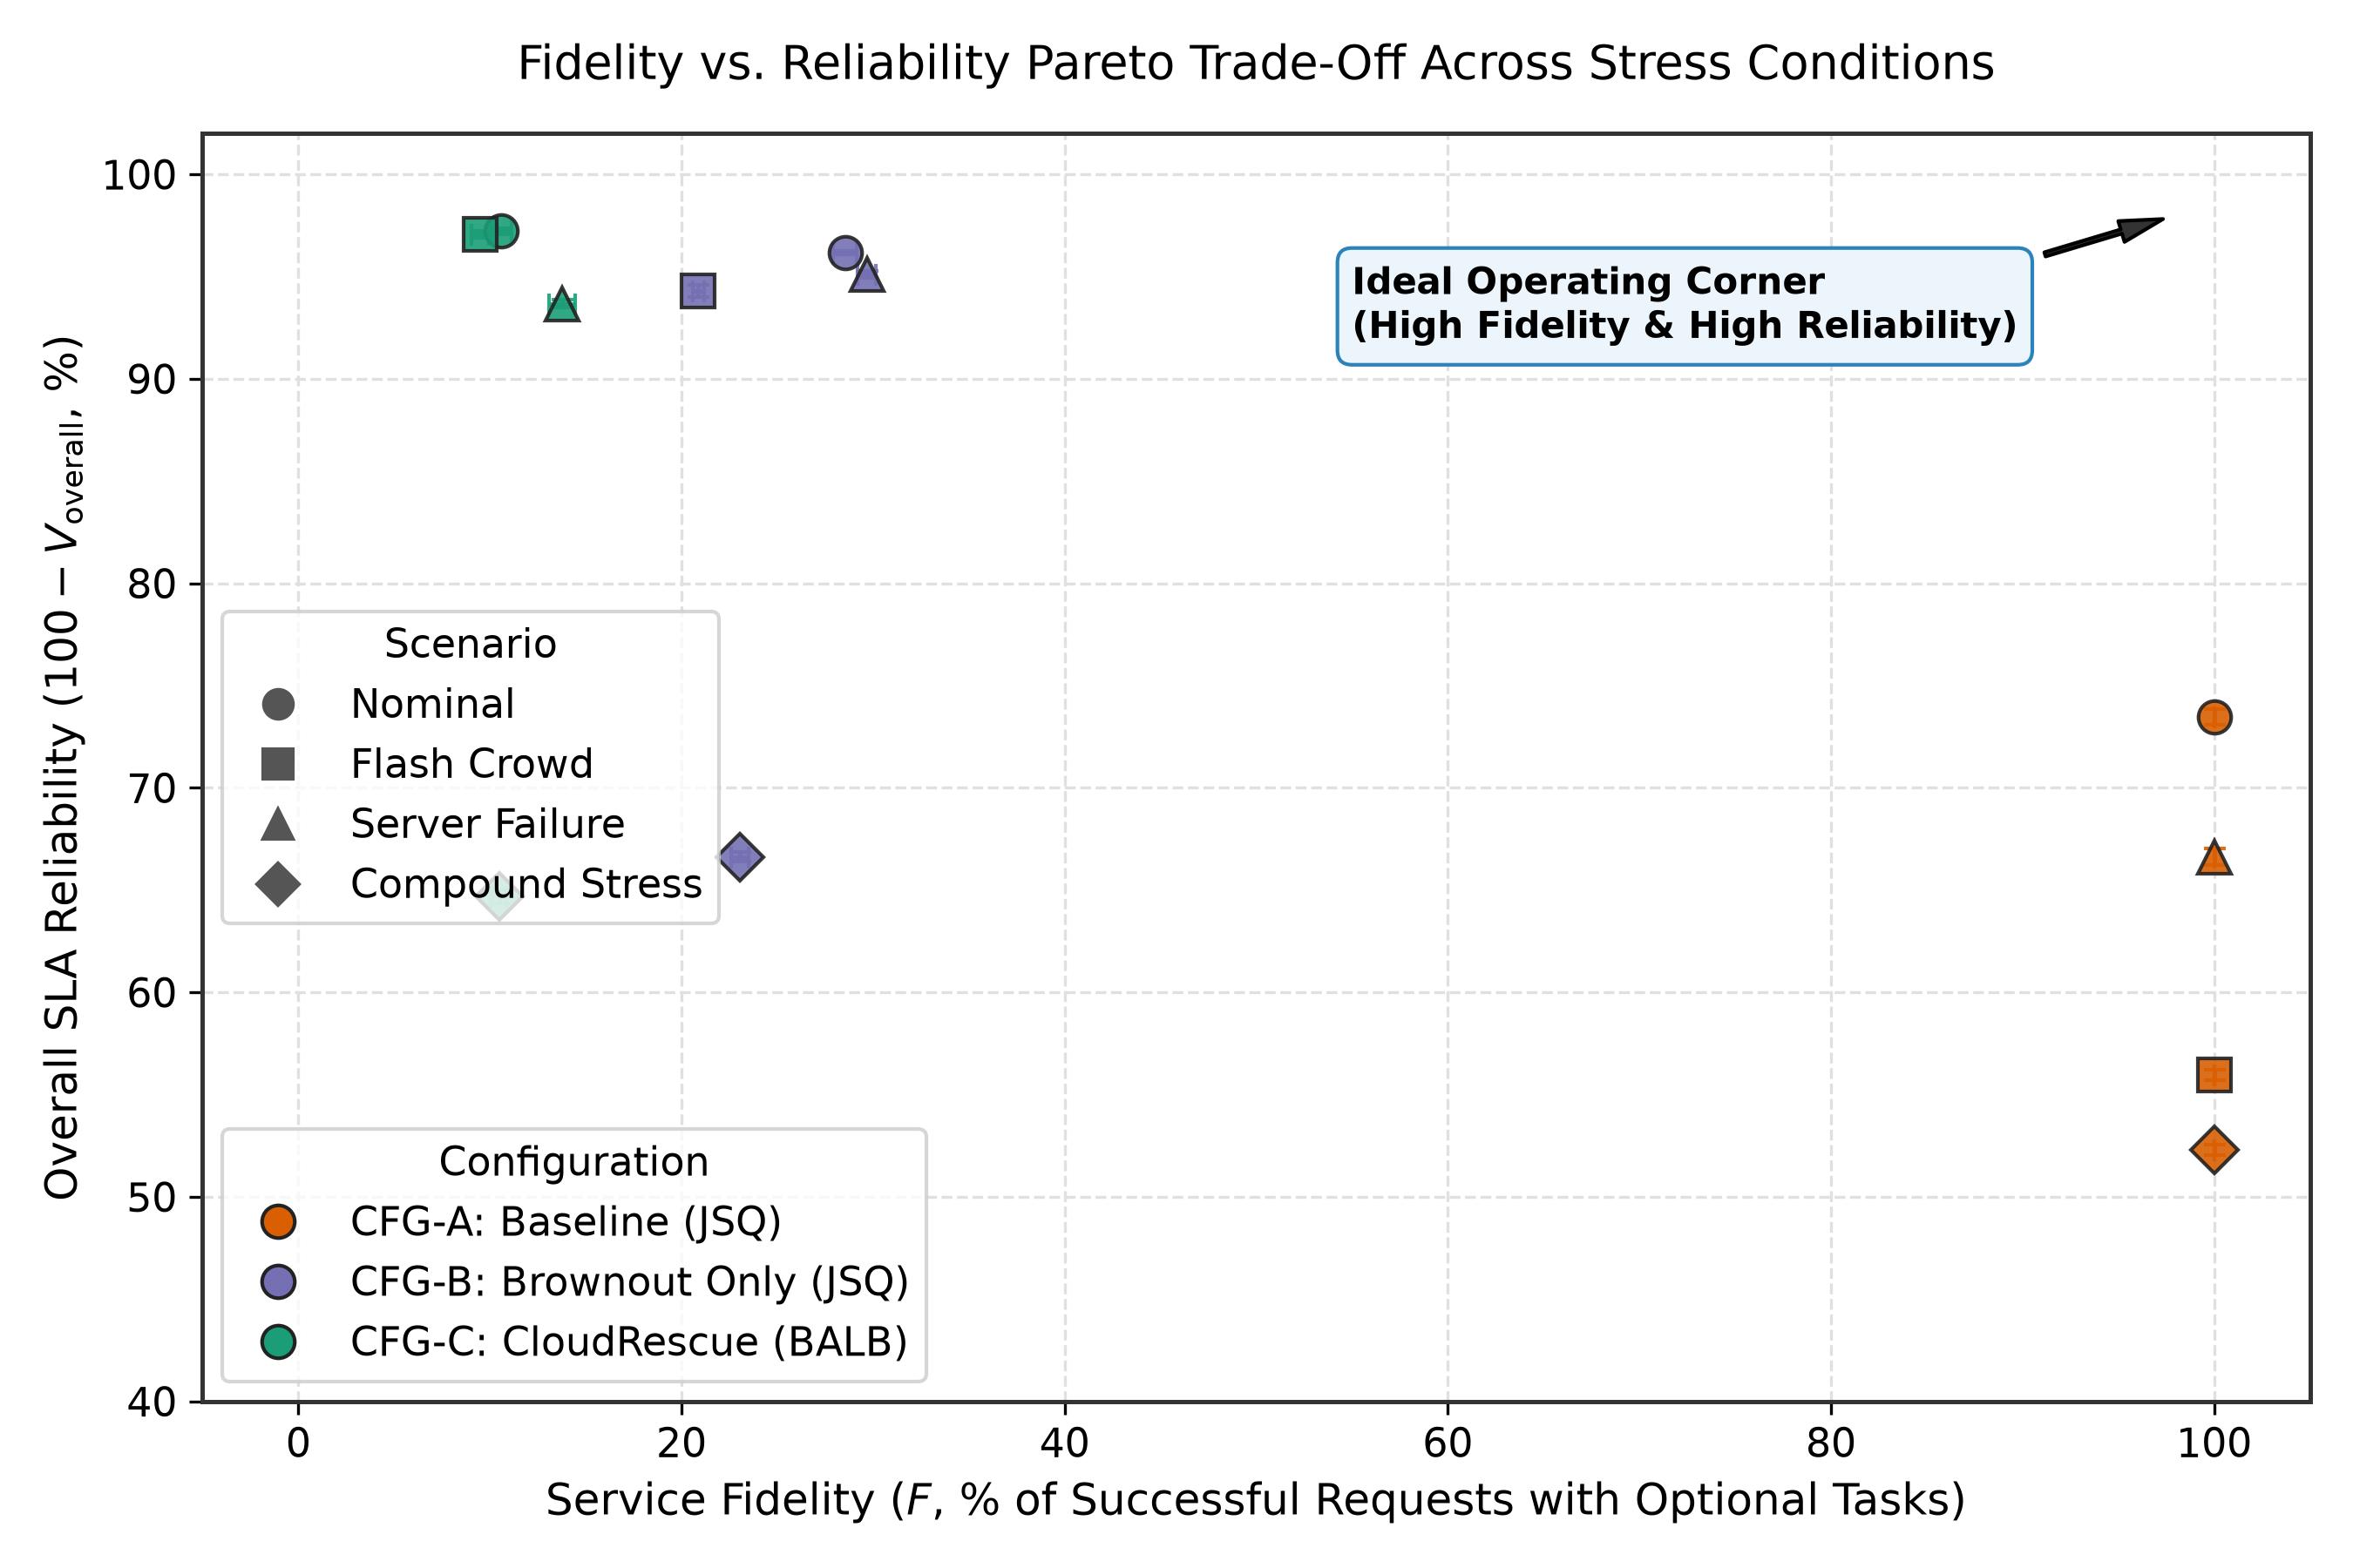
RESULTS & EVALUATION
Workload Equity Proven, Fidelity Superiority Rejected
Empirical demonstration of a fundamental architectural trade-off in autonomic systems
DIMENSION 1: LOAD FAIRNESS (H1,3 — DECISIVELY SUPPORTED)
• Under JSQ (CFG-B), load skew is pathological: Jain's Index collapses to J = 0.607 (Nominal), 0.730 (Flash), 0.646 (Crash), and 0.764 (Compound).
• BALB (CFG-C) completely restores workload equity: J ≥ 0.981 to 0.996 across all scenarios (ΔJ = +0.232 to +0.374, p < 10^-8 across all tests).
• Eliminates degraded worker starvation and balances processor utilization.
DIMENSION 2: SERVICE FIDELITY (H1,3 — DECISIVELY REJECTED)
• Pre-registered hypothesis H1,3 expected BALB to increase fidelity F by routing requests toward high-dimmer workers.
• Empirical data decisively rejected the hypothesis (p < 10^-38): Service fidelity dropped by 11.4 to 17.9 percentage points in CFG-C vs CFG-B.
• Architectural Insight: High fidelity in CFG-B was an illusion maintained by starving healthy workers. True equity demands distributing degradation across the cluster.
CloudRescue Research • IIIT Dharwad • November 2026
Slide 13 of 15

Slide 14
CRITICAL DISCUSSION
Honest Academic Scope & Research Roadmap
Documented threats to validity and the scientific pathway toward physical testbeds
DOCUMENTED RESEARCH LIMITATIONS
• Synthetic Queuing Model:
M/M/1-FIFO queues; production systems feature microservice DAGs, database lock contention, and heavy-tailed service distributions.
• Static BALB Dispatch Weights:
Default weights (α=1.0, β=2.0, γ=0.5) proved robust in 144-run sweep, but remain fixed rather than dynamically self-tuning.
• Single-Tier Ingress Proxy:
Production cloud infrastructures utilize distributed reverse proxies (Envoy/NGINX) with asynchronous gossip telemetry.
• Discrete-Event Timing Abstraction:
SimPy models idealized clock ticks; real-world Linux deployments incur kernel socket buffer delay and scheduler context switching.
FUTURE RESEARCH DIRECTIONS
• Autonomous Online Weight Adaptation:
Deploying reinforcement learning (contextual bandits / Q-learning) or Bayesian optimization to dynamically adjust (α, β, γ) based on traffic regimes.
• Physical Kubernetes & Mesh Testbed:
Implementing CloudRescue as an Envoy WASM filter and Istio service mesh extension deployed on a multi-node Kubernetes bare-metal cluster.
• Multi-Tier Microservice Benchmarks:
Evaluating resilience on industry microservice suites (TeaStore, DeathStarBench) with nested RPC dependencies and distributed databases.
• Multi-Dimensional Feature Shedding:
Extending beyond binary optional logic to support multi-tier discrete quality tiers (e.g. video resolution downsampling, caching depth).
CloudRescue Research • IIIT Dharwad • November 2026
Slide 14 of 15

Slide 15
SUMMARY & Q&A
CloudRescue: Summary of Scientific Contributions
Three actionable architectural tenets for autonomic cloud microservice resilience
1. Brownout is an Essential Resilience Pillar
• Eliminates catastrophic queuing dropouts without expensive hardware over-provisioning.
• Reduces overall SLA failures by up to 41.10 percentage points (p < 10^-60).
• Bounds 95th-percentile response latency within strict SLA limits under severe traffic surges.
2. Ingress Co-Design is Mandatory
• Conventional JSQ load balancing breaks down under brownout, causing pathological load skew (J ≈ 0.607).
• BALB restores near-perfect equity (J ≥ 0.985) across all scenarios.
• Accelerates adaptation stabilization by up to 28.4× and doubles post-restoration recovery speed.
3. Fundamental Architectural Trade-off
• Workload fairness and service fidelity cannot be simultaneously maximized under overload.
• True cluster equity demands distributing degradation across all operational workers.
• Provides actionable engineering trade-off envelopes for production microservice tuning.
OPEN RESEARCH ARTIFACTS & QUESTIONS / DISCUSSION
Open Source Repository: https://github.com/hariprasadkishan/CloudRescue-Research
Research Team: Hari Prasad L • Yeruva Mahesh Reddy • K. Ram Charan • Tushar (23BCS130)
Department of Computer Science & Engineering and Department of Data Science & AI Engineering, IIIT Dharwad
CloudRescue Research • IIIT Dharwad • November 2026
Slide 15 of 15

