Slide 1

22UAD607- FINAL YEAR PROJECT
FOURTH REVIEW
Multilingual Campus Assistant: A Chatbot and IVR-Based Solution
Dr. NGP INSTITUTE OF TECHNOLOGY
Presented by,
Under the Guidance of
Dr. I.DEVI,
ASSISTANT PROFESSOR
Department of Artificial Intelligence and Data Science
HARIPRASATH L V
RAM KUMAR
SURESH
(23AD047)
(23AD047)
(23AD047)
Department of Artificial Intelligence and Data Science
1

Slide 2
Abstract
This project is a multilingual, data-driven campus assistance system designed to provide intelligent and reliable access to official college information through an interactive website-integrated chatbot. The system organizes institutional data into a structured backend and delivers accurate responses to user queries related to admissions, fees, academics, scholarships,and campus services without manual staff involvement. By supporting multiple languages and guided, click-based interactions, the solution eliminates language barriers and ensures consistent, hallucination-free information delivery for students and parents. The platform operates continuously, reduces repetitive administrative workload, and enhances accessibility for diverse user groups. With its modular and scalable architecture, the system offers a practical foundation for future enhancements such as voice-based interaction and extended language support, making it suitable for real-world academic deployment.
Dr. NGP INSTITUTE OF TECHNOLOGY
Department of Artificial Intelligence and Data Science
2

Slide 3
Problem Statement
• Existing college websites are largely static, making it difficult to update academic, administrative, and departmental information in real time.
• Official college information is scattered across web pages, PDFs, and notices and is mostly available only in English, creating accessibility and language barriers.
• Students and parents must frequently depend on manual enquiries or office visits to obtain routine information such as admissions, fees, timetables, and scholarships.
• Administrative staff spend a significant portion of their time answering repetitive queries, leading to increased workload and reduced operational efficiency.
• There is a lack of an integrated, automated, and multilingual platform that combines dynamic content management with reliable, 24×7 user assistance.
Dr. NGP INSTITUTE OF TECHNOLOGY
Department of Artificial Intelligence and Data Science
3

Slide 4
Literature survey
"IEEE Access Article: “Design and Implementation of a Web-Based Campus Information Management System”"
Authors: R. Kumar, S. Nair
Year: 2021
Topics Covered: Topics Covered: Dynamic web portals, centralized database management, role-based admin access, RESTful APIs for academic systems.
Dr. NGP INSTITUTE OF TECHNOLOGY
Department of Artificial Intelligence and Data Science
4

Slide 5
Literature survey
"International Journal of Computer Applications (IJCA)_x000B_Article: “Multilingual Chatbot for Educational Institutions Using StructuredData”."
Authors: A.Sharma,K.Patel
Year: 2022
Topics Covered: Topics Covered: Multilingual chatbot design, rule-based interaction models, educational query handling, accuracy-focused chatbot systems.
Dr. NGP INSTITUTE OF TECHNOLOGY
Department of Artificial Intelligence and Data Science
5

Slide 6
Literature survey
"“Multilingual Chatbot for Educational Institutions Using StructuredData”."
Authors: K.Patel
Year: 2023
Topics Covered: Topics Covered: Multilingual chatbot design, rule-based interaction models, educational query handling, accuracy-focused chatbot systems.
Dr. NGP INSTITUTE OF TECHNOLOGY
Department of Artificial Intelligence and Data Science
6

Slide 7
Literature survey
"“Multilingual Chatbot for Educational Institutions Using StructuredData”."
Authors: K.Patel
Year: 2016
Topics Covered: Topics Covered: Multilingual chatbot design, rule-based interaction models, educational query handling, accuracy-focused chatbot systems.
Dr. NGP INSTITUTE OF TECHNOLOGY
Department of Artificial Intelligence and Data Science
7

Slide 8
Literature survey
"“Multilingual Chatbot for Educational Institutions Using StructuredData”."
Authors: k.patel
Year: 2023
Topics Covered: Topics Covered: Multilingual chatbot design, rule-based interaction models, educational query handling, accuracy-focused chatbot systems.
Dr. NGP INSTITUTE OF TECHNOLOGY
Department of Artificial Intelligence and Data Science
8

Slide 9
Existing System
1. Static College Websites Provides information through static web pages and PDFs, requiring technical updates and offering no interactive support.
2. Manual Enquiry Counters Students and parents must visit college offices to obtain information, leading to queues and time consumption.
3. Phone-Based Enquiry Systems Queries are handled through phone calls during limited office hours, increasing staff workload.
4. Email-Based Communication Information requests are sent via email, resulting in delayed responses and inefficiency.
5. English-Only Information Systems Most content is available only in English, creating accessibility issues for regional language users.
Dr. NGP INSTITUTE OF TECHNOLOGY
Department of Artificial Intelligence and Data Science
9

Slide 10
Proposed System
1. Dynamic College Website Provides real-time, database-driven content updates without technical intervention.
2. Multilingual Chatbot Integration Offers structured, accurate responses in multiple languages through guided interactions.
3. Centralized Data Management Uses a single, verified dataset to ensure consistency and reliability of information.
4. Automated Query Handling Delivers 24×7 instant responses, reducing repetitive administrative workload.
5. Scalable and Secure Architecture Supports future enhancements such as IVR, additional languages, and cloud deployment.
Dr. NGP INSTITUTE OF TECHNOLOGY
Department of Artificial Intelligence and Data Science
10

Slide 11
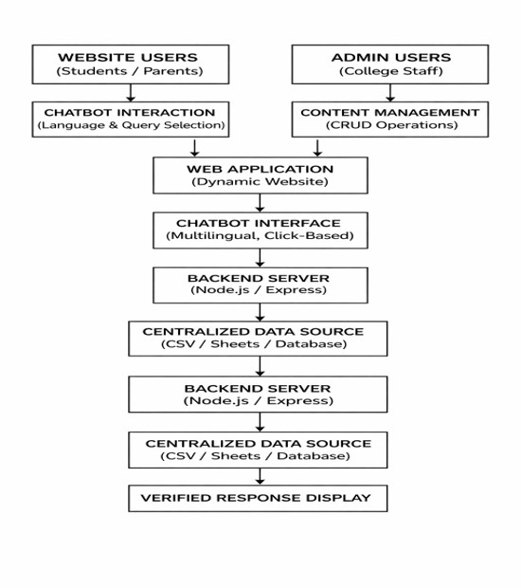
flow Diagram
Dr. NGP INSTITUTE OF TECHNOLOGY
Figure 1: architecture
Department of Artificial Intelligence and Data Science
11

Slide 12
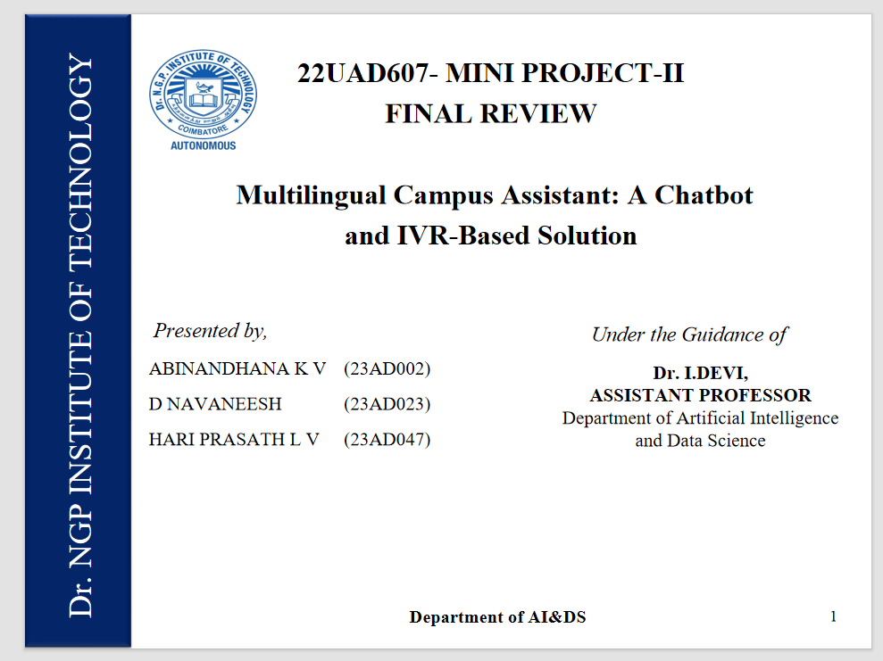
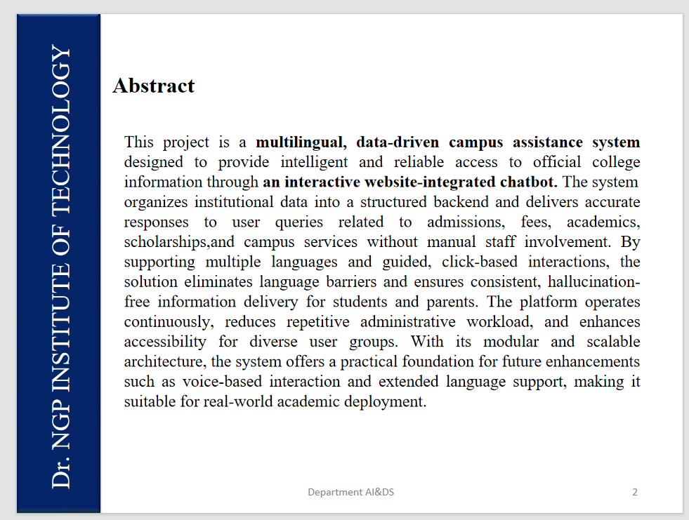
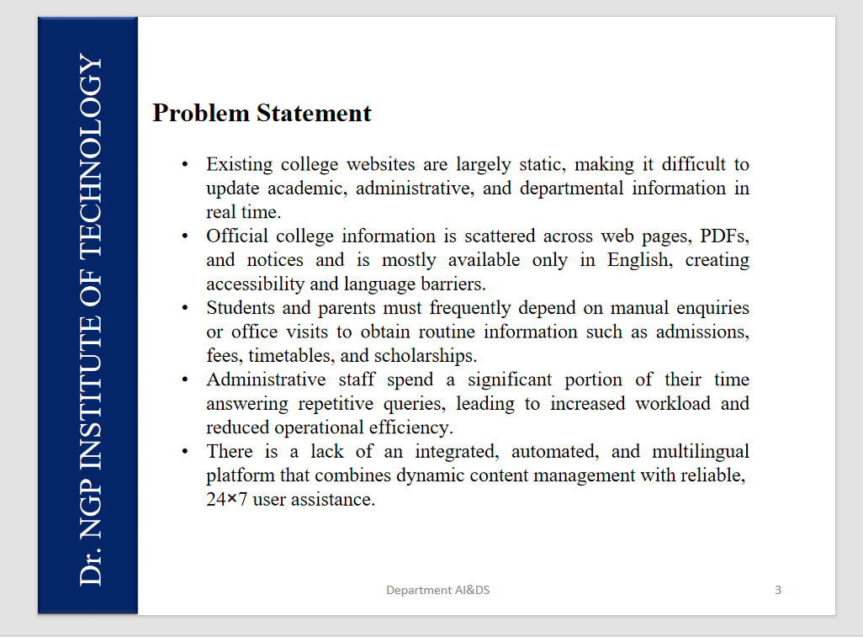
output screenshot
Dr. NGP INSTITUTE OF TECHNOLOGY
Figure 1: output 1
Figure 2: output 2
Figure 3: output 3
Department of Artificial Intelligence and Data Science
12

