Slide 1
DEPARTMENT OF
ARTIFICIAL INTELLIGENCE AND DATA SCIENCE ACADEMIC YEAR 2025 - 2026
SEMESTER III
ARTIFICIAL INTELLIGENCE LABORATORY MINI PROJECT REVIEW
<TITLE OF THE PROJECT>
REGISTER NUMBER | 2117240070305
NAME | Hariprasath M
YEAR | 2-YEAR (SEMESTER III)
SECTION | AI&DS-B
FACULTY IN-CHARGE | Dr.Rubina Begam

Slide 2

PROBLEM STATEMENT
Background:
Students often struggle to create effective study plans that balance available time, subject difficulty, and personal performance. Traditional planners are static and cannot adapt to user behavior or learning outcomes.
Problem Statement:
To develop an AI system that intelligently generates and adapts personalized study schedules using reasoning and learning techniques.
Expected Outcome:
An adaptive, data-driven planner that:
Creates time-efficient, constraint-based study plans.
Learns from user feedback using reinforcement learning.
Continuously optimizes scheduling for better learning efficiency.

Slide 3

THEORETICAL BACKGROUND
AI Concepts Involved:
Constraint Satisfaction Problem (CSP): Generates an initial valid study plan by assigning subjects to time slots under given constraints.
Reinforcement Learning (Q-learning): Improves the plan dynamically based on user feedback.
Justification for Algorithms:
CSP ensures valid, logical schedules. RL enables adaptive improvement — together they form a hybrid reasoning-learning model.
Formula (Q-learning Update Rule):
Q(s,a)=Q(s,a)+α[r+γmax(Q(s′,a′))−Q(s,a)]

Slide 4

IMPLEMENTATION AND CODE
Link to code in Git-hub Repository
List | Git-hub Repository Links
Implementation of Code Link | hariprasath729/AI-Miniproject
Word Document Report Link | AI-Miniproject/hariprasath_AI_MINIE_PROJECTS.docx at main · hariprasath729/AI-Miniproject
PPT Link | AI-Miniproject/hariprasath_AI_PPT.pptx at main · hariprasath729/AI-Miniproject

Slide 5
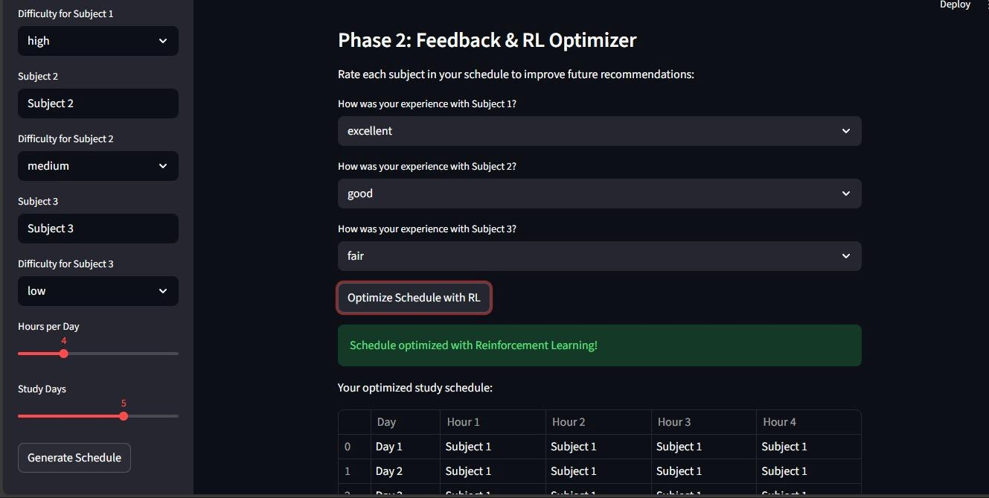
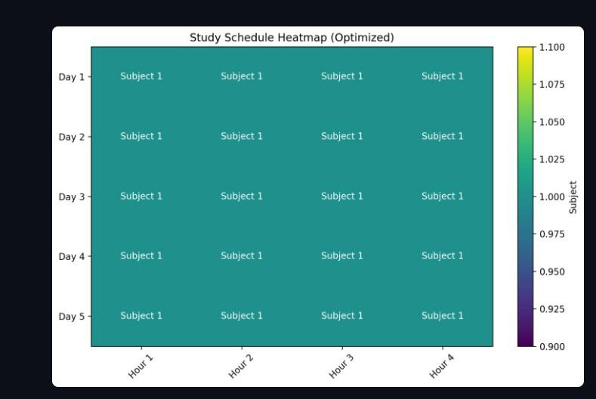
OUTPUT AND RESULTS
Output Screen shots and explanation

Slide 6

OUTPUT AND RESULTS
Results and Future Enhancements
Results:
Hybrid CSP–RL model successfully implemented.
Self-adaptive system improves study efficiency with use.
Streamlit UI enables real-time user interaction and updates.
Future Enhancements:
Integration with Google Calendar & Notifications.
Add voice/chatbot interface using NLP.
Use DQN for deep reinforcement learning.
Emotion detection via OpenCV.
Cloud database for multi-device access.
Gamification (badges, streaks, points).
Integration with LMS (e.g., Moodle).

Slide 7

REFERENCES
References (GitHub + Libraries)
python-constraint Library (Official Repository)
https://github.com/python-constraint/python-constraint
Streamlit Framework (Official Repository)
https://github.com/streamlit/streamlit
ennybritz / reinforcement-learning (Educational Repository)
https://github.com/dennybritz/reinforcement-learning
Research Papers
Momenikorbekandi, A., & Fathi, M. (2023). “Intelligent Scheduling
Based on Reinforcement Learning.”
Russell, S., & Norvig, P. (2021). Artificial Intelligence: A Modern Approach (4th Edition).

