Slide 1

Java
Inheritance and Polymorphism

Slide 2

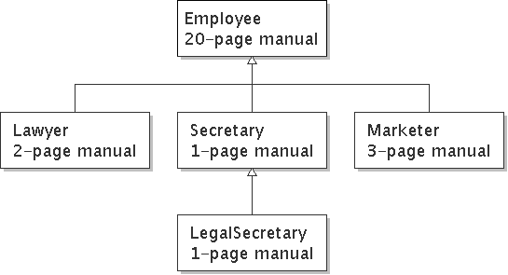
Inheritance
inheritance: Forming new classes based on existing ones.
  a way to share/reuse code between two or more classes
  superclass: Parent class being extended.
  subclass: Child class that inherits behavior from superclass.
    gets a copy of every field and method from superclass
  is-a relationship: Each object of the subclass also "is a(n)" object of the superclass and can be treated as one.

Slide 3
Inheritance syntax
  public class name extends superclass {
  public class Lawyer extends Employee {
  ...
  }
override: To replace a superclass's method by writing a new version of that method in a subclass.
  public class Lawyer extends Employee {
  // overrides getSalary method in Employee class;
  // give Lawyers a $5K raise
  public double getSalary() {
  return 55000.00;
  }
  }

Slide 4
super keyword
Subclasses can call inherited behavior with super
  super.method(parameters)
  super(parameters);
  public class Lawyer extends Employee {
  public Lawyer(int years) {
  super(years); // calls Employee constructor
  }
  // give Lawyers a $5K raise
  public double getSalary() {
  double baseSalary = super.getSalary();
  return baseSalary + 5000.00;
  }
  }
  Lawyers now always make $5K more than Employees.

Slide 5
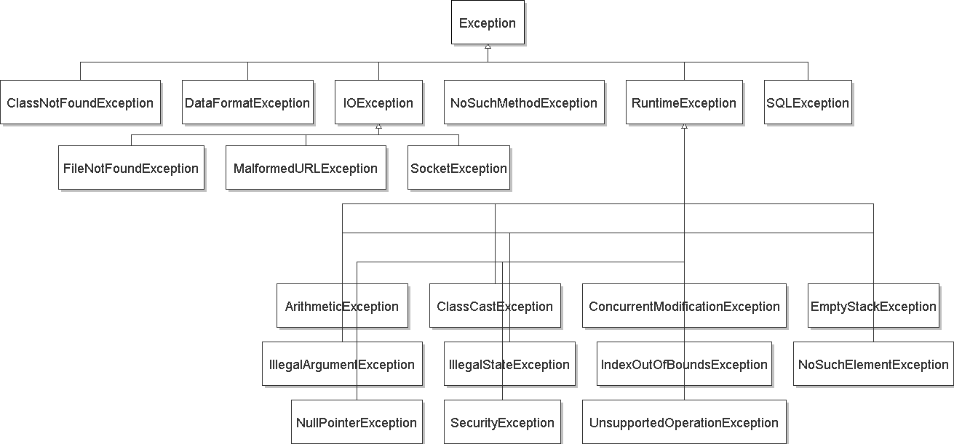
Exception inheritance
Exceptions extend from a common superclass Exception

Slide 6
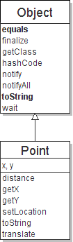
The class Object
The class Object forms the root of the
overall inheritance tree of all Java classes.
  Every class is implicitly a subclass of Object
The Object class defines several methods
that become part of every class you write.
For example:
  public String toString()
  Returns a text representation of the object,
  usually so that it can be printed.

Slide 7
Object methods
method | description
protected Object clone() | creates a copy of the object
public boolean equals(Object o) | returns whether two objects have the same state
protected void finalize() | used for garbage collection
public Class<?> getClass() | info about the object's type
public int hashCode() | a code suitable for putting this object into a hash collection
public String toString() | text representation of object
public void notify() public void notifyAll() public void wait() public void wait(...) | methods related to concurrency and locking (seen later)
  What does this list of methods tell you about Java's design?

Slide 8
Using the Object class
You can store any object in a variable of type Object.
  Object o1 = new Point(5, -3);
  Object o2 = "hello there";
You can write methods that accept an Object parameter.
  public void checkNotNull(Object o) {
  if (o != null) {
  throw new IllegalArgumentException();
  }
You can make arrays or collections of Objects.
  Object[] a = new Object[5];
  a[0] = "hello";
  a[1] = new Random();
  List<Object> list = new ArrayList<Object>();

Slide 9
Recall: comparing objects
The == operator does not work well with objects.
  It compares references, not objects' state.
  It produces true only when you compare an object to itself.
  Point p1 = new Point(5, 3);
  Point p2 = new Point(5, 3);
  Point p3 = p2;
  // p1 == p2 is false;
  // p1 == p3 is false;
  // p2 == p3 is true
  // p1.equals(p2)?
  // p2.equals(p3)?
...
p1
x | 5 | y | 3
p2
...
x | 5 | y | 3
p3

Slide 10
Default equals method
The Object class's equals implementation is very simple:
  public class Object {
  ...
  public boolean equals(Object o) {
  return this == o;
  }
  }
However:
  When we have used equals with various objects, it didn't behave like == . Why not? if (str1.equals(str2)) { ...
  The Java API documentation for equals is elaborate. Why?

Slide 11
Implementing equals
  public boolean equals(Object name) {
  statement(s) that return a boolean value ;
  }
  The parameter to equals must be of type Object.
  Having an Object parameter means any object can be passed.
    If we don't know what type it is, how can we compare it?

Slide 12
Casting references
  Object o1 = new Point(5, -3);
  Object o2 = "hello there";
  ((Point) o1).translate(6, 2); // ok
  int len = ((String) o2).length(); // ok
  Point p = (Point) o1;
  int x = p.getX(); // ok
Casting references is different than casting primitives.
  Really casting an Object reference into a Point reference.
  Doesn't actually change the object that is referred to.
  Tells the compiler to assume that o1 refers to a Point object.

Slide 13
The instanceof keyword
  if (variable instanceof type) {
  statement(s);
  }
Asks if a variable refers
to an object of a given type.
  Used as a boolean test.
  String s = "hello";
  Point p = new Point();
expression | result
s instanceof Point | false
s instanceof String | true
p instanceof Point | true
p instanceof String | false
p instanceof Object | true
s instanceof Object | true
null instanceof String | false
null instanceof Object | false

Slide 14
equals method for Points
  // Returns whether o refers to a Point object with
  // the same (x, y) coordinates as this Point.
  public boolean equals(Object o) {
  if (o instanceof Point) {
  // o is a Point; cast and compare it
  Point other = (Point) o;
  return x == other.x && y == other.y;
  } else {
  // o is not a Point; cannot be equal
  return false;
  }
  }

Slide 15
More about equals
Equality is expected to be reflexive, symmetric, and transitive:
  a.equals(a) is true for every object a
  a.equals(b) ↔ b.equals(a)
  (a.equals(b) && b.equals(c)) ↔ a.equals(c)
No non-null object is equal to null:
  a.equals(null) is false for every object a
Two sets are equal if they contain the same elements:
  Set<String> set1 = new HashSet<String>();
  Set<String> set2 = new TreeSet<String>();
  for (String s : "hi how are you".split(" ")) {
  set1.add(s); set2.add(s);
  }
  System.out.println(set1.equals(set2)); // true

Slide 16
Polymorphism

Slide 17
Polymorphism
polymorphism: Ability for the same code to be used with different types of objects and behave differently with each.
A variable or parameter of type T can refer to any subclass of T.
  Employee ed = new Lawyer();
  Object otto = new Secretary();
  When a method is called on ed, it behaves as a Lawyer.
  You can call any Employee methods on ed.
  You can call any Object methods on otto.
    You can not call any Lawyer-only methods on ed (e.g. sue).
    You can not call any Employee methods on otto (e.g. getHours).

Slide 18
Polymorphism examples
You can use the object's extra functionality by casting.
  Employee ed = new Lawyer();
  ed.getVacationDays(); // ok
  ed.sue(); // compiler error
  ((Lawyer) ed).sue(); // ok
You can't cast an object into something that it is not.
  Object otto = new Secretary();
  System.out.println(otto.toString()); // ok
  otto.getVacationDays(); // compiler error
  ((Employee) otto).getVacationDays(); // ok
  ((Lawyer) otto).sue(); // runtime error

Slide 19
"Polymorphism mystery"
Figure out the output from all methods of these classes:
  public class Snow {
  public void method2() {
  System.out.println("Snow 2");
  }
  public void method3() {
  System.out.println("Snow 3");
  }
  }
  public class Rain extends Snow {
  public void method1() {
  System.out.println("Rain 1");
  }
  public void method2() {
  System.out.println("Rain 2");
  }
  }

Slide 20
"Polymorphism mystery"
  public class Sleet extends Snow {
  public void method2() {
  System.out.println("Sleet 2");
  super.method2();
  method3();
  }
  public void method3() {
  System.out.println("Sleet 3");
  }
  }
  public class Fog extends Sleet {
  public void method1() {
  System.out.println("Fog 1");
  }
  public void method3() {
  System.out.println("Fog 3");
  }
  }

Slide 21
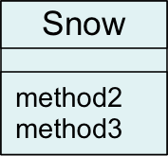
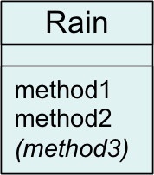
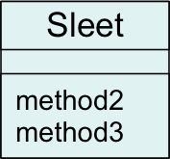
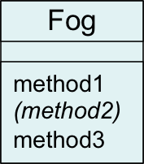
Technique 1: diagram
Diagram the classes from top (superclass) to bottom.

Slide 22
Mystery problem, no cast
  Snow var3 = new Rain();
  var3.method2(); // What's the output?
If the problem does not have any casting, then:
  Look at the variable's type.
  If that type does not have the method: ERROR.
  Execute the method, behaving like the object's type.
  (The variable type no longer matters in this step.)

Slide 23
Example 1
What is the output of the following call?
  Snow var1 = new Sleet();
  var1.method2();
Answer:
  Sleet 2
  Snow 2
  Sleet 3
variable
object

Slide 24
Example 2
What is the output of the following call?
  Snow var2 = new Rain();
  var2.method1();
Answer:
  ERROR
  (because Snow does not
  have a method1)
variable
object

Slide 25
Mystery problem with cast
  Snow var2 = new Rain();
  ((Sleet) var2).method2(); // What's the output?
If the problem does have a type cast, then:
  Look at the cast type.
  If that type does not have the method: ERROR.
  Make sure the object's type is the cast type or is a subclass of the cast type. If not: ERROR. (No sideways casts!)
  Execute the method, behaving like the object's type.
  (The variable / cast types no longer matter in this step.)

Slide 26
Example 3
What is the output of the following call?
  Snow var2 = new Rain();
  ((Rain) var2).method1();
Answer:
  Rain 1
variable
cast
object

Slide 27
Example 4
What is the output of the following call?
  Snow var2 = new Rain();
  ((Sleet) var2).method2();
Answer:
  ERROR
  (because the object's
  type, Rain, cannot
  be cast into Sleet)
variable
object
cast

