Slide 1
Java -Arrays

Slide 2
Array Methods
Initializing Arrays
Arrays can be initialized when declared or later.
Example: int[] numbers = {1, 2, 3, 4, 5};
Accessing Elements
Array elements are accessed using an index starting from 0.
Example: int firstElement = numbers[0];

Slide 3
Array Methods
Array Length
Use the length property to get the number of elements in an array.
Example: int arrayLength = numbers.length;
Sorting Arrays
Arrays.sort() to sort elements in ascending order.
Example: Arrays.sort(numbers);

Slide 4
Array Methods
Searching Arrays
Use Arrays.binarySearch() to search for an element in a sorted array.
Example: int index = Arrays.binarySearch(numbers, 3);
Comparing Arrays
Use Arrays.equals() to check if two arrays are equal.
Example: boolean isEqual = Arrays.equals(numbers1, numbers2);

Slide 5
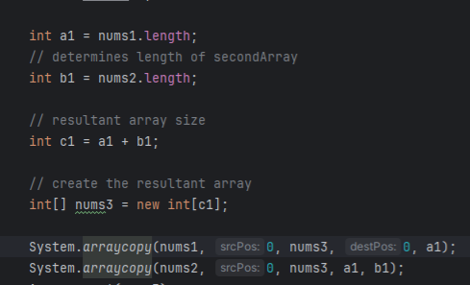
Array Methods
Copying Arrays

Slide 6
Java -Strings

Slide 7
String Methods
String Length
Use the length() method to get the length of a string.
Example: int length = greeting.length();
Substrings
Extract a portion of a string using substring() method.
Example: String sub = greeting.substring(0, 5);

Slide 8
String Methods
Searching
Find the index of a character or substring with indexOf() and lastIndexOf() methods.
Example: int index = greeting.indexOf("Java");
Removing Whitespace
Trim leading and trailing whitespace with trim() method.
Example: String trimmed = inputString.trim();

Slide 9
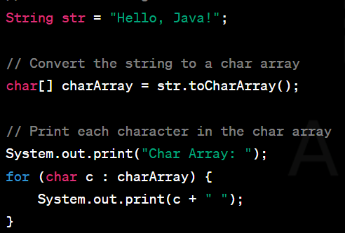
String Methods
Splitting
Split a string into an array of substrings with split() method.
InputString= “Hello World to Java”
Example: String[] parts = inputString.split(" ");

