Slide 1
Java Data Structures
Collections Framework

Slide 2
Introduction
What is a Data Structure
A data structure is a particular way of organizing data using one or more ADT (Abstract Data types) so that they can used efficiently.
What is a Collection?
A collection is an Object that represents a group of objects known as elements such as Vector, Set, List etc classes.
What is a Framework?
A framework is an abstraction providing generic functionalities that can be modified by user to create and maintain reusable large scale softwares with the ease of maintenance.

Slide 3
Java Collections Framework
The collections framework is an universal way for representing and manipulating data. It provides,
Interfaces:
Interface are ADT’s that represent collections and provides a form of hierarchy. Interfaces allow collections to be manipulated independent of their representation details.
Implementations:
These are reusable data structures providing implementations of collections interfaces.
Algorithms:
These built in methods to perform computations efficiently. Such as searching, sorting an Object that implements collections interface. The algorithms are polymorphic meaning the method can be used for various implementations of appropriate collections interfaces.

Slide 4

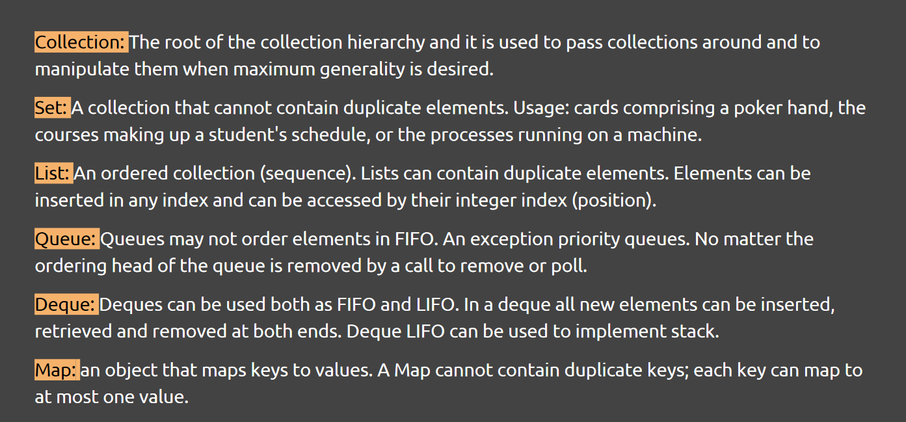

Slide 5
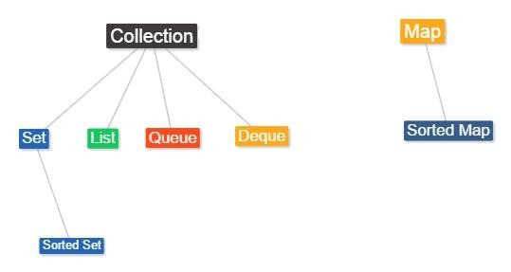
Core Collections Interface Hierarchy

Slide 6
General Purpose Implementations
Interfaces | Hash Table Implementations | Resizable Array Implementations | Tree Implementations | Linked List Implementations | Hash Table + Linked List Implementations
Set | HashSet |  | TreeSet |  | LinkedHashSet
List |  | ArrayList |  | LinkedList
Queue
Deque |  | ArrayDeque |  | LinkedList
Map | HashMap |  | TreeMap |  | LinkedHashMap

Slide 7
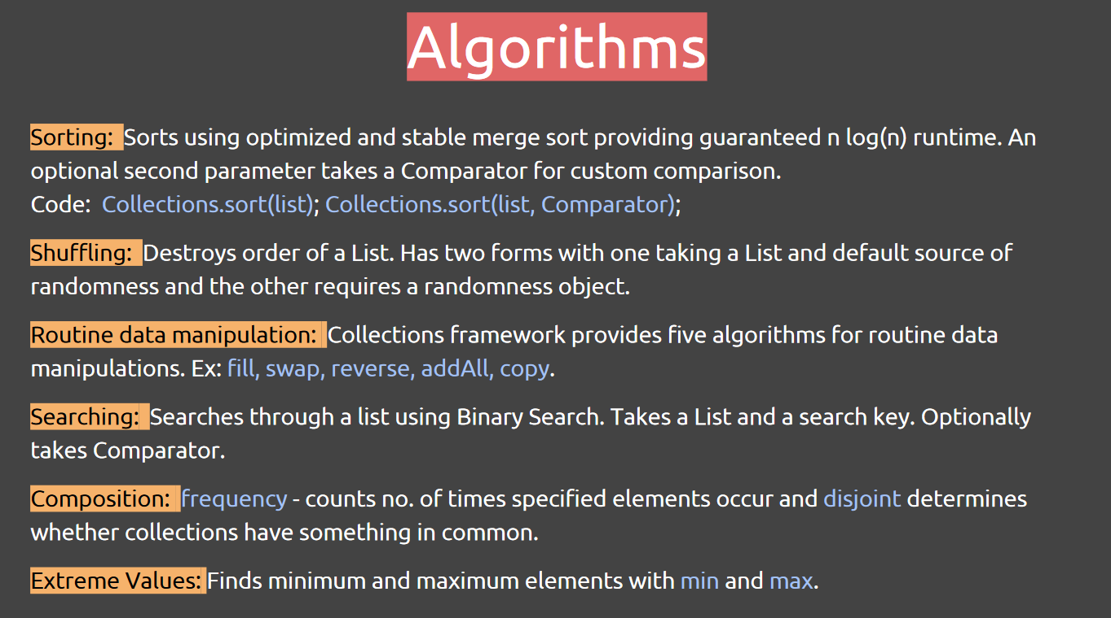

Slide 8
Comparator and Iterator Interface
Comparator:
Comparators are used to control how data is sorted in certain data structures. It can be passed to sort function to allow precise control over sorting.
Important methods:
compare() , Compares two arguments for order.
equals() , Indicates whether some other object is equal to this comparator.
Iterator:
Iterator is used to cycle through elements in a collection. ListIterator extends Iterator to provide bidirectional traversal of list also modify collection during iteration.
Important methods:
next() , Returns the next element in iteration. hasNext() , return true if iterator has more elements
remove() , removes the current element from the collections

Slide 9
An Example Code
List a = new ArrayList();
a.add("A");
a.add("B");
// Traverse the list Forward using ListIterator Iterator it = a.iterator();
while(it.hasNext()) { Object obj = it.next(); System.out.println(obj);
}
// Traverse the list backwards using ListIterator ListIterator li = a.listIterator();
System.out.print("List backwards using ListIterator: "); while(li.hasPrevious()) {
Object obj = li.previous(); System.out.println(obj);
}

Slide 10
Concurrent Programming
Applications that use collections for more than one thread must be programmed carefully. This is generally known as concurrent programming.
Threads:
Threads are called lightweight process. Threads exist within process and every process has at least one thread.
Processes:
It is a self contained execution environment with its own memory. IPC (Inter Process communication) such as pipes and sockets facilitates communication between different processes.
Concurrent Collection Interfaces:
BlockingQueue, TransferQueue, BlockingDeque, ConcurrentMap, ConcurrentNavigableMap
Concurrent Collection classes:
LinkedBlockingQueue, ArrayBlockingQueue, PriorityBlockingQueue, DelayQueue, SynchronousQueue, LinkedBlockingDeque, LinkedTransferQueue, CopyOnWriteArrayList, CopyOnWriteArraySet, ConcurrentSkipListSet, ConcurrentHashMap, ConcurrentSkipListMap

