Slide 1


DEPARTMENT OF ELECTRICAL AND ELECTRONICS ENGINEERING 18EEP201L - MINOR PROJECT I SECOND REVIEW ULTRASONIC GLASSES FOR BLIND PEOPLE USING ARDUINO BATCH NO:20
PRESENTED BY:
BARATHKUMAR R [927621BEE013]
JANANI S [927621BEE051]
NAVEENA A [22LEE004]
GUIDED BY:
Mrs.P.Sasirekha AP/EEE

Slide 2
LIST OF CONTENT
Abstract
Objectives
Introduction
Problem Identified
Block Diagram
Circuit Diagram
Components Detail
Reference

Slide 3


ABSTRACT
These “Smart Glasses” are designed to help the blind people. It is used to walk for helping them navigate the ground. To make a prototype of glasses which can be able to detect the objects in front of them, and tell the user by speaking. This smart glasses can make a huge impact in the lives of blind people.These Ultrasonic Smart Glasses for Blind people is a portable device, easy to use, light weight, user friendly and cheap in price.These glasses could easily guide the blind people and help them avoid obstacles.

Slide 4
Objectives
The glasses can now detect obstacles and transmit this to the blind person. The ultrasonic sensors are mounted on glasses on 2 sides to act as eyes. The sensors constantly transmit and receive ultrasonic waves to receive obstacle data.

Slide 5
Introduction
There are multiple smart accessories such as smart glasses, smartwatches, etc. Available in the market.
But all of them are built for us. There is a significant lack of technology to aid the physically challenged.
I wanted to build something that is useful for visually challenged people. So I designed low-cost smart glass that can be used to help the visually impaired.
The circuit board used in this project is designed in the form of a spectacle, which can be worn by a visually impaired person.

Slide 6
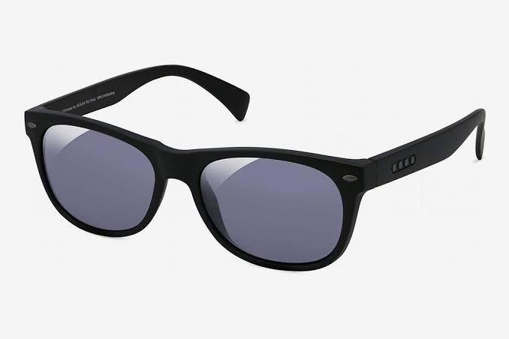
Problem Identification
This is a device only used for the blind people.
The ultrasonic sensor are finding obstacles within the range.
The ultrasonic sensor are inflexible scanning.
This glasses are used by the ultrasonic sound waves.

Slide 7
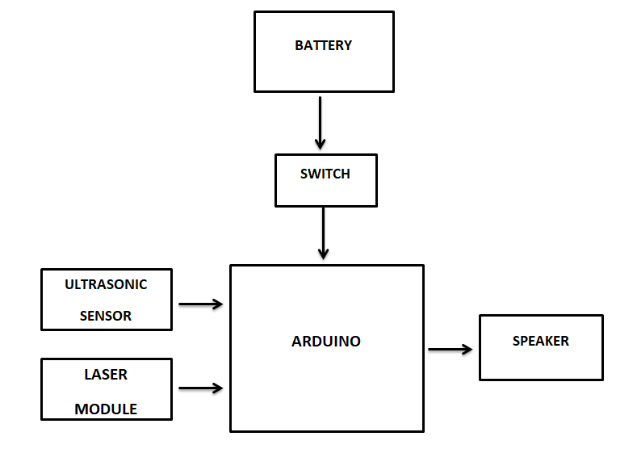
Block Diagram

Slide 8
Block Diagram
Power Supply is distributed to the Arduino Board.
Next Ultrasonic Sensor and Laser Module takes reading and gives that input to the Arduino Board.
That Input is converted into the output by Arduino Board.
The converted Output is produced for commanding the User.

Slide 9
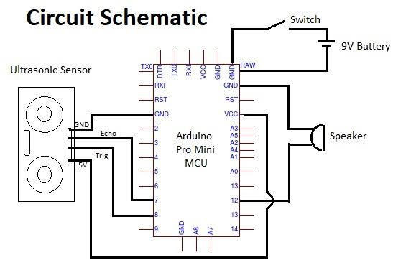
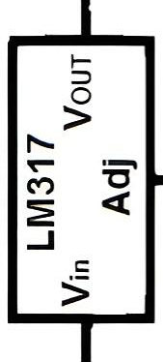
Circuit Diagram
Laser module

Slide 10
Components Details
Arduino Board
Ultrasonic Sensors
Laser Module
Speaker
Connecting Wires
Components Budget:
S. No. | Components | Amount
1. | Arduino Board | Rs.500
2. | Ultrasonic Sensors | Rs.400
3. | Laser Module | Rs.350
4. | Speaker | Rs.250
5. | Others | Rs.500
6. | Total | Rs.2000

Slide 11
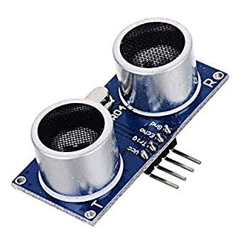
Ultrasonic Sensor
The purpose of ultrasonic sensors is to measure the distance using ultrasonic waves.
Ultrasonic sensors emit the ultrasonic waves and receive back the reflected.
So, by this time the ultrasonic sensor will measure the distance to the object. It can sense from 2-400 cm.
The distance should be from 40 cm to 150 cm and that is because this is the required rangimag capture a clear image.

Slide 12
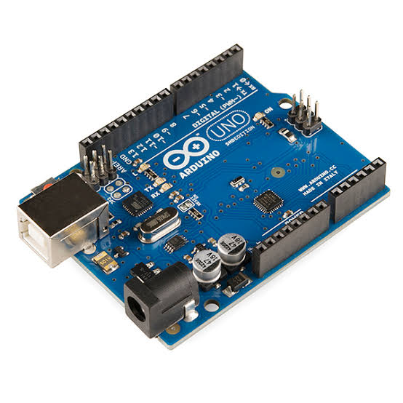
Arduino Board
Arduino is an open-source electronics platform based on easy-to-use hardware and software.
Arduino boards are able to read inputs - light on a sensor.
You can tell your board what to do by sending a set of instructions to the microcontroller on the board.

Slide 13
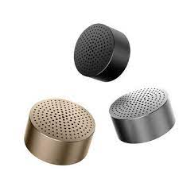
Speaker
A Speaker is one type of electroacoustic transducer that is a device that converts an electrical audio signal into corresponding sound.
An audio signal is amplified electrically to the power level capable.

Slide 14
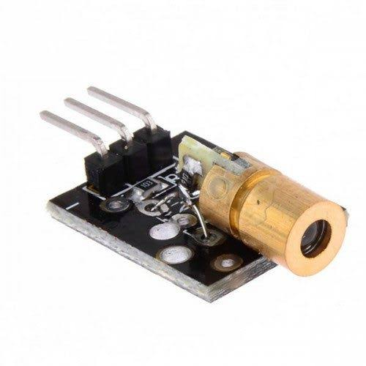
Laser Module
The laser beam signal is used in this system a circuit is designed which will detect this laser beam and will calculate the intensity of the signal and distance.
A TOF(time-of-flight) laser range finder consists of a laser transmitter, one or two receivers and timing discriminators, and a time measuring unit.
In the transmitter usually avalanche transistors are used for generating the short (3–10 ns) and powerful (20–100 A) current pulses for the semiconductor laser

Slide 15
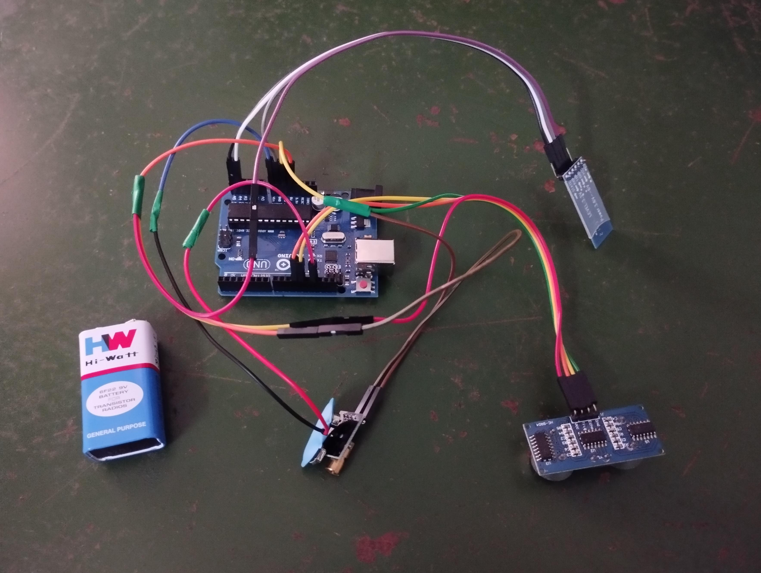
Hardware Image

Slide 16
Reference
Tailong Shi, Bruce, Ting-Chia Huang “Design, Demonstration and characterization of Ultra-Thin Low-Warpage Glass BGA Packages for smart mobile Application processor”, Electronics Components and Technology Conference(ECTC),2016 IEEE 66th ,2016.

Slide 17
THANK YOU

