Slide 1
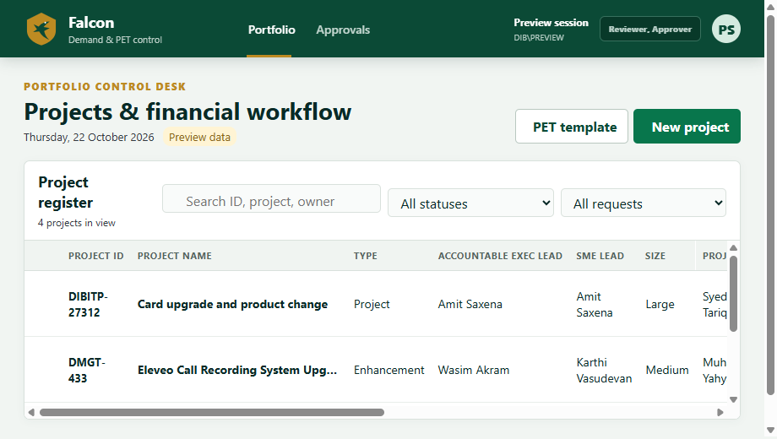
PORTAL INTERFACE
DIB MANAGEMENT / INTRODUCTION
Falcon
Portfolio Portal
Connected oversight from demand to invoice.
Projects, PET approvals, budgets and spend in one governed workspace.
PROJECT REGISTER | PREVIEW DATA
Illustrative portal screen; no live portfolio data is shown.
REGISTER > REVIEW > TRACK SPEND
VISIBILITY. ACCOUNTABILITY. CONTROL.
FALCON PORTFOLIO PORTAL | DIB
01

Slide 2
KEY FEATURES & BUSINESS BENEFITS
Clearer oversight. More disciplined execution.
Portal capabilities that support management visibility and control.
CAPABILITY
WHAT THE PORTAL ENABLES
BUSINESS BENEFIT
Portfolio visibility
Searchable project register; ownership, status and pending-action views.
Clearer accountability and prioritization.
Governed approvals
Assigned PET reviews and approvals, send-back, workflow history and alerts.*
Traceable decisions and focused follow-up.
Financial control
CAPEX / OPEX balances and utilization; approved-PET budget lines, CAM / LPO and invoices.
Connected visibility from approved demand to recorded spend.
Efficient processing
CSV / Excel imports with editable PET previews; linked supporting documents.
Less manual re-entry and easier document retrieval.
CONTROL FOUNDATION Windows sign-in via approved DFM Helper devices; role-based access.
*Workflow desktop notifications require DFM Helper running and updated server/helper components.
DIB MANAGEMENT | FALCON PORTFOLIO PORTAL
02

